Slide 1
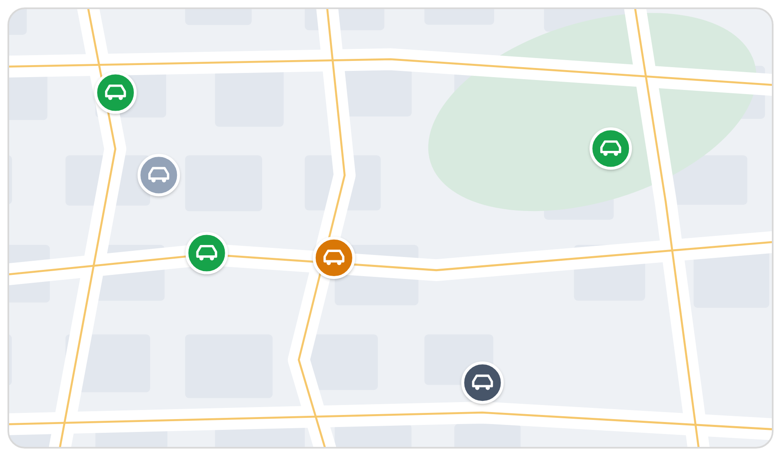
Get your fleet
off spreadsheets
COMPANY PROFILE
Fleet management built for Saudi fleets
Live map · GPS tracker
Company name · DD/MM/YYYY · fleetana.sa
Notes:
Cover layout. Eyebrow = document type (company profile, pitch, proposal). Title in two lines: statement in black, payoff in Accent Blue.

Slide 2
Contents
01
02
03
04
The problem
What Fleetana does
Built for Saudi fleets
Proposal
Where fleet time and money slip away
One workspace for every vehicle
Istimara, Fahes, SAR, Arabic
Rollout and next steps
Notes:
Title only layout with four cards. Keep each item to a short title and one line.

Slide 3
The problem
01
Fleets run on spreadsheets, receipts and memory
Notes:
Section divider layout. Number, title and one supporting line.

Slide 4



Your fleet runs on
spreadsheets and memory
Spreadsheets
Receipts
Chat threads
Service dates, plates and Istimara expiries live in files nobody updates on time.
Fuel and repair spend sits in drawers and photos, so odd fill-ups go unnoticed.
Checks, faults and approvals happen in WhatsApp, and nothing links back to the vehicle.
Notes:
Three cards with icons. One problem per card, in the customer's words. No invented statistics.

Slide 5
What Fleetana does
02
One place for everything that touches your fleet

Slide 6
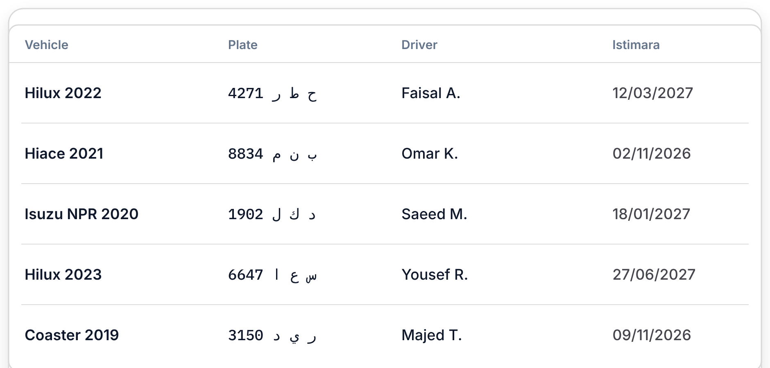
One workspace
for every vehicle
Every fuel log, service entry, issue, inspection and work order links to the same vehicle
Service due by km, engine hours or date, whichever comes first
Istimara, insurance and Fahes listed 30 days before they expire
Arabic and English, SAR with 15% VAT, km and engine hours
Notes:
Text left, product screen right. Product screens are our illustrations; demo data must look like demo data.

Slide 7




Everything that
touches your fleet
Vehicles
Service & PM
Fuel
Plates, drivers, documents and status for every vehicle.
Programs by km, hours or date. Due soon and overdue at a glance.
km/L on every full fill. Fills below 70% of the 30-day average flagged.
Inspections
Work orders
Live map
Custom checklists with photos. A failed item opens an issue.
Parts, labour and fees, with 15% VAT and approval steps.
Moving, idle, parked. Trip replay and driver scores.
GPS tracker
Notes:
Six feature cards. GPS-dependent features carry the 'GPS tracker' tag.

Slide 8
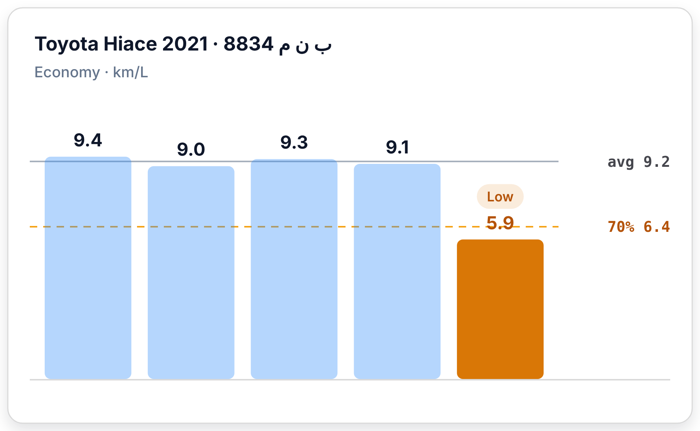
Odd fill-ups
get flagged
1
Economy on every full fill
Distance since the last full fill ÷ fuel added, with an odometer reading.
2
Compared with its own average
Each vehicle against its 30-day average, not against the fleet.
3
Below 70%? Flagged Low
Worth checking for a vehicle problem or a logging error.
Notes:
One product screen with three numbered points that explain it.

Slide 9
Rules you can check,
not promises
70%
30
15%
3
Fuel flag
Days ahead
VAT built in
Service triggers
A full fill below 70% of the vehicle's 30-day average is flagged Low.
Istimara, insurance and Fahes expiring within 30 days are listed on Home.
Work orders and costs in SAR, with VAT added or split out.
km, engine hours or date, whichever comes first.
Each figure is a rule in the product, not a customer result.
Notes:
Stat callouts. Only use numbers that are product rules or proven data, and say which.

Slide 10




How it
works
01 Capture
02 Organise
03 Decide
Drivers and operators log fuel, run inspections and report issues from any device.
Everything links to the right vehicle. Reminders come from your service programs.
Open Home or a vehicle to see what is due, what is overdue and what is expiring.
Notes:
Three-step process with icons.

Slide 11
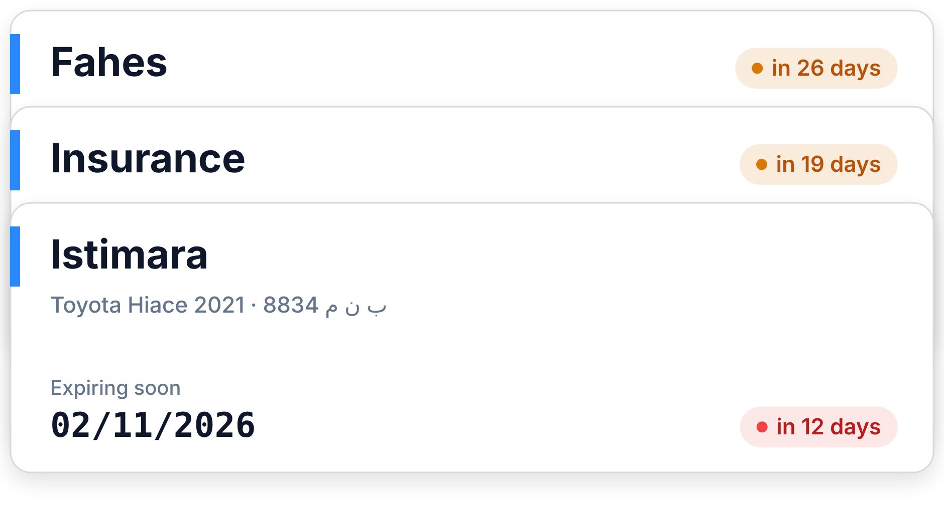

Built for
Saudi fleets
Istimara
Fahes
Insurance
SAR + 15% VAT
km & engine hours
العربية · English
For fleets of 10 to 50 vehicles
Expiry dates live on each vehicle, and Home lists everything expiring in the next 30 days.
Delivery & courier
Construction & heavy equipment
Distribution & retail
Passenger & school transport
Notes:
Chips, audience list and a supporting screen.

Slide 12
Proposal
03
How we would roll Fleetana out for you

Slide 13
Proposed
rollout
Phase | What happens | Owner | Week
Set up | Add vehicles, drivers, documents and team members | Your team | 1
Service programs | Choose service tasks and intervals from the default set | Together | 1–2
Daily use | Log fuel, run inspections and raise issues | Your drivers | 2–4
Review | Walk through what is due, overdue and expiring | Together | 4
Example plan. Adjust phases, owners and weeks to the client.
Notes:
Table layout for proposals. Use the house table: Tint header, hairline rules, Paper banding.

Slide 14
Log the odometer.
We flag the rest.
Fleetana does the arithmetic and the remembering. Your team does the driving.
Notes:
Big statement on a Tint card. Use once per deck.

Slide 15
Next
steps
1
Agree the scope
CONTACT
Vehicles, sites and the people who will use Fleetana.
Full name
Role, Fleetana
name@fleetana.sa
+966 5X XXX XXXX
2
Set up your workspace
Vehicles, drivers and document dates added in week one.
3
Review together
After four weeks, review what is due, overdue and expiring.
fleetana.sa
Notes:
Numbered next steps with a contact card.

Slide 16
Get your fleet off spreadsheets.
fleetana.sa
Notes:
Closing layout. Logo, the line, the URL.

