Slide 1
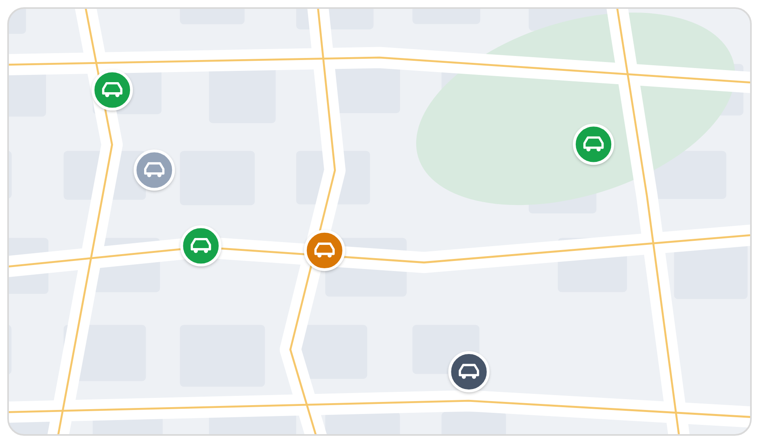
Your whole fleet.
One place.
COMPANY PROFILE
Fleet and cost visibility, built for Saudi fleets
Fleetana · 2026 · fleetana.sa
Notes:
Fleetana company profile for prospective clients.

Slide 2
Who
we are
Fleetana is fleet-management software built in Saudi Arabia for the people who run vehicles.
FOUNDED
HEADQUARTERS
2026
Riyadh, Saudi Arabia
One platform for vehicles, drivers, routes, fuel, service, inspections and work orders
Shows what every vehicle is doing and what every vehicle costs
Our own GPS trackers, supplied and installed by our team
Web app for managers, mobile app for drivers, in Arabic and English
CR NUMBER
LANGUAGES
7051877566
Arabic · English
Notes:
Software and hardware from one Saudi partner.

Slide 3


Vision &
mission
VISION
MISSION
Every Saudi fleet run on facts with the lifecycle optimized and efficient.
One place to see every vehicle, its cost, its next job, and execution.
Notes:
Read both lines aloud; let them stand.

Slide 4
The problem
01
Fleets run on spreadsheets, receipts and memory

Slide 5




Where does your
fleet's money go?
Spreadsheets
Receipts
Blind spots
Chat threads
Service dates, plates and Istimara expiries live in files nobody updates on time.
Fuel and repair spend sits in drawers and photos, so odd fill-ups go unnoticed.
Nobody can say which route a vehicle took, or how long it sat idling.
Checks, faults and approvals happen in WhatsApp, and nothing links back to the vehicle.
Notes:
Ask the client which of these four sounds most like their week.

Slide 6
The solution
02
Software and trackers from one partner

Slide 7


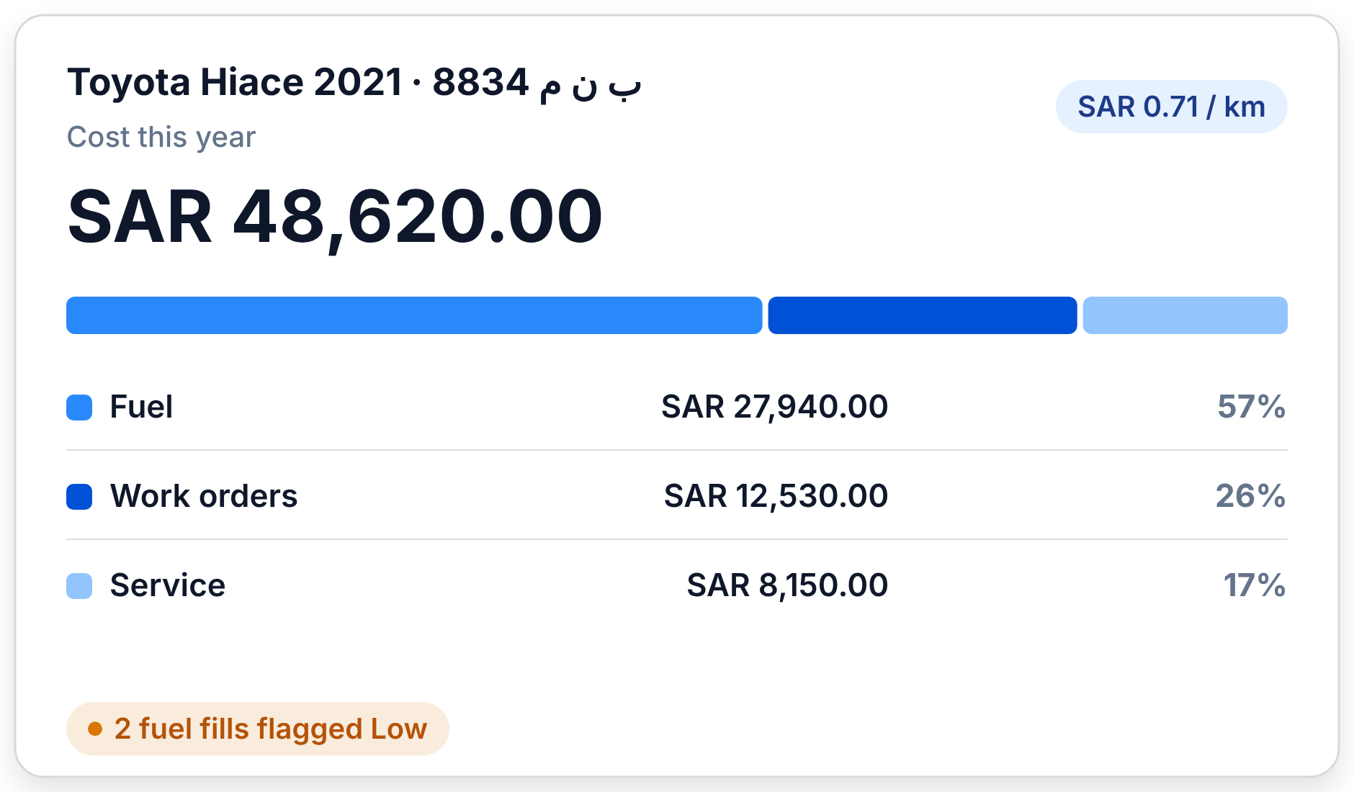

How Fleetana
works
IN EVERY VEHICLE
ON ONE PLATFORM
IN YOUR DECISIONS
Our GPS tracker
Fleetana web & mobile
See, decide, save
We supply and install a tracker that fits the vehicle, from pickups to heavy trucks.
Location, trips, fuel, service and costs land in one place, for every vehicle.
Spot the waste, act on it, and watch the cost per vehicle come down.
Notes:
The whole offer on one slide: hardware, software, outcome.

Slide 8


Everything that
touches your fleet
Vehicles & documents
Service & maintenance
Fuel
Plates, drivers, Istimara, insurance and Fahes for every vehicle.
Programs by km, engine hours or date. Due soon and overdue at a glance.
km/L on every full fill. Low fills flagged.
Inspections & issues
Work orders & parts
Live map & routes
Custom checklists with photos. A failed item opens an issue.
Parts, labour and fees, with 15% VAT and approval steps.
Live positions, trip replay, optimised routes and driver scores.
Notes:
The six modules. The next slides go deeper.

Slide 9


Know what every
vehicle is doing
Live map
Every vehicle as moving, idle, parked or no signal, updated every few seconds.
Trip replay
See the exact route each vehicle drove, stop by stop.
Idle time
Engine-on minutes per trip and per day, for every vehicle.
Driver scores
Harsh driving, speeding and collisions turned into a 0–100 score.
Fleetana GPS tracker
Notes:
Powered by the Fleetana GPS tracker in each vehicle.

Slide 10
See where your fleet's
money really goes
1
Cost per vehicle
Fuel, service and work orders add up on each vehicle, in SAR, with cost per km.
2
Fuel anomalies flagged
A full fill below 70% of that vehicle's 30-day average is flagged Low.
3
Every riyal itemised
Work orders split parts, labour and fees, with 15% VAT.
4
Warranty on record
Check the warranty before you pay for the same repair twice.
Notes:
Illustration uses demo figures.

Slide 11
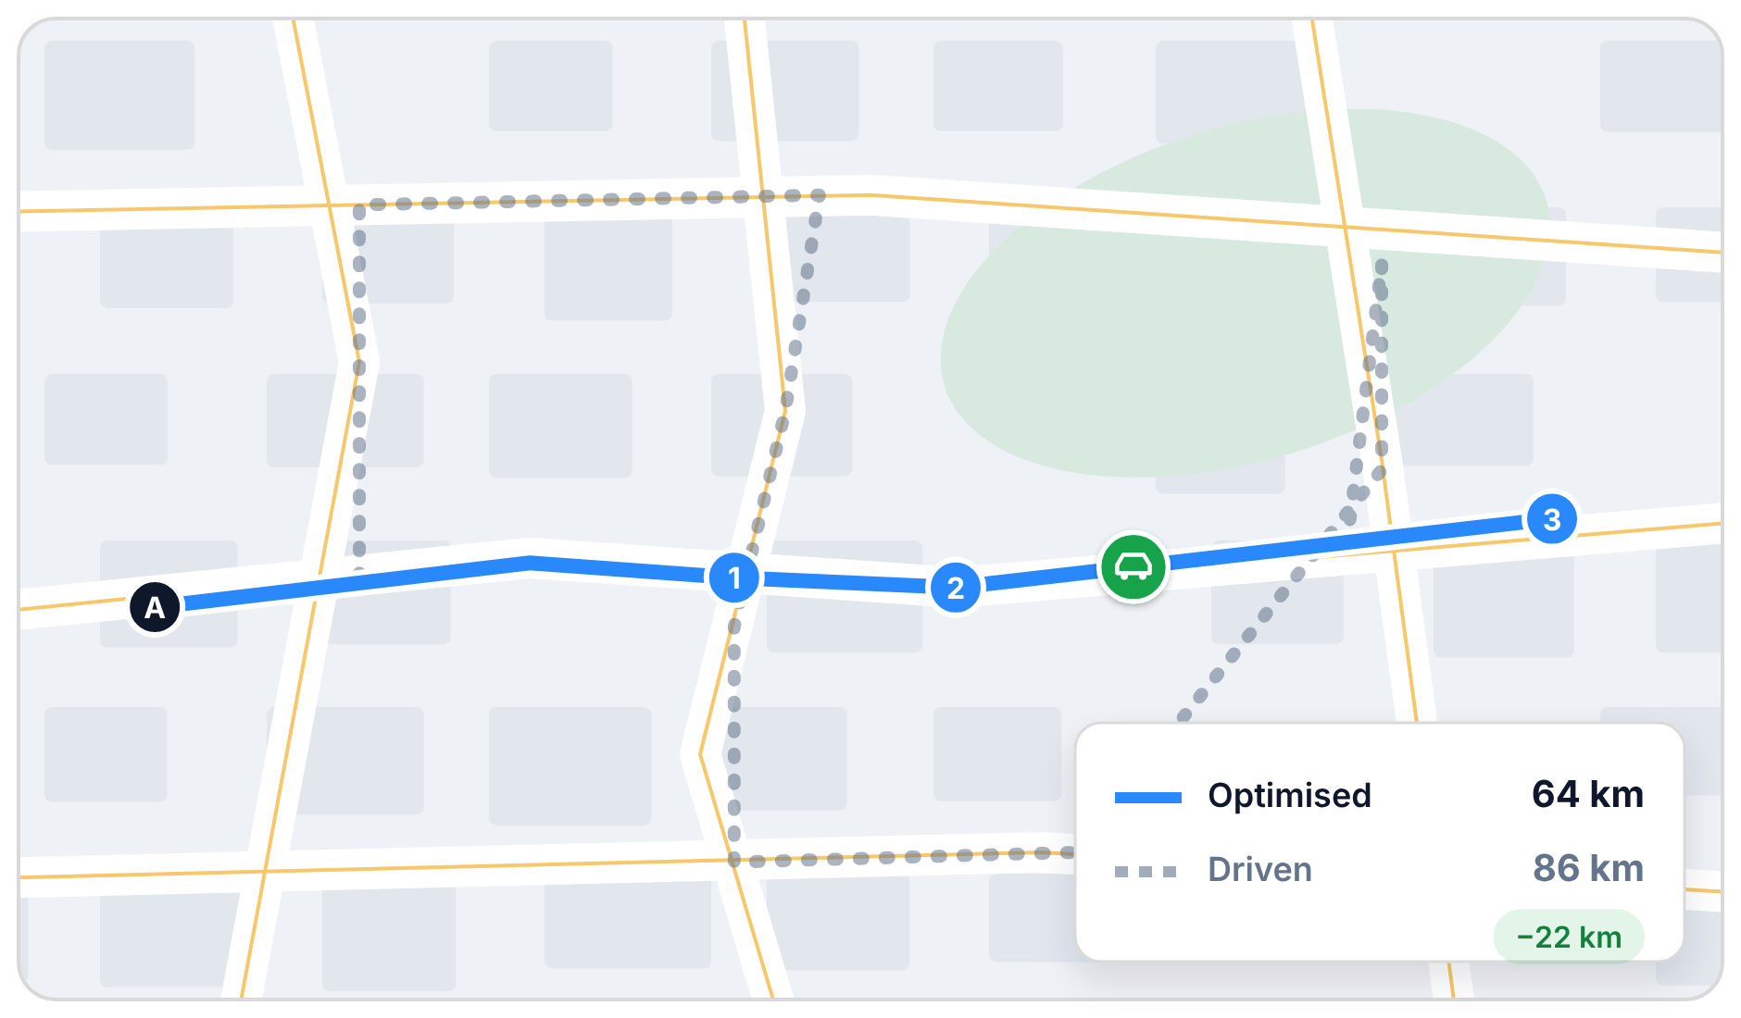
Shorter routes,
less fuel
1
Optimised routes
Fleetana orders your stops into the shortest route before the vehicle leaves.
2
Planned vs driven
Compare the route you planned with the route actually driven.
3
Fewer wasted kilometres
Every kilometre saved is fuel, time and wear you don't pay for.
Fleetana GPS tracker
Notes:
Map and distances are demo figures.

Slide 12
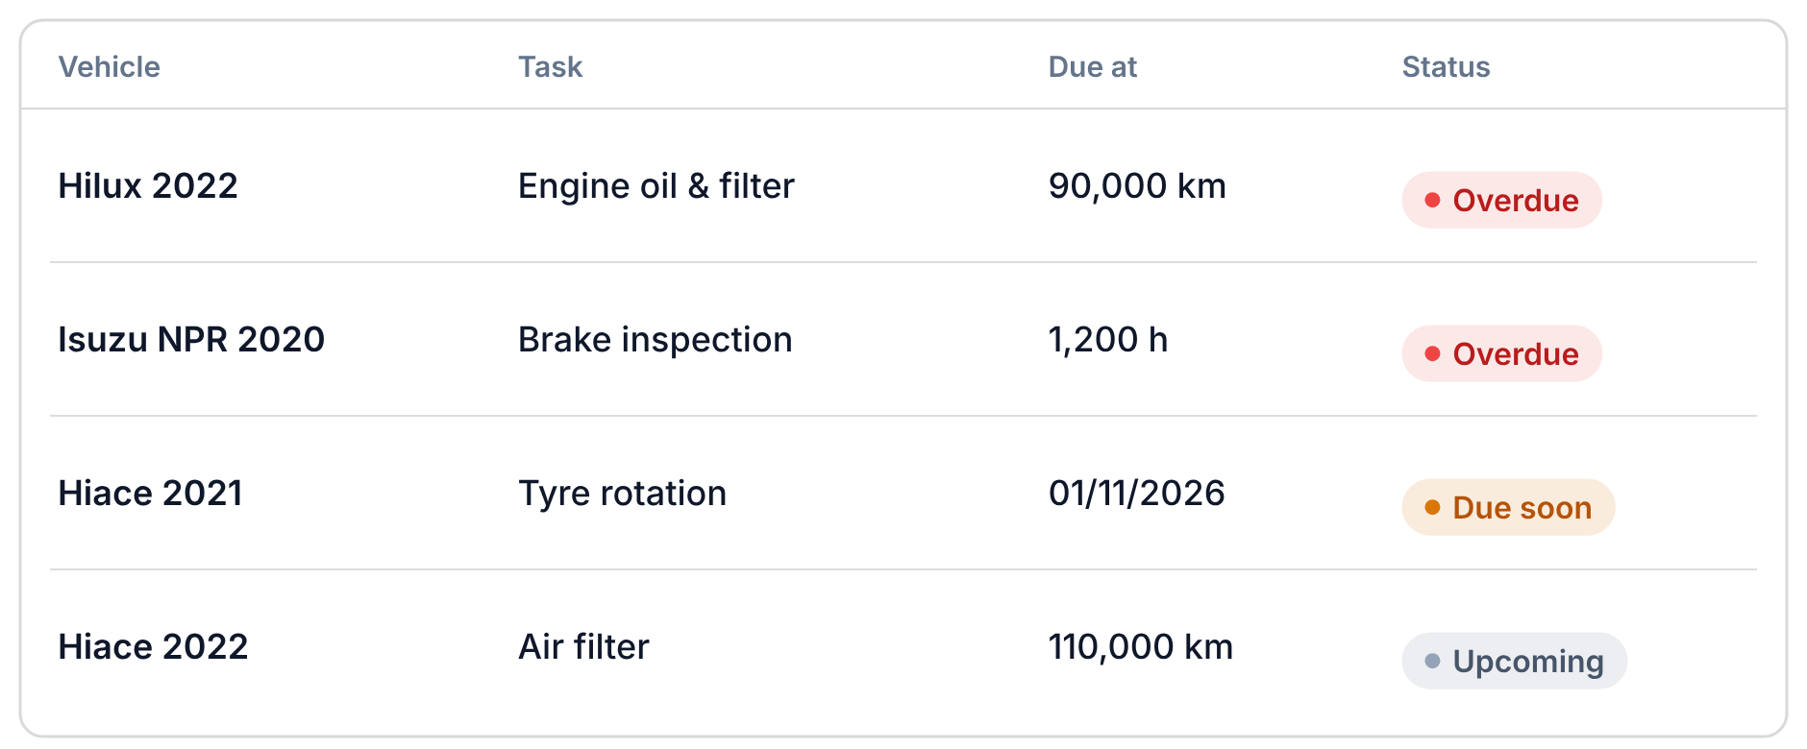
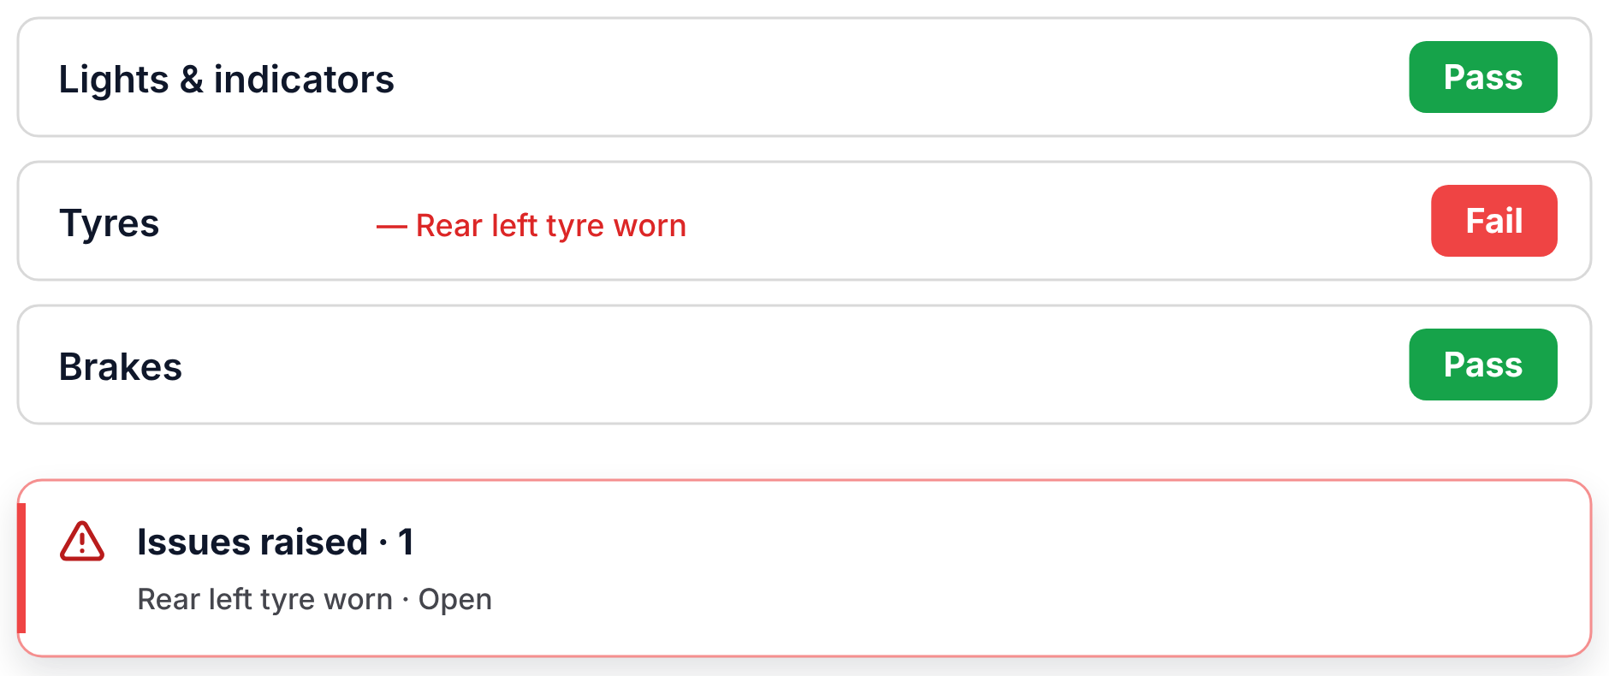
Maintenance that
runs on schedule
Service due by km, engine hours or date, whichever comes first
36 standard service tasks ready on day one
Inspections on the mobile app, with photos; a failed item opens an issue automatically
Work orders with parts, labour, fees, 15% VAT and approval
Parts stock per location, and warranty periods on parts and repairs
Notes:
Demo data on screen.

Slide 13
Our trackers
03
Hardware we supply, install and support

Slide 14
Two trackers,
every vehicle covered
TELTONIKA
SEEWORLD
FMC003
R12L
Plug-and-play OBD tracker
Hard-wired tracker for any vehicle
Plugs into the OBD-II port in minutes, no wiring
4G LTE with GPS, GLONASS, Galileo and BeiDou
Reads the vehicle's own odometer and fuel level
Eco-driving, crash, towing and unplug detection
CST-certified in Saudi Arabia
Hidden install, 9–90 V for trucks, buses and equipment
4G LTE with GPS and BeiDou
IP65 dust and water resistant
Remote engine cut-off and ignition detection
Vibration, power-cut and over-speed alarms
Best for cars, pickups and vans
Best for trucks, buses, equipment and theft protection
Notes:
We supply, install and support both trackers.

Slide 15
What each tracker
unlocks
Fleetana feature | FMC003 | R12L
Live map and trip replay | ✓ | ✓
Idle time and driver scores | ✓ | ✓
Route optimisation | ✓ | ✓
Over-speed alerts | ✓ | ✓
Tamper alerts (unplug / power cut) | ✓ | ✓
Crash detection | ✓ | —
Fuel level and odometer from the vehicle | ✓ | —
Remote engine cut-off | — | ✓
Trucks and heavy equipment (up to 90 V) | — | ✓
Supplied, installed and supported
We pick the right tracker for each vehicle
Our team installs it
Live in Fleetana the same day
One partner for software and hardware
Notes:
Mixed fleets often use both: FMC003 for light vehicles, R12L for heavy ones.

Slide 16

Find the leaks.
Fix them.
Fuel
Maintenance
Fleet
Safety
Fuel anomalies flagged
Idle time cut
Shorter, optimised routes
Service before breakdowns
No paying twice under warranty
Every work order itemised
Cost per vehicle and per km
Retire the costliest vehicles
Keep documents valid
Driver scores and coaching
Crash and over-speed alerts
Remote engine cut-off
Notes:
Where the savings come from. Each one is an action the client takes with what Fleetana shows them.

Slide 17
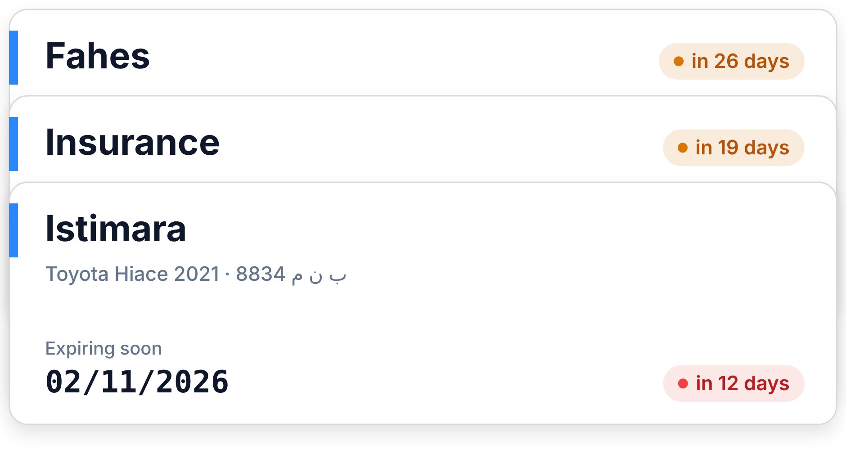

Built for
Saudi fleets
Istimara
Fahes
Insurance
SAR + 15% VAT
CST-certified trackers
العربية · English
Made for fleets like yours
Expiry dates live on each vehicle, and Home lists everything expiring in the next 30 days.
Delivery & courier
Construction & heavy equipment
Distribution & retail
Passenger & school transport
Notes:
Adjust the industries to the client.

Slide 18
How we get
you running
01 Sign up
02 Add vehicles
03 We install trackers
04 See, decide, save
Create your workspace at fleetana.sa and invite your team.
Vehicles, drivers and document dates, imported or added by hand.
The right tracker for each vehicle, installed by our team.
Live map, costs and savings from day one.
Notes:
Most of setup happens in the first week.

Slide 19




The founders
behind Fleetana
Abdallah Daban
Abdulrahman Alaskar
Faisal Qassem
Ali Choudhary
Operations & Strategy
Product Manager
Business Development
Business & Customer Manager
Notes:
Four founders, one team: operations, product, business development and customers.

Slide 20
Get your fleet off spreadsheets.
fleetana.sa · info@fleetana.sa

