Slide 1
Prototyping
Abdallah Daradkeh
21110446

Slide 2
MySchool

Slide 3
My idea
application which give some educational services

Slide 4
User segmentation
User segmentation:
Segmentation types | Segmentation Chosen Ex: age, region, …etc. | Segmentation criteria Ex: age>18, region=Amman, …etc.
Demographic Segmentation | Income level | Any income level
Geographic Segmentation | Country | Jordan
Lifestyle Segmentation | Interests | Local schools
Behavioral Segmentation | Navigation patterns | The most will known navigation patterns

Slide 5
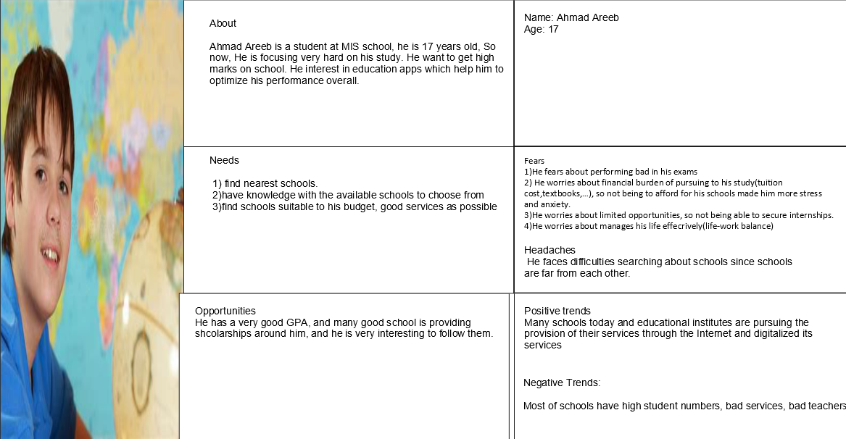
Persona

Slide 6
Methodology
I choose Evoloutionary prototype as our prototype methodology.

Slide 7
Tool
JustInMind

Slide 8
Testing low fidelity
Focus group

Slide 9
Testing mid fidelity
A/B testing

Slide 10
Testing High fidelity
Moderated testing

Slide 11
High fidelity prototype
Ready to show through oral

