Slide 1
Mathematical Computing with Python (NumPy)

Slide 2


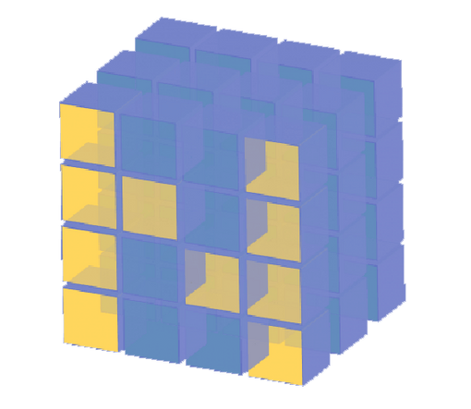
What is Numpy?

Slide 3
WHAT IS NUMPY?
NumPy is an open-source numerical Python library.
Contains a large number of mathematical, algebraic, and transformation functions
Numpy also contains random number generators.
Pandas objects rely heavily on NumPy objects.

Slide 4
Why do we need NumPy
Let’s see for ourselves!

Slide 5
Why do we need NumPy
Python does numerical computations slowly.
1000 x 1000 matrix multiply
Python triple loop takes > 10 min.
Numpy takes ~0.03 seconds

Slide 6
Logistics: Versioning
In this class, your code will be tested with:
Python 2.7.6
Numpy version: 1.8.2
Scipy version: 0.13.3
OpenCV version: 2.4.8
Two easy options:
Class virtual machine (always test on the VM)
Anaconda 2 (some assembly required)

Slide 7
NumPy Overview
Arrays
Shaping and transposition
Mathematical Operations
Indexing and slicing
Broadcasting

Slide 8
Arrays
Structured lists of numbers.
Vectors
Matrices
Images
Tensors
ConvNets

Slide 9
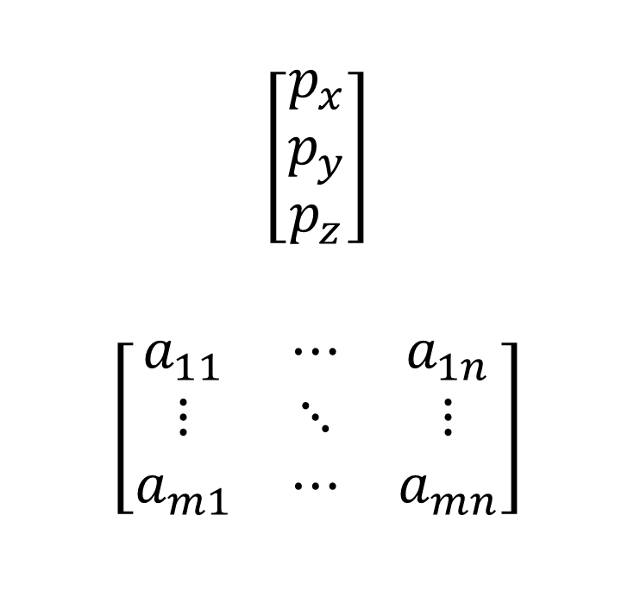
Arrays
$$\left[\begin{matrix}p_{x} \\ p_{y} \\ p_{z}\end{matrix}\right]$$
$$\left[\begin{matrix}a_{11} & ⋯ & a_{1n} \\ ⋮ & ⋱ & ⋮ \\ a_{m1} & ⋯ & a_{mn}\end{matrix}\right]$$
Structured lists of numbers.
Vectors
Matrices
Images
Tensors
ConvNets

Slide 10

Arrays
Structured lists of numbers.
Vectors
Matrices
Images
Tensors
ConvNets

Slide 11
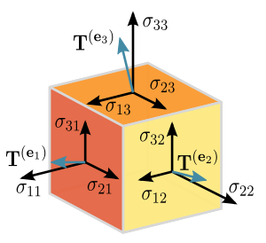
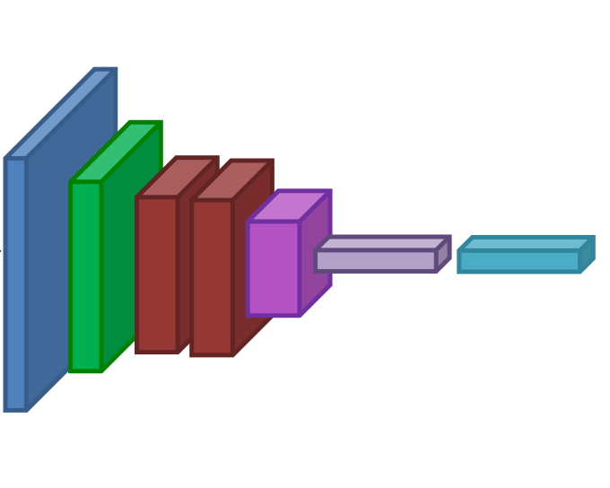
Arrays
Structured lists of numbers.
Vectors
Matrices
Images
Tensors
ConvNets

Slide 12
Arrays
Structured lists of numbers.
Vectors
Matrices
Images
Tensors

Slide 13
Arrays, Basic Properties
import numpy as np
a = np.array([[1,2,3],[4,5,6]],dtype=np.float32)
print(a.ndim, a.shape, a.dtype )
Arrays can have any number of dimensions, including zero (a scalar).
Arrays are typed: np.uint8, np.int64, np.float32, np.float64
Arrays are dense. Each element of the array exists and has the same type.

Slide 14
Arrays, creation
np.ones, np.zeros
np.arange
np.concatenate
np.astype
np.zeros_like, np.ones_like
np.random.random

Slide 15
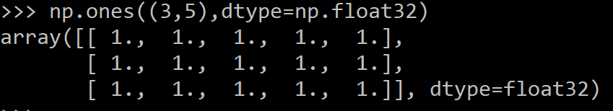
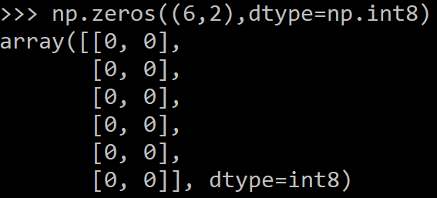
Arrays, creation
np.ones, np.zeros
np.arange
np.concatenate
np.astype
np.zeros_like, np.ones_like
np.random.random

Slide 16

Arrays, creation
np.ones, np.zeros
np.arange
np.concatenate
np.astype
np.zeros_like, np.ones_like
np.random.random

Slide 17
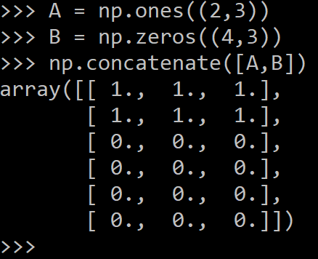
Arrays, creation
np.ones, np.zeros
np.arange
np.concatenate
np.astype
np.zeros_like, np.ones_like
np.random.random

Slide 18
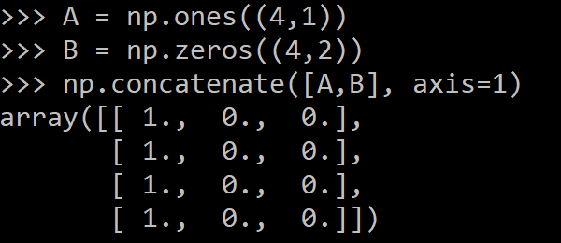
Arrays, creation
np.ones, np.zeros
np.arange
np.concatenate
np.astype
np.zeros_like, np.ones_like
np.random.random

Slide 19
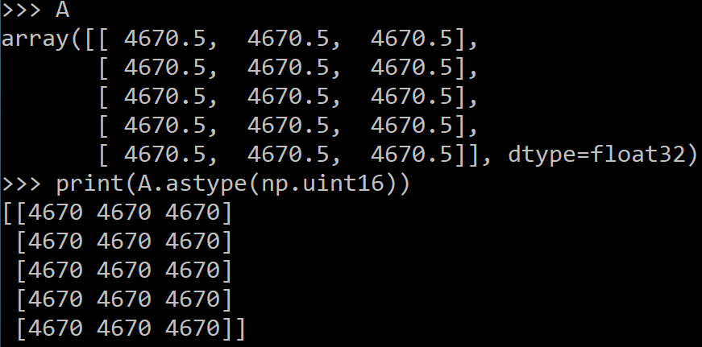
Arrays, creation
np.ones, np.zeros
np.arange
np.concatenate
np.astype
np.zeros_like, np.ones_like
np.random.random

Slide 20
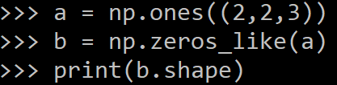
Arrays, creation
np.ones, np.zeros
np.arange
np.concatenate
np.astype
np.zeros_like, np.ones_like
np.random.random

Slide 21
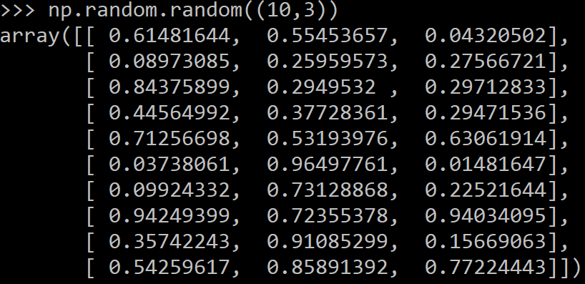
Arrays, creation
np.ones, np.zeros
np.arange
np.concatenate
np.astype
np.zeros_like, np.ones_like
np.random.random

Slide 22
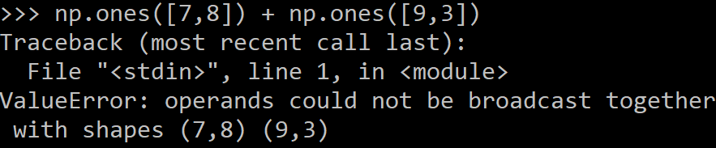
Arrays, danger zone
Must be dense, no holes.
Must be one type
Cannot combine arrays of different shape

Slide 23
Shaping
a = np.array([1,2,3,4,5,6])
a = a.reshape(3,2)
a = a.reshape(2,-1)
a = a.ravel()
Total number of elements cannot change.
Use -1 to infer axis shape
Row-major by default (MATLAB is column-major)

Slide 24
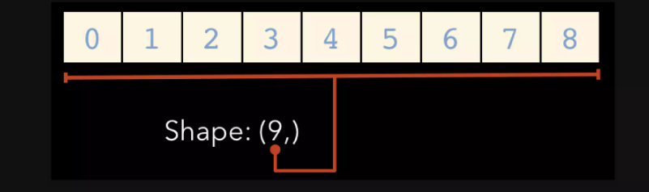
Array Shape
One dimensional arrays have a 1-tuple for their shape

Slide 25
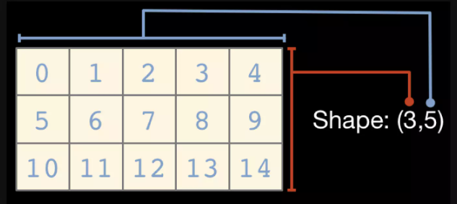
Array Shape
Two dimensional arrays have a 2-tuple

Slide 26
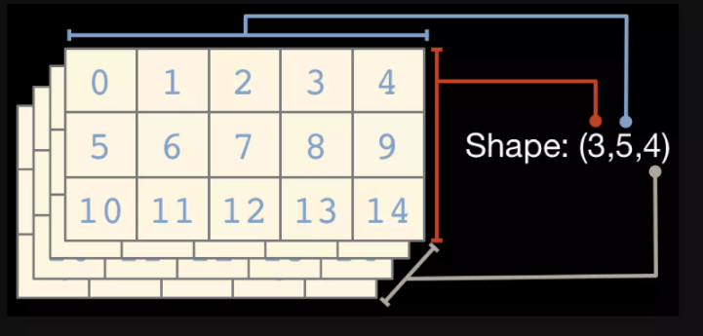
Array Shape
And so on..

Slide 27
Return values
Numpy functions return either views or copies.
Views share data with the original array, like references in Java/C++. Altering entries of a view, changes the same entries in the original.
The numpy documentation says which functions return views or copies
Np.copy, np.view make explicit copies and views.

Slide 28
Transposition
a = np.arange(10).reshape(5,2)
a = a.T
a = a.transpose((1,0))
np.transpose permutes axes.
a.T transposes the first two axes.

Slide 29
Recap
We just saw how to create arrays, reshape them, and permute axes
Questions so far?

Slide 30
Recap
We just saw how to create arrays, reshape them, and permute axes
Questions so far?
Now: let’s do some math

Slide 31
Mathematical operators
Arithmetic operations are element-wise
Logical operator return a bool array
In place operations modify the array

Slide 32
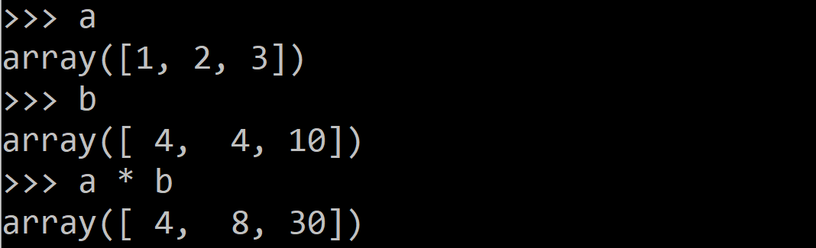
Mathematical operators
Arithmetic operations are element-wise
Logical operator return a bool array
In place operations modify the array

Slide 33
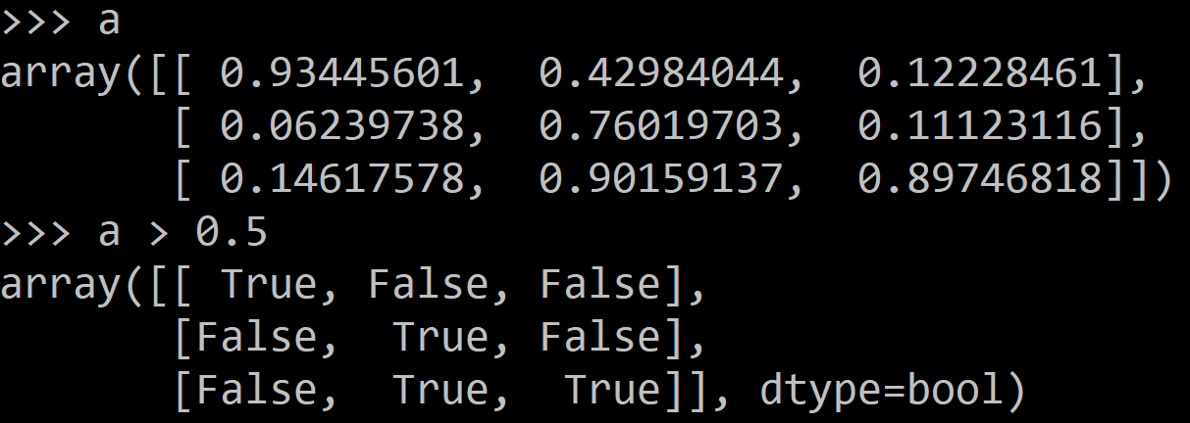
Mathematical operators
Arithmetic operations are element-wise
Logical operator return a bool array
In place operations modify the array

Slide 34
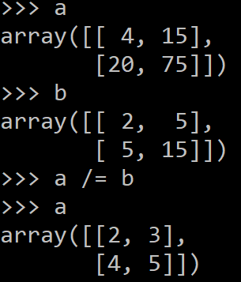
Mathematical operators
Arithmetic operations are element-wise
Logical operator return a bool array
In place operations modify the array

Slide 35
Math, upcasting
Just as in Python and Java, the result of a math operator is cast to the more general or precise datatype.
uint64 + uint16 => uint64
float32 / int32 => float32
Warning: upcasting does not prevent overflow/underflow. You must manually cast first.
Use case: images often stored as uint8. You should convert to float32 or float64 before doing math.

Slide 36
Math, universal functions
Also called ufuncs
Element-wise
Examples:
np.exp
np.sqrt
np.sin
np.cos
np.isnan

Slide 37
Math, universal functions
Also called ufuncs
Element-wise
Examples:
np.exp
np.sqrt
np.sin
np.cos
np.isnan

Slide 38
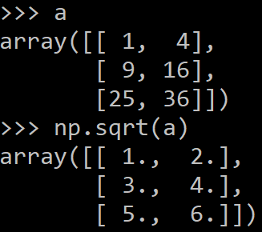
Math, universal functions
Also called ufuncs
Element-wise
Examples:
np.exp
np.sqrt
np.sin
np.cos
np.isnan

Slide 39
Indexing
x[0,0] # top-left element
x[0,-1] # first row, last column
x[0,:] # first row (many entries)
x[:,0] # first column (many entries)
Notes:
Zero-indexing
Multi-dimensional indices are comma-separated (i.e., a tuple)

Slide 40
Indexing, slices and arrays
I[1:-1,1:-1] # select all but one-pixel border
I = I[:,:,::-1] # swap channel order
I[I<10] = 0 # set dark pixels to black
I[[1,3], :] # select 2nd and 4th row
Slices are views. Writing to a slice overwrites the original array.
Can also index by a list or boolean array.

Slide 41
Python Slicing
Syntax: start:stop:step
a = list(range(10))
a[:3] # indices 0, 1, 2
a[-3:] # indices 7, 8, 9
a[3:8:2] # indices 3, 5, 7
a[4:1:-1] # indices 4, 3, 2 (this one is tricky)

Slide 42
Axes
a.sum() # sum all entries
a.sum(axis=0) # sum over rows
a.sum(axis=1) # sum over columns
a.sum(axis=1, keepdims=True)
Use the axis parameter to control which axis NumPy operates on
Typically, the axis specified will disappear, keepdims keeps all dimensions

Slide 43
Broadcasting
a = a + 1 # add one to every element
When operating on multiple arrays, broadcasting rules are used.
Each dimension must match, from right-to-left
Dimensions of size 1 will broadcast (as if the value was repeated).
Otherwise, the dimension must have the same shape.
Extra dimensions of size 1 are added to the left as needed.

Slide 44
Broadcasting example
Suppose we want to add a color value to an image
a.shape is 100, 200, 3
b.shape is 3
a + b will pad b with two extra dimensions so it has an effective shape of 1 x 1 x 3.
So, the addition will broadcast over the first and second dimensions.

Slide 45
Broadcasting failures
If a.shape is 100, 200, 3 but b.shape is 4 then a + b will fail. The trailing dimensions must have the same shape (or be 1)

Slide 46

Let's Code!

Slide 47
Quiz Time!

Slide 48

Any Questions?

Slide 49
Thanks

