Slide 1



Sales Forecasting and Demand Prediction – EDA
Supervised by: Mahmoud Talaat

Slide 2
CONTENT
01 Introduction
02 Dataset Overview
03 Data Cleaning and Preprocessing
04 EDA Insights
05 Modeling

Slide 3

01 Introduction
Sales Forecasting Analysis
This project aims to analyze sales trends and predict future sales using historical data to support data-driven decision-making.
Key Questions:
What are the key factors affecting sales trends?
How can we improve sales forecasting accuracy?
What actionable insights can help optimize business strategies?
Methodology
Data cleaning and preprocessing.
Exploratory Data Analysis (EDA).
Deriving actionable insights.

Slide 4
Project Statement
This project aims to develop a machine learning-based forecasting system to predict future sales and product demand using historical data and external factors such as promotions, holidays, and weather. Through data collection, analysis, model development, deployment, and monitoring, the goal is to enable businesses to make data-driven decisions that optimize inventory management, enhance demand planning, and improve overall operational efficiency. The final solution will include an interactive dashboard and a deployed predictive model ready for real-world use.

Slide 5
Stakeholders
Stakeholder | How They Benefit
Inventory Managers | Maintain optimal stock levels; avoid shortages & surpluses
Marketing Teams | Plan promotions aligned with predicted demand
Sales Teams | Focus efforts on high-demand periods/products
Finance Department | Improve revenue forecasting and budget planning
Operations Teams | Align staffing and logistics with forecasted demand

Slide 6
Related Projects
Inventory Optimization System:
Uses historical and forecasted demand data to automate restocking
Complements the forecasting model by closing the loop on supply decisions
Supply Chain Visibility Dashboard:
Real-time tracking of logistics and stock movement
Can integrate demand predictions for proactive planning
Customer Purchase Pattern Analysis:
Understands buyer behavior to improve product placement and recommendations
Data feeds into demand models for more accurate forecasts

Slide 7
02 Dataset Overview
Data Source
This dataset is real data of 9,800 records collected from a private Super Store provider. Dataset Link
Challenges
Imbalanced distributions in Target Sales.
Outliers Termination
Key Features
- Sales: Target variable.stions:
- Time-Based Features: Order Date & Ship Date.
- Product Name: Identfier for each product.
- Category: Product Category.
- Region, State & City: Geographical Features.

Slide 8

03 Data Cleaning and Preprocessing
Columns Manipulation
Removed The identifier columns that were unrelevant to the Analysis Row ID, Customer ID & Product ID

Slide 9
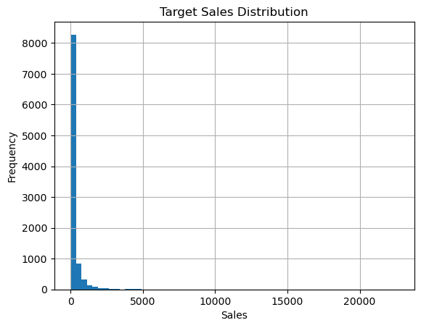
03 Data Cleaning and Preprocessing
Outliers
The Analysis Showed an Imbalance in the Distribution of Target Variable “Sales”
Which was Eliminated Using Feature Scaling (Normalization & Standardization)

Slide 10
03 Data Cleaning and Preprocessing
Feature Engineering
Encoded Categorical Variables (One-Hot & Label Encoding): Ship Mode, Segment …etc.
Maintained a Unified Date Format across features “%d/%m/%Y”. And extracted Temporal features from the date column (Day, Month, Year)
Obtained an Aggregated Sales Performance per Product Feature

Slide 11
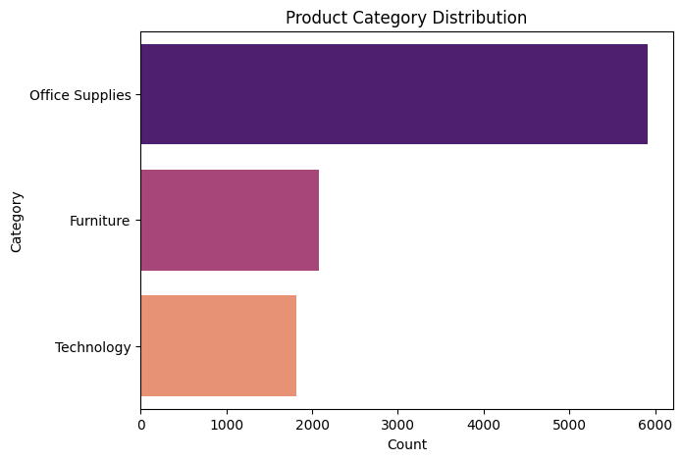
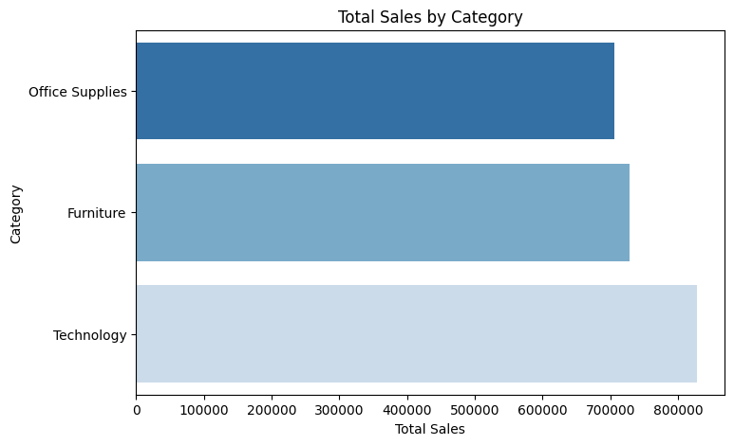
04 EDA Insights
Product Analysis
The analysis indicates that the Technology product category generates the highest sales, despite the majority of offered products belonging to the Office Supplies category.
This suggests that expanding the range of technology-related products could lead to higher future sales and revenue growth.

Slide 12
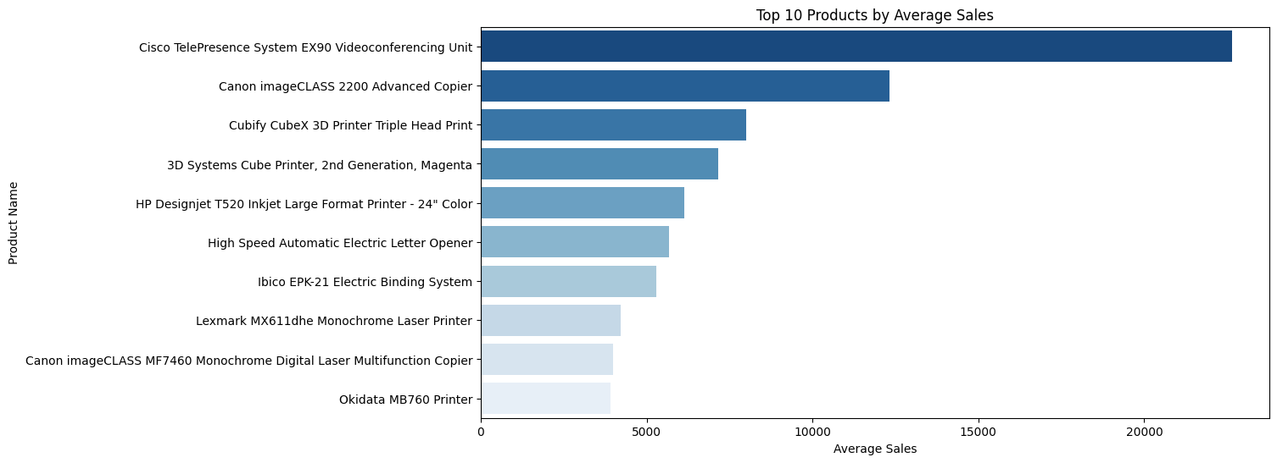
04 EDA Insights
Top 10 Products Sales

Slide 13
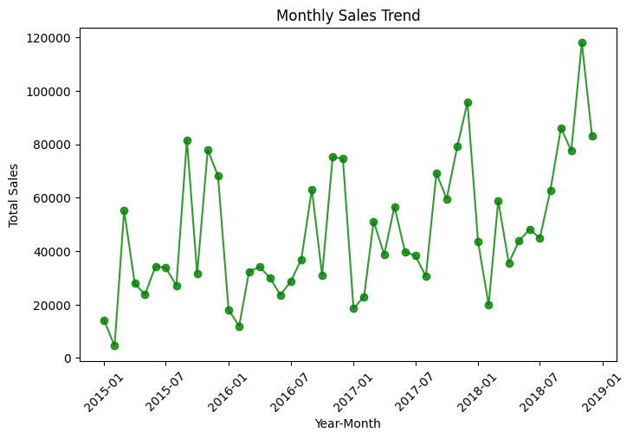
04 EDA Insights
Time Series Analysis
Peak sales occurred between 2018 and 2019.

Slide 14
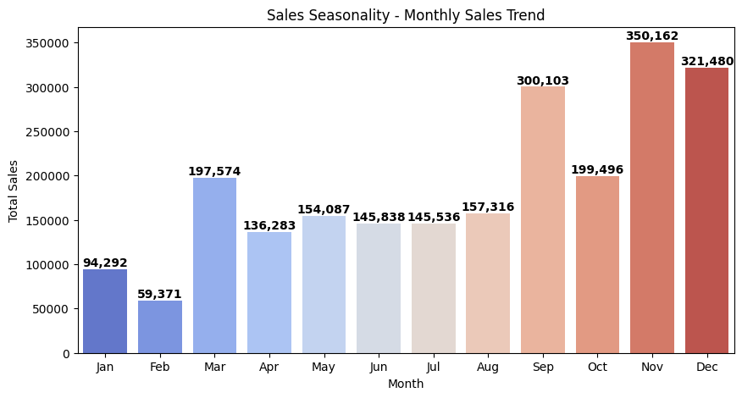
04 EDA Insights
Time Series Analysis
Peak sales occur in November, suggesting the need for targeted marketing and optimized inventory to maximize revenue.

Slide 15
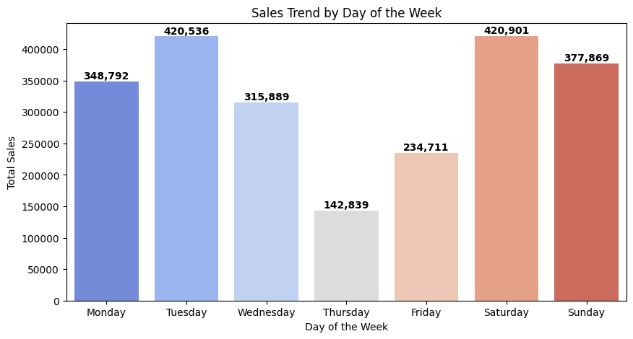
04 EDA Insights
Time Series Analysis
Highest sales occur on Saturdays, suggesting a strategic focus on weekend promotions and inventory management to maximize revenue.

Slide 16
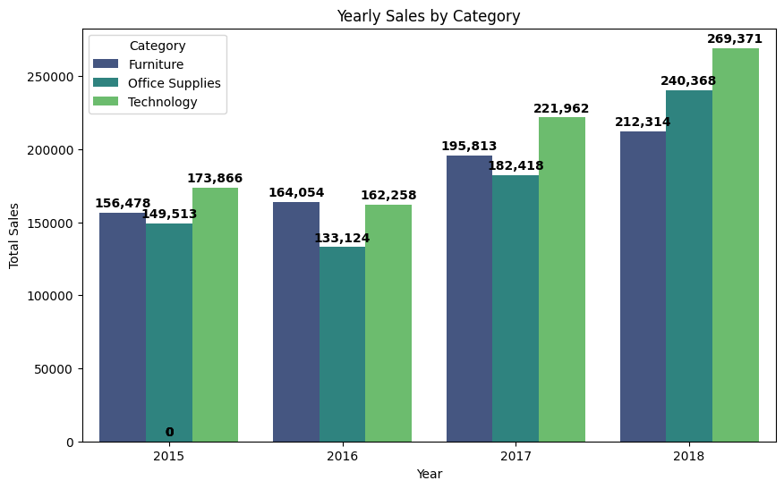
04 EDA Insights
Time Series Analysis
Highest Sales For Tech Category, This suggests that expanding the range of technology-related products could lead to higher future sales and revenue growth.

Slide 17
04 EDA Insights
Geographical Analysis
Top 3 Cities in sales are
25.1% in
17.2% in
11.5% in
New York
Los Angeles
Seattle

Slide 18
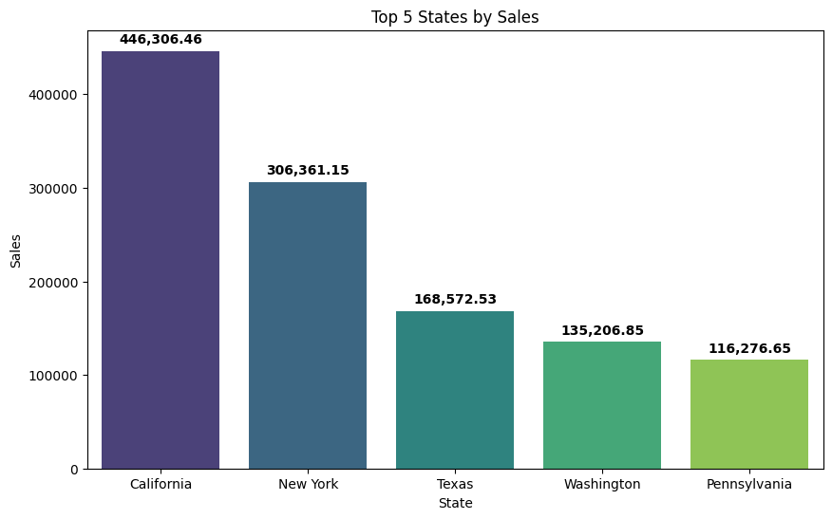
04 EDA Insights
Geographical Analysis
California records the highest sales, indicating a strong market presence and potential for further expansion.

Slide 19
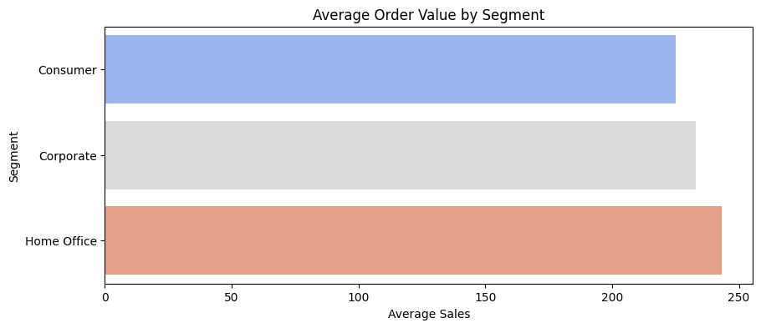
04 EDA Insights
Customer Analysis
The Home Office segment generates the highest sales, suggesting a key target audience for future strategies

Slide 20
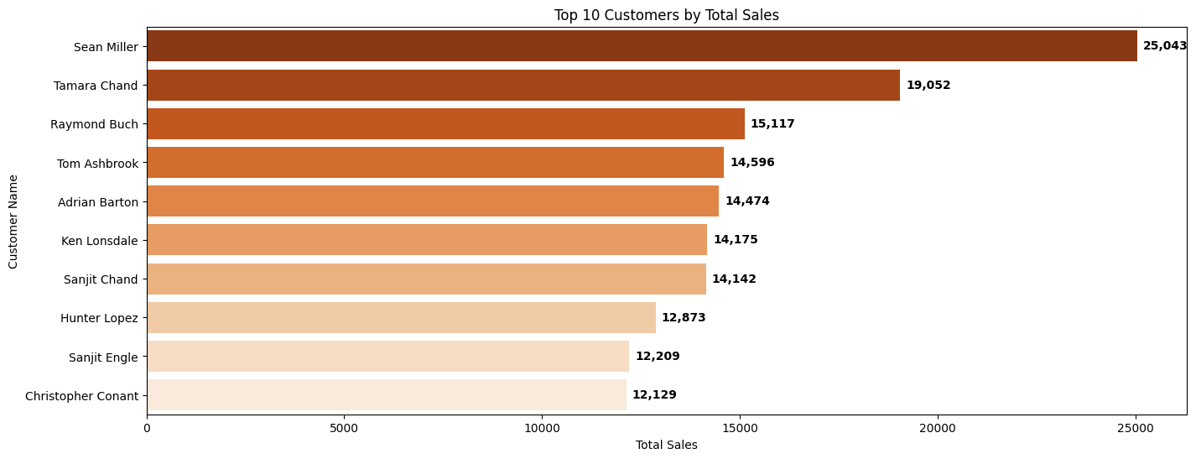
04 EDA Insights
Customer Analysis

Slide 21
05 Modeling
Objectives:
Select appropriate regression models
Evaluate their performance using key metrics
Apply cross-validation to ensure model reliability
Models Used:
Linear Regression
Decision Tree Regressor
Random Forest Regressor
Evaluation Metrics
MAE, MSE, RMSE: Measure prediction error
RMSLE: Accounts for relative error, useful for skewed sales data

Slide 22
05 Modeling : Linear Regression
Interpretation:
The average error between predicted and actual sales is ~241 units.
A relatively high RMSLE (1.55) suggests the model struggles more with larger sales values.
Performance Metrics
RMSLE | 1.55
RMSE | 740.92
MSE | 548960.22
MAE | 240.86
Conclusion
The linear regression model gave us a decent start, but as seen in the metrics, there’s quite a bit of error — especially noticeable in the RMSLE. This suggests that our sales data might have a skewed or wide distribution, which this linear model doesn’t capture well. That’s why we explored more flexible models next.

Slide 23
05 Modeling : Decision Tree Regressor
Interpretation:
The MAE increased to ~326 units compared to Linear Regression's 240.
RMSLE (1.63) is higher than Linear Regression → worse at handling larger sales values.
Performance Metrics
RMSLE | 1.63
RMSE | 1053.69
MSE | 1110271.53
MAE | 326.07
Conclusion
The Decision Tree didn’t outperform Linear Regression, indicating a need for either better tuning or an ensemble method like Random Forest.

Slide 24
05 Modeling : Random Forest
Interpretation:
Best RMSLE of all models (1.52), suggesting it's better at predicting both low and high sales values.
Lower RMSE and MSE than Decision Tree → better generalization.
Slightly higher MAE than Linear Regression, but overall more balanced performance.
Performance Metrics
RMSLE | 1.52
RMSE | 783.14
MSE | 613309.2
MAE | 265.67
Conclusion
Random Forest offers the most consistent performance across all metrics. It handles complexity better than a single Decision Tree and reduces overfitting while capturing non-linear patterns.

Slide 25
05 Modeling : Cross-Validation
Interpretation:
Linear Regression has the lowest average MAE, indicating the most consistent performance across folds.
Random Forest provides a good tradeoff: lower RMSLE and RMSE than Decision Tree while keeping MAE close to Linear Regression.
Decision Tree performs the worst, confirming its tendency to overfit.
Model | RMSLE | RMSE | MSE | MAE
Linear Regression | 1.552 | 569.81 | 324685.17 | 213.69
Decision Tree | 1.682 | 832.26 | 692660.93 | 289.28
Random Forest | 1.554 | 668.04 | 4446271.71 | 248.64
Conclusion
Cross-validation confirms that Random Forest is the most robust overall, while Linear Regression is still surprisingly strong as a baseline.

Slide 26
Questions

Slide 27

Thank You
Presented By
Abdallah Gasem
Mazen Karam
Abdallah Sayed
Youseff Ali
Micheal Emad
Mostafa Ahmed
Group
GIZ2_AIS4_S9
Contact

