Slide 1

SALES FORECASTING
and
DEMAND PREDICTION
Supervised by: Eng. Mahmoud Talaat
1

Slide 2
Table of Content
01 Introduction
02 Problem Statement
03 Proposed solution
04 Methodology
05 Conclusion
05/08/2025
2

Slide 3
Introduction
Sales Forecasting & Demand Prediction is a data science project aimed at building a predictive system that accurately forecasts future product demand using historical sales data and external variables such as promotions, holidays, and weather conditions. The objective is to help businesses reduce stockouts and overstocking, improve operational and financial planning, and enable more effective, data-driven decisions across marketing, supply chain, and inventory management.
05/08/2025
3

Slide 4
Problem Statement
Businesses often struggle to predict demand accurately in a world driven by dynamic factors like promotions, seasonality, and customer behavior.
Traditional methods often lead to stockouts, overstocking, and lost opportunities.
This creates a critical need for a forecasting system that aligns inventory, marketing, and operations with real-world demand patterns.
05/08/2025
4

Slide 5
Proposed Solution
We built a machine learning model that uses historical sales data and time-based features to forecast future demand.
Key steps included:
Segment analysis through EDA.
Feature engineering (lags, promotions, seasonality).
Model training with XGBoost for high accuracy.
Deployment using Flask to serve forecasts via API.
Forecast generation to guide inventory and marketing decisions.
This solution enables accurate, accessible, and data-driven sales planning.
05/08/2025
5

Slide 6
Methodology
Problem Understanding
Data Collection
Data Preprocessing
Exploratory Data Analysis
Model Development
Model Deployment
1.Problem Understanding:
Defined business objective: Improve sales forecasting accuracy to optimize inventory and planning.
2. Data Collection:
Collected historical sales data, customer segments, promotional events, holidays, and weather factors.
3. Data Preprocessing:
Handled missing values, outliers, and duplicates.
Performed feature engineering
4. Exploratory Data Analysis (EDA):
Identified trends, seasonality, and high-performing segments
Visualized segment-wise sales and demand behavior.
5. Model Development:
Tested multiple models.
Selected best-performing model based on RMSE and accuracy.
6. Model Deployment:
Deployed model using Flask and IBM Cloud to generate real-time predictions.
05/08/2025
6

Slide 7
Methodology
“Problem Understanding”
Business Objective:
To enhance the accuracy of sales forecasting in order to optimize inventory levels, reduce waste, and align business operations with real demand.
Challenge:
Traditional forecasting methods fail to account for time-based patterns and external influences like promotions or customer segment behavior, leading to overstocking or stockouts.
05/08/2025
7

Slide 8
Methodology
“Data Collection”
Data Source:
Historical sales data from Kaggle (CSV dataset).
Included features: Row ID, Order ID, Order Date, Ship Date, Ship Mode, Customer ID, Customer Name, Segment, Country, City, State, Postal Code, Region, Product ID, Category, Sub-Category, Product Name, Sales, Quantity, Discount, Profit.
Data Scope:
Captures transactions across multiple customer segments and product categories.
Date range spans multiple years, allowing analysis of trends and seasonality.
05/08/2025
8

Slide 9
Methodology
“Data Preprocessing”
Part 1: Data Cleaning
Date Conversion: Converted Order Date and Ship Date to datetime format for time-based operations.
Removed Unnecessary Columns: Dropped irrelevant or duplicate columns not useful for modeling (e.g., IDs).
Handled Missing Values: Checked for and confirmed the absence of missing values in relevant columns.
Removed Duplicates & Outliers: Ensured data uniqueness and integrity by removing any duplicated records or outliers.
05/08/2025
9

Slide 10
Methodology
“Data Preprocessing”
Part 2: Feature Engineering
Time-Based Features: Extracted Year, Month, Day, and Weekday from Order Date.
Sales Aggregation: Grouped sales data monthly by Segment to generate a time-series format.
Lag Features: Created lag-based features (e.g., previous month’s sales) to capture momentum.
05/08/2025
10

Slide 11
Methodology
“Data Preprocessing”
Part 3: Encoding & Transformation
Categorical Encoding: Encoded segment and categorical columns where necessary.
Data Formatting: Reformatted the grouped data into a structured time series dataframe for modeling.
05/08/2025
11

Slide 12
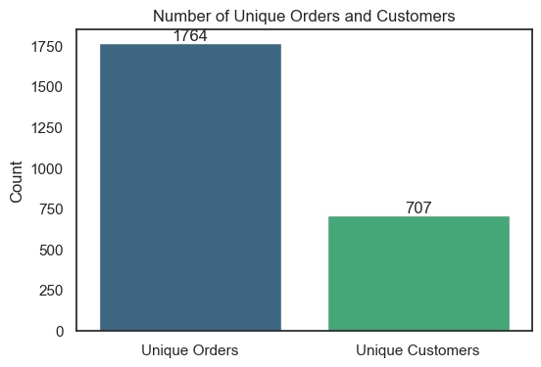
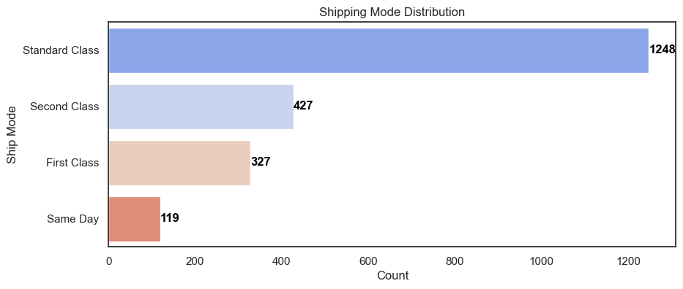
Methodology
“Exploratory Data Analysis”
Graph 1
Graph 1: Number of Unique Orders vs. Customers
Description: This bar chart compares the total number of unique orders (1764) to the number of unique customers (707 ) in the dataset.
Key Insight: Customers place multiple orders on average (~2.5 per customer), indicating repeat business or bulk purchasing behavior.
Graph 2: Shipping Mode Distribution
Description: This horizontal bar chart shows how often each shipping mode was used.
Key Insight: Most customers prefer cost-effective Standard Class , while faster options like Same Day are rarely chosen.
Graph 2
05/08/2025
12

Slide 13
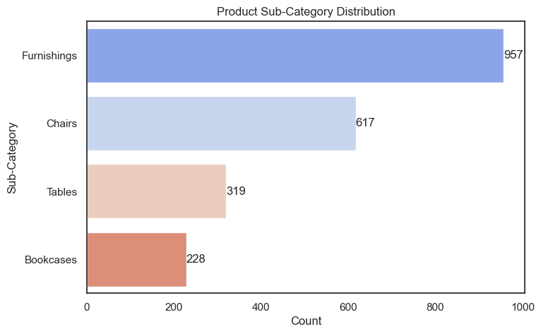
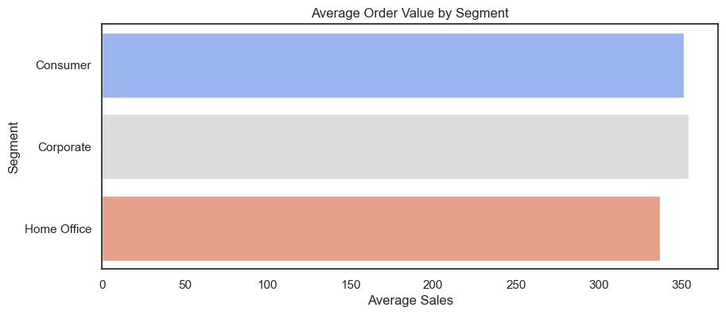
Methodology
“Exploratory Data Analysis”
Graph 3: Product Sub-Category Distribution
Description: This horizontal bar chart shows how frequently different furniture sub-categories appear in the dataset.
Key Insight: Customers buy more furniture accessories (Furnishings) and seating (Chairs) than larger items like Tables or Bookcases .
Graph 3
Graph 4: Average Order Value by Segment
Description: This horizontal bar chart shows the average order value for each customer segment.
Key Insight: Consumer and Corporate customers spend about the same per order, while Home Office customers spend slightly less..
Graph 4
05/08/2025
13

Slide 14
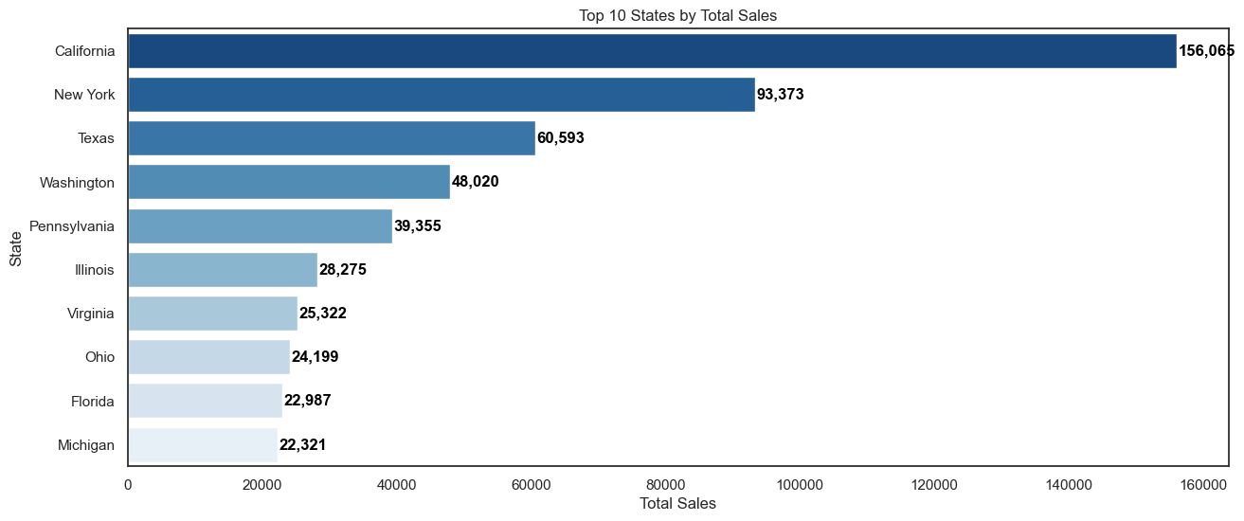
Methodology
“Exploratory Data Analysis”
Graph 5: Top 10 States by Total Sales
Description: This horizontal bar chart ranks the top 10 states based on their total sales. The chart shows the following.
Key Insight: California Dominates Sales : California has significantly higher sales compared to other states, indicating it is a major market for the business .
Graph 5
05/08/2025
14

Slide 15
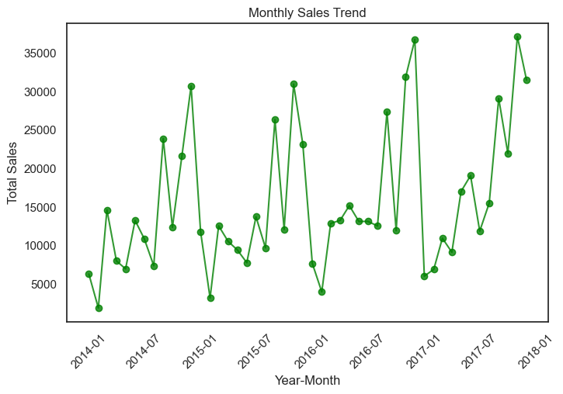
Methodology
“Exploratory Data Analysis”
Graph 6: Monthly Sales Trend
Description: This line chart illustrates the total sales over time, measured monthly from January 2014 to January 2018 .
The x-axis represents the year-month, and the y-axis shows the total sales in dollars..
Key Insight:
Steady sales growth from 2014 to 2018.
Seasonal peaks suggest strong holiday and mid-year demand.
Mid-2016 dip indicates a possible market challenge or supply issue.
Post-2016 recovery shows resilience and growth potential.
Graph 6
05/08/2025
15

Slide 16
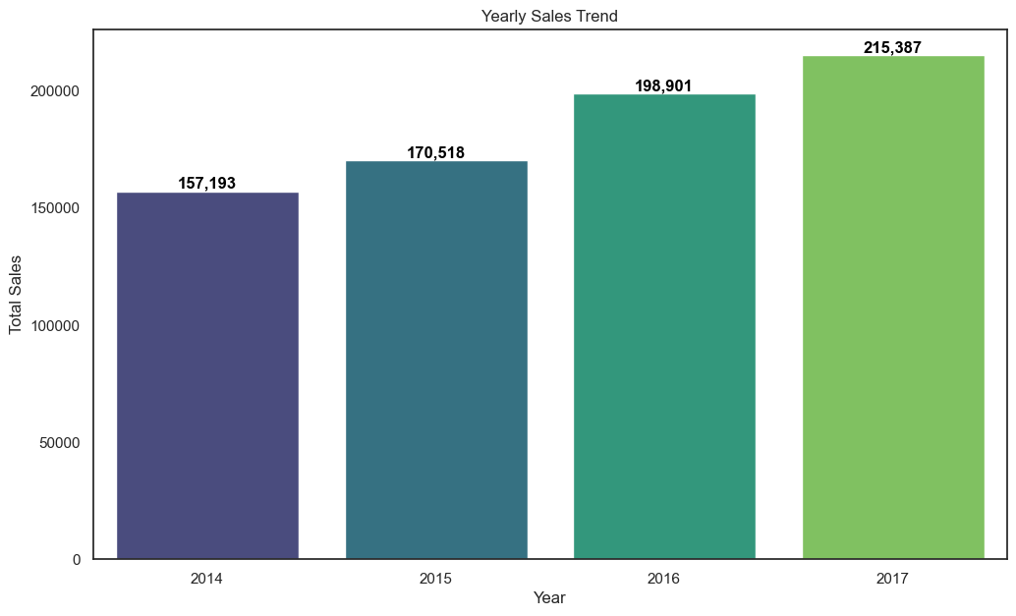
Methodology
“Exploratory Data Analysis”
Graph 7: Yearly Sales Trend
Description: This bar chart shows the total sales for each year from 2014 to 2017.
Key Insight: Sales have consistently increased year-over-year , with a steady growth trend over the four years.
Graph 7
05/08/2025
16

Slide 17
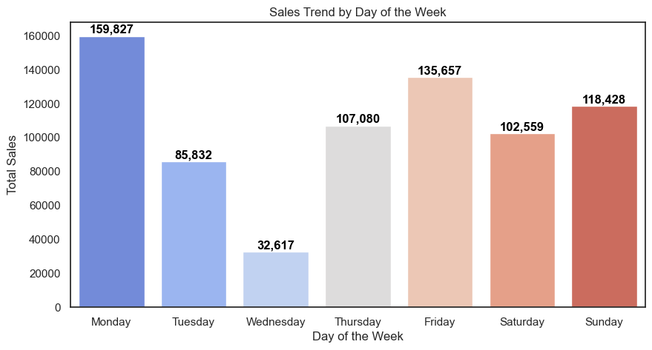
Methodology
“Exploratory Data Analysis”
Graph 8: Sales Trend by Day of the Week
Description: This bar chart shows the total sales for each day of the week.
Key Insight:
Highest Sales on Monday.
Lowest Sales on Wednesday.
Midweek Recovery : Thursday and Friday show a recovery in sales, suggesting increased customer engagement toward the end of the week.
Weekend Performance : Saturday and Sunday maintain relatively high sales, showing consistent demand throughout the weekend.
Graph 8
05/08/2025
17

Slide 18
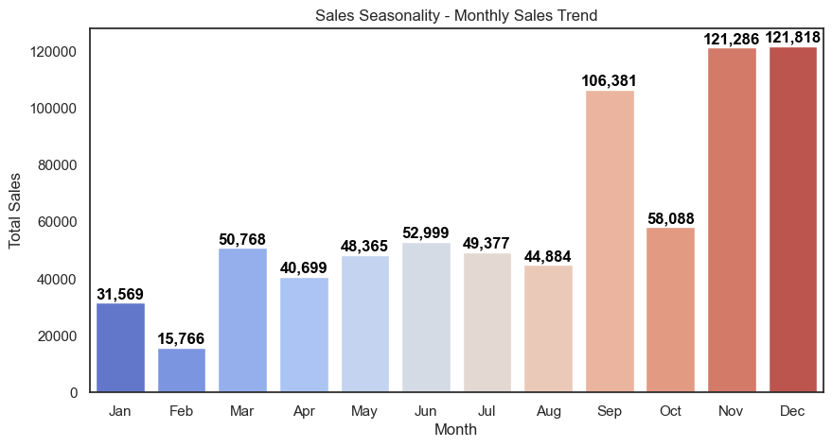
Methodology
“Exploratory Data Analysis”
Graph 9: Sales Seasonality - Monthly Sales Trend
Description: This bar chart shows the total sales for each month of the year, highlighting seasonal trends in sales performance.
Key Insight: - Seasonal Patterns : Sales see a low point in January and February after the holidays, then steadily increase from March to September, reaching their highest point in November and December due to holiday shopping.
- Holiday Impact : The significant spike in November and December reflects strong consumer spending during the holiday season.
Graph 9
05/08/2025
18

Slide 19
Methodology
“Model Development”
After completing data preprocessing and exploratory analysis, we developed and evaluated several machine learning models to predict weekly sales, our objective was to identify the most accurate and generalizable model to help optimize inventory, staffing, and marketing strategies.
Models Explored:
Linear Regression
Decision Tree Regressor
Random Forest Regressor
XGBoost Regressor
XGBoost with Log-Transformed Target
05/08/2025
19

Slide 20
Methodology
“Model Development”
Performance Metrics
RMSLE | 1.00
RMSE | 179.2
MSE | 32,111.44
MAE | 129.65
1.Linear Regression:
Target: Weekly Sales Data
Processing:
- Train-Test split: 80% – 20%
- Standardized features
Interpretation:
Model explains ~42.7% of the variance in test data.
Good start but shows underfitting – fails to capture complex, non-linear trends.
R² Score
Training | 0.0478
Testing | 0.427
05/08/2025
20

Slide 21
Methodology
“Model Development”
Performance Metrics
RMSLE | 0.62
RMSE | 165.25
MSE | 27,307.89
MAE | 101.26
2. Decision Tree Regressor:
Target: Weekly Sales Data
Processing:
- Random state set to ensure reproducibility.
Interpretation:
Better performance than Linear Regression.
Captures more complex relationships.
High train R² indicates possible overfitting.
R² Score
Training | 1.000
Testing | 0.513
05/08/2025
21

Slide 22
Methodology
“Model Development”
3. Random Forest:
Hyperparameters:
- n_estimators = 100
- min_samples_leaf = 5 - max_depth = None
Interpretation:
Strong generalization (less overfitting than Decision Tree).
RMSE is only ~52.7% of average weekly sales (241.83).
Performance Metrics
RMSLE | 0.54
RMSE | 127.42
MSE | 16,235.72
MAE | 79.87
R² Score
Training | 0.88
Testing | 0.71
05/08/2025
22

Slide 23
Methodology
“Model Development”
4. XGBoost:
Hyperparameters:
- n_estimators = 100
- learning_rate = 0.1
- max_depth = 6
Interpretation:
Excellent training fit and strong generalization.
RMSE is ~53.3% of average weekly sales.
Fast training with great accuracy
Performance Metrics
RMSLE | 0.55
RMSE | 128.84
MSE | 16,599.59
MAE | 80.31
R² Score
Training | 0.97
Testing | 0.70
05/08/2025
23

Slide 24
Methodology
“Model Development”
5. XGBoost with Log-Transformed Target :
Why Log Transformation?
- Sales data is skewed with extreme high values.
- Log transformation (log1p) stabilizes variance and reduces impact of outliers.
Interpretation:
Highest test R² across all models.
RMSLE is the lowest overall.
Indicates improved generalization and smoother predictions.
Performance Metrics
RMSLE | 0.48
RMSE | 132.2
MSE | 17,477.38
MAE | 77.32
R² Score
Training | 0.97
Testing | 0.87
05/08/2025
24

Slide 25
Methodology
“Cross Validation”
Interpretation:
- XGBoost (Log Target) achieved the lowest RMSLE (0.464) and MAE (69.5), making it the most reliable for minimizing
relative and absolute errors.
- XGBoost with Log Target is the best choice for deployment as it balances accuracy and error robustness effectively.
Model | RMSLE | RMSE | MSE | MAE
Linear Regression | 0.999 | 178.697 | 31932.487 | 130.277
Decision Tree | 0.619 | 158.045 | 24978.293 | 94.348
Random Forest | 0.515 | 119.429 | 14263.239 | 75.771
XGBoost | 0.552 | 116.891 | 13663.398 | 73.344
XGBoost (Log Target) | 0.464 | 118.420 | 14023.196 | 69.469
05/08/2025
25

Slide 26
Methodology
“Model Deployment”
Deployment Strategy:
Developed a Flask-based web application to host the forecasting model.
Designed with HTML and CSS for a responsive and user-friendly interface.
The user interface allows input of 12 key features like order date, ship mode, category, and profit for real-time sales predictions.
Output displays the expected weekly sales based on the provided inputs.
05/08/2025
26

Slide 27
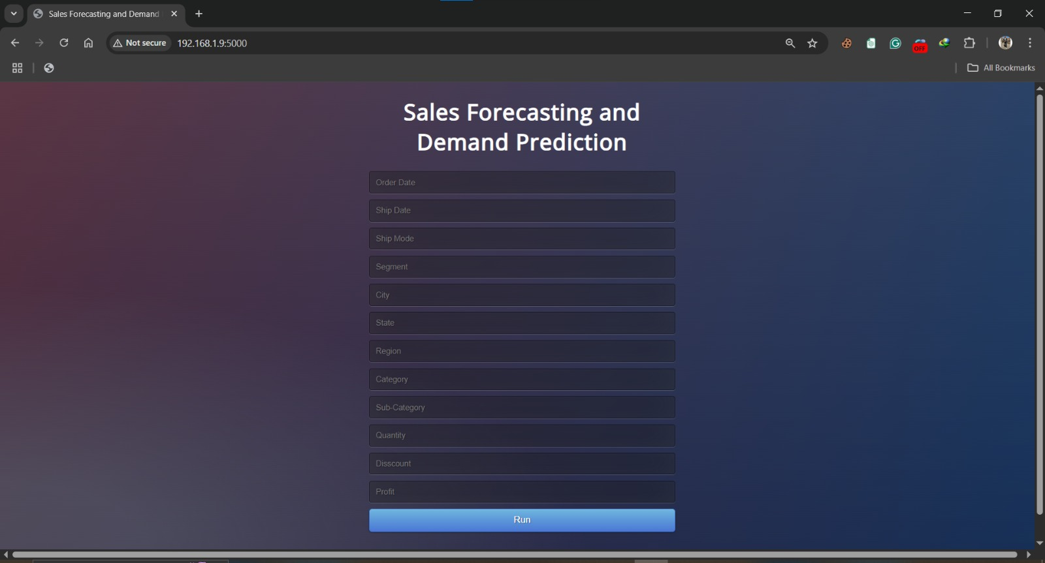
Methodology
“Model Deployment”
Step 1:
Prepare all the data (mentioned in the input cells) needed by the model to predict your sales properly.
Make sure that all the data is accurate.
05/08/2025
27

Slide 28
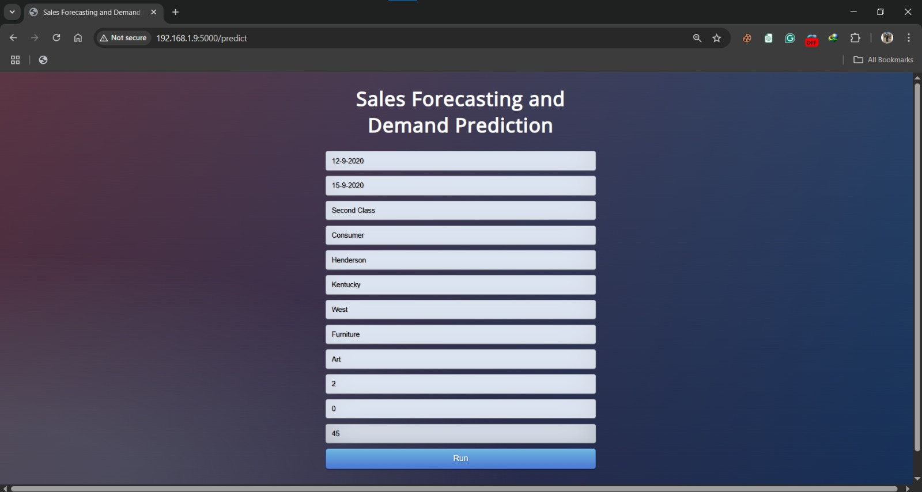
Methodology
“Model Deployment”
Step 2:
Fill in the cells.
Review your inputs.
Press the run button.
05/08/2025
28

Slide 29
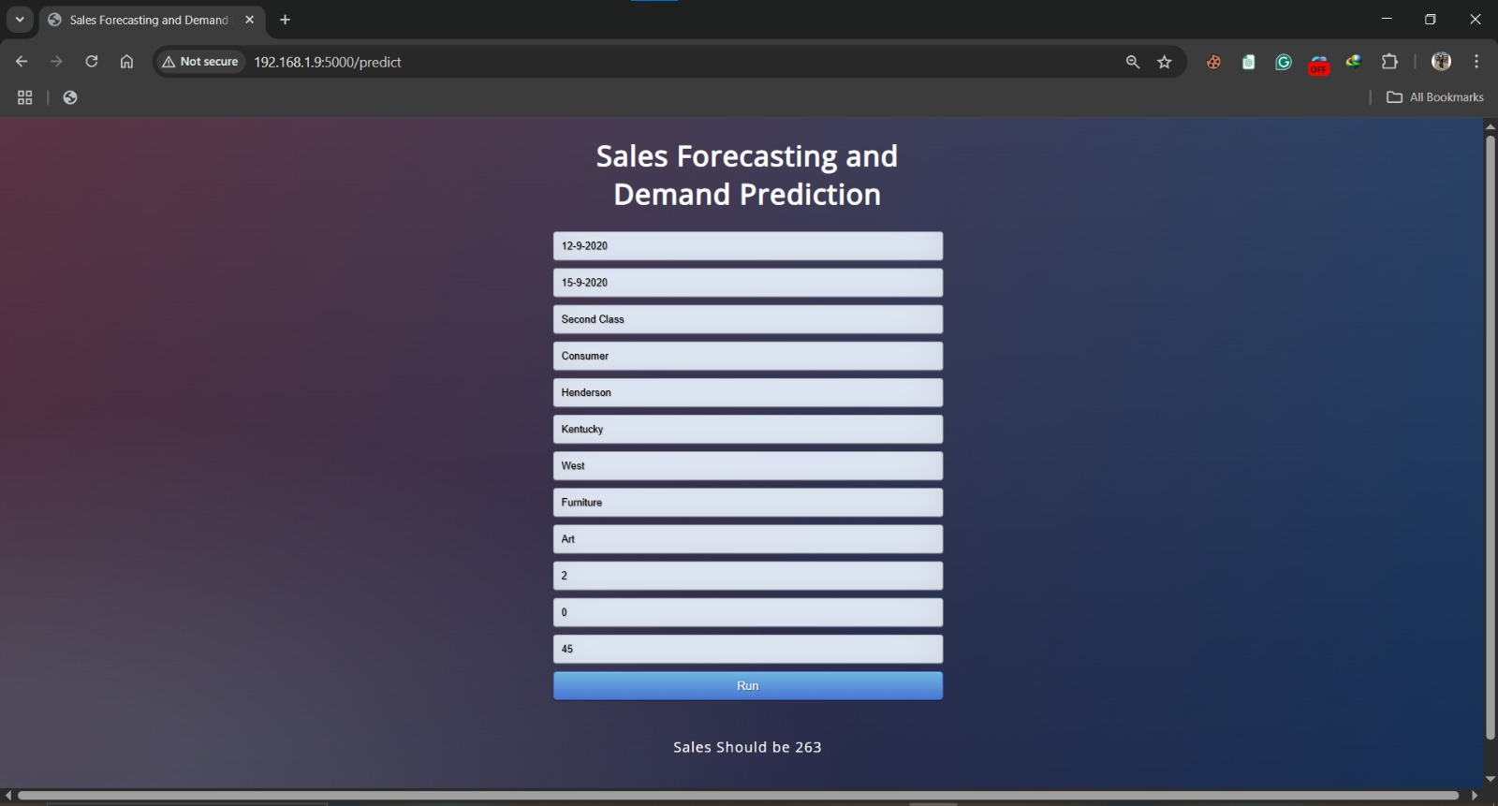
Methodology
“Model Deployment”
Step 3:
The predicted weekly sales value will be displayed.
Use it to enhance your future business strategy.
05/08/2025
29

Slide 30
Conclusion
Key Achievements:
Developed a robust machine learning model (XGBoost with log transformation) for accurate sales forecasting, achieving an R² score of 0.87 on test data.
Identified critical seasonal trends, customer behaviors, and high-performing segments through comprehensive EDA.
Engineered features like time-based variables and lag features to enhance model performance.
Deployed a user-friendly Flask API to enable real-time demand predictions for business decision-making.
Business Impact:
Reduces stockouts and overstocking by aligning inventory with predicted demand.
Improves operational efficiency through data-driven planning for marketing, staffing, and supply chain.
05/08/2025
30

Slide 31









Tools & Technologies Used
05/08/2025
31

Slide 32

Thank you
Presented by:
Abdallah Gasem
Mazen Karam
Abdallah Sayed
Youssef Ali
Micheal Emad
Mostafa Ahmed
Group:
GIZ2_AIS4_S9
Contact:
05/08/2025
32

