Slide 1



Student Performance Insights Challenge – EDA
Abdallah Gasem
Supervised by: Mahmoud Talaat

Slide 2
CONTENT
01 Introduction
02 Dataset Overview
03 Data Cleaning and Preprocessing
04 EDA Insights
05 Actionable Insights and Recommendations

Slide 3

01 Introduction
Student Performance Analysis
This project aims to analyze factors influencing student performance to provide actionable insights for improvement.
Key QuestionsKey Questions:
- What factors influence student performance?
- How can we help students achieve better academic results?
Methodology Questions:
- Data cleaning and preprocessing.
- Exploratory Data Analysis (EDA).
- Deriving actionable insights.

Slide 4
02 Dataset Overview
Data Source
This dataset is real data of 5,000 records collected from a private learning provider. Dataset Link
Challenges
- Missing values in Parent_Education_Level, Assignments_Avg, and Attendance (%).
- Imbalanced distributions in some departments.
Key Features
- Grade: Final letter grade (A, B, C, D, F).stions:
- Assignments_Avg: Average assignment scores.
- Total_Score: Weighted sum of all grades.
- Study_Hours_per_Week: Average study hours per week.
- Attendance (%): Student attendance percentage.

Slide 5

03 Data Cleaning and Preprocessing
Columns Manipulation
Removed the identfier columns that were unrevelant to the Analysis Email, Student_ID, First_Name and Last_Name

Slide 6
03 Data Cleaning and Preprocessing
Missing Values
32.88% of
10.34% of
10.32% of
Parent_Education_Level
Assignments_Avg
Attendance (%)
Values were Missing, which was Handled by Introducing a new category called “Not Provided”
Values were Missing, which was imputed using the Statistical Median
Values were Missing, which was also imputed using the Statistical Median

Slide 7
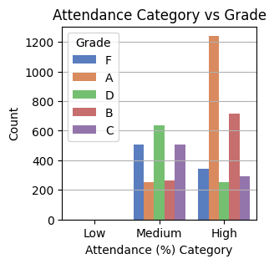
04 EDA Insights
Academic Performance
The analysis shows that students who achieve higher grades (A & B) have an average attendance of 81.5% to 85.4%.
This suggests that maintaining a higher attendance rate is beneficial for academic performance.

Slide 8
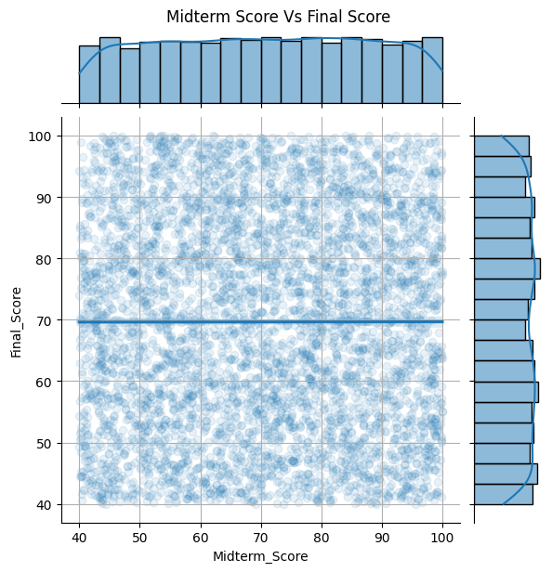
04 EDA Insights
Academic Performance
The analysis reveals that there is no significant relationship between Final_Score and Midterm_Score, with an almost negligible correlation of “0.000841”.
This suggests that a student's performance in the midterm does not necessarily predict their performance in the final exam

Slide 9
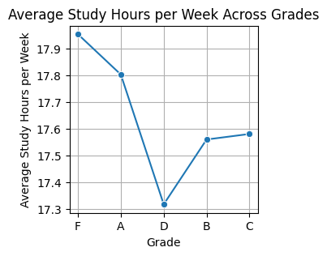
04 EDA Insights
Behavioral and Lifestyle Factors
Studying more hours doesn’t necessarily lead to better grades. as
F Graders had the highest average study hours (~17.9 hours per week), which is unexpected.
A Graders studied slightly less (~17.8 hours), followed by a sharp drop for students with D (~17.3 hours).
Surprisingly, B and C Graders studied more than those with D, but still less than those with F or A.

Slide 10
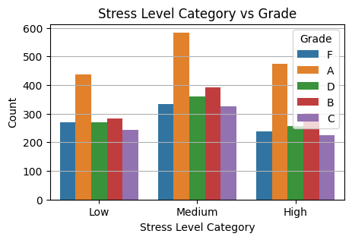
04 EDA Insights
59.3% of
Behavioral and Lifestyle Factors
The students Reported a stress level between 5 and10
Students experiencing a medium stress level achieved the highest number of A and B grades, suggesting that a balanced level of stress may be linked to better academic performance.
Low and Medium stress students are more likely to get better grades (A, B).
High stress students are over-represented in lower grades like D and F.

Slide 11
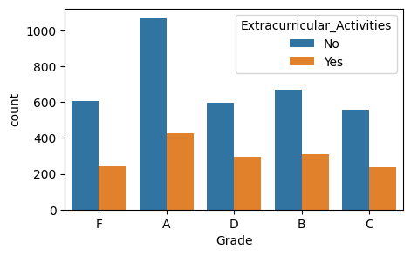
04 EDA Insights
Extracurricular and Environmental Factors
The Analysis shows that the higher percentage of the A & B grade Students do not Participate in Activities.
So, there Might Be a bad Influence on the performance For the students who Participated in Extracurricular_Activities!

Slide 12
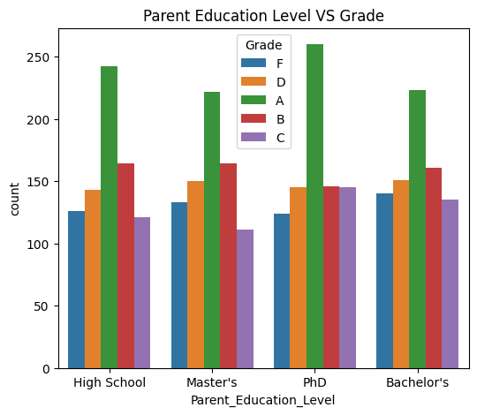
04 EDA Insights
Parental and Socioeconomic Factors
The Higher the Parent Education Level may lead to a Higher student Grades!

Slide 13
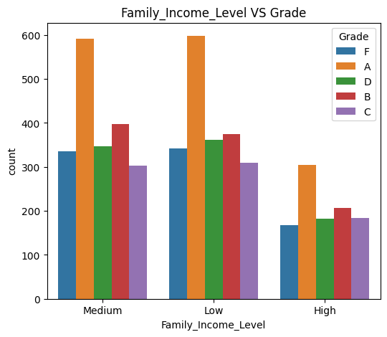
04 EDA Insights
Parental and Socioeconomic Factors
Students from medium and low -income Backgrounds Achieved the Highest Grades
Suggesting that the Income level may not be a limiting factor for academic success

Slide 14
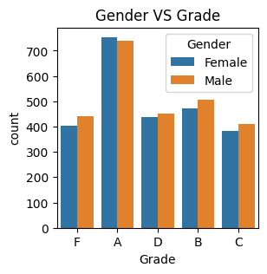
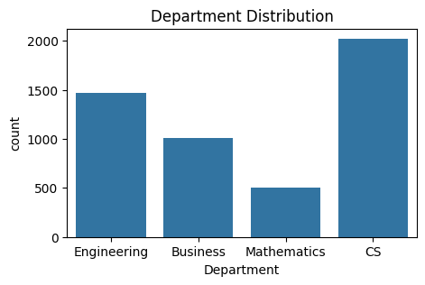
04 EDA Insights
Department and Demographic Factors
The Engineering Department has the highest percentage of students achieving top grades at 52.34%, followed by Business at 48.50%, and Computer Science closely behind at 48.46%.
Female students demonstrate a slightly better academic performance, with 50.02% achieving higher grades, compared to 48.92% of male students.

Slide 15
05 Actionable Insights
Academic Performance
Improve Attendance: Track attendance and incentivize good attendance.
Focus on Quizzes: Provide practice quizzes and study materials.
Review Grading System: Ensure all components contribute meaningfully to the final grade.

Slide 16
05 Actionable Insights
Behavioral
Promote Effective Study Habits: Teach time management and active learning techniques.
Manage Stress Levels: Offer counseling and stress-relief workshops.
Encourage Healthy Sleep: Educate students on the importance of sleep.

Slide 17
05 Actionable Insights
Parental, Socioeconomic and Extracurriculars
Support Students with Less Educated Parents: Offer mentorship programs and parent workshops.
Address Income Disparities: Provide scholarships and subsidized academic resources.
Balance Extracurriculars: Ensure activities do not interfere with academics.

Slide 18
05 Actionable Insights
Departments and Demographics
Department-Specific Interventions: Share best practices from high-performing departments.
Gender-Specific Support: Offer tailored academic support for male students.

Slide 19
General Recommendations
Regular Performance Reviews: Identify at-risk students early.
Enhance Student Engagement: Use interactive teaching methods.
Collect Feedback: Continuously improve based on student feedback

Slide 20
Questions

Slide 21

Thank You

