Slide 1


Brazilian E-Commerce Public Dataset by Olist
Data Analysis GIZ1_DAT1_G4e (G3)
DEPI Graduation Project

Slide 2
Introduction
Objective: Analyze e-commerce data from Olist to drive strategic decision-making in marketing, inventory, and customer engagement.
Dataset: 100,000 orders from 2016-2018 across various online marketplaces in Brazil.
Key Dimensions:
Order status and performance.
Pricing, payment methods, and product attributes.
Customer demographics, reviews, and geolocation insights.
Focus Areas:
Identifying top-selling products to optimize marketing and stocking efforts.
Analyzing sales trends to plan profitable promotions and pricing strategies.
Comparing new vs. repeat customer behaviors for loyalty improvement.
Pinpointing high-sales regions for potential expansion.
Outcome: Deliver actionable insights and recommendations for enhancing profitability, customer satisfaction, and marketing effectiveness.

Slide 3

Abdallah Gayle
Mohammed kamal
Mohamed Abdelrahman
Mohamed Atito
Esraa Sobhy

Slide 4
Agenda Style
Business Questions
Analyze Data
Get Data
Explore Data
Prepare Data
Present Findings

Slide 5
Business Questions & KPI
Top-Selling Products: Focus on marketing and stocking high-demand products.
2. Profitable Periods: Target promotions and campaigns during peak sales periods.
3. Customer Behavior: Analyze and enhance loyalty strategies by comparing repeat vs. new customer behavior.
4. Pricing Strategy: Optimize pricing based on its impact on sales volume and profitability.
5. Geographic Insights: Direct resources to high-sales regions and explore expansion opportunities.

Slide 6

Exploration of the dataset by MS SQL Server

Slide 7
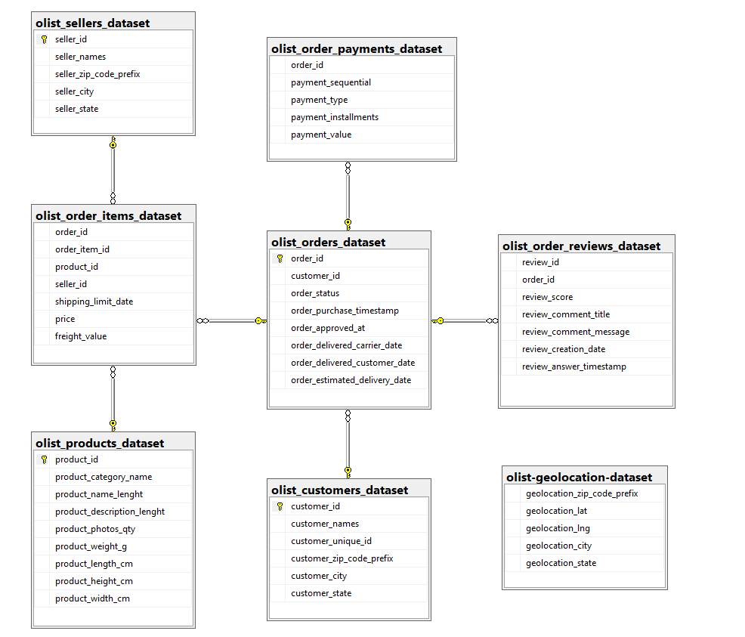
Dataset Diagram

Slide 8
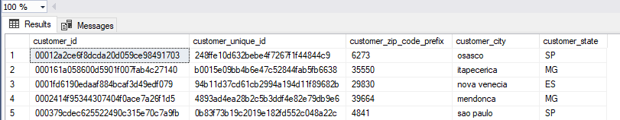
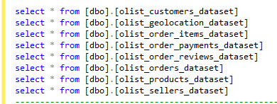
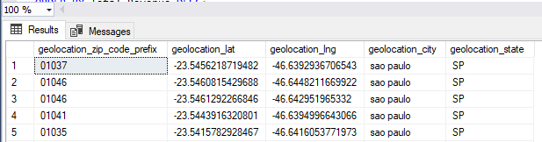
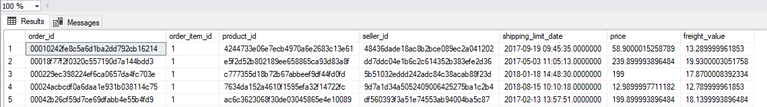
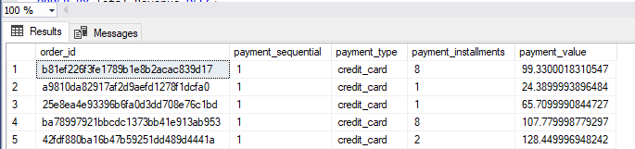





Slide 9
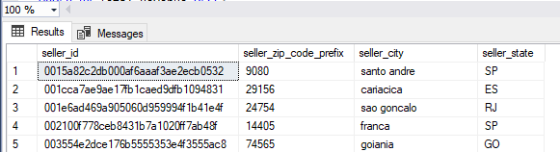
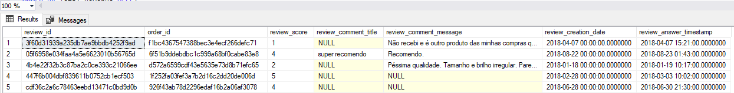
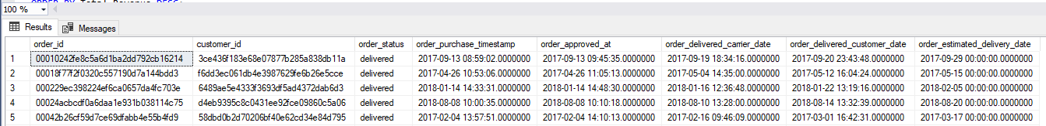
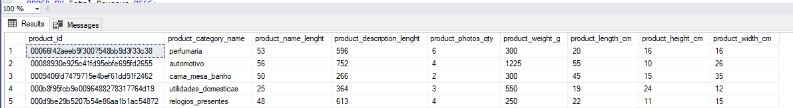





Slide 10

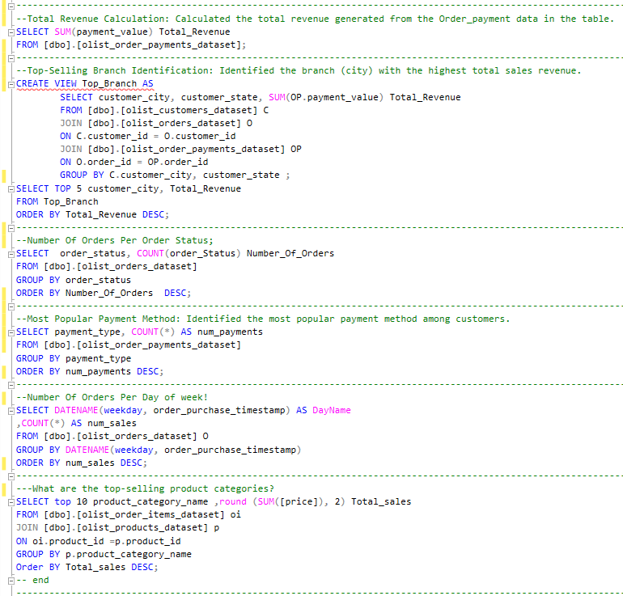
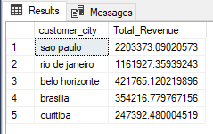
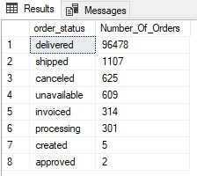
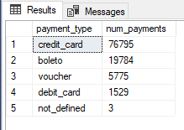
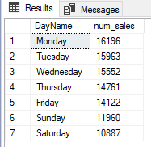
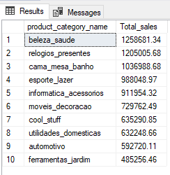

Slide 11
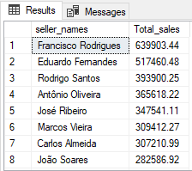
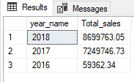
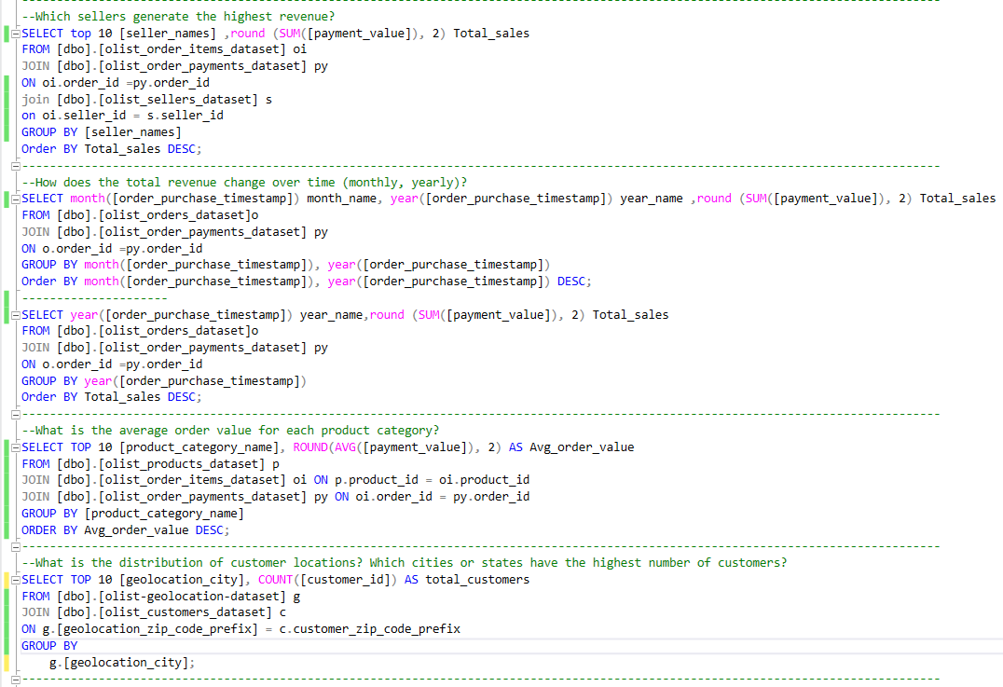
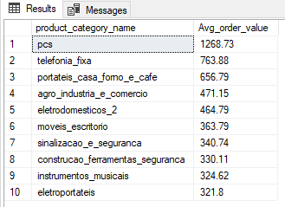
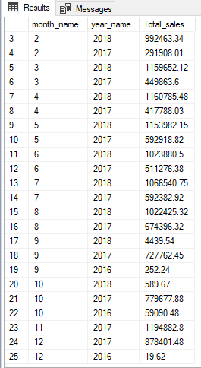
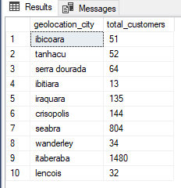

Slide 12

Cleansing and Forecasting of the dataset by Python

Slide 13
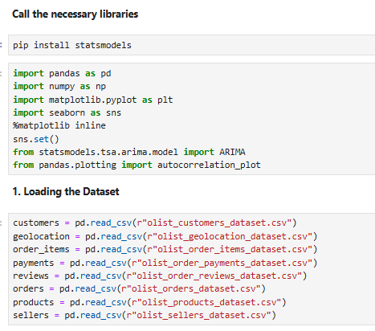
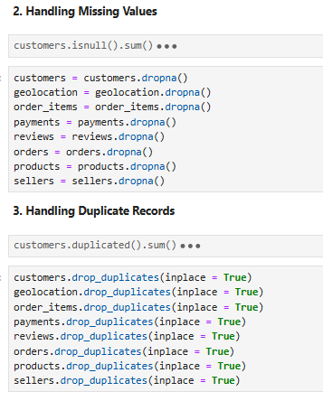
Dataset Handling

Slide 14
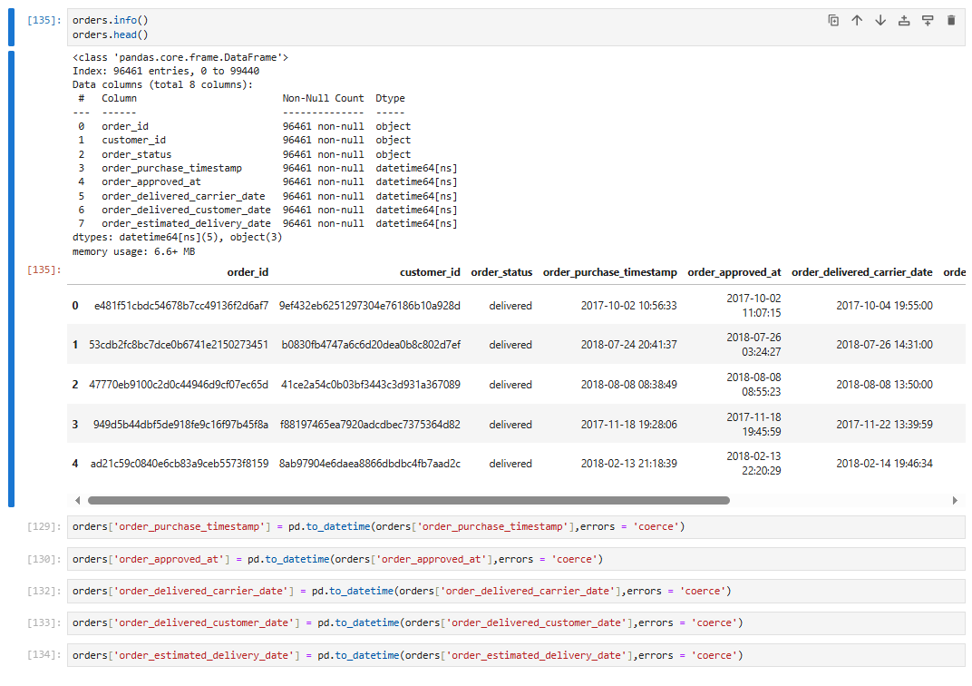
Data Type Conversion

Slide 15
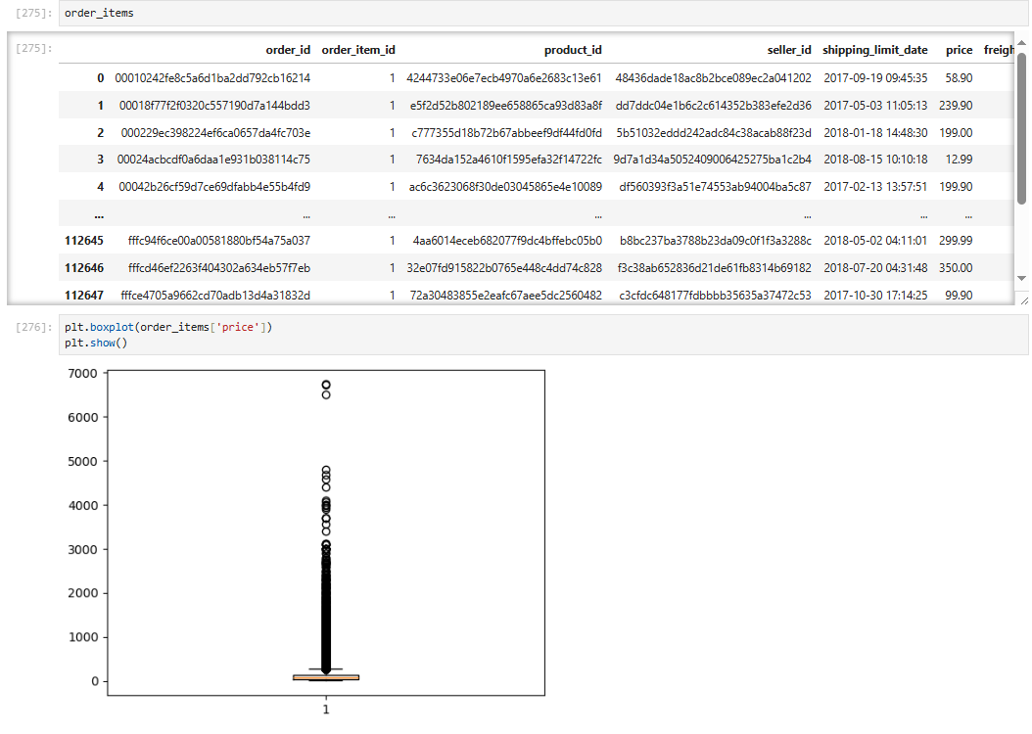
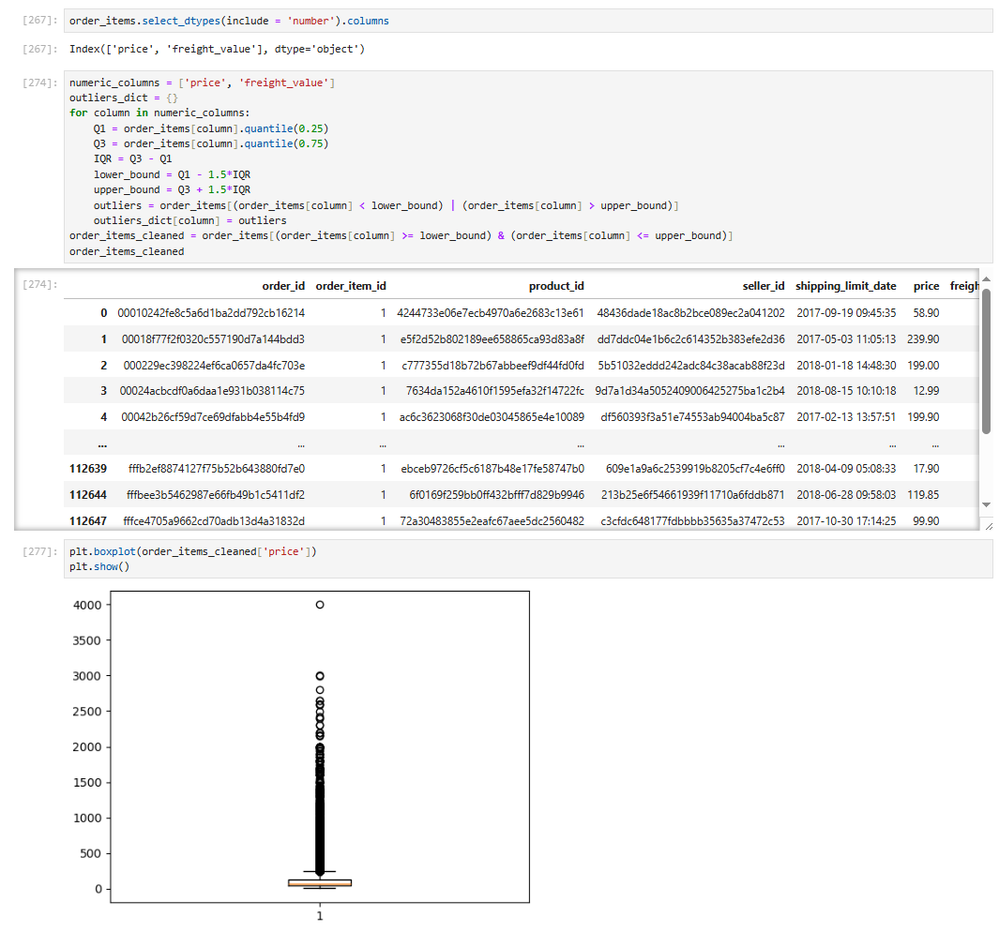
Outliers handling
2
1

Slide 16
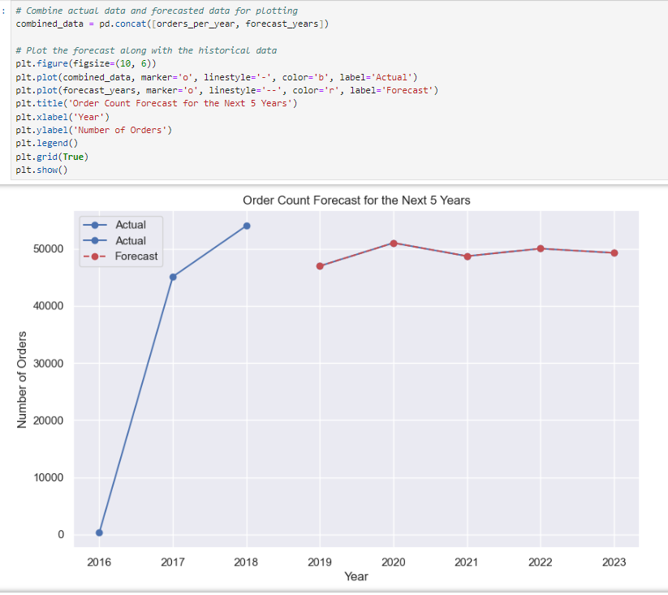
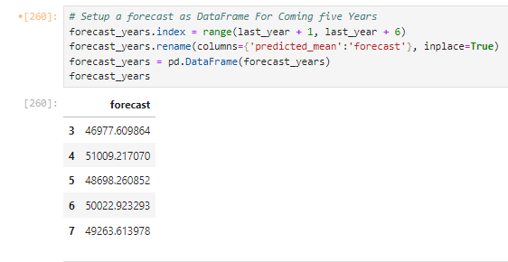
Machine Learning & Forecasting

Slide 17
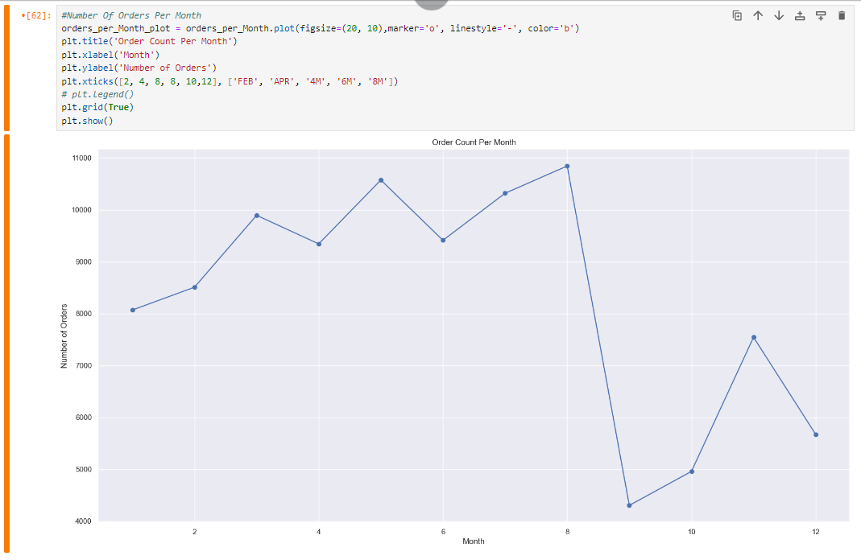
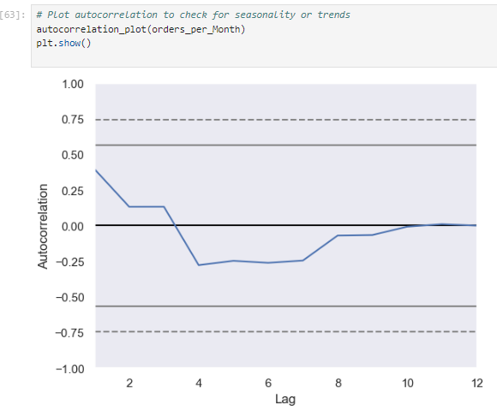
Machine Learning & Forecasting

Slide 18
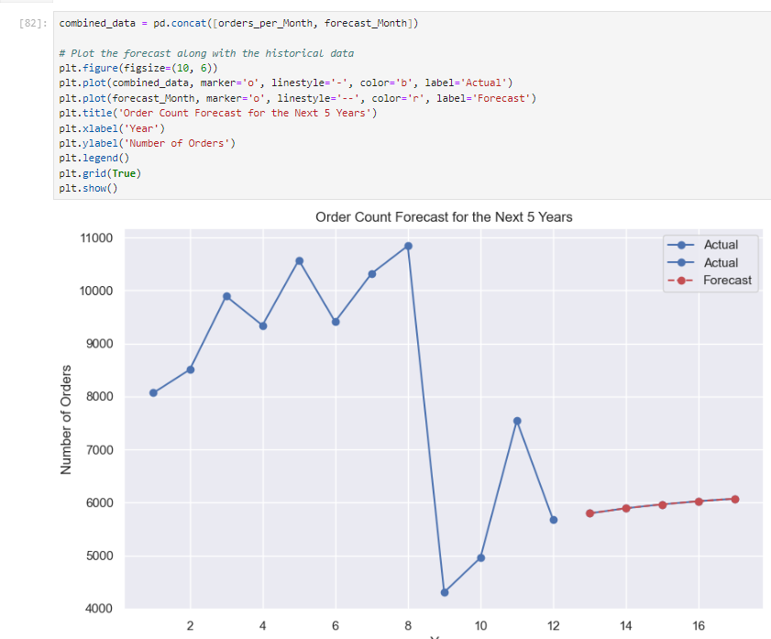
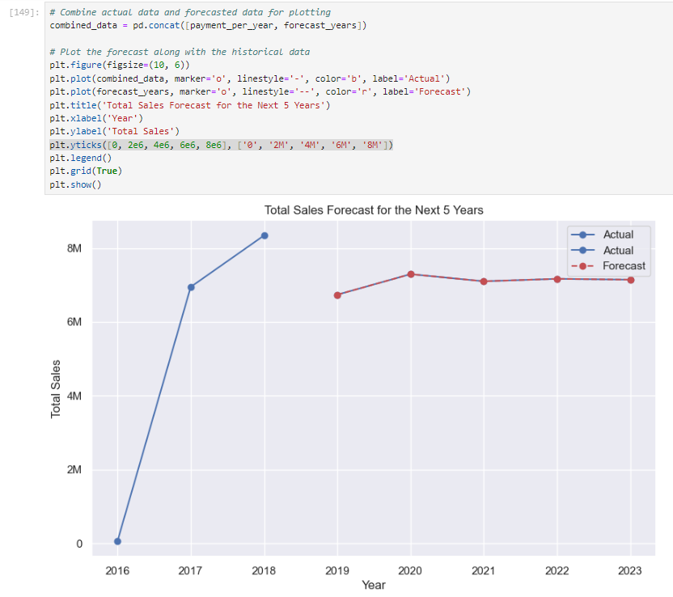
Machine Learning & Forecasting

Slide 19
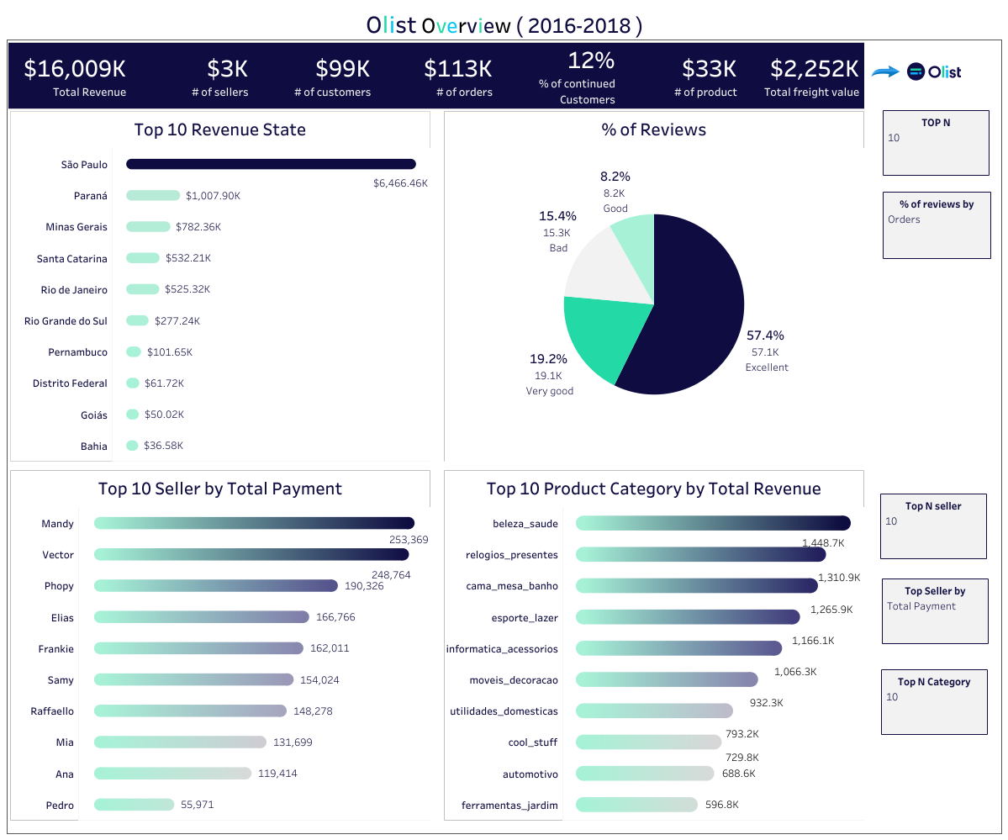

Slide 20
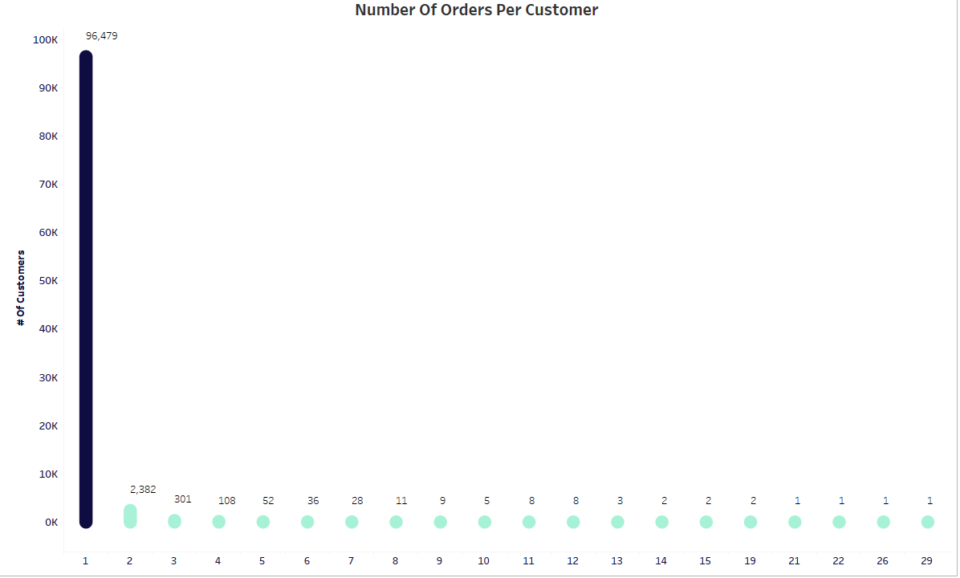

Slide 21
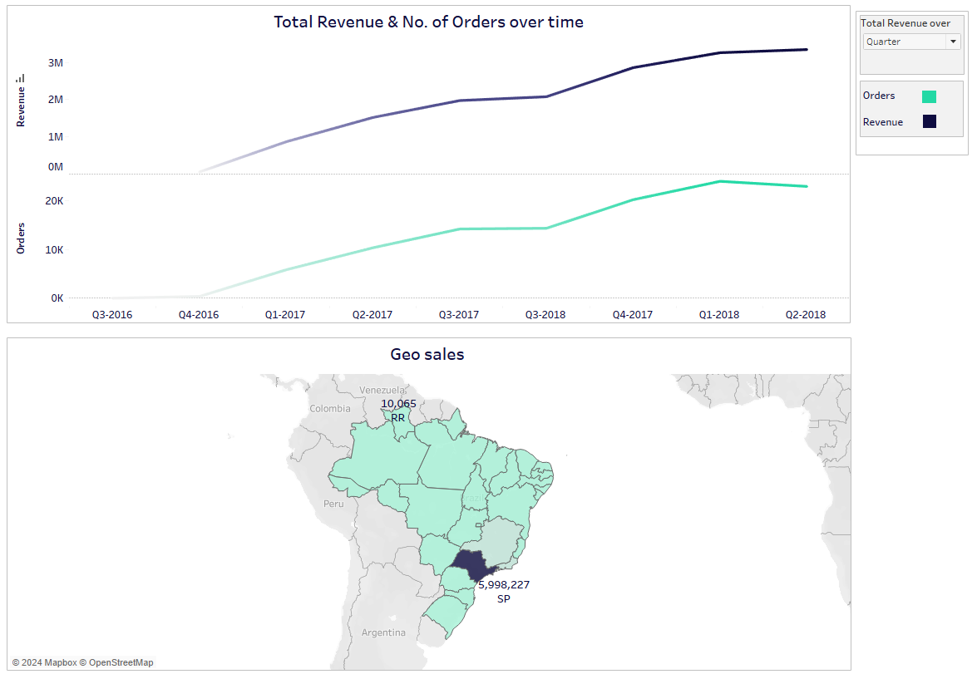

Slide 22
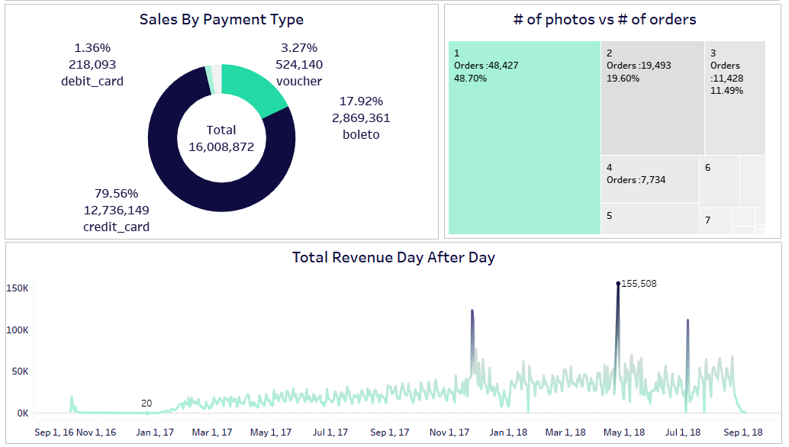

Slide 23
Findings
Increasing Customer Loyalty:
-Implement attractive loyalty programs that incentivize repeat purchases through:
rewards points, exclusive discounts, and special offers.
-Utilize available data to create personalized offers based on each customer's purchase history and preferences.
-Focus on enhancing the customer experience at every stage of their journey, from product discovery to post-sale support.

Slide 24
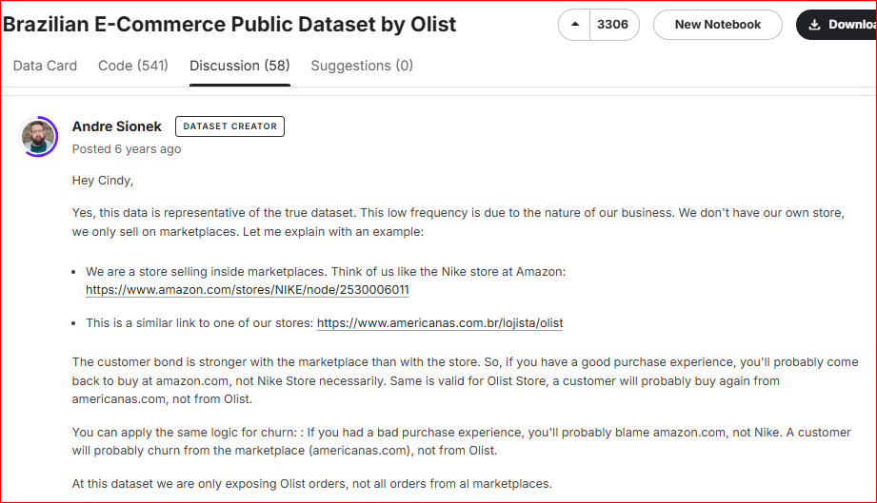
Findings

Slide 25
Findings
Focusing on Credit Cards as a Payment Method:
-Ensure that the credit card payment process is smooth and secure.
-Alongside credit cards, provide multiple payment options, including cash on delivery and e- wallets, to meet diverse customer needs.
-Offer special promotions that encourage customers to use all payment methods when making purchases.
Daily Performance Analysis:
-Identify the factors that contributed to higher sales on days with peak revenue, such as: successful marketing campaigns, special events, or discounts.
-Aim to replicate these successful elements on other days and continuously monitor daily performance to adjust marketing strategies based on results.

Slide 26
Findings
City Performance Analysis:
-Determine the factors that lead to higher sales in specific cities, considering demographic, cultural, or economic influences.
-Adapt marketing strategies to suit the unique characteristics of each city and leverage successful practices from top-performing cities to enhance results elsewhere.

Slide 27
THANK YOU

