Slide 1
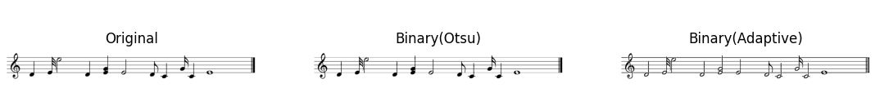
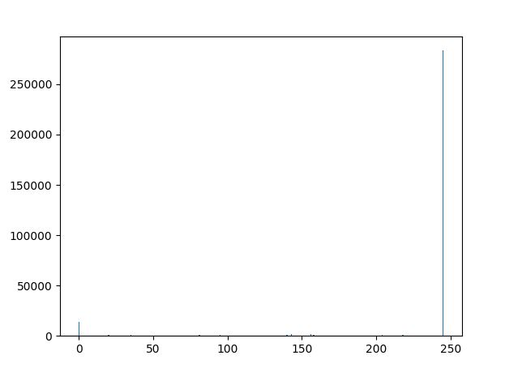
Scanned

Slide 2
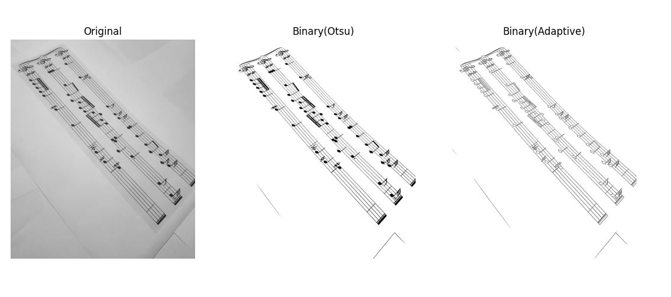
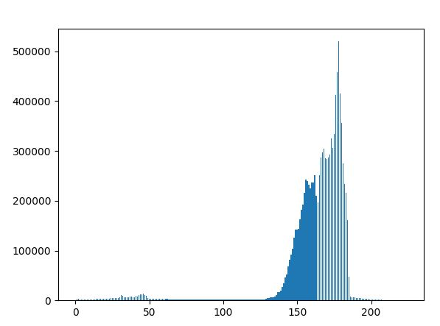
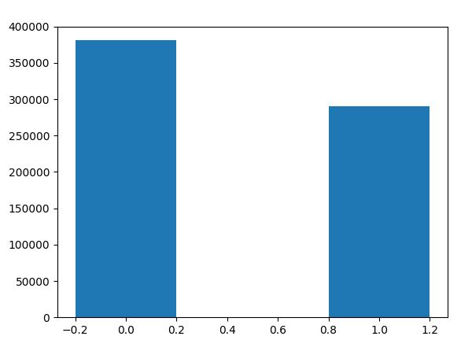
Camera Captured (Printed)

Slide 3
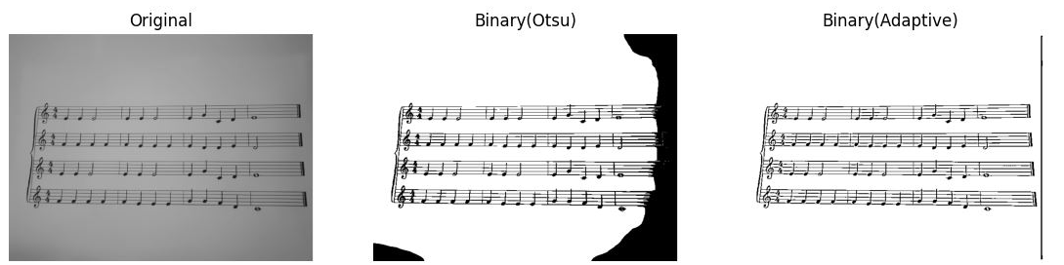
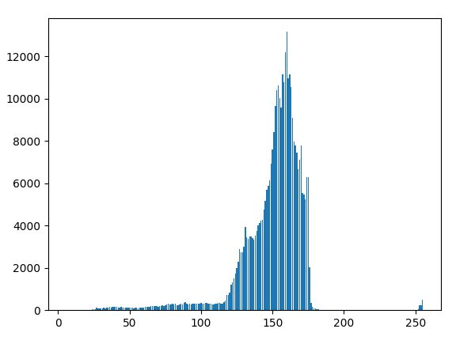
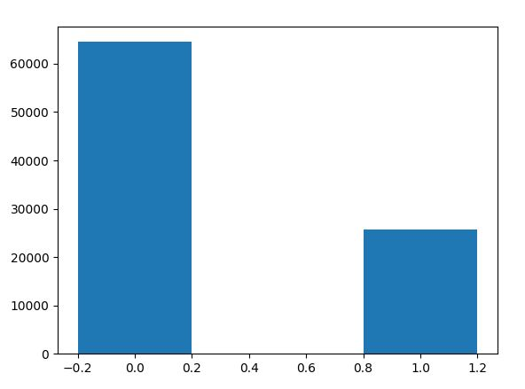
Camera Captured (Printed)

Slide 4
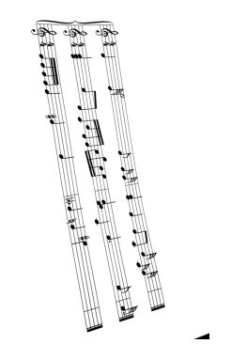
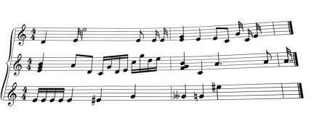
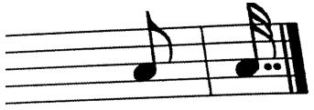
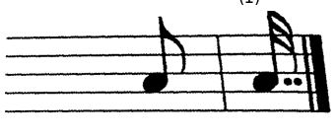
Rotation & De-Skewing

Slide 5
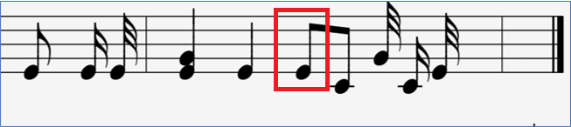
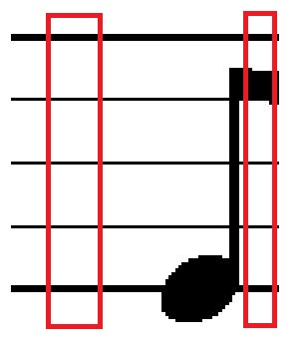
Staff line Thickness & White Space between consecutive Staff Lines
11 | 1
2 | 0
17 | 1
1 | 0
18 | 1
1 | 0
18 | 1
1 | 0
17 | 1
2 | 0
22 | 1
11 | 1
2 | 0
9 | 1
10 | 0
17 | 1
1 | 0
18 | 1
1 | 0
17 | 1
2 | 0
22 | 1

Slide 6
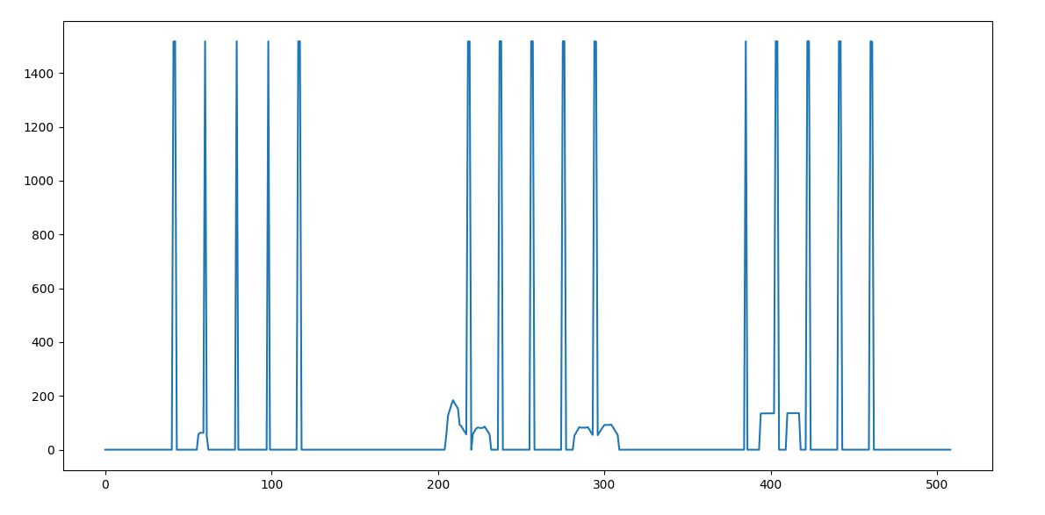
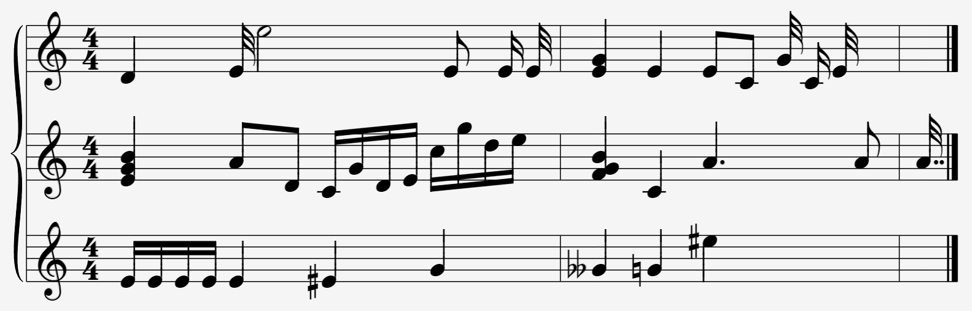

Segmentation

Slide 7




Clefs Detection & Removal
Template

Slide 8




Note Heads Detection
Initial Implementation
Structuring Element
Template

Slide 9


Note Heads Detection
Current Implementation
Template

Slide 10
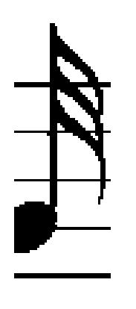
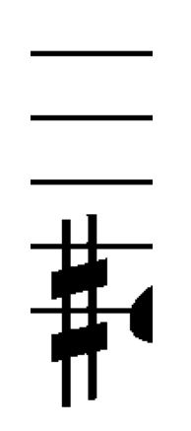


Accidentals & Flags Detection

Slide 11


Beams & Chords Detection

Slide 12


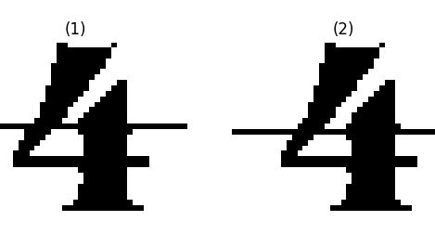
Time Signature Detection

