Slide 1
Lab 8 Pipelined Implementation of RISC-V Hazard Handling
Prepared by:
Mostafa GHouneem

Slide 2
Objectives
The objective of this lab is to complete the implementation of the RISC-V pipelined datapath including data and control hazards handling mechanisms

Slide 3
Agenda
An introduction
Experiment 1: forwarding unit
Experiment 2: hazard detection unit
Experiment 3: instructions flushing
Report Requirements

Slide 4
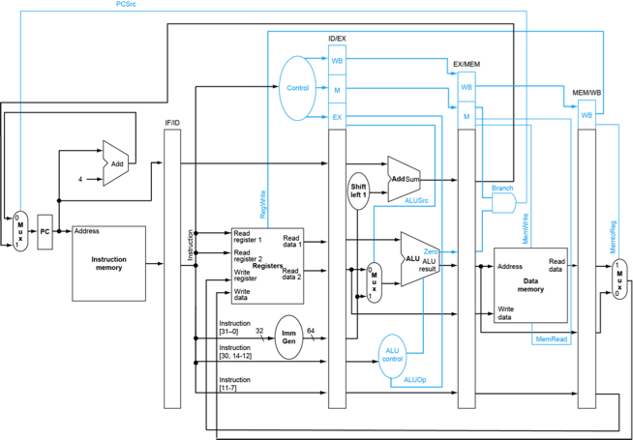
Introduction
In the previous labs, you should have completed the Verilog modeling and simulation of the single cycle RISC-V processor

Slide 5
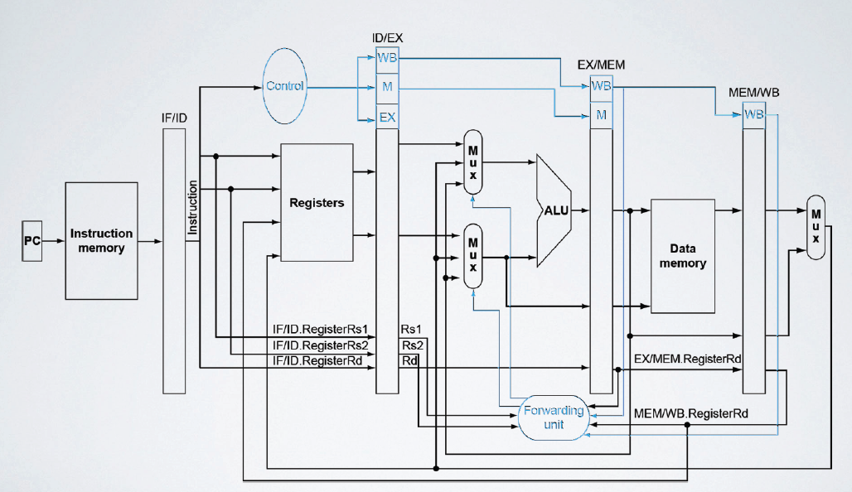
Experiment 1: forwarding unit
Accordingly the forwarding unit has two outputs:
forwardA
forwardB
6 inputs:
ID/EX.RegisterRs1
ID/EX.RegisterRs2
EX/MEM.RegisterRd
MEM/WB.RegisterRd
EX/MEM.RegWrite,
MEM/WB.RegWrite.

Slide 6
Experiment 1: forwarding unit
The forwarding unit is responsible for forwarding operands to the ALU inputs if these operands are available in the EX/MEM register or at the output of the MUX after the MEM/WB register
The forwarding unit should produce two outputs forwardA and forwardB according to the following conditions

Slide 7
Experiment 1: forwarding unit
EX hazard
if (EX/MEM.RegWrite and (EX/MEM.RegisterRd ≠ 0)
and (EX/MEM.RegisterRd = ID/EX.RegisterRs1))
forwardA = 10
if (EX/MEM.RegWrite and (EX/MEM.RegisterRd ≠ 0)
and (EX/MEM.RegisterRd = ID/EX.RegisterRs2))
forwardB = 10

Slide 8
Experiment 1: forwarding unit
MEM hazard
if (MEM/WB.RegWrite and (MEM/WB.RegisterRd ≠ 0)
and (MEM/WB.RegisterRd = ID/EX.RegisterRs1))
and not (EX/MEM.RegWrite and (EX/MEM.RegisterRd ≠ 0)
and (EX/MEM.RegisterRd = ID/EX.RegisterRs1))
forwardA = 01
if (MEM/WB.RegWrite and (MEM/WB.RegisterRd ≠ 0)
and (MEM/WB.RegisterRd = ID/EX.RegisterRs2))
and not (EX/MEM.RegWrite and (EX/MEM.RegisterRd ≠ 0)
and (EX/MEM.RegisterRd = ID/EX.RegisterRs2))
forwardB = 01

Slide 9
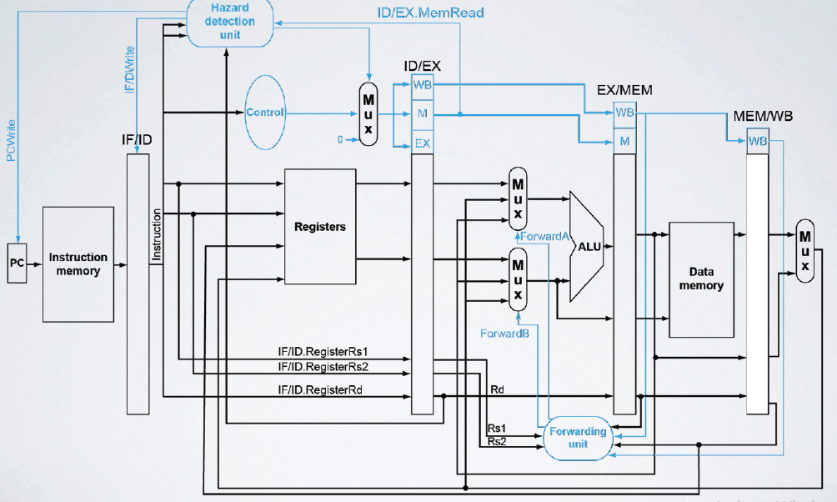
Experiment 2: hazard detection unit
Accordingly, the hazard detection has one output:
stall
4 inputs:
IF/ID.RegisterRs1
IF/ID.RegisterRs2
ID/EX.RegisterRd
ID/EX.MemRead

Slide 10
Experiment 2: hazard detection unit
The hazard detection unit is responsible for stalling the datapath for one clock cycle in case of a load-use hazard.
This detection is possible during the decoding of the using instruction according to the following condition
if ((IF/ID.RegisterRs1=ID/EX.RegisterRd) OR (IF/ID.RegisterRs2=ID/EX.RegisterRd))
and ID/EX.MemRead
and ID/EX.RegisterRd ≠ 0
stall = 1

Slide 11
Experiment 2: hazard detection unit
The stall output should be used to control
the load of the PC and IF/ID registers (preventing them from loading when stall = 1)
control the selection line of a newly added 2x1 multiplexer providing the control values to be stored in the ID/EX register in such a way that when stall = 1, zeros are stored instead of all the control values

Slide 12
Experiment 3: instructions flushing
When a BEQ instruction is encountered according to the current datapath nothing happens until it reaches the MEM stage in which the branch outcome is decided.
Meanwhile the 3 instructions following the BEQ instruction were introduced in the pipeline.
In case the branch outcome is not to take the branch, nothing needs to be done and execution continues normally;
however, if the branch outcome is to take the branch, the PCSrc control signal is set to 1 forcing the PC to start fetching instructions from the BEQ target address.

Slide 13
Experiment 3: instructions flushing
This is the correct behavior (assuming an always-not-taken static branch predictor)
except that in case the branch is to be taken, the 3 instructions following the BEQ have to be flushed from the pipeline.
No special flushing detection unit needs to be implemented, since the PCSrc signal serves as a flag that we need to flush all 3 instructions.

Slide 14
Experiment 3: instructions flushing
So when PCSrc=1, we need to flush:
Fetch Stage
Decode Stage
Execution Stage

