Slide 1
MENOUFIA NATIONAL UNIVERSITY · FACULTY OF COMPUTERS & ARTIFICIAL INTELLIGENCE
Operix
Industrial operations and safety intelligence through existing CCTV networks
PROJECT
Multi-Department Industrial Operations & Safety Intelligence Platform
PROJECT TEAM
Abdallah Waleed · Seif Sameh · Mohamed Shaheen · Toka Medhat · Mohamed Salah · Mahmoud Abdelghany
1
Notes:
Operix turns the CCTV networks factories already run into live operational intelligence, built by the Faculty of Computers and Artificial Intelligence at Menoufia National University. Introduce the project and the six-person team, then move to the visibility gap on the next slide.

Slide 2




Manual records
Unseen time
They capture checkpoints, not what happens between them.
Unproductive time remains difficult to explain precisely.
THE OPERATIONS GAP
Factories do not lack data. They lack live operational visibility.
PPE risk
Late intervention
Missing protection can persist until a supervisor notices.
Early signals become incidents with avoidable cost.
2

Slide 3
SYSTEM ARCHITECTURE
From camera stream to an executable decision
One governed path turns raw video into alerts, records, and an operations view.
01
02
03
04
05
06
RTSP
Message Queue
AI Workers
Rules Evaluator
FastAPI + PostgreSQL
React UI
Camera streams
Reliable delivery
YOLOv8/v9 · ByteTrack · MediaPipe
Events become alerts
One operations view
Logs and evidence
SECURE · SCALABLE · ACTIONABLE
3
Notes:
Walk the path left to right. Camera streams enter through RTSP and pass through a message queue for reliable delivery. AI workers run YOLOv8/v9, ByteTrack, and MediaPipe. The rules evaluator turns events into alerts. FastAPI and PostgreSQL keep logs and evidence, and the React UI gives the team one operations view.

Slide 4
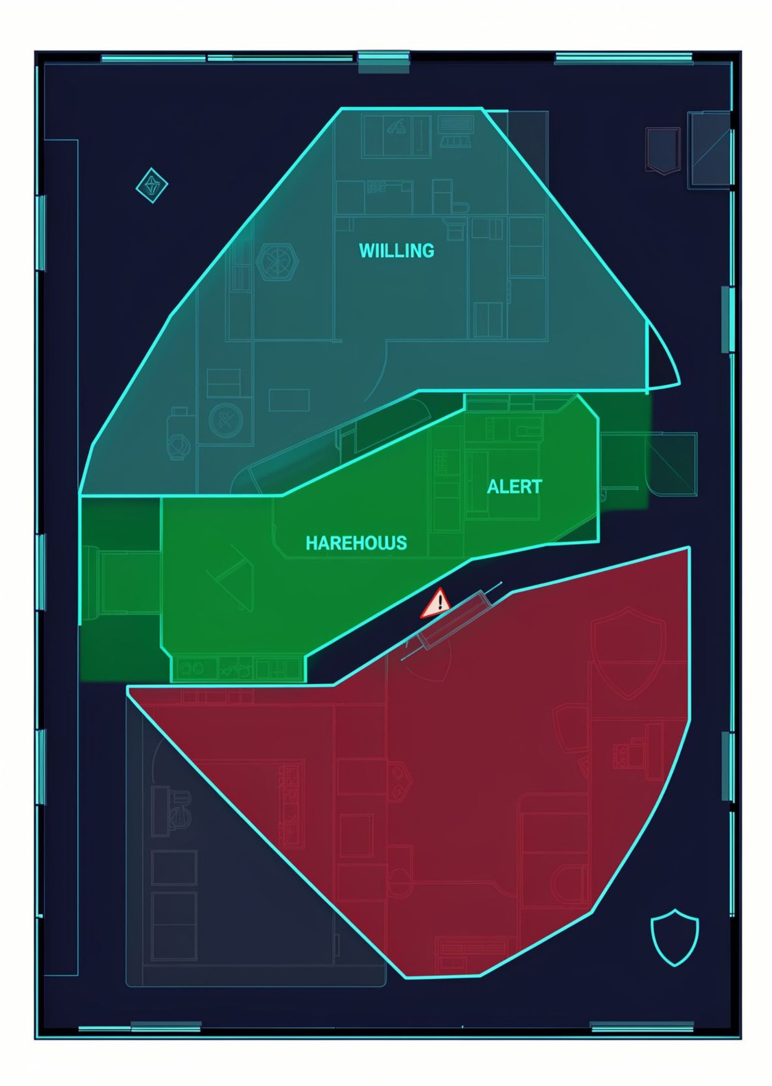



ZONE-AWARE SAFETY
Every zone has its own rules.
The Custom Constraints Engine links each Polygon Zone to independent operating and safety requirements.
Welding Zone
Helmet + Vest · maximum idle time
Warehouse
Vest only · different movement and density rules
Every violation
Linked to zone, time, and operational identity
4
Notes:
Each Polygon Zone carries its own requirements. The welding zone requires helmet and vest and limits idle time. The warehouse requires only a vest and has its own movement and density rules. Every violation is recorded against its zone, time, and operational identity.

Slide 5

OPERATIONAL TIME MODEL
Net Working Hours explain what actually happened.
Presence alone is not enough. Operix separates presence, idle time, approved breaks, and unobserved camera gaps.
Camera gaps are recorded as uncertain states, never assumed absence.
NET HOURS MODEL
Presence | Observed events
Idle | No-activity periods
Breaks | Approved periods
Net | Reconstructed hours
Reconstructing net hours from observed events makes the gap reviewable, rather than guessed.
5

Slide 6
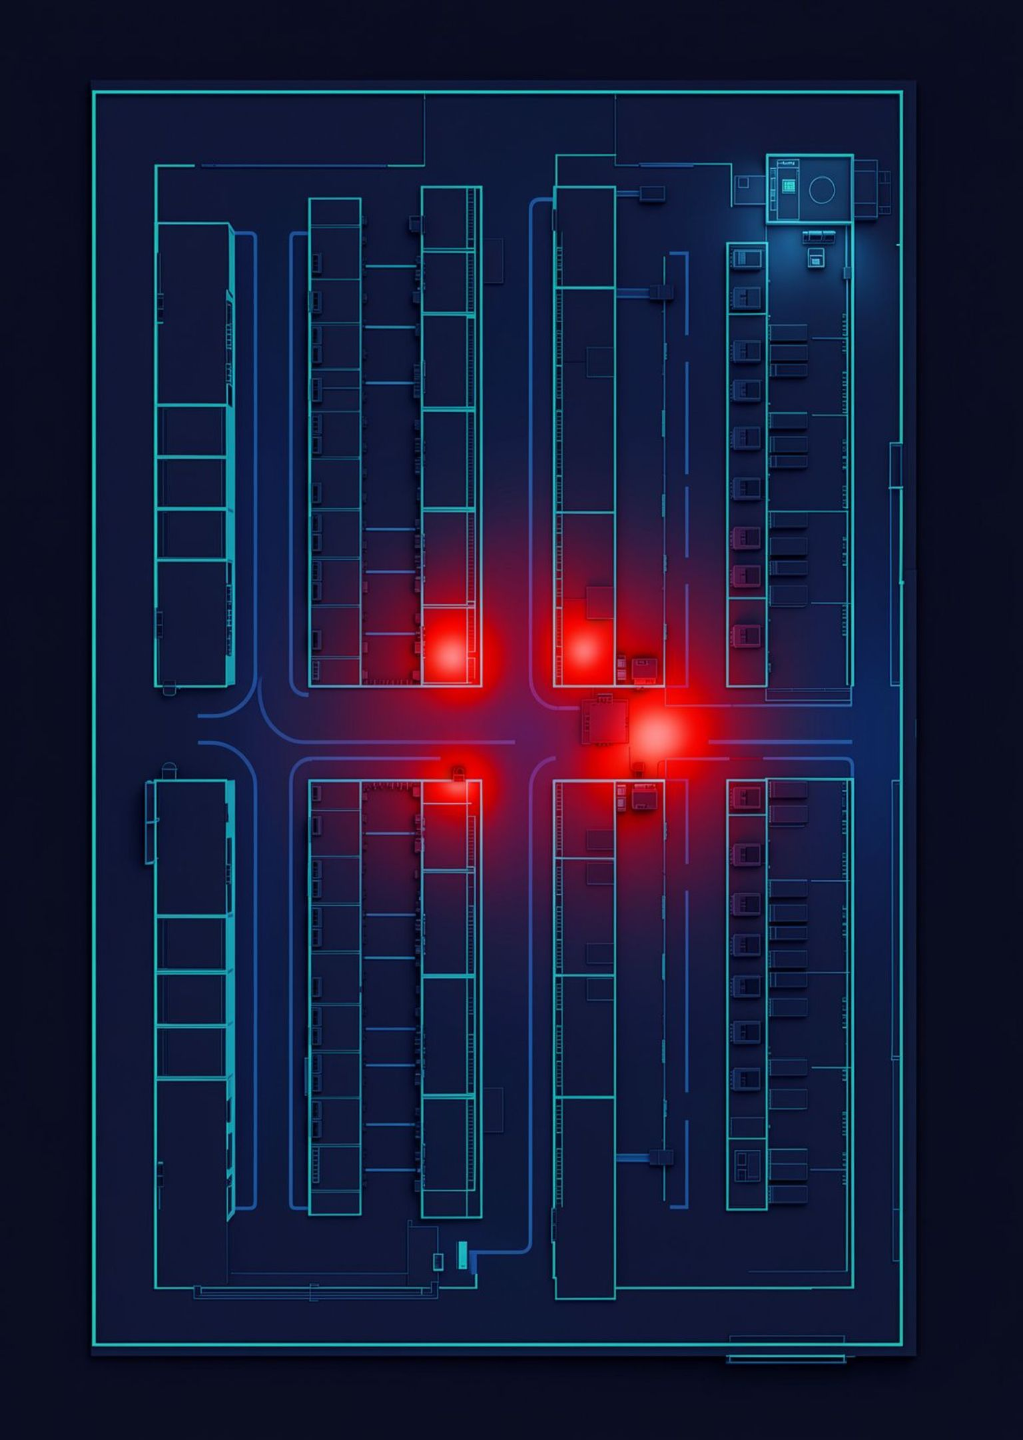
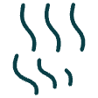


ANALYTICS & INSIGHTS
Heatmaps show where movement concentrates.
Foot-Traffic Heatmaps turn worker paths into an interpretable density map.
Blue → Red
Low density to high density
Congestion + dwell
Measured inside each zone
Better decisions
Space and resource allocation
6
Notes:
Heatmaps aggregate worker paths into a density map. Blue marks low density and red marks high density. Congestion and dwell time are measured inside each zone, which supports space and resource allocation decisions.

Slide 7



ADVANCED SAFETY & PPE
From detecting a person to understanding the risk.
Worker
PPE + Zone
Real-time person detection
Requirements and risk context
Danger Zone
Immediate entry alert
PPE missing
Required protection absent
Operix links each worker to required protective equipment and the zone context, moment by moment.
Evidence snapshot
For review and audit
7

Slide 8



OPERATIONS ASSISTANT
OPERIX ASSISTANT
The LLM Operations Assistant makes the record queryable.
Where did Helmet violations recur this week?
They recurred in Welding Zone during the recorded periods this week.
A conversational interface queries PostgreSQL logs in natural language and links each answer to Video Evidence.
Time: reviewable · Zone: Welding Zone
Open Video Evidence · 00:14:32
Ask
Where did Helmet violations recur this week?
Understand
Get a concise answer linked to time and zone.
Verify
Open visual evidence before acting.
VERIFIABLE ANSWER
8

Slide 9


DELIVERY ROADMAP
Roadmap: from MVP Core to SaaS Readiness.
SEMESTER 1
SEMESTER 2
MVP Core & Infrastructure
SaaS Readiness
RTSP ingestion, Message Queue, AI Workers, and Rules Evaluator.
Initial React dashboard, PostgreSQL logs, PPE, and Net Hours.
LLM Operations Assistant, Heatmaps, and multi-department permissions.
Improved observability, scalability, and commercial packaging.
9

Slide 10



COMMERCIAL VALUE
Operix turns CCTV from recording into commercial value.
B2B SaaS
Scalable subscriptions across departments and sites.
From a saved frame to continuous operational visibility that teams can trust.
Incident latency
Earlier alerts and visual context reduce response time.
Make every zone accountable.
Auditable records
A shared record for safety, operations, and accountability.
Continuous operational visibility, faster decisions, and a record teams can trust.
Operix · Menoufia National University · Faculty of Computers & Artificial Intelligence
10
Notes:
Operix moves CCTV from a stored archive to a live operational view. Lead with the business model, then the two outcomes: faster response and a record every team can check.

