Slide 1

COMPUTER SCIENCE & AI · GRADUATION PROJECT
Vetrix
Next-Gen Intelligent Veterinary Pharmaceutical Laboratory Information Management System (LIMS)
Menoufia National University · Faculty of Computers & Artificial Intelligence
Abdallah Waleed · Saif Sameh · Mohamed Shaheen · Taqa Medhat · Mohamed Salah · Mahmoud Abdelghany
VETERINARY PHARMA · LIMS

Slide 2



01 · THE CASE FOR CHANGE
Transformative Vision & Problem Statement
One secure, traceable ecosystem from sample receipt to governed approval.
Digitize the lab
Connect the evidence
Govern every action
Replace fragmented traditional QA/QC work with connected digital records.
Bind instrument data, sample identity, testing standards, and approvals.
Design for CFR 21 Part 11 and GMP-aligned operations.
2

Slide 3
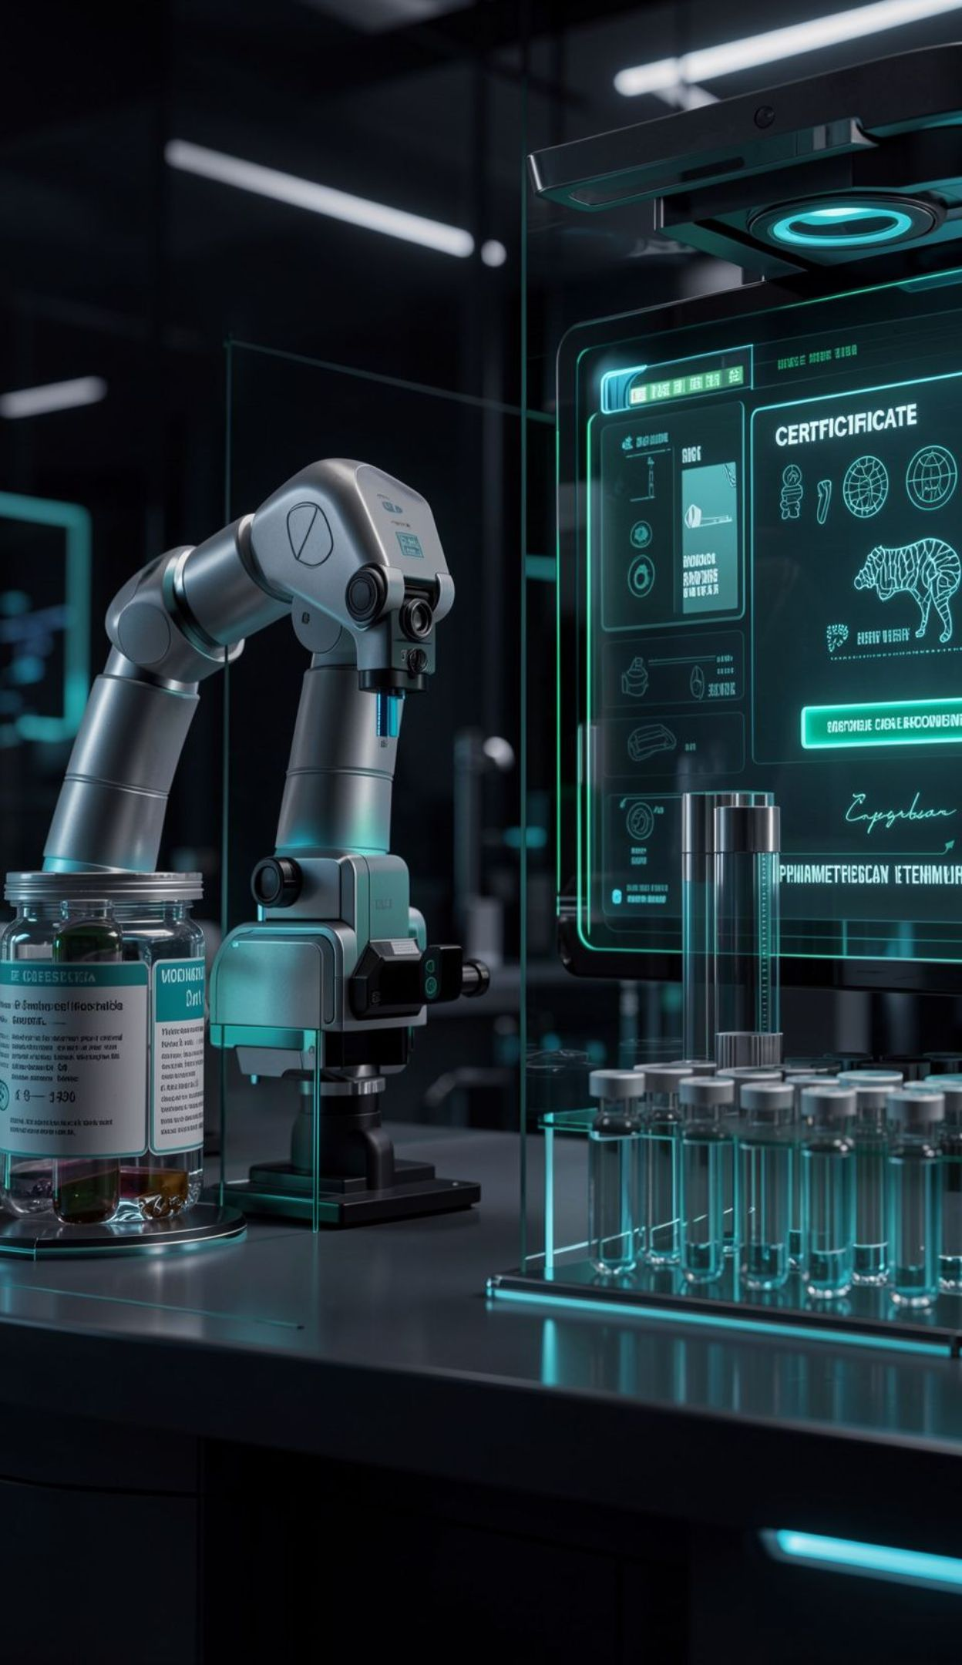
02 · SYSTEM ARCHITECTURE
End-to-End System Architecture
A connected pipeline turns physical samples and legacy instruments into reviewable evidence.
Receive and identify the sample
Generate a QR code and bind the sample record
Capture legacy instrument displays
Extract, validate, and structure results
Review and approve the final Certificate of Analysis
From lab floor to governed CoA.
3

Slide 4
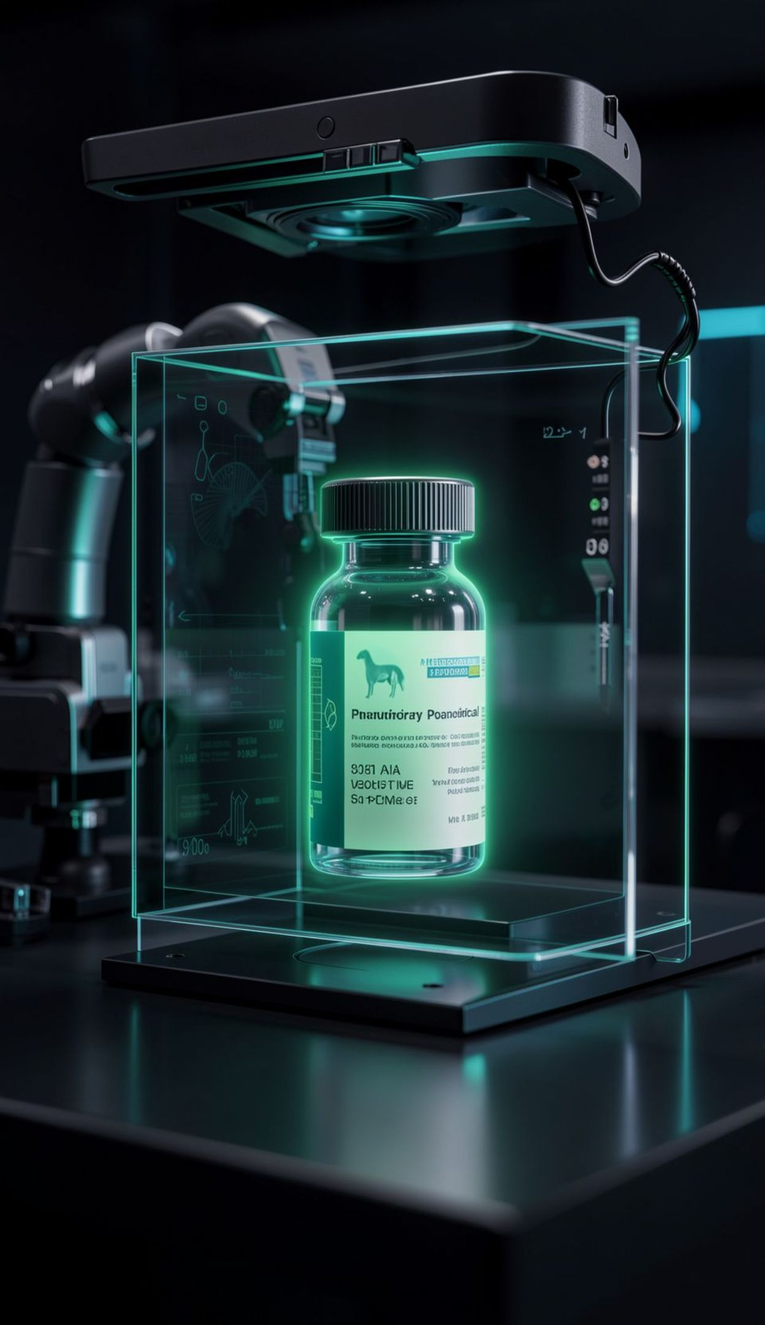
03 · COMPUTER VISION & DEVICE INGESTION
Old devices become
living data
Vetrix captures what legacy equipment already shows, then converts it into structured, validated records.
01
02
03
Detect
Read
Verify
YOLO finds the display area on legacy lab equipment.
EasyOCR extracts numerical readings into structured JSON.
Visual inspection checks container integrity and QR-code validity.
4

Slide 5
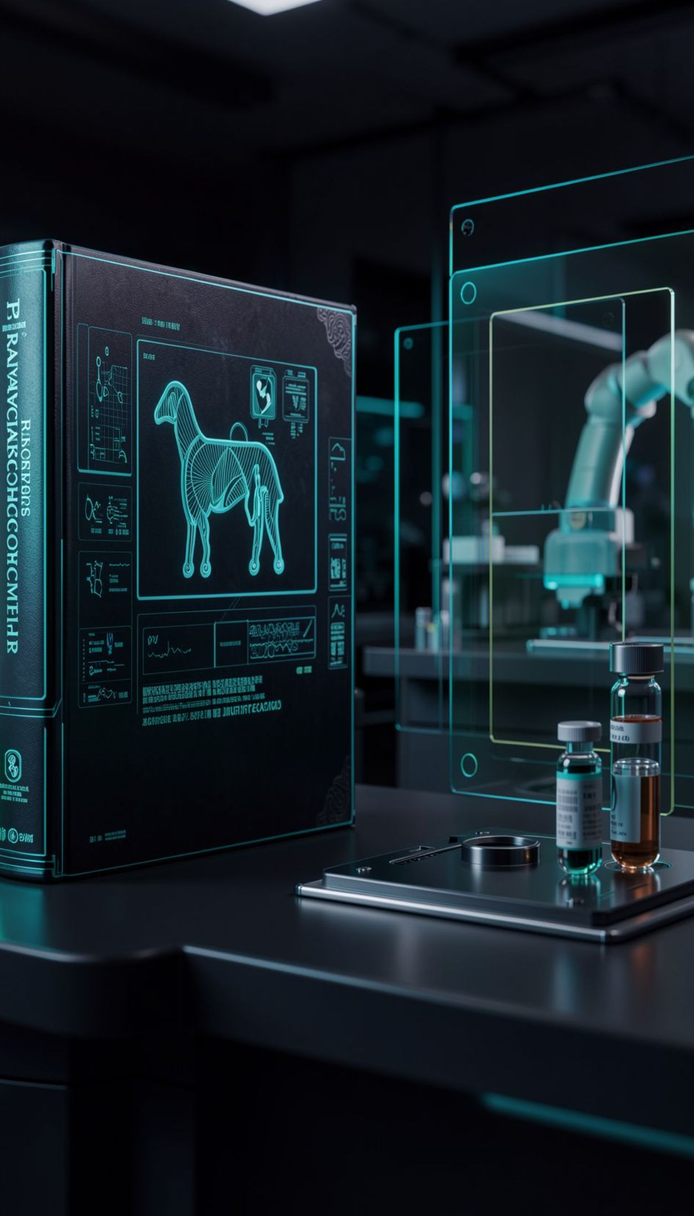
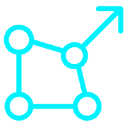


04 · RAG KNOWLEDGE ASSISTANT
RAG-Powered Pharmacopoeia Knowledge Assistant
Retrieval supplies evidence first. Generation explains it with exact citations at query time.
Retrieve
Ground
Answer
Qdrant or FAISS vector database for semantic retrieval.
Ingest Egyptian Drug Authority and British Pharmacopoeia Veterinary standards.
Return testing standards, impurity limits, and exact citations.
5

Slide 6
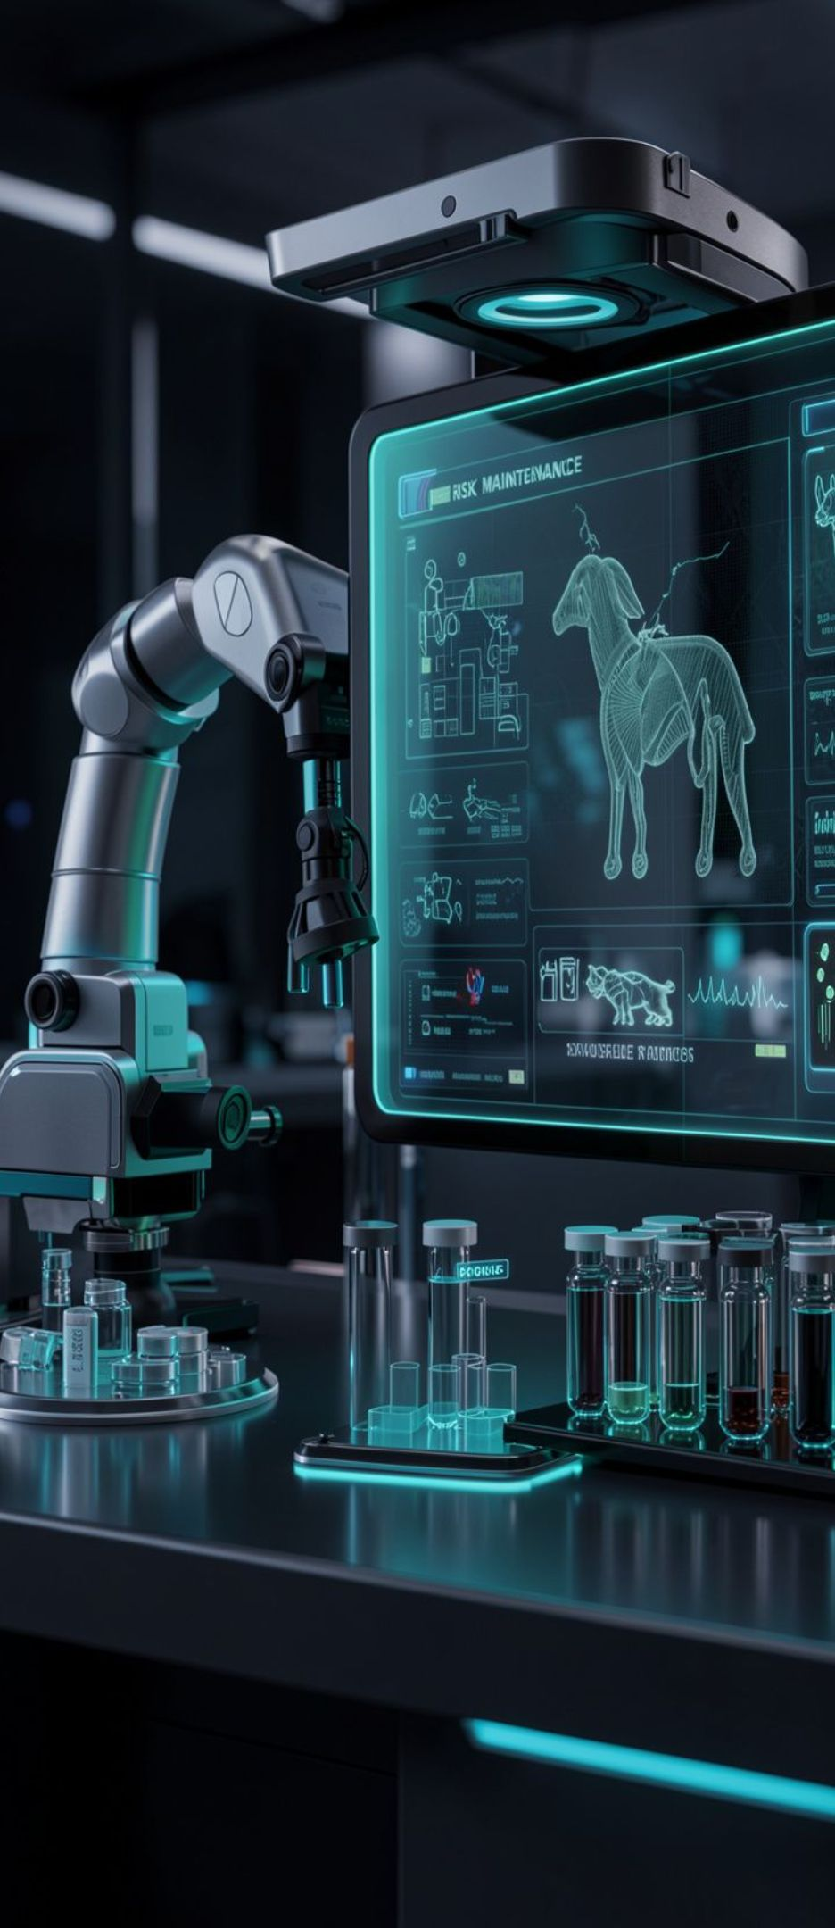
05 · PREDICTIVE ANALYTICS
Risk is scored, explained, and monitored
Vetrix pairs classification with explainability and operational awareness.
Low · Medium · High
Random Forest or XGBoost classifies supplier and batch risk.
Feature importance + SHAP
Model decisions remain interpretable for laboratory review.
10 instruments monitored
Predictive maintenance tracks connected lab equipment by operational hours.
6

Slide 7



06 · TRUST LAYER
Log
Control
Sign
Compliance becomes
operational trust
Every material action enters an immutable audit trail.
Role-based access follows the laboratory workflow.
Two-factor electronic signatures govern approvals.
Trustworthy data is captured, controlled, signed, and traceable from first reading to final approval.
Cryptographic security turns compliance from a final checkpoint into a property of the workflow.
7

Slide 8
07 · EXECUTION MATRIX
Six workstreams. One integrated system.
Each role owns a technical layer that must connect cleanly to the next.
BACKEND
VISION
RAG
Abdallah Waleed
Saif Sameh
Mohamed Shaheen
Architecture, APIs, CFR 21 audit trail & IoT protocols.
YOLO, OCR & laboratory devices simulator.
Retrieval pipeline, vector DB & LLM assistant.
PRODUCT
MODELING
PLATFORM
Taqa Medhat
Mohamed Salah
Mahmoud Abdelghany
React/Next.js UI/UX & CoA PDF generator.
ML risk scoring, SHAP & predictive maintenance.
Data pipelines, Docker containers & DevOps.
8

Slide 9
08 · FIRST-TERM DELIVERY
01
02
03
A tight path from
prototype to demo
Foundation
Capture
Reason
Core API endpoints and sample lifecycle tracking.
OCR extraction pipeline from legacy displays.
RAG question-answering demonstration with citations.
The first term prioritizes a demonstrable MVP over disconnected feature work.
04
Decide
Risk dashboard widgets for supplier and batch scoring.
70% MVP FOCUS
The MVP is complete when the core lifecycle, evidence retrieval, and risk view work together in one integrated demonstration.
9

Slide 10
09 · CONCLUSION & FUTURE ROADMAP
Capture
Automation improves compliance efficiency.
Vetrix connects the lab
so decisions can be trusted.
See
Decision visibility becomes continuous.
From fragmented veterinary lab work to a connected, auditable system.
Scale
The prototype points toward Egyptian veterinary pharma impact.
Next: integrate live instruments, harden deployment, and move toward industrial rollout.
10

