Slide 1
ACADEMIC DEFENSE · VETERINARY PHARMACEUTICALS
VetLIMS AI
Intelligent Veterinary Pharmaceutical Laboratory Information Management System
Menoufia National University
Faculty of Computers & Artificial Intelligence
Abdallah Waleed · Saif Sameh · Mohamed Shaheen · Taqa Medhat · Mohamed Salah · Mahmoud Abdelghany

Slide 2
01 · CORE VISION
TODAY
WITH VETLIMS AI
From fragmented QA/QC to one secure ecosystem
Disconnected evidence
Traceable intelligence
Instruments, analysts, standards, approvals, and reports remain separated.
Manual handoffs make review slower and traceability harder.
One workflow connects data, people, decisions, and reports.
CFR 21 Part 11 and GMP expectations shape the foundation.
A modern operating layer for veterinary pharmaceutical laboratories.
SECURE DIGITAL ECOSYSTEM
FRAGMENTED QA/QC

Slide 3
02 · SYSTEM WORKFLOW
One connected path from sample to signed CoA
Every handoff leaves a traceable record.
01
Register
02
Track
03
Ingest
Receive and register the sample.
Generate a unique QR code and chain-of-custody record.
Ingest instrument data through APIs, IoT simulation, OCR, or manual entry.
04
Review
05
Issue
Run validation, testing logic, and AI-assisted review.
Approve and issue the final Certificate of Analysis.

Slide 4




03 · COMPUTER VISION
Computer Vision & Legacy Digitization
Camera input turns legacy instrument displays into validated, machine-readable records.
Camera input
YOLO detection
Capture instrument displays and sample-container condition.
Detect numeric displays on legacy laboratory equipment.
EasyOCR extraction
Validation
Automatically extract readings from instrument screens.
Verify QR identity, container integrity, and record consistency.

Slide 5

04 · KNOWLEDGE ASSISTANT
Grounded answers, retrieved from trusted standards
Question
Embeddings
“What acceptance criteria apply to this test?”
Convert the request into a semantic search representation.
Retrieval
Grounded answer
FAISS or Qdrant finds relevant passages: testing standards, acceptance criteria, and impurity limits—instantly.
Return a concise response with standards-based context.
Indexed sources: Egyptian Drug Authority guidance, BP Vet, and USP references.

Slide 6
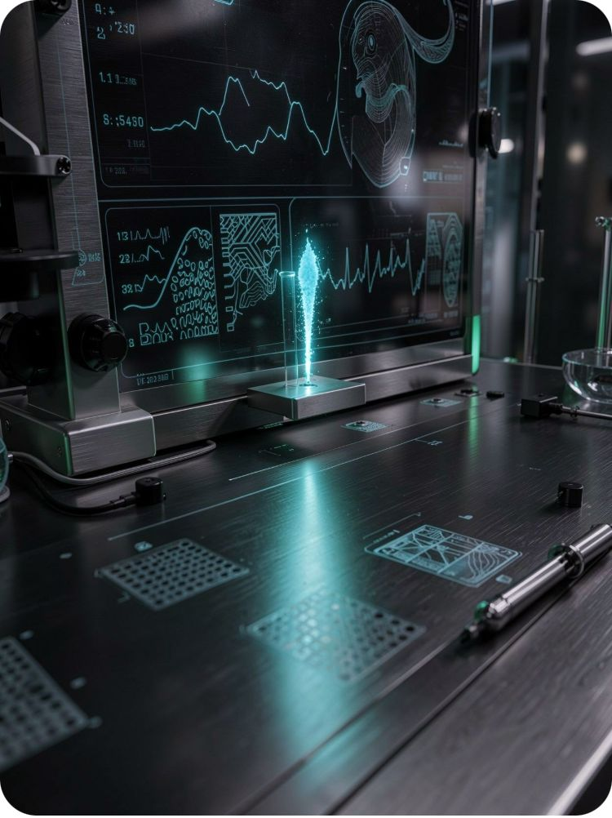
05 · PREDICTIVE ANALYTICS
Detect the signal before it becomes an investigation
RESULT SIGNAL
EQUIPMENT SIGNAL
OOS risk
Maintenance horizon
Isolation Forest and XGBoost flag likely Out-of-Specification results for earlier investigation and corrective action.
Operational hours across 10 lab instruments support predictive maintenance before disruption.
MONITOR CONTINUOUSLY
ANOMALY DETECTED
The system turns operational history into a decision cue for analysts and maintenance teams.

Slide 7



TRUST INFRASTRUCTURE
Security & Audit Trail
Audit logging
Immutability
Cryptographic history makes changes tamper-evident.
Regulated records preserve their original evidence.
RBAC
2FA signatures
Access follows the user's role and responsibility.
Electronic approvals support CFR 21 Part 11 workflows.
GMP expectations meet role-based action, signed approval, and a tamper-evident audit trail.

Slide 8
07 · TEAM EXECUTION
Team Roles & Milestone Execution
Term 1 establishes the backbone. Term 2 connects, validates, and deploys it.
Abdallah Waleed
Saif Sameh
TERM 1
TERM 2
System Architecture, Backend APIs & IoT Ingestion
Computer Vision (YOLO/OCR) & Device Simulation
Foundations
Integration & deployment
MVP backbone, APIs, OCR, RAG demonstration, and initial data flows.
Connect modules, validate workflows, harden security, and prepare the system for deployment.
Mohamed Shaheen
Taqa Medhat
RAG Pipeline, Vector DB & LLM Integration
Frontend UI/UX (React/Next.js) & CoA Reporting
Mohamed Salah
Mahmoud Abdelghany
ML Models for Anomaly Detection & Predictive Maintenance
Data Engineering, Docker & System Integration

Slide 9




08 · TERM 1 OUTPUT
Prototypes make the architecture executable
MVP backbone
Initial APIs
Minimal Viable Product scope and initial system backbone.
Endpoints for samples, instruments, users, and approvals.
FOUNDATION
Each deliverable turns one system promise into something the team can run, inspect, and improve.
CONNECTIVITY
OCR pipeline
Script for legacy display ingestion from laboratory equipment.
RAG demonstration
Question-answering grounded in indexed references.
VISION
EVIDENCE
Initial scope focuses on a minimal viable backbone, not a production claim.

Slide 10

09 · CONCLUSION
VetLIMS AI connects laboratory operations, AI assistance, and regulated traceability.
Roadmap: graduation prototype to production-ready laboratory intelligence.
Prototype
Future scope
Graduation prototype.
Industrial impact: faster QA/QC, fewer manual errors, stronger audit readiness.
Blockchain-backed audit trails and live deployment across veterinary laboratories.

