Slide 1





WAREHOUSE
SIMULATION
ENIE 310
Department of industrial & System Engineering
College of Engineering
University of Jeddah
First Semester 2023
Group members
[Mohammed Bakheet Alsaedi] [ID:2140715]
[Suhaib Hayas Alshaikhi] [ID:2140651]
[Abdulrahman Atif Kalantan] [ID:2140968]

Slide 2
TABLE OF CONTENTS
1-INTRODUCTION
6-INPUT DATA ANALYSIS
2-SYSTEM DESCRIPTION
7-CONSTRAINTS &ASSUMPTIONS
3-SYSTEM OPERATION
8-SYSTEM PERFROMANCE MEASURES
4-PROBLEM DEFINITION
03 - SOCIAL MEDIA
9-MODEL BUILDING
03 - SOCIAL MEDIA
5-INPUT VARIABLES
10-VERIFYING & VALIDATING
11- RESULTS CONCLUSION AND RECOMMENDATION

Slide 3


INTRODUCTION
shaker group have two types of warehouses:
first one is for a fully functional devices.
second one is for spare parts usually the spare parts could be classified into three types Type A,B and C.

Slide 4
SYSTEM DESCRIPTION
Starting by transferring the crates inside the system using one forklift, sorting process starts after that the parts being held in storage until requested, lastly order preparation starts and leaves the system

Slide 5



SYSTEM
OPERATION
There two operations in the system
Sorting
Preparation
2 workers
3 workers

Slide 6

PROBLEM DEFINITION
The stacking of different types of spare parts (Part A, Part B, Part C). A number of challenges exist as a result of the current stacking that is being predicted in the warehouse operations, affecting their efficiency and organization.

Slide 7
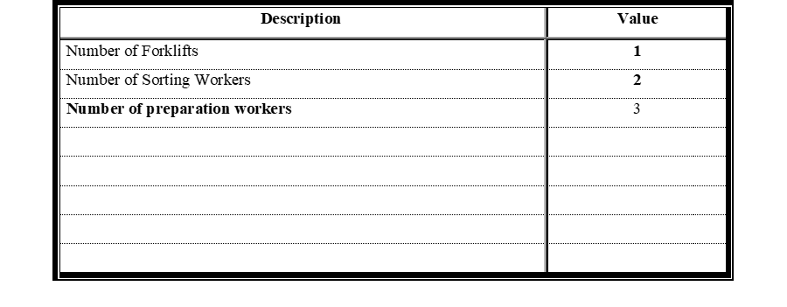

INPUT VARIABLES AND PARAMETERS
Summary of Data about Major System Characteristics

Slide 8
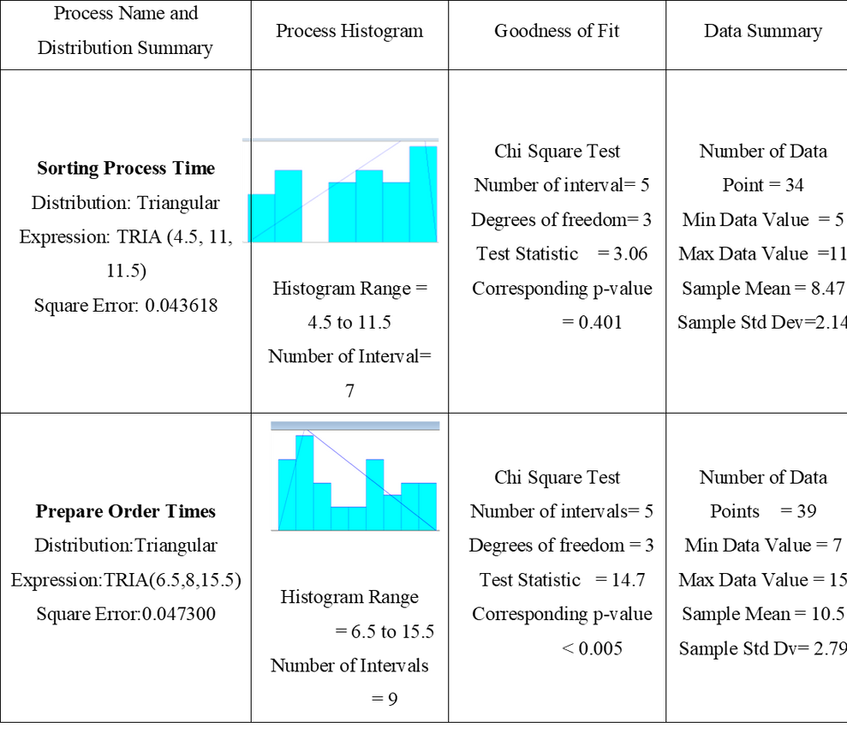

INPUT DATA ANALYSIS
Summary of Arena Input Analyzer Results of Processing Time

Slide 9

CONSTRAINTS AND ASSUMPTIONS
Working hours (8:00 AM – 4:00PM
No Overtime Procedures assume that employees accomplish tasks during their designated work hours and overtime is not required.
Storage Capacity Assumes that the warehouse has sufficient storage capacity
No External Disruptions The process assumes minimal external disruptions

Slide 10
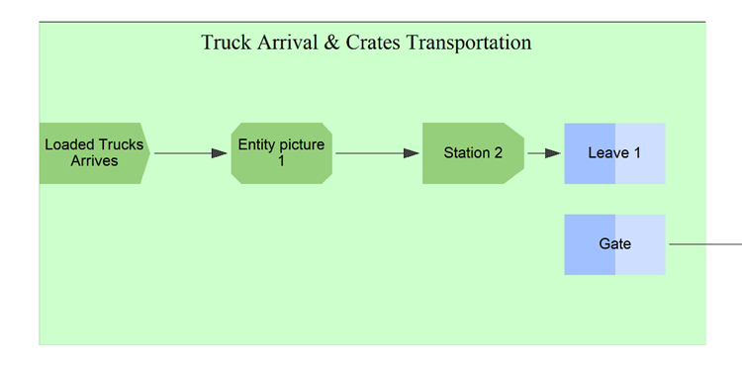
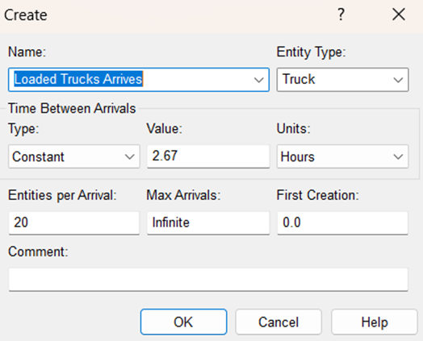
MODEL BUILDING
Sub model 1

Slide 11
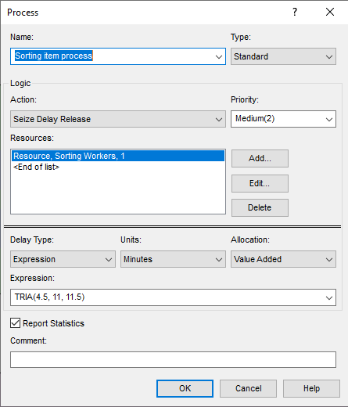
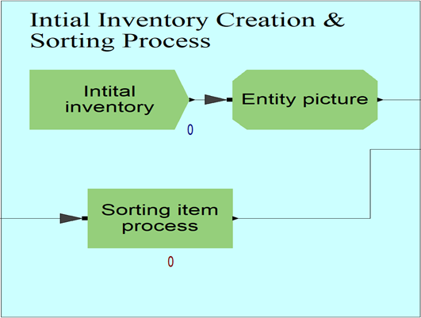
MODEL BUILDING
Sub model 2

Slide 12
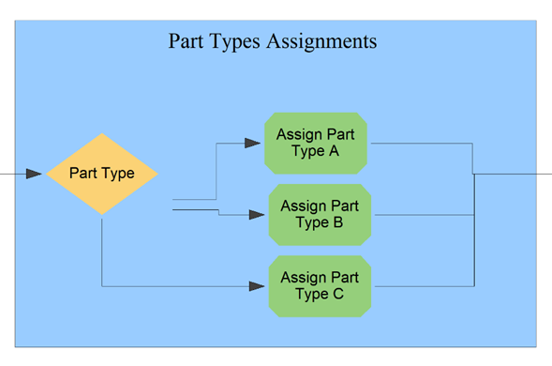
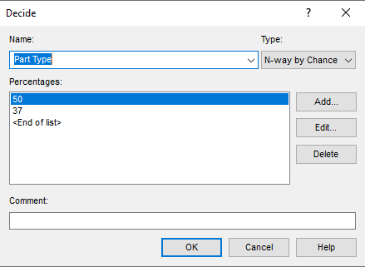
MODEL BUILDING
Sub model 3

Slide 13
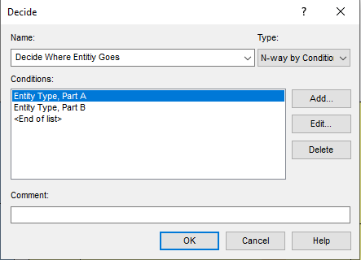
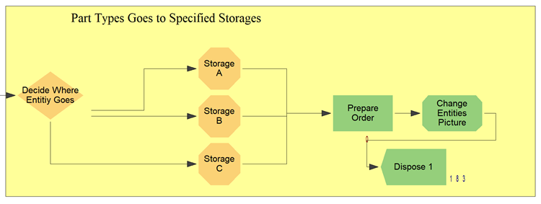
MODEL BUILDING
Sub model 4

Slide 14
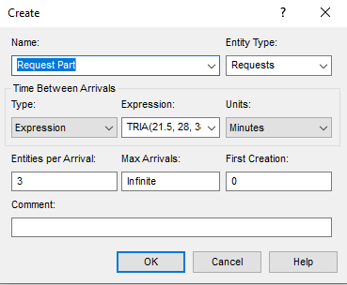
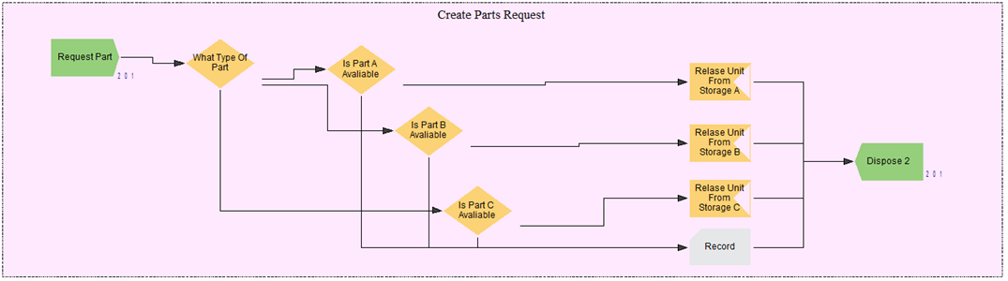
MODEL BUILDING
Sub model 5

Slide 15

Verification and Validation
The model's verification process involved a thorough simulation of the real system, presenting the model to engineers for scrutiny and garnering their approval.
the validity of the model it Is impossible to reach a reasonable result due to the limitations of Arena student version, it cannot reach further than 150 entities in the system,

Slide 16
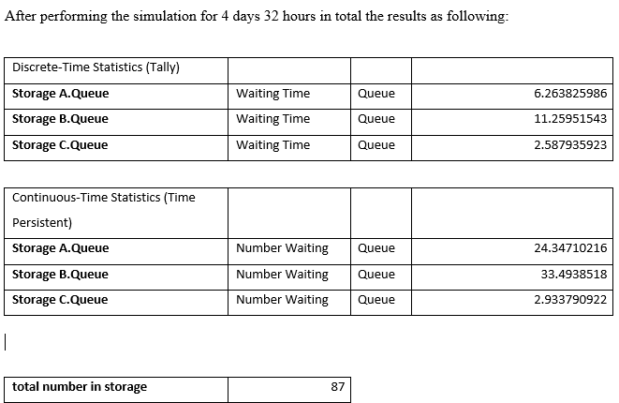
Results and Analysis

Slide 17

Recommendations
Optimizing Inventory Dynamics:
some parts need to have less order because it might cause the warehouse to have some unnecessary or unneeded parts thus will result in holding cost and order or manufacturing cost.

Slide 18
CONCLUSION
Simulation Analysis: Unveiling Stacking Challenges and Prioritizing Solutions
that part B would be more likely to have the stacking problem.
part A has the highest number out due to its high order.
part C is unlikely to have the stacking problem.

Slide 19
THANK YOU

