Slide 1
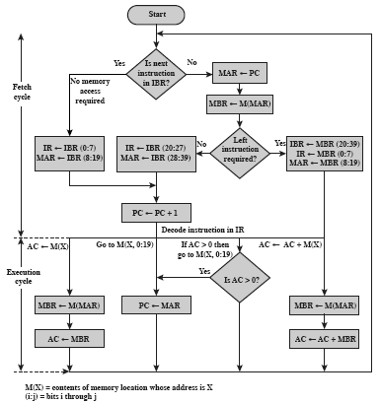
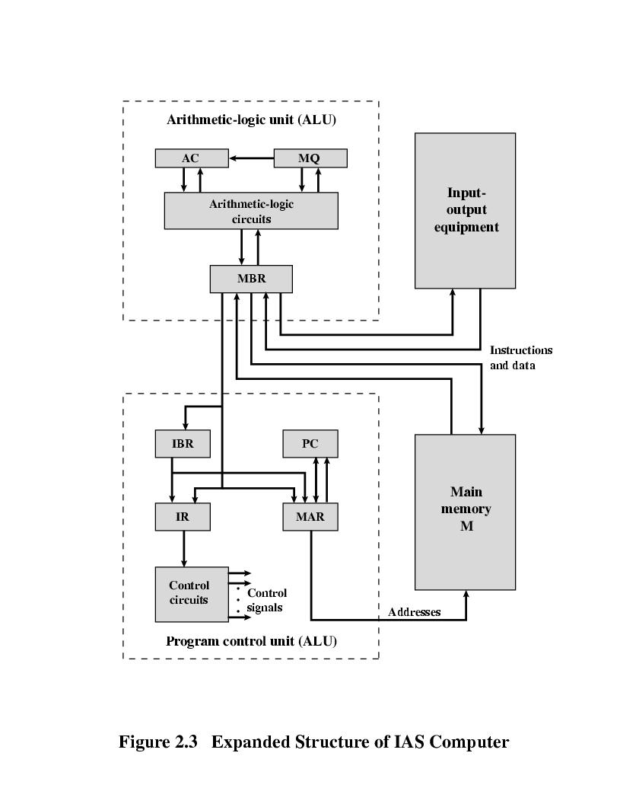
Flowchart of IAS Operation
1

Slide 2
Is next instruction in IBR?
Yes
No
MAR ← PC
No memory access required
MBR←M(MAR)
Left instruction required?
FETCH CYCLE
IR ← IBR(0:7) MAR ← IBR(8:19)
IR ← MBR(20:27) MAR ← MBR(28:39)
No
Yes
IBR ← MBR(20:39) IR ← MBR(0:7) MAR ← MBR(8:19)
PC ← PC + 1
MEMORY
1. LOAD M(X) 500, ADD M(X) 501
2. STOR M(X) 500, (Other Ins)
.....
3
4
PC
1
2
MAR
1
500
501
2
500
MBR
LOAD M(X) 500, ADD M(X) 501
STOR M(X) 500, (Other Ins)
IR
LOAD M(X)
ADD M(X)
STOR M(X)
IBR
ADD M(X) 501
(Other Ins)
AC
2
3
7

Slide 3
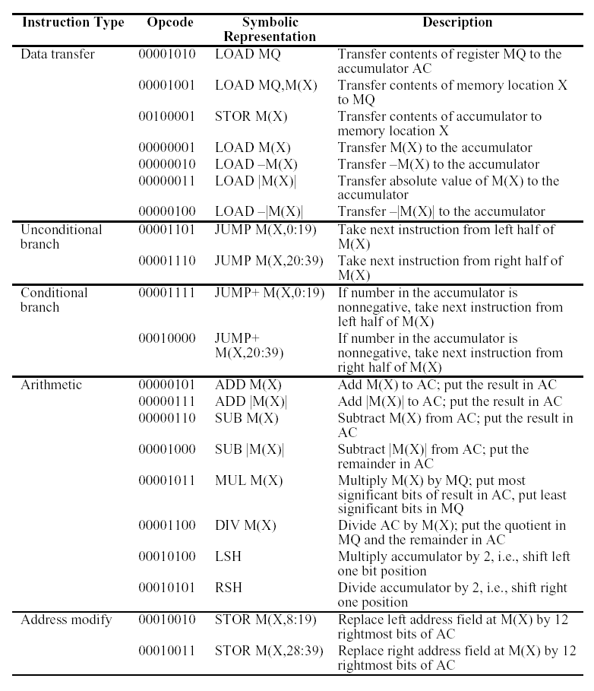
The IAS Instruction Set
3

