Slide 1
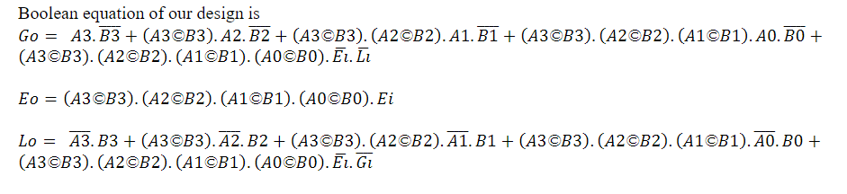
Design Methodology
The main reason of using GDI technique is due to its low
propagation delay, low power consumption and low chip area.

Slide 2
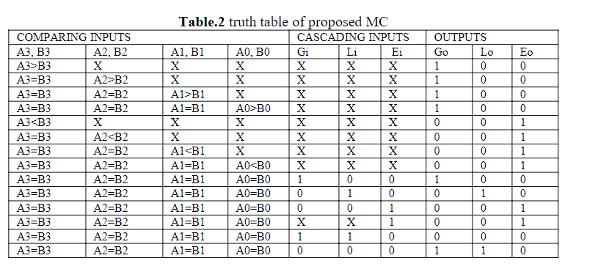
truth table of proposed MC

Slide 3
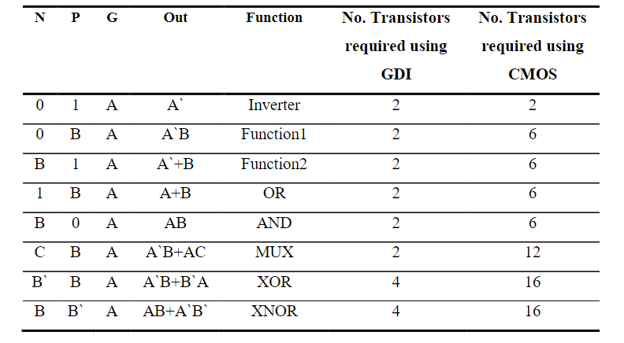
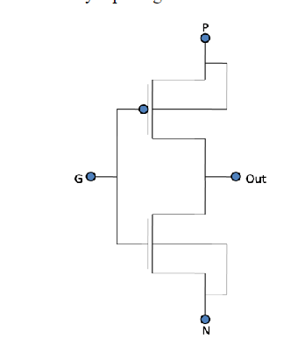
Basic GDI Structure

Slide 4
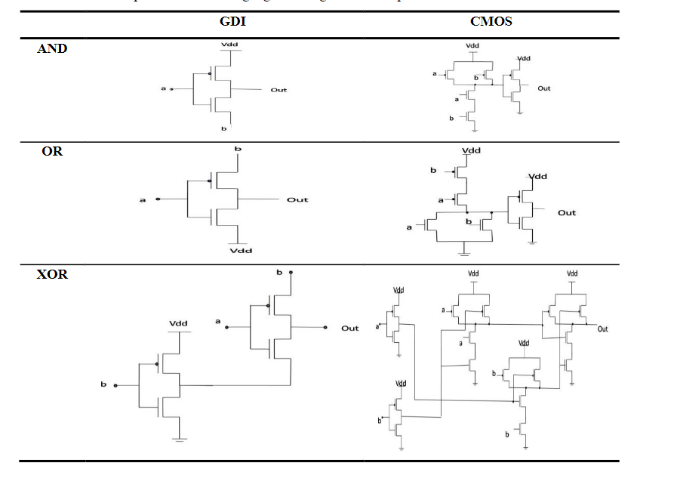

Slide 5
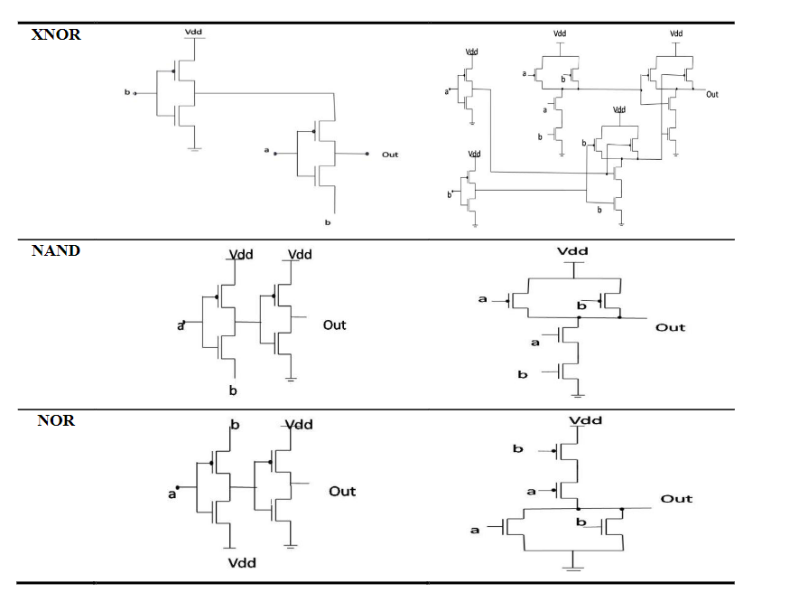

Slide 6
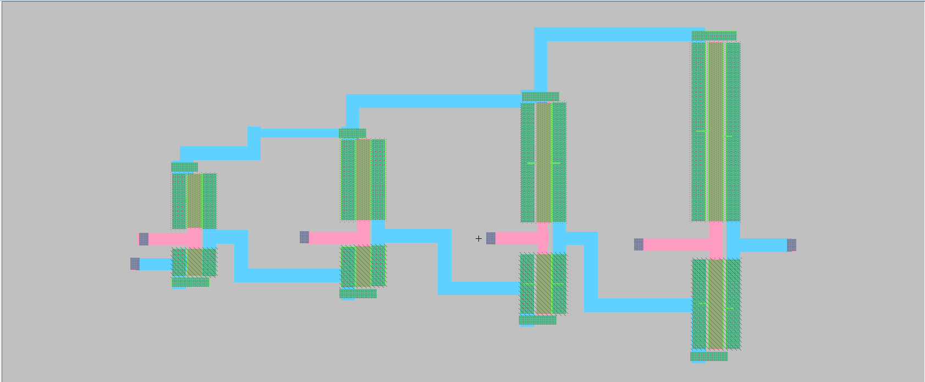
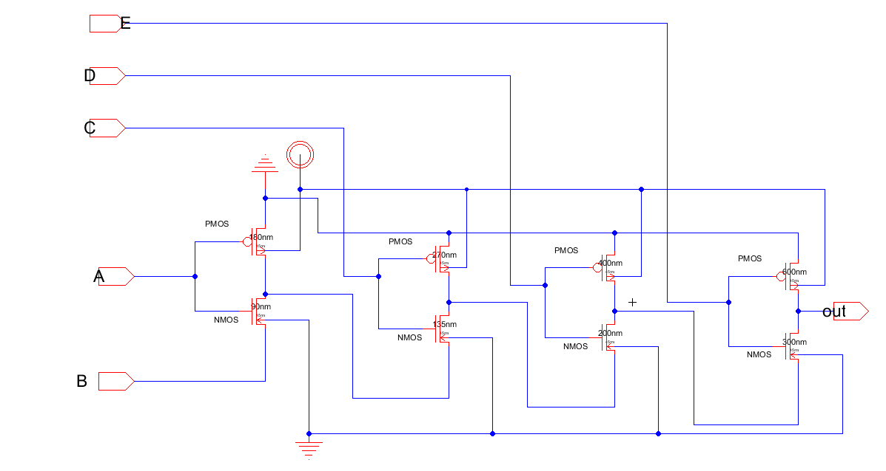
AND GATE 5 inputs

Slide 7
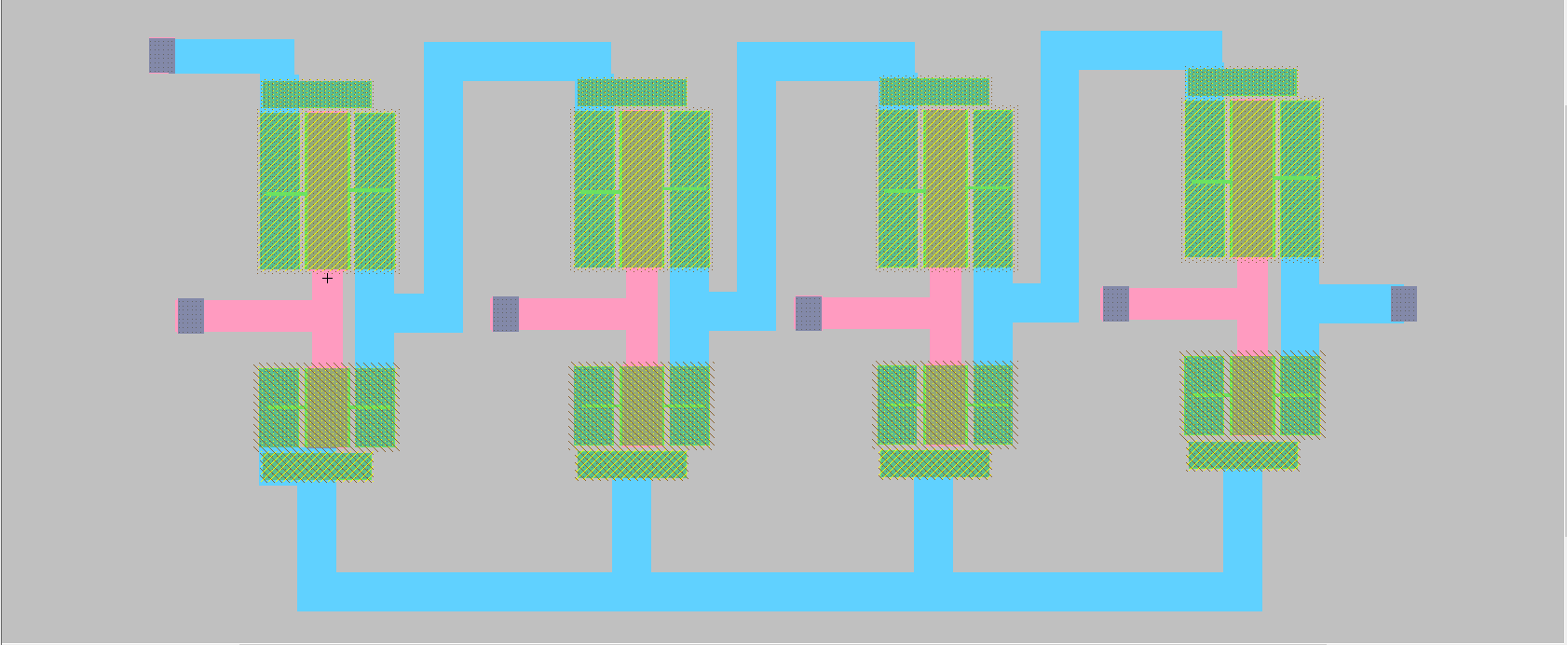
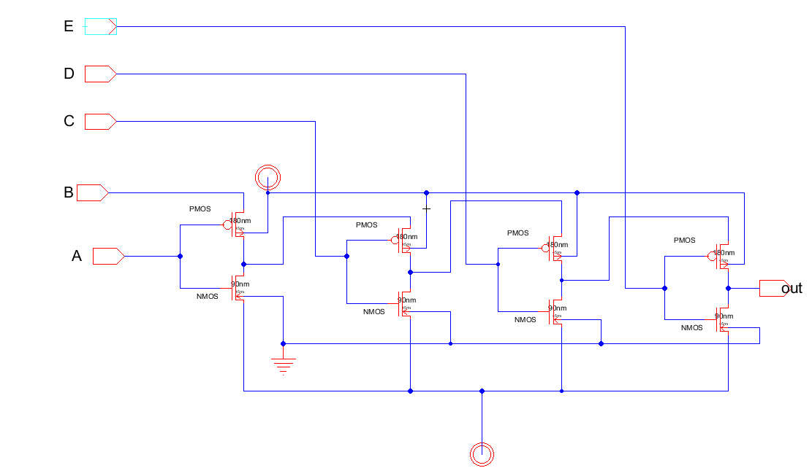
OR GATE 5 inputs

Slide 8
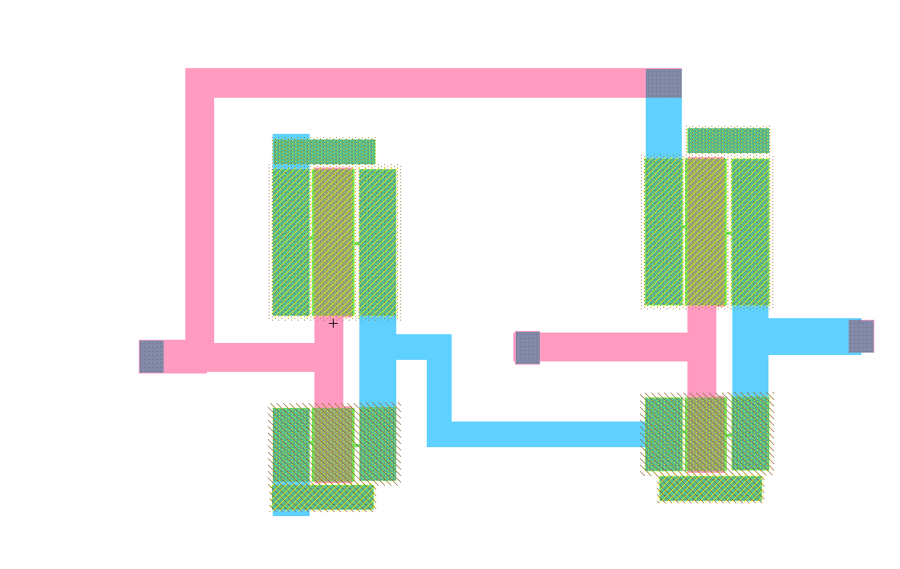
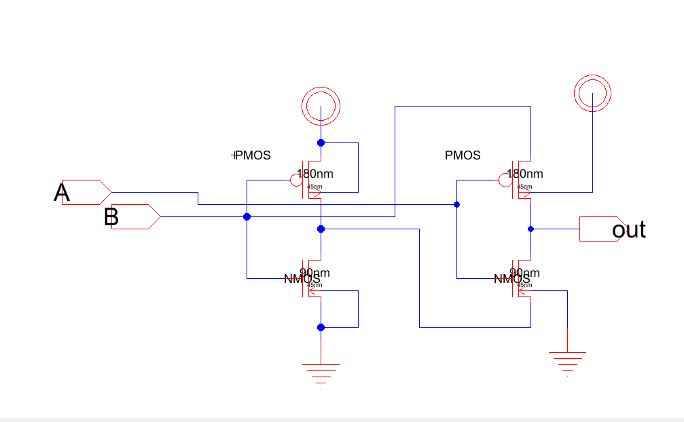
2 - XOR

Slide 9
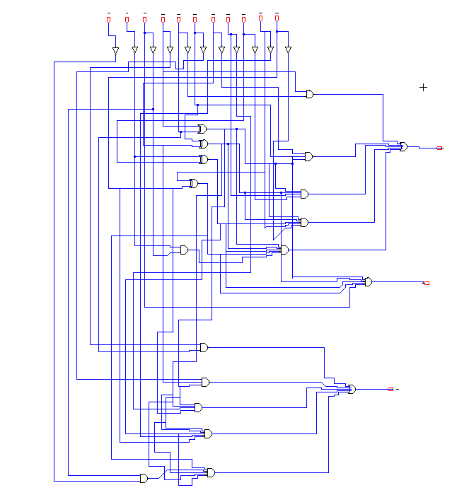

Slide 10
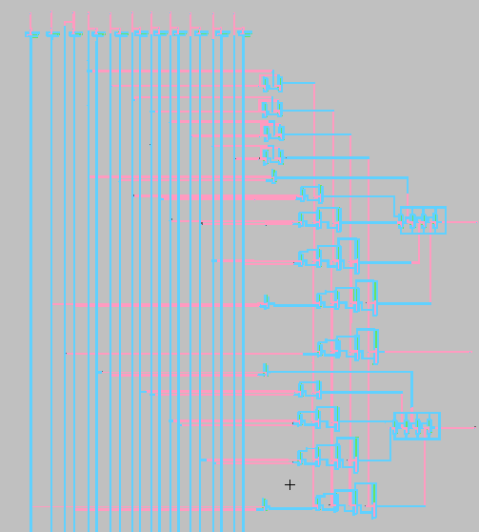

Slide 11
When you cascade multiple IC 7485s together, you can compare binary numbers that are longer than 4 bits by comparing the most significant bits first with one comparator and then using the cascading inputs of subsequent comparators to compare the less significant bits. By chaining these comparators together, you can compare binary numbers of any desired length.

Slide 12
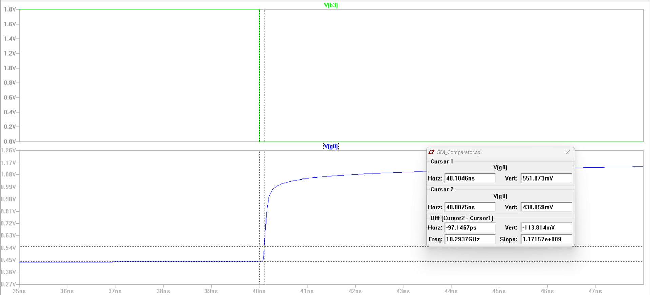
Tphl-G0=40.1046-40=0.1046

Slide 13
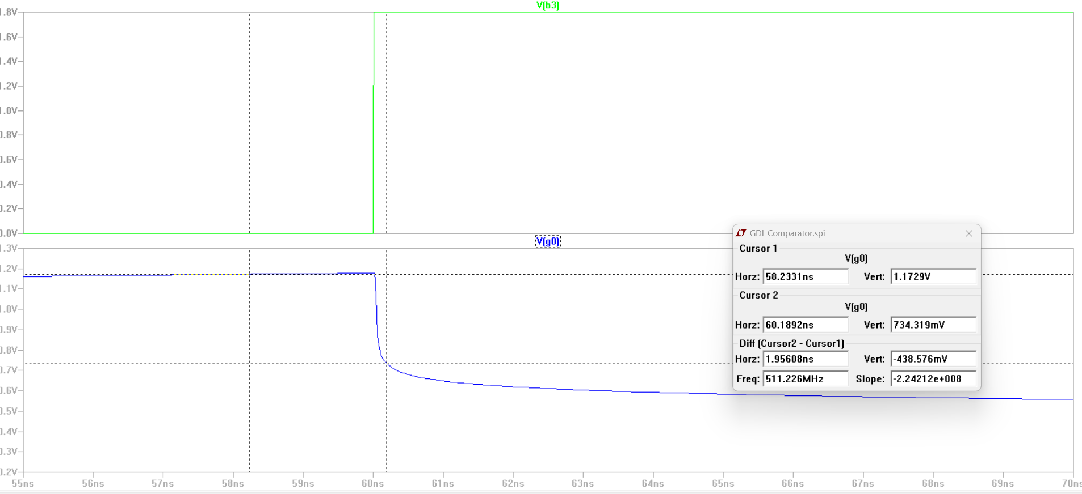
Tplh-G0 = 60.1892-60=0.1892

Slide 14
G0_avarage delay
Tp = (0.1046 + 0.1892) / 2= 0.1469 ns

Slide 15
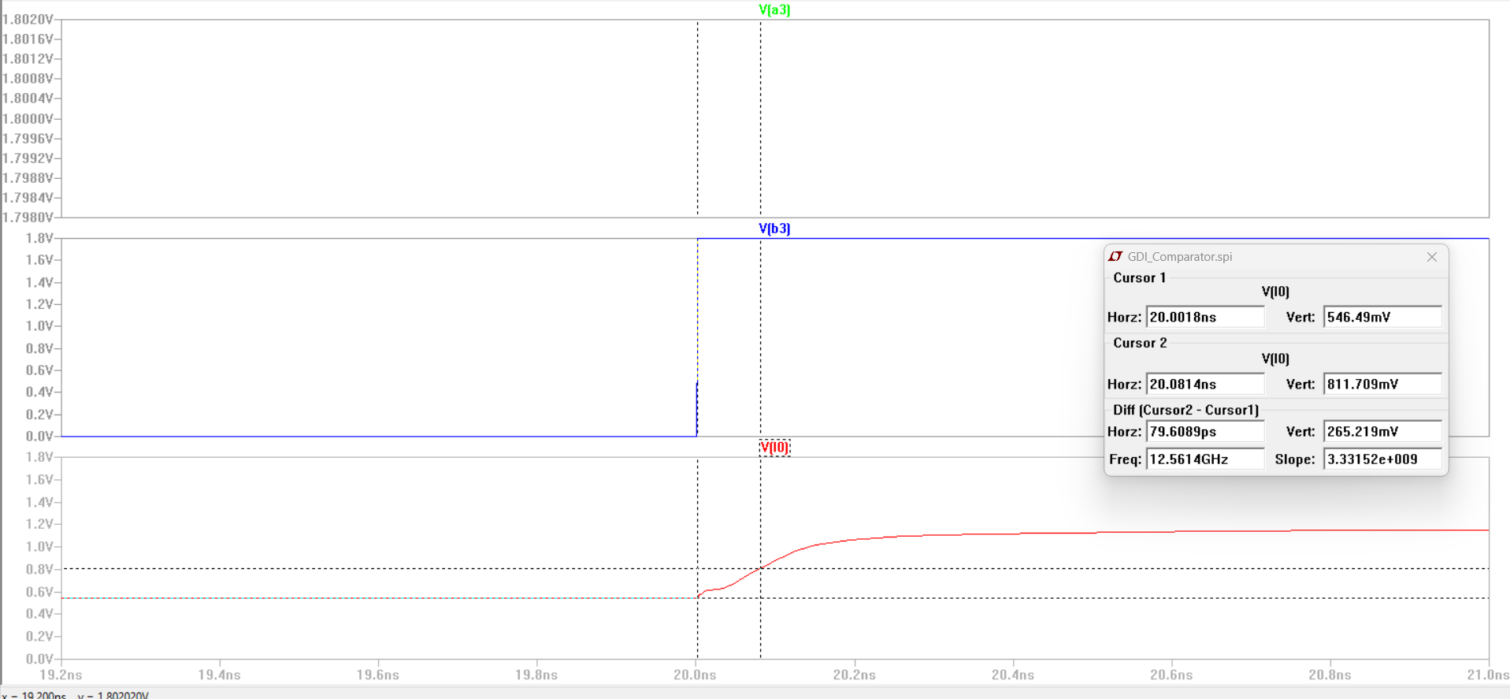
Tphl-L0=20.0814ns-20=0.0814ns

Slide 16
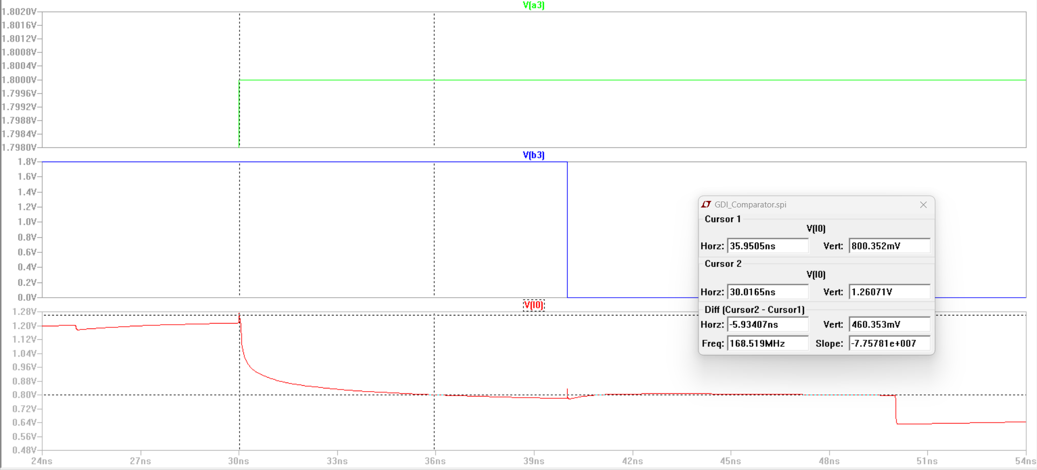
Tplh-L0 = 35.9505ns-30.0165ns=5.93407ns

Slide 17
L0_avarage delay
Tp = (0.0814ns + 5.93407ns) / 2= 3.01ns

Slide 18
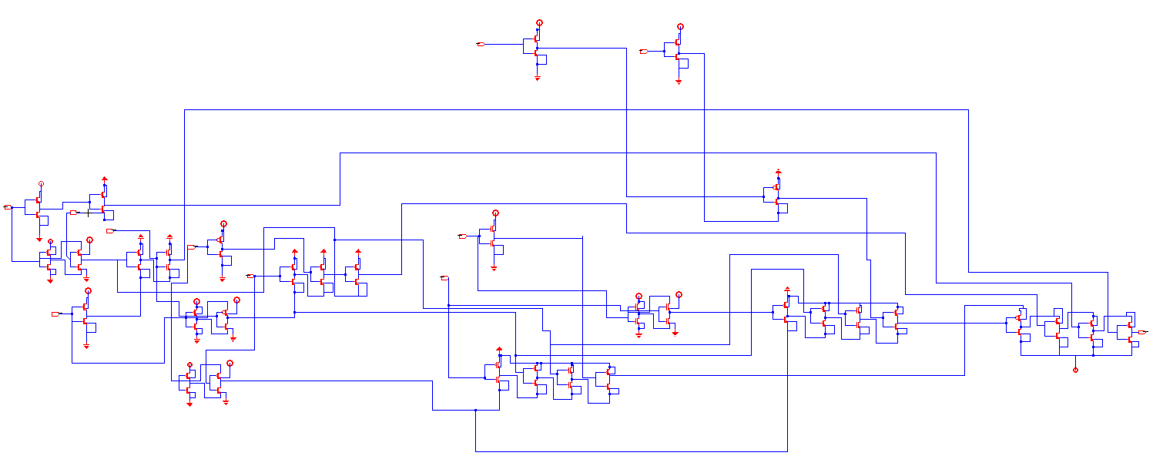
Fig.8 schematic of G0 (GDI tech)

Slide 19
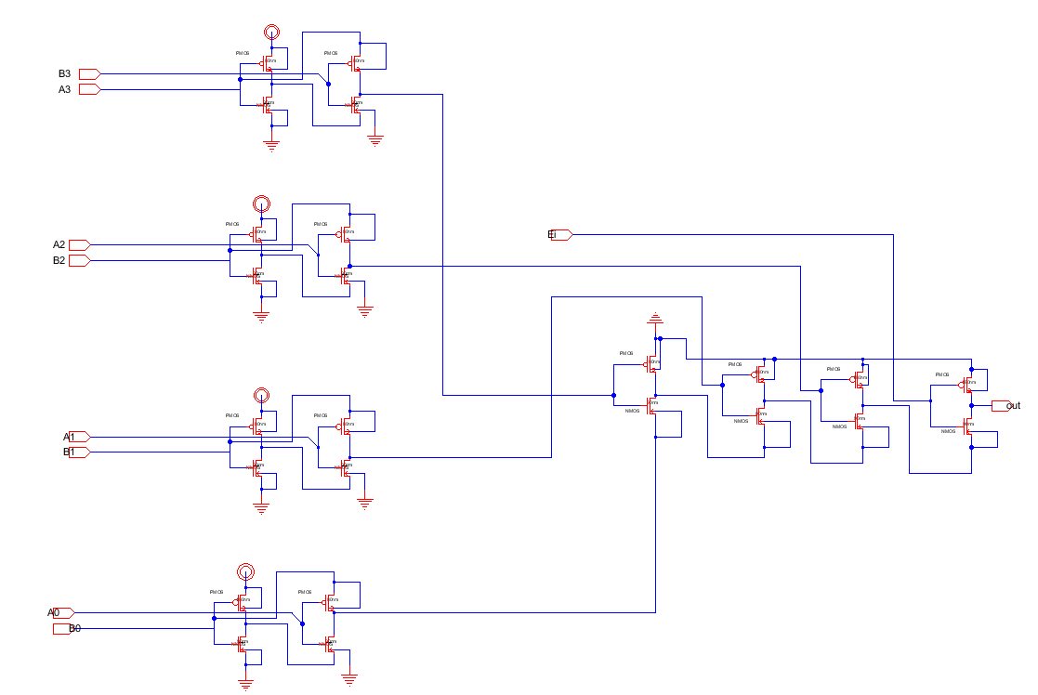
Fig.9 schematic of E0 (GDI tech)

Slide 20
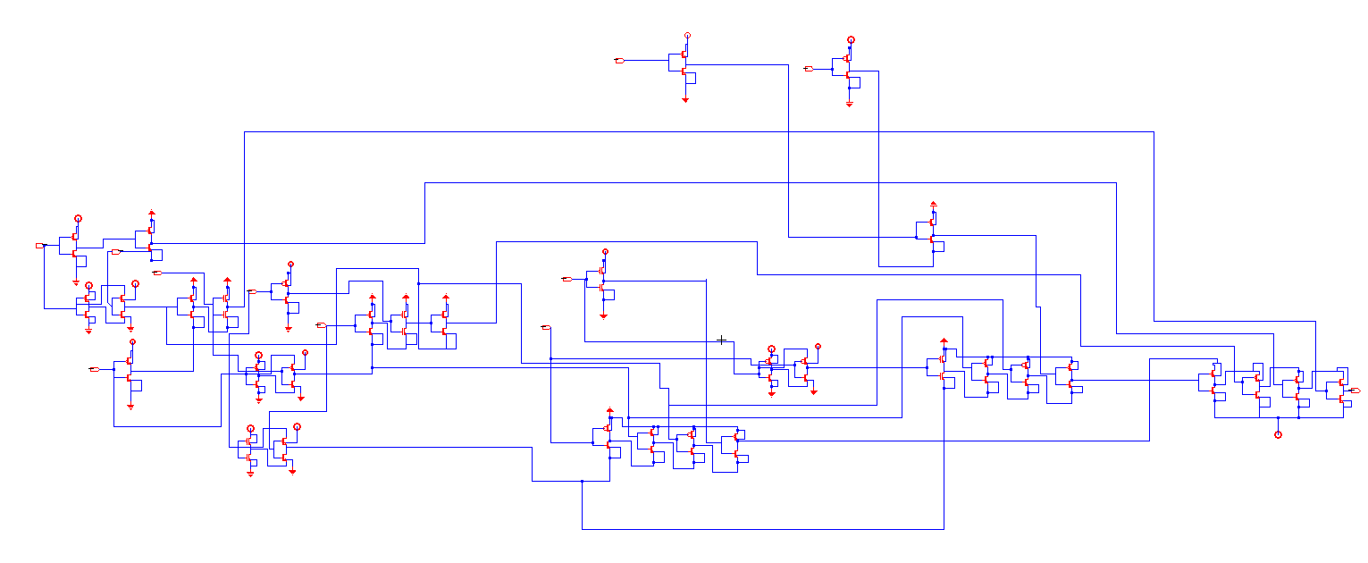
Fig.10 schematic of L0 (GDI tech)

Slide 21
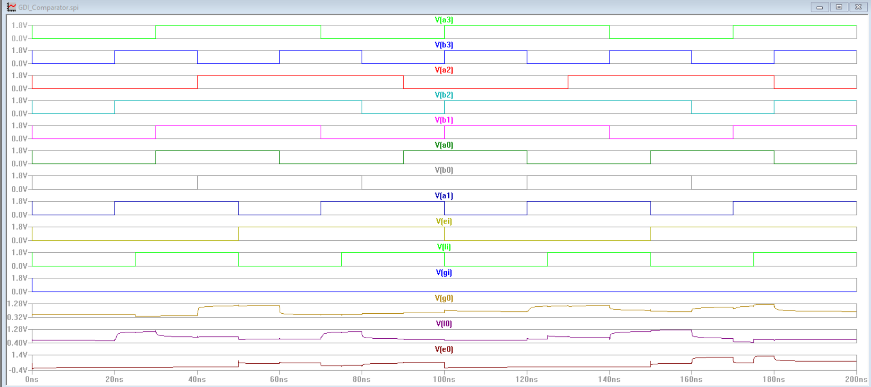
Fig.11 (a) simulation result of 4-bit MC (Schematic)

Slide 22
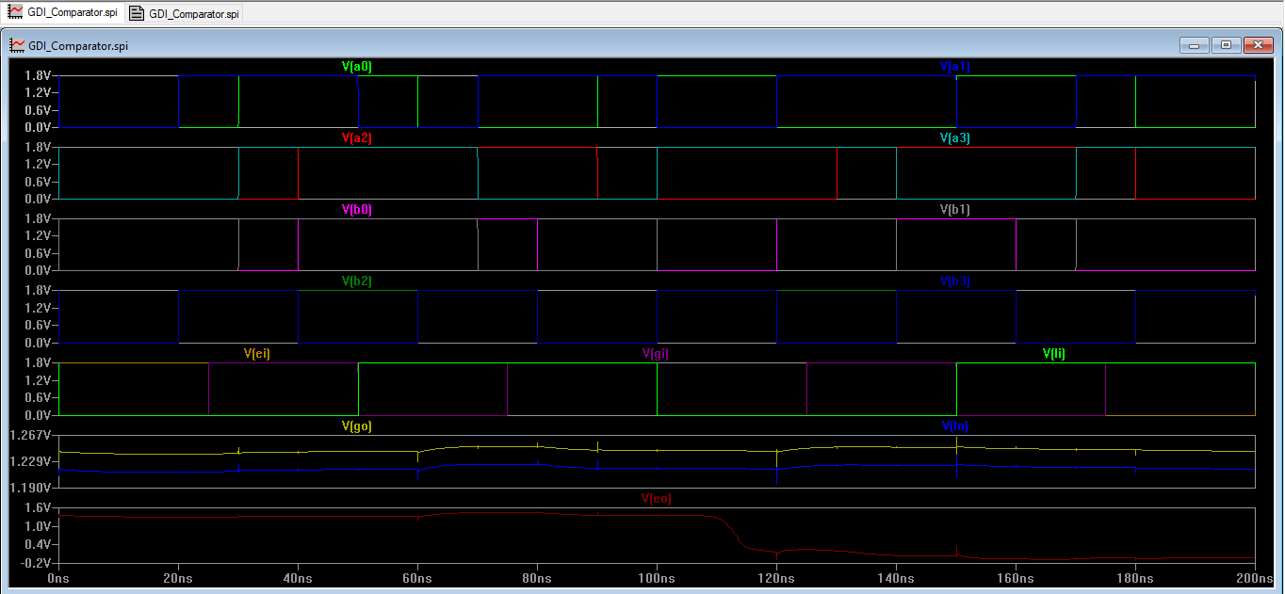
Fig.11 (b) simulation result of 4-bit MC (layout)

Slide 23
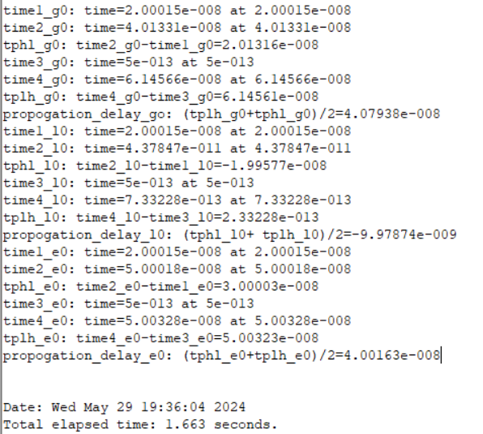
Finding critical path
Using simulation

Slide 24
As seen for the previous outputs we can conclude the propagation delay for all outputs are:
Tp(G0) = 40.8 ns
Tp(L0) = 0.998 ns
Tp(E0) = 40 ns

Slide 25
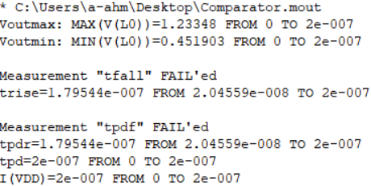
Finding average power
Average Power = Ivdd * VDD
= 1.8 * 0.2u = 0.35 µW

Slide 27
