Slide 1
Data Science – What IS IT?

Slide 2
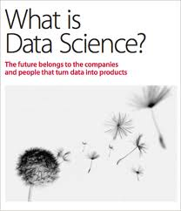
“Data Science” an Emerging Field
O’Reilly Radar report

Slide 3
Data Science is the art of turning data into actions.
creation of data products
Examples of data products include answers to questions such as: “Which of my products should I advertise more heavily to increase profit? How can I improve my compliance program, while reducing costs? What manufacturing process change will allow me to build a better product?” The key to answering these questions is: understand the data you have and what the data inductively tells you.

Slide 4
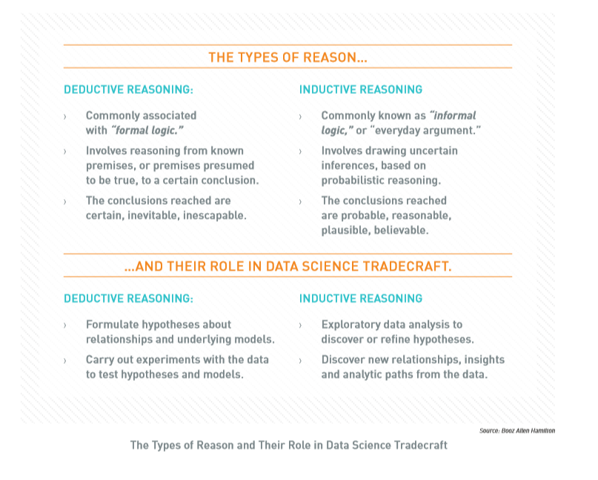
What makes Data Science Different?

Slide 5
Business Intelligence vs. Data Science
Discovery vs. Pre-canned Questions: Data Science actually works on discovering the question to ask as opposed to just asking it.
Power of Many vs. Ability of One: An entire team provides a common forum for pulling together computer science, mathematics and domain expertise.
Prospective vs. Retrospective: Data Science is focused on obtaining actionable information from data as opposed to reporting historical facts.

Slide 6
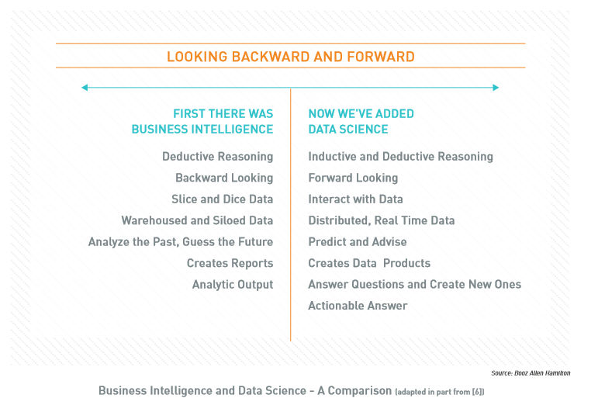

Slide 7
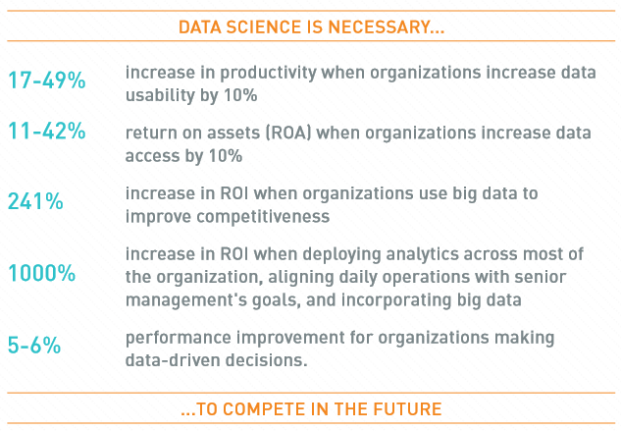
What is the Impact of Data Science?
If you have perfect information or zero information then your task is easy – it is in between those two extremes that the trouble begins.

Slide 8
What is Different Now?
Opportunity Costs
Enhanced Processes

Slide 9
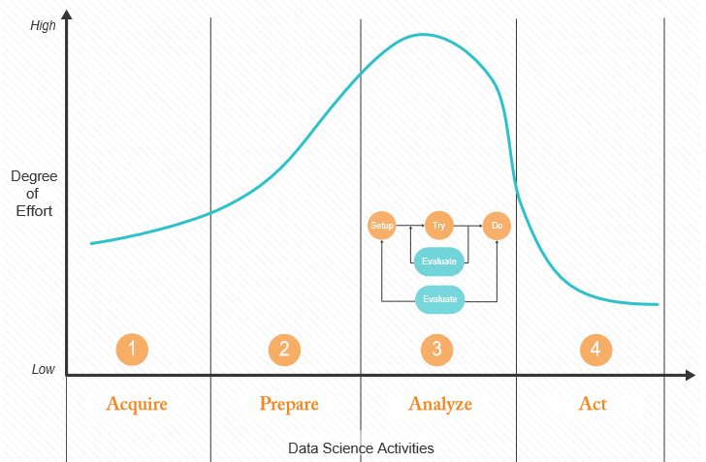
How does Data Science Actually Work?

Slide 10
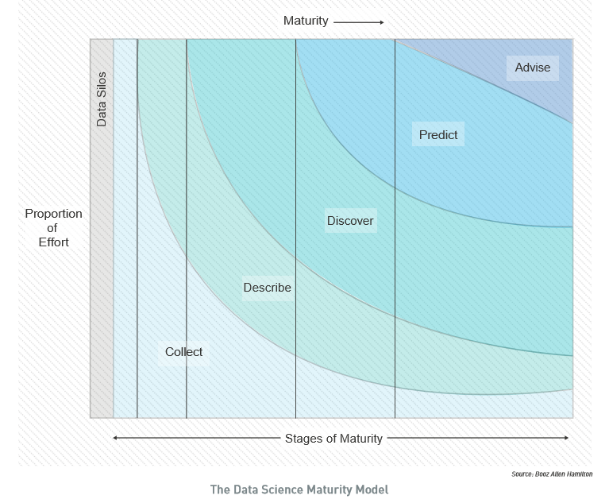
Data Science Maturity within an Organization

Slide 11
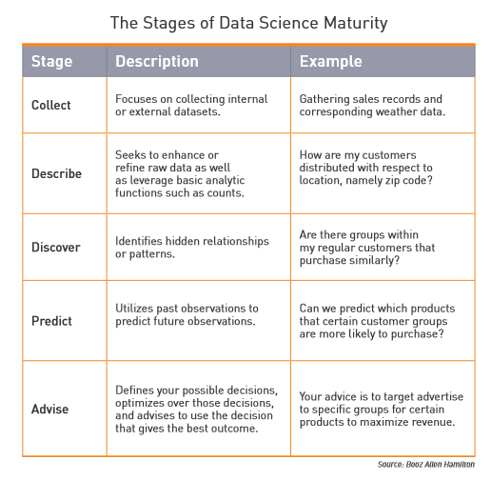

Slide 12

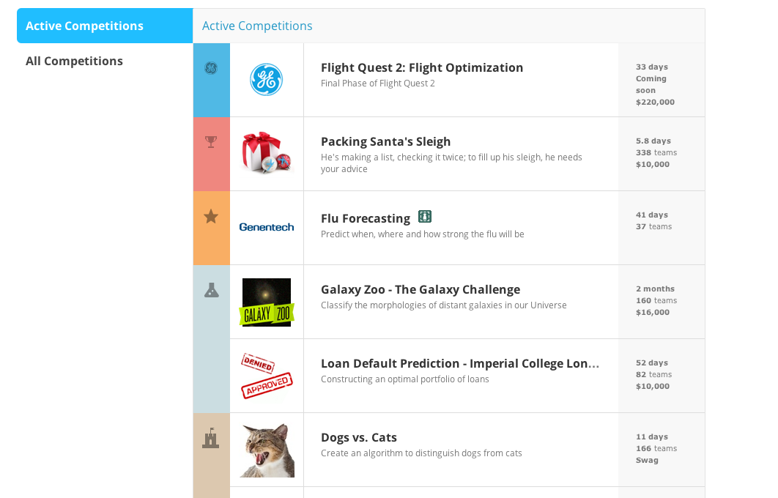
Some recent ML Competitions

Slide 13
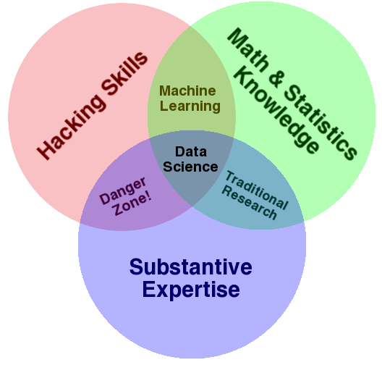
Data Science – One Definition
Notes:
Drew Conway’s definition

Slide 14
What Does it Take to Create a Data Science Capability?

Slide 15
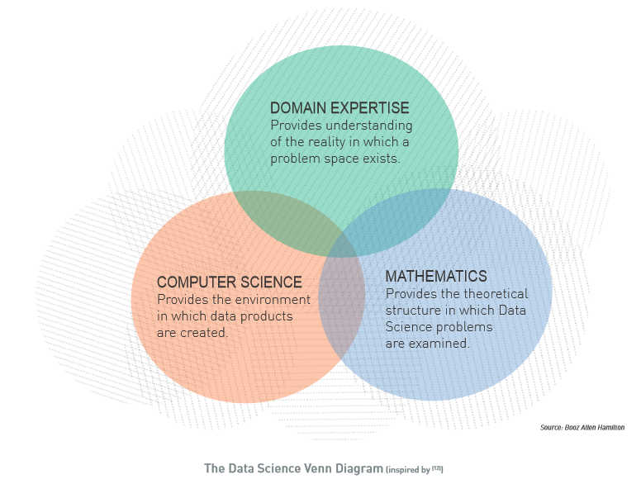

Slide 16
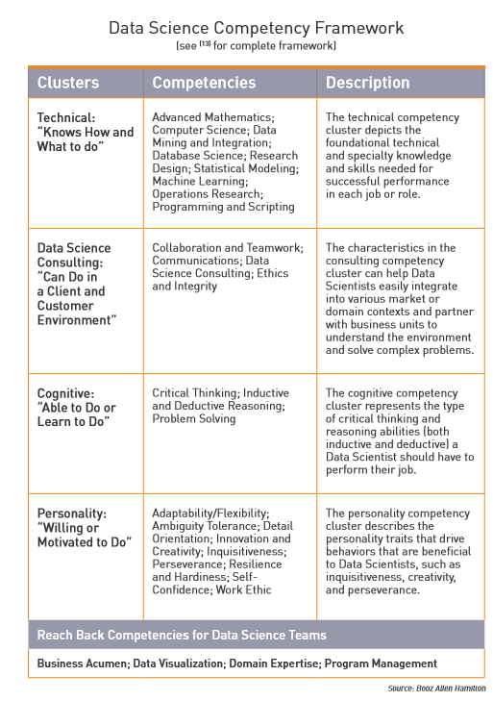

Slide 17
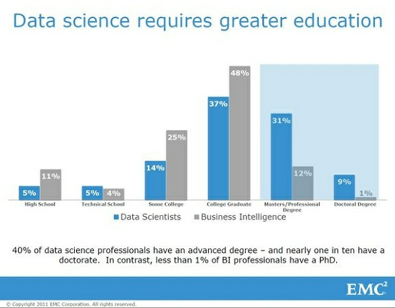

Slide 18
Doing Data SciENCE

Slide 19
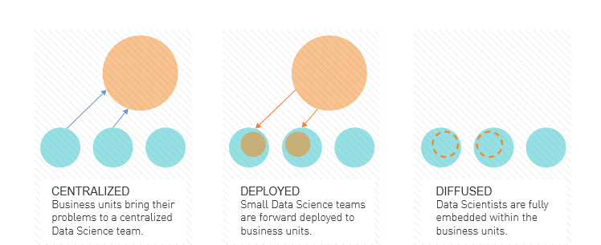
Selecting Your Operating Mode

Slide 20
Ben Fry’s Model
Acquire
Parse
Filter
Mine
Represent
Refine
Interact

Slide 21

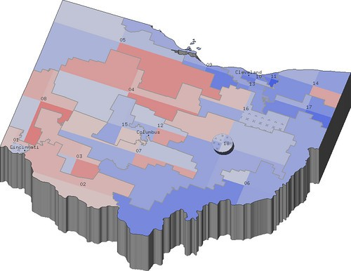
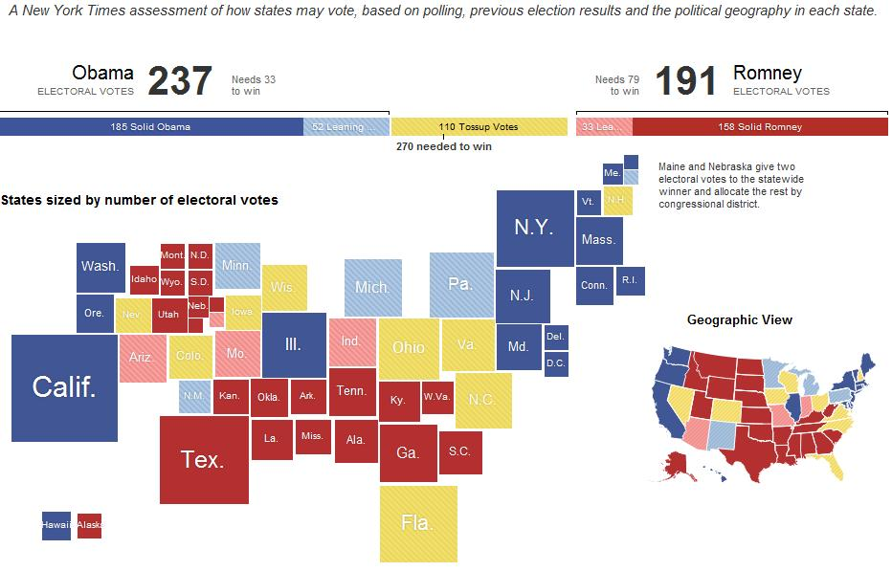
Jeff Hammerbacher’s Model
1. Identify problem
2. Instrument data sources
3. Collect data
4. Prepare data (integrate, transform, clean, ﬁlter, aggregate)
5. Build model
6. Evaluate model
7. Communicate results

Slide 22
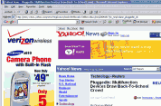
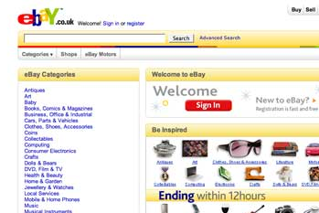
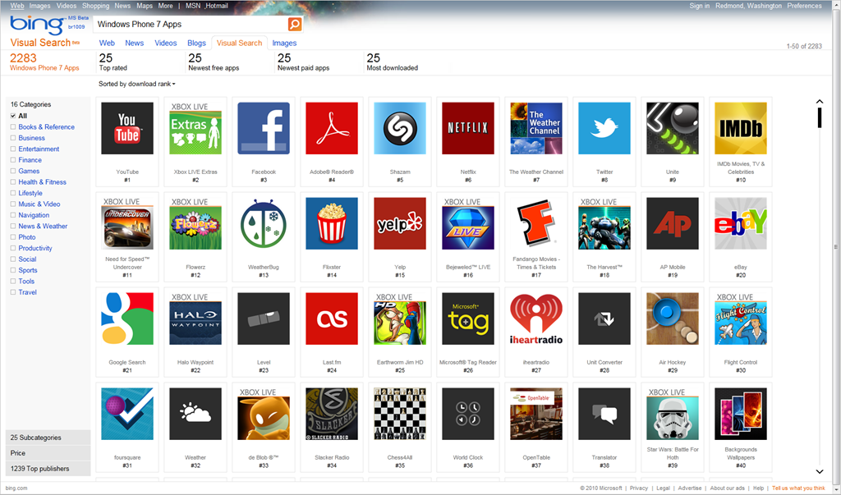
From the Trenches
Yahoo [KDD 2009, best app. paper]
Ebay [SIGIR 2011, hon. mention]
Quantcast [2012]
Microsoft [CIKM 2014]

Slide 23
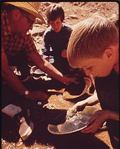
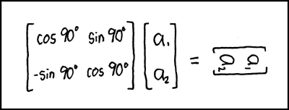
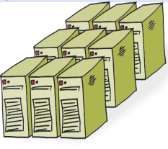
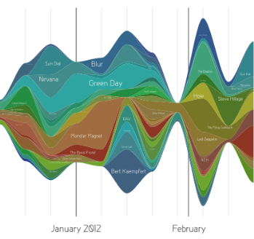
Data Scientist’s Practice
Clean,
prep
Hypothesize Model
Large Scale Exploitation
Digging Around in Data
Evaluate Interpret

Slide 24
What’s Hard about Data Science
Overcoming assumptions
Making ad-hoc explanations of data patterns
Overgeneralizing
Communication
Not checking enough (validate models, data pipeline integrity, etc.)
Using statistical tests correctly
Prototype → Production transitions
Data pipeline complexity (who do you ask?)
Notes:
Quote from paper “I’d rather the data go away than be wrong and not know”
Assumptions not communicated: transformations not documented.

