Slide 1
Analyzing Games
staffan.bjork@chalmers.se

Slide 2
Structure of today’s lecture
Motives for analyzing games
  With a structural focus
General components of games
  Example from course book
  Example from Rules of Play
An Activity-centric Approach
  Component Framework
Presentation of Assignment 2

Slide 3
Reasons to analyze games
Common structures
  Deeper understanding of what games are
Identify differences
  What works and what doesn’t work
Prove hypothesis
  Find or isolate problems
Learn how a game works
  How it affects people
  How one can reproduce the effects

Slide 4
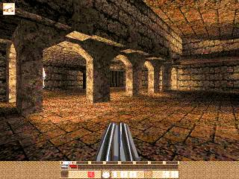
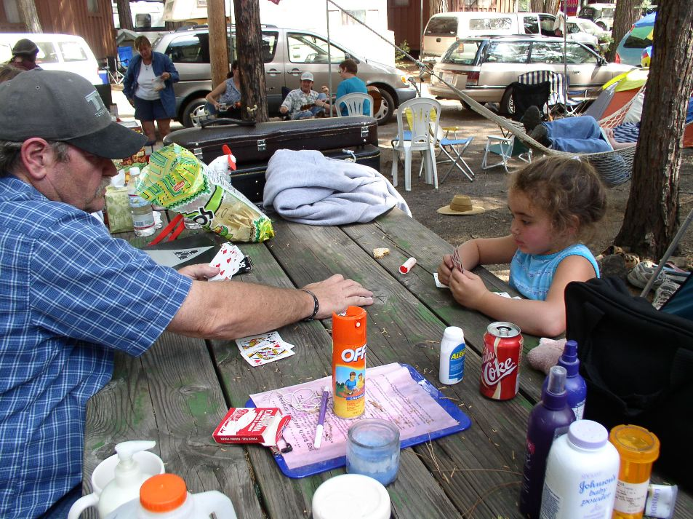
Example: Quake and Go Fish

Slide 5
Example: Quake and Go Fish
Comparison to understand what games consist of
  Identify formal and dramatic elements
  Find a definition
    Closed, formal system
    Engages players in structured conflict
    Resolves in an unequal outcome

Slide 6
Example: Quake and Go Fish, cont.
Formal elements
  Players
  Objectives
  Procedures
  Rules
  Resources
  Conflict
  Boundaries
  Outcome
Dramatic elements
  Challenge
  Play
  Premise
  Character
  Story

Slide 7
Ways of studying games
Structural – what does a game consist of?
  Interaction design – gameplay
  Operational processes - programming
  Problem solving – game theory
  Events and stories – narratology (more later lecture)
Operational - how is a game played?
  What do players do when playing?
    Self-organization
    Social structures
    Extra-game motivation and consequences

Slide 8
Ways of studying games, cont.
Motivational - Why is a game played?
  Learning
  Immersion (Catharsis?)
  Social activity
  Creativity
Player-focused - Who plays games?
  What player groups exist?
  When, why and how do people start playing games?
  When, why and how do people stop playing games?

Slide 9
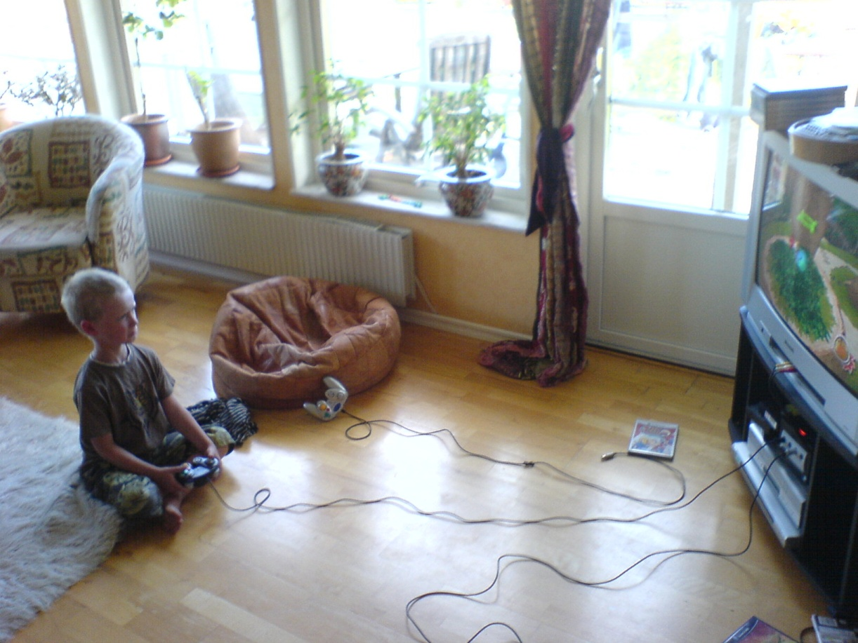
Ways of studying games, cont.

Slide 10
Ways of studying games, cont.
Games
Notes:
Game theory von Neumann
Computer science Juul
Maybe Salen & Zimmerman’s definition of what a game is (at least that part of their work)
The only thing concretely present for designers to work with
Gameplay design patterns
Hardware development

Slide 11
Ways of studying games, cont.
Gamers
Notes:
Sociology
Psychology
Education?
Business?
T.L. Taylor WoW
Linderoth, J. Construction of meaning in games (?)
Mäyrä immersion

Slide 12
Ways of studying games, cont.
Gaming
Notes:
Interaction & conversation analysis
Petersson, difference between play and pre-play
Linderoth
Sjöblom
Interaction Design
The goal of the design activity

Slide 13
Ways of studying games, cont.
Gaming
Gamers
Games
Notes:
Suggested core
Different perspectives or different units of investigation
Rules of irrelevance
Already done? Hybrids?
Linderoth & Taylor – interaction analysis
Design – goal is gaming and gamers are used in the design process
Interaction design
Second-order design
These may be seen as more game research

Slide 14
Focus for this course
Gaming
Specifically
game mechanics
i.e. rule constructs
Games
Notes:
Suggested core
Different perspectives or different units of investigation
Rules of irrelevance
Already done? Hybrids?
Linderoth & Taylor – interaction analysis
Design – goal is gaming and gamers are used in the design process
Interaction design
Second-order design
These may be seen as more game research

Slide 15
Perspective of games in Rules of Play
Game Design Schemas
  Rules
  Play
  Culture
Core Concepts
  Meaningful Play
  Design
  Systems
  Interactivity
  The Magic Circle
Games as rules, play or culture

Slide 16
Types of Rules
From Rules of Play
Operational Rules
  “Rules of Play”
  Written rules in traditional games
Constitutive Rules
  Underlying formal structures
  Consequences and emergent features
Implicit Rules
  Good sportsmanship
  Let other player “take back” a move
  Explain options and consequences
Additional distinctions
Instantiation Level
  Game rules
  Gaming rules
Explicitly changed rules
  House Rules

Slide 17
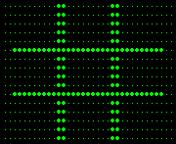
Rules of Play example: Tic-Tac-Toe

Slide 18
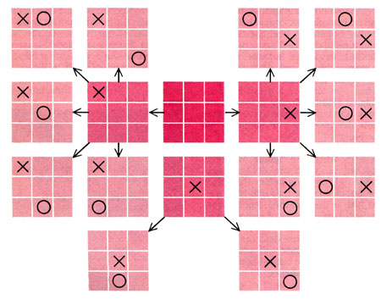
Rules of Play example: Tic-Tac-Toe
Operational Rules
  X starts; alternate placing one symbol on free space; wins if three-in-a-row; draw if no free spaces
Constitutive Rules
  Unwinnable if both players play optimally
Implicit Rules
  Not tell other player constitutive rules?

Slide 19
An Activity-Centric Approach to Game Research

Slide 20
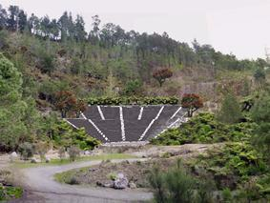
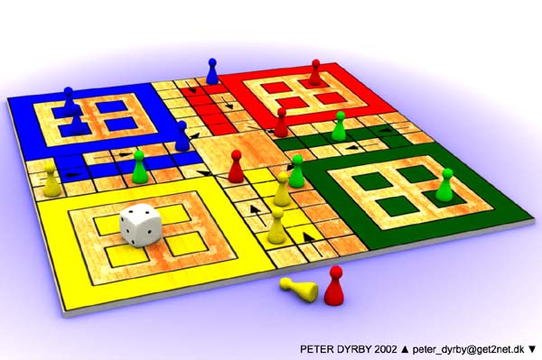
Grounded in Interaction Design
Design area focused on interaction
  Focused upon artifact (game) but aimed at interaction (gaming)
  IT a powerful enabler
Describes interaction in games
  Game Design Patterns
  Game Ontology Projects
Describes interaction facilitators
  Component framework
    Used in assignment 2

Slide 21
The Component Framework

Slide 22
Component Framework
An activity-based model of game interaction
Includes traditional concepts used to describe games
  Player, element, rule, goal, etc.
Lays out how games are constructed
  Focus on game mechanical aspects
  Describe, analyze and compare games
Game state assumed
  Playing the game is making changes in the game state! (and getting and refining information about the game state)

Slide 23
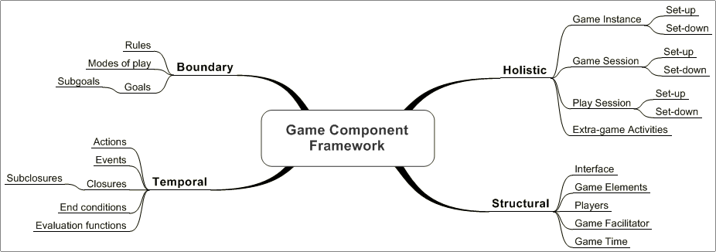
Component Framework

Slide 24
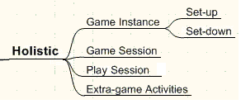
Holistic
How the activity of playing the game is divided
Game Instance: whole lifetime of the game
Game Session: the whole activity of a player playing one game
Play Session: a player actively playing the game
Extra-game activities: activities related to game
Set-up/down: preparatory and end game activities

Slide 25
Game Instance
Setting up the game
  All the actions of all the players participating in the game
  Ending the game and determination of the final outcome
  Activities required to restore or clear the game state after playing the game
  Rules used in an instance are the gaming rules
    Contrasted to the generic game rules

Slide 26

Game Instance: A typical Chess game
Two players decide to play Chess
  Beginning of a game instance of Chess
Setting up the initial board and determining who is playing which side
The actions of both of the players
Determining the outcome and possible impact outside this game instance (tournament etc.)
Clearing the game state
  Players put the board and pieces away

Slide 27
Game Session
Complete activity of one player participating in a game instance
  Player specific
    Chess game instance has two game sessions
  Usually game instance and game session coincide in time

Slide 28
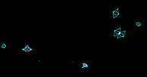
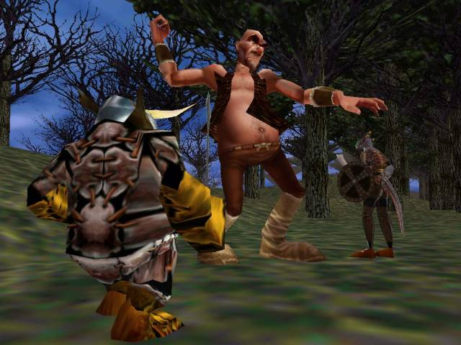
Game Session: Examples
Asteroids
  Player puts in coins: set-up
  Plays the game until loses all lives: play session
  Enters initials to the high-score list: set-down
Massively Multiplayer Online Role-Playing Game
  Player creates a character: set-up
  Logs in to play every now and then: several play sessions
  Finally decides to stop playing the game and removes the character: set-down

Slide 29
Play Session
The length of time one player is actively playing the game
  One game session can consist of many play sessions
    But in many games game and play sessions coincide
  Play session consists of all the player actions during the session
    Can be described as a sequence of changes in modes of play

Slide 30
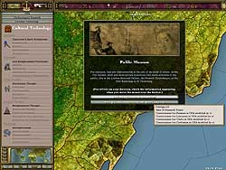

Play Session: Examples
Asteroids
  The same as the game session for one player
Strategy games
  Player can save the progress, close the game and come back later
  Many player controlled play sessions
Play-by-mail Chess
  Player opens the envelope
  Makes his move by writing it on a piece of paper
  Sends the move sheet to the other player
World of Warcraft
  Doing one raid

Slide 31
Set-up Session
Game Instance
    Set-up the initial game state
    Invite players
    Allow the game to start
Game Session
    The player or the facilitator configures the initial starting position in the game
    The player registers to the game
Play Session
    Prepare the play session
      Log in the game, select profile etc.

Slide 32
Set-down Session
Game Instance
  Declare that the game has ended
  Determine the final outcome
  Return the initial game state if need be
  Usually the facilitator takes care of this
Game Session
  The player’s initial state restored or removed altogether
  Take care of possible meta-game effects
Play Session
  Save the current state for further play sessions
  … or end the game session

Slide 33
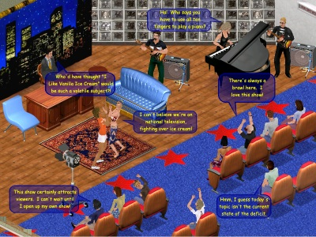
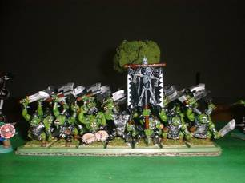
Extra-game activities
Activities related to the game but do not have a direct effect on the game state
Planning activities
  Creating strategies
Modifications to the game
  Skins in Sims
  Game mods
    Create new games!
Acquiring equipment or game elements
  Buying a booster pack for Magic: the Gathering
Using the game for other purposes
  Creating movies, stories, or stunt shows

Slide 34
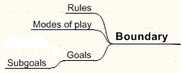
Boundary Components
Limit the player activities by allowing certain actions and making some activities more rewarding.
Rules: dictate how everything works!
Modes of Play: different phases of the game
Goals and subgoals: motivation for playing the game in certain ways

Slide 35
Rules
Limit player actions
Describe and lay out the boundaries of the game
Govern how the other components of the framework are instantiated
  Meta-components
Static or dynamic
  Chess vs. Nomic
Explicit or implicit
  Rules explicitly known to the player
  Rules “hidden” in the game system

Slide 36
Modes of Play
Different phases or sections of the game where
  Actions are different, or
  Goals are different, or
  Interface is different, or
  Players are different
Changes between modes governed by rules
Modes can have sub-modes

Slide 37
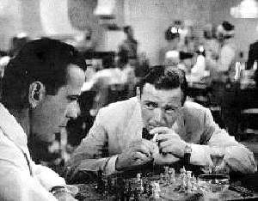
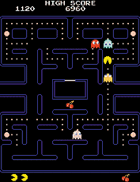
Modes of Play: Examples
Taking turns in Chess
  While the other player makes his move the player cannot move his pieces
Inventory mode
  Many adventure and RPG computer games have a different mode for manipulating the inventory
Different phases in board games
  Diplomacy has diplomatic, action and turn resolution phases
Eating the power pill in Pac-Man
  Possible to hunt the ghosts!

Slide 38
Goals and subgoals
Define the game states the player tries to achieve
Motivation for playing the game
  Achievement
Almost always nested hierarchies or networks
  Subgoals of subgoals of subgoals etc.
Can be player defined during the play
  SimCity and Sims

Slide 39
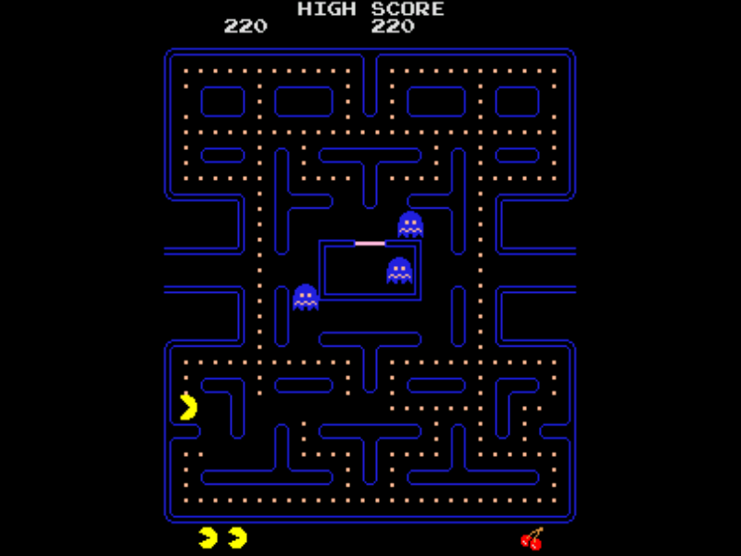
Goals and subgoals: Examples
Pac-Man
  Get as high score as possible
  Complete the level
  Eat a dot
  Eat a power pill
    Eat as many ghosts as possible during the effect of the pill

Slide 40
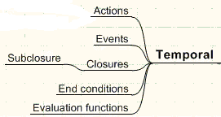
Temporal Components
Describe the flow of the game play and define the changes in the game state
Actions: what the player can do
Events: what are the game state changes
Closures: meaningful game state changes
End conditions: determine changes of mode of play and closures
Evaluation functions: determine the outcome of an end condition

Slide 41
Actions
What the player can do to change the game state
Explicit or implicit
  Directly available through controller or the UI
  “Hidden” in the game system
    Text adventures
The way to change the game state
  Not the actual physical movement of pressing the button
Related to the interface

Slide 42
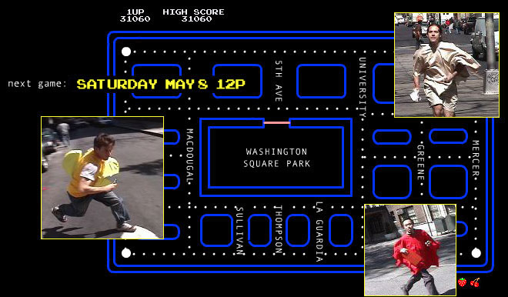
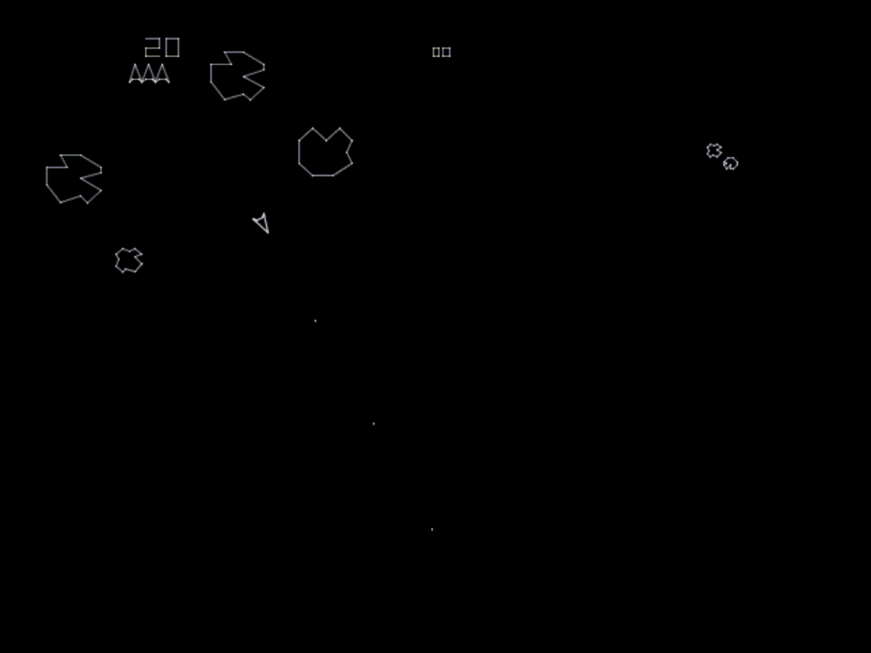
Actions: Examples
Pac-Man
  Movement up, down, left and right using the joystick
Asteroids
  Steer left or right
  Use the rocket to move the ship
  Shoot bullets
Space invaders
  Move left or right
  Shoot a bullet

Slide 43
Events
Changes in the game state
  Perceivable to the players
  Change of mode of play, closures
Consequences of the actions
  Own actions
  Other player actions
Game system generated
  Computer controlled opponents
  Gravitation, inertia and other automatic events

Slide 44
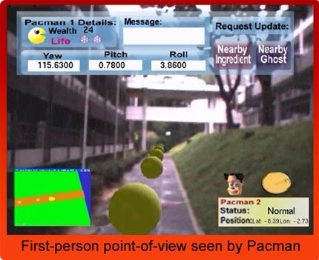
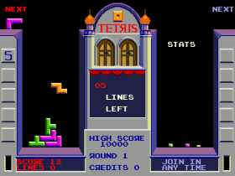
Events: Examples
Pac-Man
  Pac-Man starts to move the direction
  Eats a pill
  The ghosts move, regenerate etc.
Tetris
  New block appears
  The block starts to fall down
  The block gets stuck
  Full rows are removed
  The game ends

Slide 45
Closures
Quantifiable and meaningful player experiences normally associated with game state changes
Associated with goals
  Reaching a goal (winning condition)
  Failing to reach a goal or losing the game (loss condition)
  Occur during gameplay (while goals are part of the game)
Not necessarily defined as particular game states
  Borderline between first and second order game design concepts, may be player defined
Normally deeply nested
  Subclosures of subclosures of subclosures

Slide 46
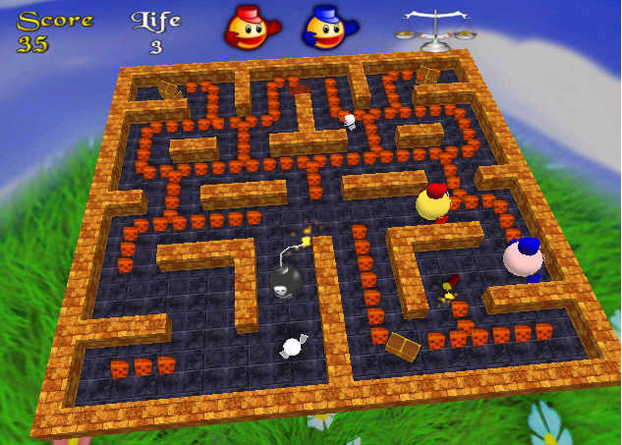
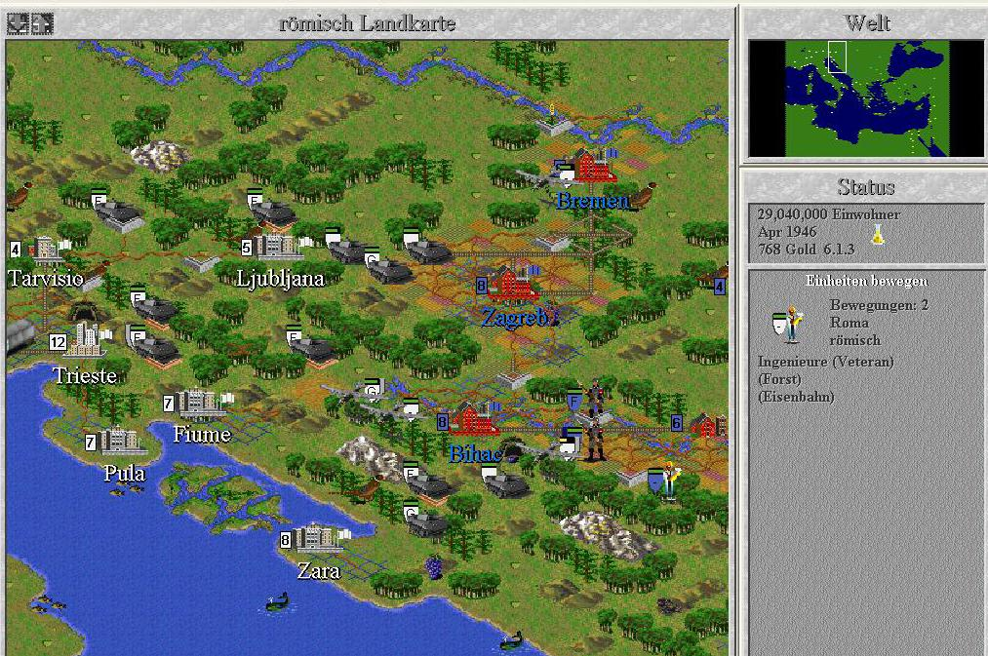
Closures: Examples
Pac-Man
  Eating a pill
  Eating a power pill
  Eating a ghost
  Eating all the ghosts
  Finishing a level
  Losing a life
  Losing all lives
  Getting the high score
  Etc.
Civilization
  Founding a city
  Completing a building/unit
  Completing research
  Winning a fight
  Discovering a hut/nation
  Eliminating an opponent
  Traveling to a star
  Etc.

Slide 47
End Conditions and Evaluation Functions
End condition is a game state requirement for
  Switching the mode of play
  Completion of a closure
  End of a game instance, game or play session
Always associated with an evaluation function
  Together define win and loss conditions
Evaluation function defines what is the outcome of the end condition

Slide 48
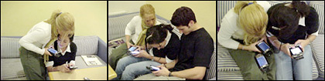
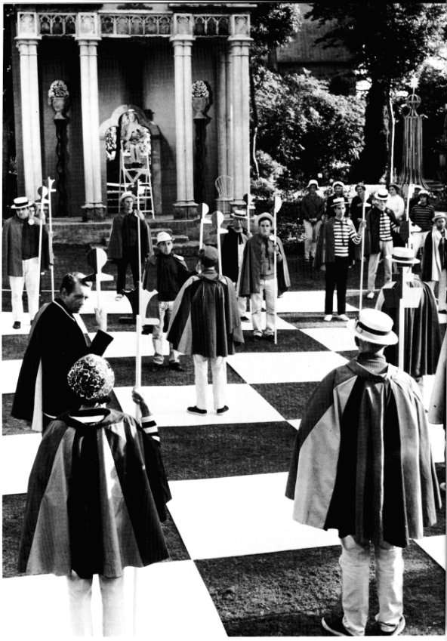
End Conditions and Evaluation Functions: Examples
Pac-Man
  Eating a pill: Pac-Man moves over the pill -> more points
  Finishing a level: All pills eaten -> progress to next level
  Etc.
Chess
  Check mate opponent’s king: the king cannot move -> the other player wins

Slide 49
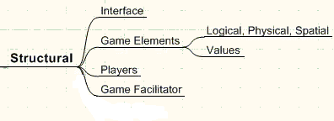
Structural Components
Define the parts of the game which are manipulated by the players and the game system
Interface: provides players information about the game state and possible actions
Game Elements: components that contain the game state
Players: entities that try to achieve their own goals within the game
Game Facilitator: synchronizes the game state

Slide 50
Interface
Provides the player information
  The game state
  What actions are available
Provides the player access to the actions
  What the player has to physically do to perform the action
Can help to express the theme of the game
  Audio-visual style

Slide 51
Interface: Examples
Chess:
  The board laid out as 8X8 grids
  The pieces on the grids define the game state
  The player can move the piece by picking it up and putting it down
Pac-Man
  Joystick for controlling the movement of the Pac-Man
  The level is shown on the screen
  Audio effects related to events

Slide 52
Game Elements
Physical and logical components that contain the game state
Can be manipulated by player actions and game events
Usually have attribute values that define their abilities
  Type
  Who controls
  What does it look like
  Etc.

Slide 53
Game Elements: Examples
Elements that define the game world
  Chess board
  The landscape in a strategy game
  The geography of a fantasy role-playing game
Elements that personify the player
  Pac-Man
  Asteroids ship
  Player’s avatar in the RPG
Elements that are controlled by the player
  Units in a strategy game
  Chess pieces

Slide 54
Players
Representation of entities trying to achieve goals
Change the game state through actions
Can be human players or computer controlled
Can compete against each other
Can cooperate with other players
Different ways of analysis
  Ghosts in Pac-Man as other players
  Tetris as a two player game?

Slide 55
Players: Examples
Pac-Man
  The player controls the yellow Pac-Man
    Avoids the ghosts
  Computer controls the ghosts
    Try to catch Pac-Man
  Similarities to Tag
Chess
  The white and black player try to eliminate each other
MMORPGs
  Thousands of players represented by avatars in the game world

Slide 56
Facilitator
Takes care of setting up the game
Synchronizes the game state
Can be players themselves
  Children games
Ultimate arbitrator of disputes between the players and the game system

Slide 57
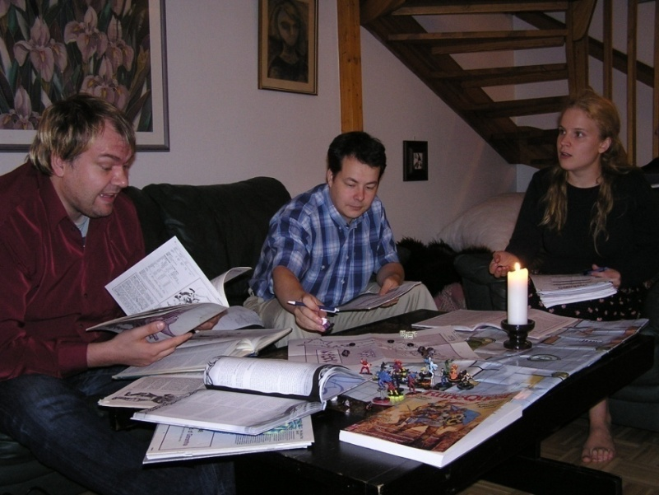
Facilitator: Examples
Tag
  The players define the boundaries
  The players keep track who is “it”
Pac-Man
  The computer inside the arcade machine
Tabletop RPGs
  The game master

Slide 58
Assignment 2

Slide 59
Task
Identify an interesting question/problem regarding gameplay in one genre (e.g. FPS, RTS, MMORPG, Puzzle Games)
  Choose 2 games in the genre that highlight the question/problem in different ways
  Analyze the games regarding gameplay and answer the question
  Take games you have played or have access to
For the analysis
  Use the component framework
  Identify your own suggestions for gameplay design patterns (described in the next lecture)
  Use your definitions from assignment 1 if relevant
The report shall also contain general description of the games and gameplay
The report shall also discuss what did not emerge from using the component framework and gameplay design patterns

Slide 60
Requirements
Number of people: 2
  Form groups yourself
Deadline: 20110204
Length: maximum of 8 pages
Learning objectives
  Define own question/problem regarding gameplay
  Explain how two games are similar and different regarding gameplay.
  Make use of theoretical frameworks and tools for own analysis
  Make use of references to external descriptions of the games (i.e. reviews) as well as arguments regarding their gameplay
  Have critical perspective towards the concepts, frameworks, and tools

Slide 61
Thank you!

