Slide 1
Introduction to Data Science Session 2 Data Preparation

Slide 2
Outline for this Evening
Some Ideas from Kandel et al. Paper
Data Types and Sources
Data Preparation and Manipulation
Files

Slide 3
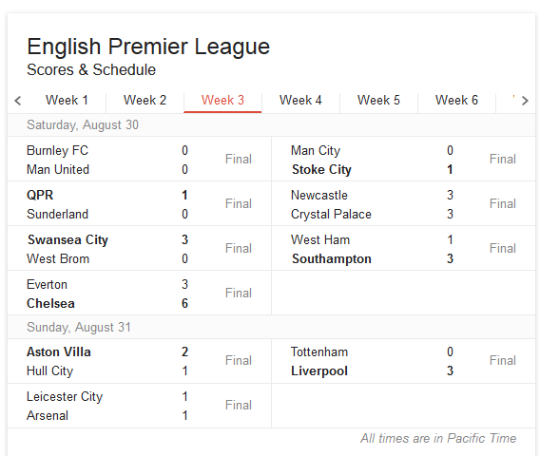
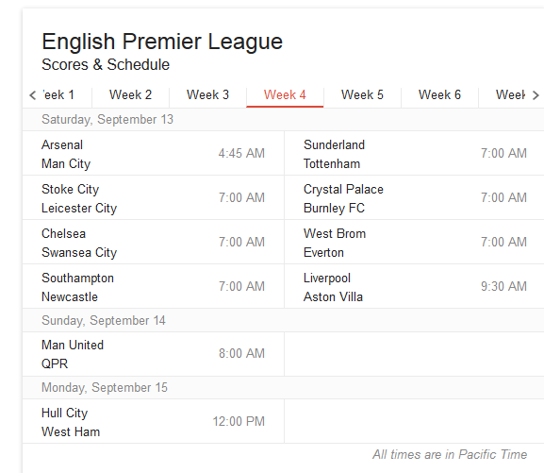
Data Science is about checking assumptions

Slide 4
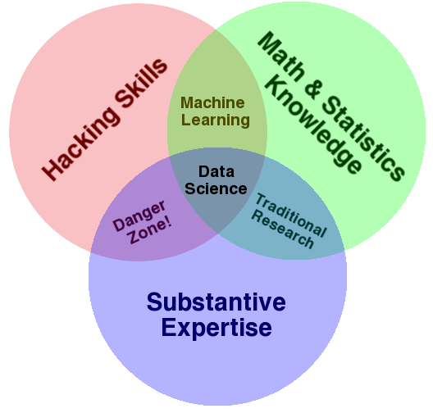
Data Science – One Definition

Slide 5
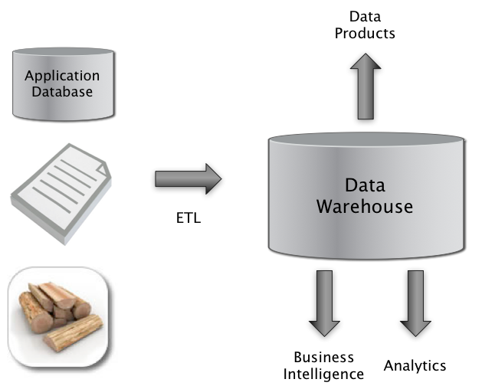
The Big Picture
Extract
Transform
Load

Slide 6
Data Preparation overview
ETL
We need to extract data from the source(s)
We need to load data into the sink
We need to transform data at the source, sink, or in a staging area
Sources: file, database, event log, web site, HDFS…
Sinks: Python, R, SQLite, RDBMS, NoSQL store, files, HDFS…

Slide 7
Data Preparation overview
Process model
The construction of a new data preparation process is done in many phases
Data characterization
Data cleaning
Data integration
We must efficiently move data around in space and time
Data transfer
Data serialization and deserialization (for files or network)

Slide 8
Data Preparation overview
Workflow
The transformation pipeline or workflow often consists of many steps
For example: Unix pipes and filters
$ cat data_science.txt | wc | mail -s "word count” myname@some.com
If the workflow is to be used more than once, it can be scheduled
Scheduling can be time-based or event-based
Use publish-subscribe to register interest (e.g. Twitter feeds)
Recording the execution of a workflow is known as capturing lineage or provenance

Slide 9
The Businessperson
Data Sources
Web pages
Excel
ETL
Copy and paste
Data Warehouse
Excel
Business Intelligence and Analytics
Excel functions
Excel charts
Visual Basic?!

Slide 10
The Programmer
Data Sources
Web scraping, web services API
Excel spreadsheet exported as CSV
Database queries
ETL
wget, curl, Beautiful Soup, lxml
Data Warehouse
Flat files
Business Intelligence and Analytics
Numpy, Matplotlib, R, Matlab

Slide 11
The Enterprise
Data Sources
Application databases
Intranet files
Application server log files
ETL
Informatica, IBM DataStage, Ab Initio, Talend
Data Warehouse
Teradata, Oracle, IBM DB2, Microsoft SQL Server
Business Intelligence and Analytics
Business Objects, Cognos, Microstrategy
SAS, SPSS, R

Slide 12
The Web Company
Data Sources
Application databases
Logs from the services tier
Web crawl data
ETL
Flume, Sqoop, Pig, Crunch, Oozie
Data Warehouse
Hadoop/Hive, Spark/Shark
Business Intelligence and Analytics
Custom dashboards: Argus, BirdBrain
R

Slide 13
Compare to Categories in the Kandel et al. Paper?
Hackers?
Scripters
Application Users
The process:
Discover, Wrangle, Profile, Model, Report
Today we’ll start discussing “Wrangling”
integrating, cleaning and transforming

Slide 14
Impediments to Collaboration
Diversity of tools and PLs makes it hard to share
Finding a script or computed result is harder than just writing the program from scratch!
Q: How could we fix this?
View that much of the analysis work is “throw away”

Slide 15
Data Sources at Web Companies
Examples from Facebook
Application databases
Web server logs
Event logs
API server logs
Ad server logs
Search server logs
Advertisement landing page content
Wikipedia
Images and video

Slide 16
Tabular Data
What is a table?
A table is a collection of rows and columns
Each row has an index
Each column has a name
A cell is specified by an (index, name) pair
A cell may or may not have a value

Slide 17
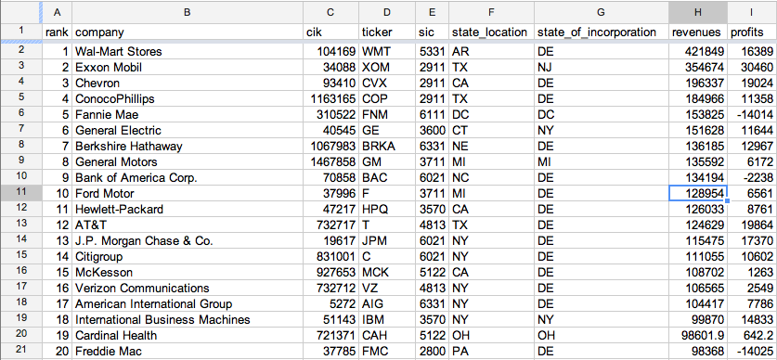
Tabular Data
Fortune 500

Slide 18
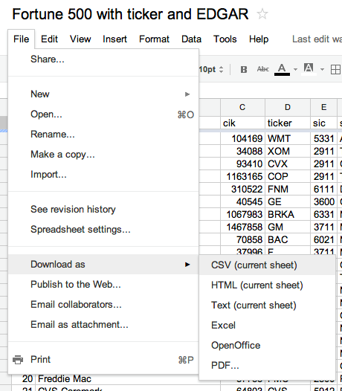
Tabular Data
Fortune 500

Slide 19
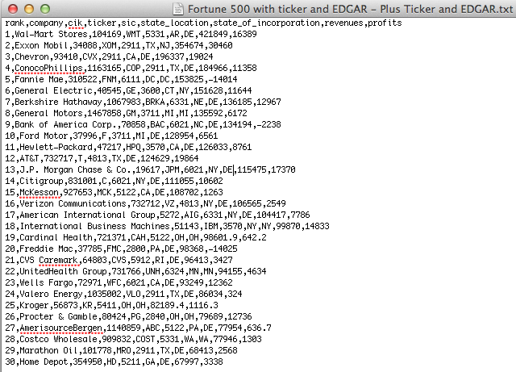
Tabular Data (csv)
Fortune 500

Slide 20
Protein Data Bank
HEADER APOPTOSIS 05-OCT-10 3IZA
TITLE STRUCTURE OF AN APOPTOSOME-PROCASPASE-9 CARD COMPLEX
COMPND MOL_ID: 1;
COMPND 2 MOLECULE: APOPTOTIC PROTEASE-ACTIVATING FACTOR 1;
COMPND 3 CHAIN: A, B, C, D, E, F, G;
COMPND 4 SYNONYM: APAF-1;
COMPND 5 ENGINEERED: YES
SOURCE MOL_ID: 1;
SOURCE 2 ORGANISM_SCIENTIFIC: HOMO SAPIENS;
SOURCE 3 ORGANISM_COMMON: HUMAN;
SOURCE 4 ORGANISM_TAXID: 9606;
SOURCE 5 GENE: APAF1, KIAA0413;
SOURCE 6 EXPRESSION_SYSTEM: SPODOPTERA FRUGIPERDA;
SOURCE 7 EXPRESSION_SYSTEM_TAXID: 7108;
SOURCE 8 EXPRESSION_SYSTEM_STRAIN: SF21;
SOURCE 9 EXPRESSION_SYSTEM_VECTOR_TYPE: INSECT VIRUS;
SOURCE 10 EXPRESSION_SYSTEM_PLASMID: PFASTBAC1
KEYWDS APOPTOSOME, APAF-1, PROCASPASE-9 CARD, APOPTOSIS
EXPDTA ELECTRON MICROSCOPY
AUTHOR S.YUAN,X.YU,M.TOPF,S.J.LUDTKE,X.WANG,C.W.AKEY
REVDAT 1 03-NOV-10 3IZA 0
SPRSDE 03-NOV-10 3IZA 3IYT
JRNL AUTH S.YUAN,X.YU,M.TOPF,S.J.LUDTKE,X.WANG,C.W.AKEY
JRNL TITL STRUCTURE OF AN APOPTOSOME-PROCASPASE-9 CARD COMPLEX
JRNL REF STRUCTURE V. 18 571 2010

Slide 21

Internet of Things: Example measurements
36m
33m: 111
32m: 110
30m: 109,108,107
20m: 106,105,104
10m: 103, 102, 101

Slide 22
Tabular Data from Sensors
Challenges
May be many missing fields (a particular sensor may not produce all types of output).
Device may go offline for a while.
Device may be damaged (permanently or intermittently).
Timestamps usually critical but may not be accurate.
Other meta-data (location, device ID) may have errors.

Slide 23
Log Files – Example Apache Web Log
Processes, usually daemons, create logs
e.g., httpd, mysqld, syslogd
66.249.65.107 - - [08/Oct/2007:04:54:20 -0400] "GET /support.html HTTP/1.1" 200 11179 "-" "Mozilla/5.0 (compatible; Googlebot/2.1; +http://www.google.com/bot.html)"
111.111.111.111 - - [08/Oct/2007:11:17:55 -0400] "GET / HTTP/1.1" 200 10801 "http://www.google.com/search?q=log+analyzer&ie=utf-8&oe=utf-8 &aq=t&rls=org.mozilla:en-US:official&client=firefox-a" "Mozilla/5.0 (Windows; U; Windows NT 5.2; en-US; rv:1.8.1.7) Gecko/20070914 Firefox/2.0.0.7"
111.111.111.111 - - [08/Oct/2007:11:17:55 -0400] "GET /style.css HTTP/1.1" 200 3225 “"http://www.loganalyzer.net/" "Mozilla/5.0 (Windows; U; Windows NT 5.2; en-US; rv:1.8.1.7) Gecko/20070914 Firefox/2.0.0.7"

Slide 24

Syslog – A Standard for System Messages
Developed by Eric Allman (at Berkeley) as part of the Sendmail project
Standardized by the IETF in RFC 3164 and RFC 5424
Listens on port 514 using UDP
Puts data in /var/log/messages by default
Enables rich analysis:

Slide 25
Syslog
dhcp-47-129:DataScienceF14> syslog -w 10
Feb 3 15:18:11 dhcp-47-129 Evernote[1140] <Warning>: -[EDAMAccounting read:]: unexpected field ID 23 with type 8. Skipping.
Feb 3 15:18:11 dhcp-47-129 Evernote[1140] <Warning>: -[EDAMUser read:]: unexpected field ID 17 with type 12. Skipping.
Feb 3 15:18:11 dhcp-47-129 Evernote[1140] <Warning>: -[EDAMAuthenticationResult read:]: unexpected field ID 6 with type 11. Skipping.
Feb 3 15:18:11 dhcp-47-129 Evernote[1140] <Warning>: -[EDAMAuthenticationResult read:]: unexpected field ID 7 with type 11. Skipping.
Feb 3 15:18:11 dhcp-47-129 Evernote[1140] <Warning>: -[EDAMAccounting read:]: unexpected field ID 19 with type 8. Skipping.
Feb 3 15:18:11 dhcp-47-129 Evernote[1140] <Warning>: -[EDAMAccounting read:]: unexpected field ID 23 with type 8. Skipping.
Feb 3 15:18:11 dhcp-47-129 Evernote[1140] <Warning>: -[EDAMUser read:]: unexpected field ID 17 with type 12. Skipping.
Feb 3 15:18:11 dhcp-47-129 Evernote[1140] <Warning>: -[EDAMSyncState read:]: unexpected field ID 5 with type 10. Skipping.
Feb 3 15:18:49 dhcp-47-129 com.apple.mtmd[47] <Notice>: low priority thinning needed for volume Macintosh HD (/) with 18.9 <= 20.0 pct free space

Slide 26
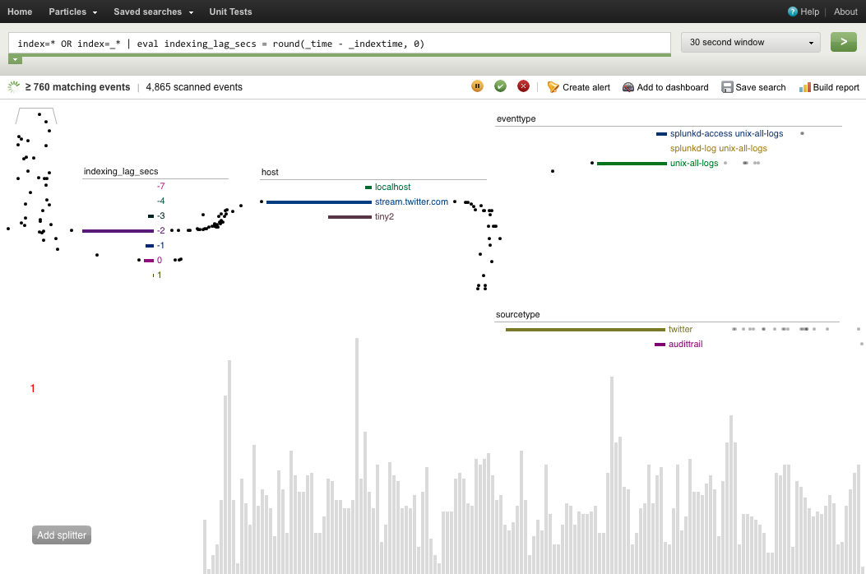
“Splunking”
Grab data from many machines
Index it
Check for unusual events:
Disk problems
Network congestion
Security attacks
Monitor Resources
Network
Memory usage
Disk use, latency
Threads
Dashboard for cloud administration.

Slide 27
Outline for this Evening
Some Ideas from Kandel et al. Paper
Data Types and Sources – “Document” data
Data Preparation and Manipulation
Files

Slide 28
Some Questions
1) How Many Characters are there in a Tweet?
2) How Many Bytes are there in a Tweet (msg)?

Slide 29
Tweet JSON Format

Slide 30
Tweet JSON Format
So how do we process the JSON from Twitter?
Stay tuned, but first some concepts from the XML world…

Slide 31
XML, DOM and SAX
<?xml version="1.0" encoding="UTF-8"?>
<!-- bookstore.xml -->
<bookstore>
<book ISBN="0123456001">
<title>Java For Dummies</title>
<author>Tan Ah Teck</author>
<category>Programming</category>
<year>2009</year>
<edition>7</edition>
<price>19.99</price>
</book>

Slide 32
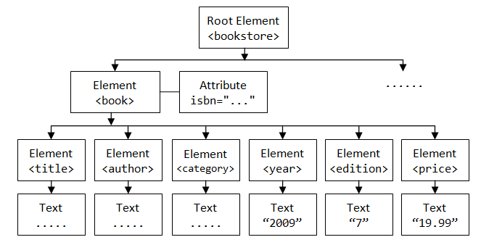
XML, DOM and SAX
XML is a text format that encodes DOM (Document-Object Models) which is a data structure e.g. for Web pages.
The DOM is tree-structured:

Slide 33
XML, DOM and SAX
The DOM is an easy object to work with: all the data in the object is accessible by links.
The problem is that I might not care about most of the data, and I might not be able to fit the DOM for a large object in RAM.

Slide 34
SAX
SAX (Simple API for XML) is an alternative “lightweight” way to process XML.
A SAX parser generates a stream of events as it parses the XML file. The programmer registers handlers for each one.
It allows a programmer to handle only parts of the data structure.

Slide 35
SAX
<?xml version="1.0" encoding="UTF-8"?>
<!-- bookstore.xml -->
<bookstore>
<book ISBN="0123456001">
<title>Java For Dummies</title>
<author>Tan Ah Teck</author>
<category>Programming</category>
<year>2009</year>
<edition>7</edition>
<price>19.99</price>
</book>
Document Header
Comment
Start-element “bookstore”
Start-element “book”
Start-element “title”
End-element “title”
End-element “book”

Slide 36
What about JSON?
Most JSON parsers construct the “DOM” directly.
But there are a few SAX-style parsers:
Jackson
JSON-simple

Slide 37
What about HTML?
Common Crawl, about 5 billion web pages, between 0.2-0.5% of Google’s web crawl.
60 TB, hosted on Amazon S3, also available for download.
Includes link data, page rank.
In ARC (Internet Archive) File format.
So there’s plenty of data, and there are many crawlers for targeted exploration…
HTTrack, …

Slide 38
HTML Tag Soup
<!DOCTYPE html PUBLIC "-//W3C//DTD XHTML 1.0 Transitional//EN" "http://www.w3.org/TR/xhtml1/DTD/xhtml1-transitional.dtd">
<html xmlns="http://www.w3.org/1999/xhtml">
<head><!-- types/widgets/pages/common/page.tmpl home/index_v3.html generated by index_v3 on Wed 29 Feb 2012 11:04:41 PM PST -->
<title>San Francisco Bay Area &mdash; News, Sports, Business, Entertainment, Classifieds: SFGate</title>
<meta http-equiv="content-type" content="text/html; charset=iso-8859-1" />
<meta name="description" content="Find local news &amp; information, updated weather, traffic, classifieds, sports scores, real estate, jobs, cars, food &amp; wine, travel, entertainment, events and more on SFGate.com. Connect to the Bay Area community." />
<meta name="keywords" content="San Francisco, San Francisco Bay Area, news, local events, breaking news, world news, San Francisco Chronicle, SFGate" />
<meta property="fb:page_id" content="105702905593" />
<meta property="fb:admins" content="653226748,658759748" />
<!-- /widgets/sitewide/css/all/inc.html widgets/pages/common/post_write_mtime/css_inc.tmpl -->
<!-- generated by sitewidecss on Thu 16 Feb 2012 10:41:53 AM PST -->
<link rel="stylesheet" type="text/css" title="SFGate" media="all" href="http://imgs.sfgate.com/css1329417713/sitewide/css/sitewide.css" />
<!-- sitewide/css/all/inc.html end css_inc.tmpl -->

Slide 39
HTML Tools - Parsing
“Beautiful Soup” http://www.crummy.com/software/BeautifulSoup/ a Python API for handling real HTML. DOM or SAX interfaces.
“TagSoup” http://ccil.org/~cowan/XML/tagsoup/ provides a Sax interface, i.e. a streaming parse, to Java applications. Can transform to a format you want using XSLT.
Taggle, part of the Arabica toolset http://www.jezuk.co.uk/cgi-bin/view/arabica/code is a version of TagSoup written in C++. You probably want to use this if you have a lot of data.

Slide 40
Break
5-minute break

Slide 41
Web Services
Most large web sites today actively discourage screen-scraping to get their content, and provide Web Service APIs instead.
This is the “right” way to get data from online sources.

Slide 42
Web Services
W3C definition:
a "Web service" as "a software system designed to support interoperable machine-to-machine interaction over a network".
Two kinds:
XML-based RPC-style messages: WSDL and SOAP
REST-style stateless interactions, URLs encode state
Can run over different transports, but usually HTTP

Slide 43
Examples
Twitter: REST API and streaming API with JSON content. Provides sampling, searching and filtering capabilities.
Amazon: has a “product advertising API” in XML with a WSDL spec. Includes product search, reviews etc.
Livejournal: RSS/Atom + custom XML/RPC. Search by keyword, topic, follow friend links.
Netflix: Javascript, Atom and REST interfaces.
Ebay: Many APIs for searching, buying and posting. WSDL descriptions, client code in Java and .NET
Flickr: Comprehensive API set, free for non-commercial use. REST, XML-RPC, SOAP, with client code in many languages.
vBulletin: REST interface, most actions supported

Slide 44
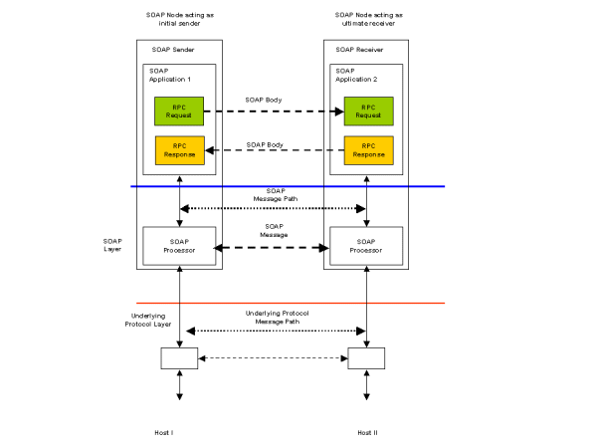
Web Services
XML-RPC, requires a request-response cycle. Often longer “conversations.”

Slide 45
WSDL and SOAP
Conceptually a Remote-Procedure-Call system, like CORBA, Java RMI etc.
But RPC often has to pass through multiple layers of firewalls, causing many problems as security increased in the 1990s.
Web services typically use HTTP as a transport, which runs almost anywhere, provides security and simple GET-POST methods. So HTTP-based RPC was a natural choice.
SOAP uses XML messages, is human-readable, easy to process from any programming language, and relatively robust to version slippage.

Slide 46
SOAP is
SOAP covers the following four main areas:
A message format for one-way communication describing how a message can be packed into an XML document.
A description of how a SOAP message should be transported using HTTP (for Web-based interaction) or SMTP (for e-mail-based interaction).
A set of rules that must be followed when processing a SOAP message and a simple classification of the entities involved in processing a SOAP message.
A set of conventions on how to turn an RPC call into a SOAP message and back.

Slide 47
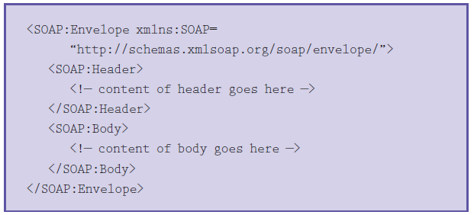
Soap Message
Typically an XML element containing header and body elements

Slide 48
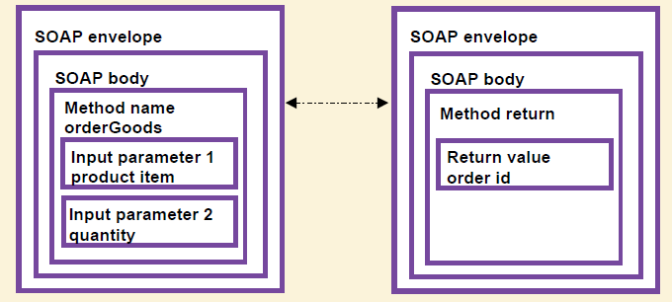
SOAP RPC
SOAP RPC messages typically encode arguments that are presented to the calling program as parameters and return values:

Slide 49
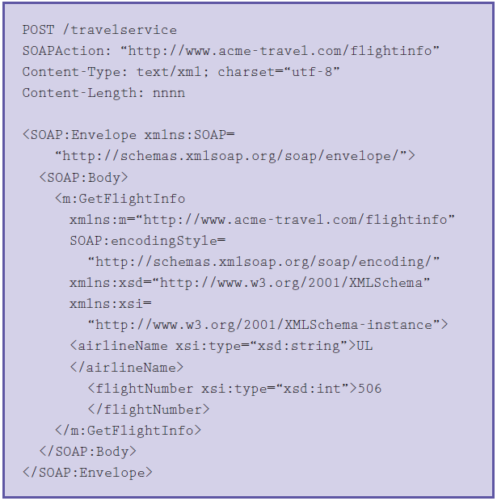
Soap RPC

Slide 50
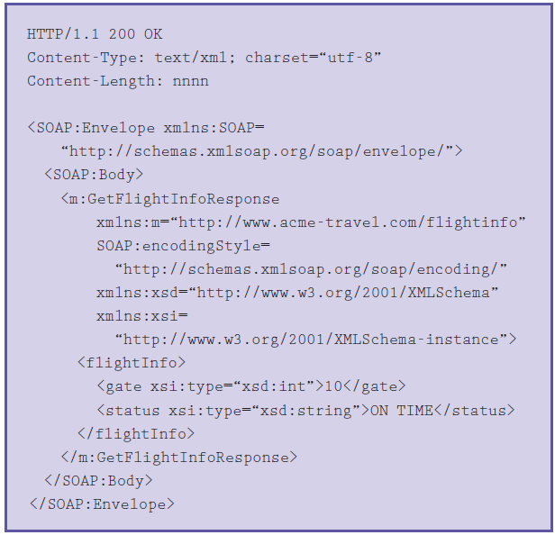
Soap Response

Slide 51
REST
REpresentation State Transfer
Stateless Client/Server Protocol: Principles
Each message in the protocol contains all the information needed by the receiver to understand and/or process it. This constraint attempts to “keep things simple” and avoid needless complexity
Set of Uniquely Addressable Resources
“Everything is a Resource” in a RESTful system
Requires universal syntax for resource identification (e.g. URI)

Slide 52
REST
Set of Well-Defined Operations that can be applied to all resources
In context of HTTP, the primary methods are
POST, GET, PUT, DELETE
these are similar (but not exactly) to the database notion of
CRUD (Create, Read, Update, Delete)
The use of Hypermedia both for Application Information and State Transitions
Resources are typically stored in a structured data format that supports hypermedia links, such as XHTML or XML

Slide 53
REST example
<user>
<name>Jane</name>
<gender>female</gender>
<location href="http://www.example.org/us/ny/new_york">
New York City, NY, USA</location>
</user>
This documentation is a representation used for the User resource
It might live at http://www.example.org/users/jane/
If a user needs information about Jane, they GET this resource
If they need to modify it, they GET it, modify it, and PUT it back
The href to the Location resource allows savvy clients to gain access to its information with another simple GET request
Implication: Clients cannot be “thin”; need to understand resource formats

Slide 54
REST vs. RPC
In RPC systems, the design emphasis is on verbs
What operations can I invoke on a system?
getUser(), addUser(), removeUser(), updateUser(), getLocation(), updateLocation(), listUsers(), listLocations(), etc.
In REST systems, the design emphasis is on nouns
User, Location
In REST, you would define XML representations for these resources and then apply the standard methods to them

Slide 55
Outline for this Evening
Some Ideas from Kandel et al. Paper
Data Types and Sources
Data Preparation and Manipulation
Files

Slide 56

Files
What is a file?
A file is a named sequence of bytes
Typically stored as a collection of pages (or blocks)
A filesystem is a collection of files organized within an hierarchical namespace
Responsible for laying out those bytes on physical media
Stores file metadata
Provides an API for interaction with files
Standard operations
open()/close()
seek()
read()/write()

Slide 57
Files
Hierarchical namespace
/ is known as the root of a filesystem
On Linux, the Filesystem Hierarchy Standard specifies which files live where
System executables in /usr/bin
Log files in /var/log
Permissions can be applied to all files beneath a directory
Files are not always arranged in a hierarchical namespace
Content-addressable storage (CAS)
Often used for large multimedia collections

Slide 58
File Formats
Considerations for a file format
Data model: tabular, hierarchical, array
Physical layout
Field units and validation
Metadata: header, side file, specification, other?
Plain text or binary
Encoding: ASCII, UTF-8, other?
Delimiters and escaping
Compression, encryption, checksums?
Schema evolution

Slide 59
File Performance
Read/Write time (180 MB tabular file)
 | Read Time (Text) | Write Time (Text) | Read Time (Binary) | Write Time (Binary)
Pandas (Python) | 88 secs | 107 secs | ** | **
Scala/Java | 12 secs | 30 secs | 0.5-2* secs | 0.5-2* secs
** Pandas doesn’t have a default binary file I/O library – you can use Python, but performance depends on what you pick.
* 2 seconds is the time for sustainable read/write. May be faster due to caching

Slide 60
File Performance - Compression
Read/Write time (180 MB tabular file, Scala/Java)
Binary File | Read Time | Write Time | File Size
Gzip level 6 (Java default) | 1-2 secs | 11 secs | 35 MB
Gzip level 3 | 1-2 secs | 4 secs | 37 MB
Gzip level 1 | 1-2 secs | 2 secs | 38 MB
LZ4 fast | 1-2 secs | 1-2 secs | 63 MB
Text File | Read Time | Write Time | File Size
Gzip level 6 (default) | 1-2 secs | 22 secs | 32 MB
Gzip level 3 | 1-2 secs | 14 secs | 35 MB
Gzip level 1 | 1-2 secs | 12 secs | 39 MB
LZ4 fast | 1-2 secs | 11 secs | 63 MB

Slide 61
Outline for this Evening
Some Ideas from Kandel et al. Paper
Data Types and Sources
Data Preparation and Manipulation
Files

Slide 62
Next Time
Structured data, Databases and NoSQL Storage

