Slide 1
Introduction to Data Science session 3 Manipulating Tabular Data

Slide 2
Predictions (Premier League Soccer)
PL Followers
Non-Followers
Everton Goals
Everton Goals
 | 0 | 1 | 2+
0
1
2+
 | 0 | 1 | 2+
0 |  | 3 | 2
1 |  | 1
2+ |  | 1
W. Bromwich Goals
W. Bromwich Goals

Slide 3
Predictions
PL Followers
Non-Followers
Everton Goals
Everton Goals
 | 0 | 1 | 2+
0
1
2+
 | 0 | 1 | 2+
0 |  | 3 | 2
1 |  | 1
2+ |  | 1
W. Bromwich Goals
W. Bromwich Goals
Actual outcome

Slide 4
Predictions
PL Followers
Non-Followers
Everton Goals
Everton Goals
 | 0 | 1 | 2+
0
1
2+
 | 0 | 1 | 2+
0 |  | 3 | 2
1 |  | 1
2+ |  | 1
W. Bromwich Goals
W. Bromwich Goals
Experts predicted 0-0 draw.

Slide 5
Watch Cognitive Biases!
People don’t like scoreless games.
People don’t like drawn games.
Beware of using data to justify your opinions vs. giving you answers.
Also important:
Don’t overinterpret: there aren’t enough data points to draw firm conclusions on this problem – but you can certainly look for trends and try to confirm them with more data.

Slide 6
Outline for this Evening
Wrap-up file storage from last time
Lecture – Data Models, Tables, Structure, etc.
SQL, NoSQL
Schema on Read vs. Schema on Write
Non-Tabular Structures

Slide 7
File Formats
Considerations for a file format
Data model: tabular, hierarchical, array
Physical layout
Field units and validation
Metadata: header, side file, specification, other?
Plain text or binary
Encoding: ASCII, UTF-8, other?
Delimiters and escaping
Compression, encryption, checksums?
Schema evolution

Slide 8
File Performance
Read/Write time (626 MB tabular file)
 | Read Time (Text) | Write Time (Text) | Read Time (Binary) | Write Time (Binary)
Pandas (Python) | 36 secs | 45 secs | ** | **
Scala/Java | 18 secs | 21 secs | 1-6* secs | 1-6* secs
Read-Write Times Comparable
** Pandas doesn’t have a default binary file I/O library – you can use Python, but performance depends on what you pick.
* 6 seconds is the time for sustainable read/write. Often faster due to caching

Slide 9
File Performance
Read/Write time (626 MB tabular file)
 | Read Time (Text) | Write Time (Text) | Read Time (Binary) | Write Time (Binary)
Pandas (Python) | 36 secs | 45 secs | ** | **
Scala/Java | 18 secs | 21 secs | 1-6* secs | 1-6* secs
Binary I/O much faster than text
** Pandas doesn’t have a default binary file I/O library – you can use Python, but performance depends on what you pick.
* 6 seconds is the time for sustainable read/write. Often faster due to caching

Slide 10
File Performance - Compression
Read/Write time (626 MB tabular file, Scala/Java)
Binary File | Read Time | Write Time | File Size
Gzip level 6 (Java default) | 4 secs | 75 secs | 286 MB
Gzip level 3 | 4 secs | 20 secs | 313 MB
Gzip level 1 | 4 secs | 14 secs | 328 MB
LZ4 fast | 2 secs | 4 secs | 423 MB
Raw binary file | 1-6 secs | 1-6 secs | 787 MB
Write times much larger than read
Text File | Read Time | Write Time | File Size
Gzip level 6 (default) | 26 secs | 98 secs | 243 MB
Gzip level 3 | 25 secs | 46 secs | 259 MB
Gzip level 1 | 25 secs | 33 secs | 281 MB
LZ4 fast | 22 secs | 24 secs | 423 MB
Raw text file | 18 secs | 21 secs | 626 MB

Slide 11
File Performance - Compression
Read/Write time (626 MB tabular file, Scala/Java)
Binary File | Read Time | Write Time | File Size
Gzip level 6 (Java default) | 4 secs | 75 secs | 286 MB
Gzip level 3 | 4 secs | 20 secs | 313 MB
Gzip level 1 | 4 secs | 14 secs | 328 MB
LZ4 fast | 2 secs | 4 secs | 423 MB
Raw binary file | 1-6 secs | 1-6 secs | 787 MB
Large range of compression times
Text File | Read Time | Write Time | File Size
Gzip level 6 (default) | 26 secs | 98 secs | 243 MB
Gzip level 3 | 25 secs | 46 secs | 259 MB
Gzip level 1 | 25 secs | 33 secs | 281 MB
LZ4 fast | 22 secs | 24 secs | 423 MB
Raw text file | 18 secs | 21 secs | 626 MB

Slide 12
File Performance - Compression
Read/Write time (626 MB tabular file, Scala/Java)
Binary File | Read Time | Write Time | File Size
Gzip level 6 (Java default) | 4 secs | 75 secs | 286 MB
Gzip level 3 | 4 secs | 20 secs | 313 MB
Gzip level 1 | 4 secs | 14 secs | 328 MB
LZ4 fast | 2 secs | 4 secs | 423 MB
Raw binary file | 1-6 secs | 1-6 secs | 787 MB
Large range of compression times
Text File | Read Time | Write Time | File Size
Gzip level 6 (default) | 26 secs | 98 secs | 243 MB
Gzip level 3 | 25 secs | 46 secs | 259 MB
Gzip level 1 | 25 secs | 33 secs | 281 MB
LZ4 fast | 22 secs | 24 secs | 423 MB
Raw text file | 18 secs | 21 secs | 626 MB

Slide 13
File Performance - Compression
Read/Write time (626 MB tabular file, Scala/Java)
Binary File | Read Time | Write Time | File Size
Gzip level 6 (Java default) | 4 secs | 75 secs | 286 MB
Gzip level 3 | 4 secs | 20 secs | 313 MB
Gzip level 1 | 4 secs | 14 secs | 328 MB
LZ4 fast | 2 secs | 4 secs | 423 MB
Raw binary file | 1-6 secs | 1-6 secs | 787 MB
Small range (15%) of compressed file sizes
Text File | Read Time | Write Time | File Size
Gzip level 6 (default) | 26 secs | 98 secs | 243 MB
Gzip level 3 | 25 secs | 46 secs | 259 MB
Gzip level 1 | 25 secs | 33 secs | 281 MB
LZ4 fast | 22 secs | 24 secs | 423 MB
Raw text file | 18 secs | 21 secs | 626 MB

Slide 14
File Performance - Compression
Read/Write time (626 MB tabular file, Scala/Java)
Binary File | Read Time | Write Time | File Size
Gzip level 6 (Java default) | 4 secs | 75 secs | 286 MB
Gzip level 3 | 4 secs | 20 secs | 313 MB
Gzip level 1 | 4 secs | 14 secs | 328 MB
LZ4 fast | 2 secs | 4 secs | 423 MB
Raw binary file | 1-6 secs | 1-6 secs | 787 MB
Text File | Read Time | Write Time | File Size
Gzip level 6 (default) | 26 secs | 98 secs | 243 MB
Gzip level 3 | 25 secs | 46 secs | 259 MB
Gzip level 1 | 25 secs | 33 secs | 281 MB
LZ4 fast | 22 secs | 24 secs | 423 MB
Raw text file | 18 secs | 21 secs | 626 MB
Binary I/O still much faster than text

Slide 15
File Performance - Compression
Read/Write time (626 MB tabular file, Scala/Java)
Binary File | Read Time | Write Time | File Size
Gzip level 6 (Java default) | 4 secs | 75 secs | 286 MB
Gzip level 3 | 4 secs | 20 secs | 313 MB
Gzip level 1 | 4 secs | 14 secs | 328 MB
LZ4 fast | 2 secs | 4 secs | 423 MB
Raw binary file | 1-6 secs | 1-6 secs | 787 MB
Text File | Read Time | Write Time | File Size
Gzip level 6 (default) | 26 secs | 98 secs | 243 MB
Gzip level 3 | 25 secs | 46 secs | 259 MB
Gzip level 1 | 25 secs | 33 secs | 281 MB
LZ4 fast | 22 secs | 24 secs | 423 MB
Raw text file | 18 secs | 21 secs | 626 MB
Binary I/O still much faster than text

Slide 16
File Performance - Compression
Read/Write time (626 MB tabular file, Scala/Java)
Binary File | Read Time | Write Time | File Size
Gzip level 6 (Java default) | 4 secs | 75 secs | 286 MB
Gzip level 3 | 4 secs | 20 secs | 313 MB
Gzip level 1 | 4 secs | 14 secs | 328 MB
LZ4 fast | 2 secs | 4 secs | 423 MB
Raw binary file | 1-6 secs | 1-6 secs | 787 MB
LZ4 compression ≈ raw I/O speed
Text File | Read Time | Write Time | File Size
Gzip level 6 (default) | 26 secs | 98 secs | 243 MB
Gzip level 3 | 25 secs | 46 secs | 259 MB
Gzip level 1 | 25 secs | 33 secs | 281 MB
LZ4 fast | 22 secs | 24 secs | 423 MB
Raw text file | 18 secs | 21 secs | 626 MB

Slide 17
File Performance - Compression
Read/Write time (626 MB tabular file, Scala/Java)
Binary File | Read Time | Write Time | File Size
Gzip level 6 (Java default) | 4 secs | 75 secs | 286 MB
Gzip level 3 | 4 secs | 20 secs | 313 MB
Gzip level 1 | 4 secs | 14 secs | 328 MB
LZ4 fast | 2 secs | 4 secs | 423 MB
Raw binary file | 1-6 secs | 1-6 secs | 787 MB
LZ4 compression ≈ raw I/O speed
Text File | Read Time | Write Time | File Size
Gzip level 6 (default) | 26 secs | 98 secs | 243 MB
Gzip level 3 | 25 secs | 46 secs | 259 MB
Gzip level 1 | 25 secs | 33 secs | 281 MB
LZ4 fast | 22 secs | 24 secs | 423 MB
Raw text file | 18 secs | 21 secs | 626 MB

Slide 18
Data Pipeline Design
TB’s
< TB
GB’s
10’s TB
10’s TB
10’s-100’s TB
10’s TB
< TB
GB’s
TB’s
< TB
GB’s
Raw Data (Text)
Binarized, Normalized Data (lossless)
Key data views (materialized)
Clicks, views,
purchases
Common (often shared) views, e.g. user history.
GB’s
GB’s
GB’s
Final views and queries

Slide 19
Data Pipeline Design
TB’s
< TB
GB’s
10’s TB
10’s TB
10’s-100’s TB
10’s TB
< TB
GB’s
TB’s
< TB
GB’s
Raw Data (Text)
Binarized, Normalized Data (lossless)
Key data views (materialized)
Clicks, views,
purchases
Common (often shared) views, e.g. user history.
GB’s
GB’s
GB’s
Final views and queries
Number of queries Increasing
Updates Increasing

Slide 20
Data Pipeline Design
TB’s
< TB
GB’s
10’s TB
10’s TB
10’s-100’s TB
10’s TB
< TB
GB’s
TB’s
< TB
GB’s
Raw Data (Text)
Binarized, Normalized Data (lossless)
Key data views (materialized)
Clicks, views,
purchases
Common (often shared) views, e.g. user history.
GB’s
gzip
best
gzip best
gzip or lz4
GB’s
lz4
or raw
GB’s
Final views and queries
Size decreasing
Per-query time decreasing

Slide 21
Outline for this Evening
Data Models, Tables, Structure, etc.
SQL
NoSQL
Schema on Read vs. Schema on Write

Slide 22
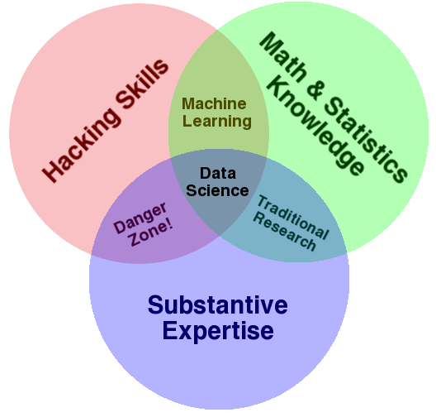
Data Science – One Definition

Slide 23
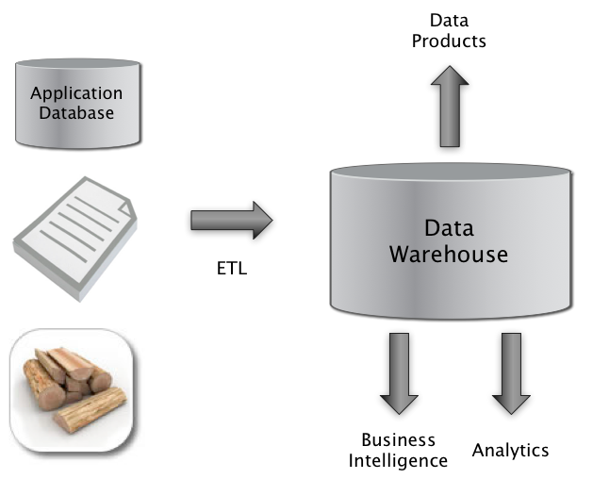
The Big Picture
Extract
Transform
Load

Slide 24
The Structure Spectrum
Structured (schema-first)
Semi-Structured (schema-later)
Unstructured (schema-never)
Relational Database
DocumentsXML
Plain Text
Media
Formatted Messages
Tagged Text/Media

Slide 25
Key Concept: Structured Data
A data model is a collection of concepts for describing data.
A schema is a description of a particular collection of data, using a given data model.

Slide 26

The Relational Model*
The Relational Model is Ubiquitous:
MySQL, PostgreSQL, Oracle, DB2, SQLServer, …
Foundational work done at
IBM - System R
UC Berkeley - Ingres
Object-oriented concepts have been merged in
Early work: POSTGRES research project at Berkeley
Informix, IBM DB2, Oracle 8i
Also has support for XML (semi-structured data)
E. F., “Ted” Codd
Turing Award 1981
*Codd, E. F. (1970). "A relational model of data for large shared data banks". Communications of the ACM 13 (6): 37

Slide 27
Relational Database: Definitions
Relational database: a set of relations
Relation: made up of 2 parts:
Schema : specifies name of relation, plus name and type of each column
Students(sid: string, name: string, login: string, age: integer, gpa: real)
Instance : the actual data at a given time
#rows = cardinality
#fields = degree / arity
A relation is a mathematical object (from set theory) which is true for certain arguments.
An instance defines the set of arguments for which the relation is true.

Slide 28
Ex: Instance of Students Relation
sid
name
login
age
gpa
536
6
6
Jones
jones
@c
s
18
3.4
536
8
8
Smith
smith@e
e
cs
18
3.2
536
5
0
Smith
smith
@m
ath
19
3.8
Cardinality = 3, arity = 5 , all rows distinct
The relation is true for these tuples and false for others

Slide 29
SQL - A language for Relational DBs*
SQL = Structured Query Language
Data Definition Language (DDL)
create, modify, delete relations
specify constraints
administer users, security, etc.
Data Manipulation Language (DML)
Specify queries to find tuples that satisfy criteria
add, modify, remove tuples
The DBMS is responsible for efficient evaluation.
* Developed at IBM by Donald D. Chamberlin and Raymond F. Boyce in the 1970s. Used to be SEQUEL (Structured English QUEry Language)

Slide 30
Creating Relations in SQL
Create the Students relation.
Note: the type (domain) of each field is specified, and enforced by the DBMS whenever tuples are added or modified.
CREATE TABLE Students
(sid CHAR(20),
name CHAR(20),
login CHAR(10),
age INTEGER,
gpa FLOAT)

Slide 31
Table Creation (continued)
Another example: the Enrolled table holds information about courses students take.
CREATE TABLE Enrolled
(sid CHAR(20),
cid CHAR(20),
grade CHAR(2))

Slide 32
Adding and Deleting Tuples
Can insert a single tuple using:
INSERT INTO Students (sid, name, login, age, gpa)
VALUES ('53688', 'Smith', 'smith@ee', 18, 3.2)
Can delete all tuples satisfying some condition (e.g., name = Smith):
DELETE
FROM Students S
WHERE S.name = 'Smith'

Slide 33
Queries in SQL
Single-table queries are straightforward.
To find all 18 year old students, we can write:
SELECT *
FROM Students S
WHERE S.age=18
To find just names and logins, replace the first line:
SELECT S.name, S.login

Slide 34
Querying Multiple Relations
Can specify a join over two tables as follows:
SELECT S.name, E.cid
FROM Students S, Enrolled E
WHERE S.sid=E.sid AND E.grade=‘B'
S
sid | cid | grade
53831 | Carnatic101 | C
53831 | Reggae203 | B
53650 | Topology112 | A
53666 | History105 | B
E
sid | name | login | age | gpa
53831 | Jones | jones@cs | 18 | 3.4
53831 | Smith | smith@ee | 18 | 3.2
Note: no referential integrity constraints have been used here.
S.name | E.cid
Jones | History105
result =

Slide 35
Basic SQL Query
SELECT [DISTINCT] target-list
FROM relation-list
WHERE qualification
relation-list : A list of relation names
possibly with a range-variable after each name
target-list : A list of attributes of tables in relation-list
qualification : Comparisons combined using AND, OR and NOT.
Comparisons are Attr op const or Attr1 op Attr2, where op is one of =≠<>≤≥
DISTINCT: optional keyword indicating that the answer should not contain duplicates.
In SQL SELECT, the default is that duplicates are not eliminated! (Result is called a “multiset”)

Slide 36
SQL Inner Joins
SELECT S.name, E.classid
FROM Students S (INNER) JOIN Enrolled E
ON S.sid=E.sid
S
S.name | S.sid
Jones | 11111
Smith | 22222
Brown | 33333
E
E.sid | E.classid
11111 | History105
11111 | DataScience194
22222 | French150
44444 | English10
S.name | E.classid
Jones | History105
Jones | DataScience194
Smith | French150
Note the previous version of this query (with no join keyword) is an “Implicit join”

Slide 37
SQL Inner Joins
SELECT S.name, E.classid
FROM Students S (INNER) JOIN Enrolled E
ON S.sid=E.sid
S
S.name | S.sid
Jones | 11111
Smith | 22222
Brown | 33333
E
E.sid | E.classid
11111 | History105
11111 | DataScience194
22222 | French150
44444 | English10
S.name | E.classid
Jones | History105
Jones | DataScience194
Smith | French150
Unmatched keys
Notes:
Missing (unmatched) key values

Slide 38
What kind of Join is this?
SELECT S.name, E.classid
FROM Students S ?? Enrolled E
ON S.sid=E.sid
S
S.name | S.sid
Jones | 11111
Smith | 22222
Brown | 33333
E
E.sid | E.classid
11111 | History105
11111 | DataScience194
22222 | French150
44444 | English10
S.name | E.classid
Jones | History105
Jones | DataScience194
Smith | French150
Brown | NULL
Notes:
Missing (unmatched) key values

Slide 39
SQL Joins
SELECT S.name, E.classid
FROM Students S LEFT OUTER JOIN Enrolled E
ON S.sid=E.sid
S
S.name | S.sid
Jones | 11111
Smith | 22222
Brown | 33333
E
E.sid | E.classid
11111 | History105
11111 | DataScience194
22222 | French150
44444 | English10
S.name | E.classid
Jones | History105
Jones | DataScience194
Smith | French150
Brown | NULL
Notes:
Missing (unmatched) key values

Slide 40
What kind of Join is this?
SELECT S.name, E.classid
FROM Students S ?? Enrolled E
ON S.sid=E.sid
S
S.name | S.sid
Jones | 11111
Smith | 22222
Brown | 33333
E
E.sid | E.classid
11111 | History105
11111 | DataScience194
22222 | French150
44444 | English10
S.name | E.classid
Jones | History105
Jones | DataScience194
Smith | French150
NULL | English10
Notes:
Missing (unmatched) key values

Slide 41
SQL Joins
SELECT S.name, E.classid
FROM Students S RIGHT OUTER JOIN Enrolled E
ON S.sid=E.sid
S
S.name | S.sid
Jones | 11111
Smith | 22222
Brown | 33333
E
E.sid | E.classid
11111 | History105
11111 | DataScience194
22222 | French150
44444 | English10
S.name | E.classid
Jones | History105
Jones | DataScience194
Smith | French150
NULL | English10
Notes:
Missing (unmatched) key values

Slide 42
What kind of Join is this?
SELECT S.name, E.classid
FROM Students S ?? Enrolled E
ON S.sid=E.sid
S
S.name | S.sid
Jones | 11111
Smith | 22222
Brown | 33333
E
E.sid | E.classid
11111 | History105
11111 | DataScience194
22222 | French150
44444 | English10
S.name | E.classid
Jones | History105
Smith | French150
Notes:
Missing (unmatched) key values

Slide 43
SQL Joins
SELECT S.name, E.classid
FROM Students S LEFT SEMI JOIN Enrolled E
ON S.sid=E.sid
S
S.name | S.sid
Jones | 11111
Smith | 22222
Brown | 33333
E
E.sid | E.classid
11111 | History105
11111 | DataScience194
22222 | French150
44444 | English10
S.name | E.classid
Jones | History105
Smith | French150
Notes:
Missing (unmatched) key values

Slide 44
What kind of Join is this?
SELECT *
FROM Students S ?? Enrolled E
S
S.name | S.sid
Jones | 11111
Smith | 22222
E
E.sid | E.classid
11111 | History105
11111 | DataScience194
22222 | French150
S.name | S.sid | E.sid | E.classid
Jones | 11111 | 11111 | History105
Jones | 11111 | 11111 | DataScience194
Jones | 11111 | 22222 | French150
Smith | 22222 | 11111 | History105
Smith | 22222 | 11111 | DataScience194
Smith | 22222 | 22222 | French150

Slide 45
SQL Joins
SELECT *
FROM Students S CROSS JOIN Enrolled E
S
S.name | S.sid
Jones | 11111
Smith | 22222
E
E.sid | E.classid
11111 | History105
11111 | DataScience194
22222 | French150
S.name | S.sid | E.sid | E.classid
Jones | 11111 | 11111 | History105
Jones | 11111 | 11111 | DataScience194
Jones | 11111 | 22222 | French150
Smith | 22222 | 11111 | History105
Smith | 22222 | 11111 | DataScience194
Smith | 22222 | 22222 | French150

Slide 46
What kind of Join is this?
SELECT *
FROM Students S, Enrolled E
WHERE S.sid <= E.sid
S
S.name | S.sid
Jones | 11111
Smith | 22222
E
E.sid | E.classid
11111 | History105
11111 | DataScience194
22222 | French150
S.name | S.sid | E.sid | E.classid
Jones | 11111 | 11111 | History105
Jones | 11111 | 11111 | DataScience194
Jones | 11111 | 22222 | French150
Smith | 22222 | 22222 | French150

Slide 47
Theta Joins
SELECT *
FROM Students S, Enrolled E
WHERE S.sid <= E.sid
S
S.name | S.sid
Jones | 11111
Smith | 22222
E
E.sid | E.classid
11111 | History105
11111 | DataScience194
22222 | French150
S.name | S.sid | E.sid | E.classid
Jones | 11111 | 11111 | History105
Jones | 11111 | 11111 | DataScience194
Jones | 11111 | 22222 | French150
Smith | 22222 | 22222 | French150

Slide 48
SQL Query Semantics
Semantics of an SQL query are defined in terms of the following conceptual evaluation strategy:
1. do FROM clause: compute cross-product of tables (e.g., Students and Enrolled).
2. do WHERE clause: Check conditions, discard tuples that fail. (i.e., “selection”).
3. do SELECT clause: Delete unwanted fields. (i.e., “projection”).
4. If DISTINCT specified, eliminate duplicate rows.
Probably the least efficient way to compute a query!
An optimizer will find more efficient strategies to get the same answer.

Slide 49
Data Model (Tabular)
SQLite
Table: fixed number of named columns of specified type
5 storage classes for columns
NULL
INTEGER
REAL
TEXT
BLOB
Data stored on disk in a single file in row-major order
Operations performed via sqlite3 shell

Slide 50
Other “Table-Like” Data ModelS

Slide 51
Pandas/Python
Series: a named, ordered dictionary
The keys of the dictionary are the indexes
Built on NumPy’s ndarray
Values can be any Numpy data type object
DataFrame: a table with named columns
Represented as a Dict (col_name -> series)
Each Series object represents a column

Slide 52
Operations
map() functions
filter (apply predicate to rows)
sort/group by
aggregate: sum, count, average, max, min
Pivot or reshape
Relational:
union, intersection, difference, cartesian product (CROSS JOIN)
select/filter, project
join: natural join (INNER JOIN), theta join, semi-join, etc.
rename

Slide 53
Matrices vs Databases
Tools like Pandas give up some of the important safety features of RDBMS (e.g. ACID), but can be much faster.
Matrix multiply in SQL:
SELECT A.row, B.col, SUM(A.value * B.value)
FROM A JOIN B
ON A.col = B.row
GROUP BY A.row, B.col
You probably never want to do this, but the opposite direction (relational aggregate query → matrix mult.) can be very useful.
A
row | col | value
1 | 1 | 5.7
3 | 1 | 3.2
2 | 2 | -5
B
row | col | value
2 | 1 | 12.0
3 | 3 | 5.1
Notes:
You would never want to do this, but it shows how you can instead convert some common relational queries to MM.

Slide 54
5 min break

Slide 55

What’s Wrong with Tables?
Too limited in structure?
Too rigid?
Too old fashioned?

Slide 56
What’s Wrong with (RDBMS) Tables?
Indices: Typical RDBMS table storage is mostly indices
Can’t afford this overhead for large datastores
Transactions:
Safe state changes require journals etc., and are slow
Relations:
Checking relations adds further overhead to updates
Sparse Data Support:
RDBMS Tables are very wasteful when data is very sparse
Very sparse data is common in modern data stores
RDBMS tables might have dozens of columns, modern data stores might have many thousands.

Slide 57
RDBMS tables – row based
Table:
Represented as:
sid | name | login | age | gpa
53831 | Jones | jones@cs | 18 | 3.4
53831 | Smith | smith@ee | 18 | 3.2
53831 | Jones | jones@cs | 18 | 3.4
53831 | Smith | smith@ee | 18 | 3.2

Slide 58
Tweet JSON Format

Slide 59
RDBMS tables – row based
Table:
Represented as:
ID | name | login | loc | locid | LAT | LONG | ALT | State
52841 | Jones | jones@cs | NULL | NULL | NULL | NULL | NULL | NULL
53831 | Smith | smith@ee | NULL | NULL | NULL | NULL | NULL | NULL
55541 | Brown | brown@ee | NULL | NULL | NULL | NULL | NULL | NULL
52841 | Jones | jones@cs | NULL | NULL | NULL | NULL | NULL | NULL
53831 | Smith | smith@ee | NULL | NULL | NULL | NULL | NULL | NULL
55541 | Brown | brown@ee | NULL | NULL | NULL | NULL | NULL | NULL

Slide 60
Column-based store
Table:
Represented as column (key-value) stores:
ID | name | login | loc | locid | LAT | LONG | ALT | State
52841 | Jones | jones@cs | Albany | 2341 | 38.4 | 122.7 | 100 | CA
53831 | Smith | smith@ee | NULL | NULL | NULL | NULL | NULL | NULL
55541 | Brown | brown@ee | NULL | NULL | NULL | NULL | NULL | NULL
ID | name
52841 | Jones
53831 | Smith
55541 | Brown
ID | login
52841 | jones@cs
53831 | smith@ee
55541 | brown@ee
ID | loc
52841 | Albany
ID | locid
52841 | 2341
ID | LAT
52841 | 38.4
ID | LONG
52841 | 122.7
…

Slide 61

Beyond Tables

Slide 62
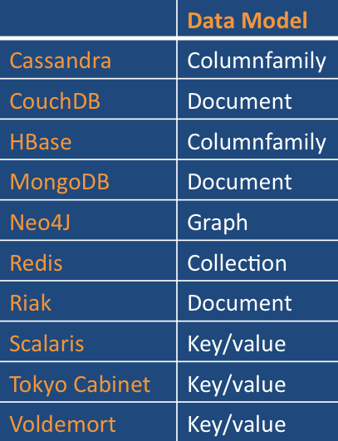
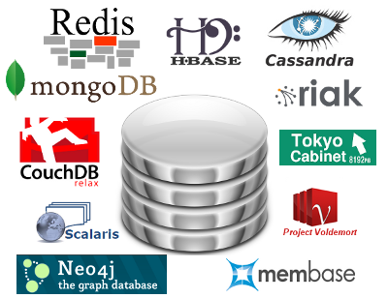
NoSQL Storage Systems

Slide 63
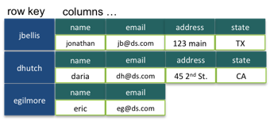
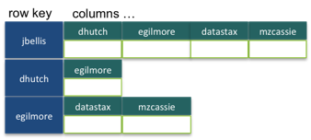
Column-Family Stores (Cassandra)
A column-family groups data columns together, and is analogous to a table.
Static column family from Apache Cassandra:
Dynamic Column family (Cassandra):

Slide 64
CouchDB Data Model (JSON)
“With CouchDB, no schema is enforced, so new document types with new meaning can be safely added alongside the old.”
A CouchDB document is an object that consists of named fields. Field values may be:
strings, numbers, dates,
ordered lists, associative maps
"Subject": "I like Plankton"
"Author": "Rusty"
"PostedDate": "5/23/2006"
"Tags": ["plankton", "baseball", "decisions"]
"Body": "I decided today that I don't like baseball. I like plankton."

Slide 65
Prerequisites for “Schemaless” DBs
Need external and internal representations for all data types that will be used.
Internal: a dynamically-typed, object-oriented language (like Java)
External: an extensible data description language: JSON or XML
For Performance: Fast SerDe (Serialization and DeSerialization) so internal data structures can be efficiently pushed or extracted from disk or network.

Slide 66
JSON format
{ "firstName": "John",
"lastName": "Smith",
"isAlive": true,
"age": 25,
"height_cm": 167.6,
"address": {
"streetAddress": "21 2nd Street",
"city": "New York",
"state": "NY",
"postalCode": "10021-3100"
}
}

Slide 67
Prerequisites for “Schemaless” DBs
JSON includes named fields in a tree structure. Primitive types (e.g. string, number, boolean,…) are implicit.
We can read JSON data (or XML) and automatically create internal representations for complex data.
Using the field names and object structure, we can query these objects once loaded.

Slide 68

Pig
Started at Yahoo! Research
Runs about 50% of Yahoo!’s jobs
Features:
Expresses sequences of MapReduce jobs
Data model: nested “bags” of items
Schema is optional
Provides relational (SQL) operators (JOIN, GROUP BY, etc)
Easy to plug in Java functions

Slide 69
An Example Problem
Suppose you have user data in one file, website data in another, and you need to find the top 5 most visited pages by users aged 18-25.
Load Users
Load Pages
Filter by age
Join on name
Group on url
Count clicks
Order by clicks
Take top 5
Example from http://wiki.apache.org/pig-data/attachments/PigTalksPapers/attachments/ApacheConEurope09.ppt

Slide 70
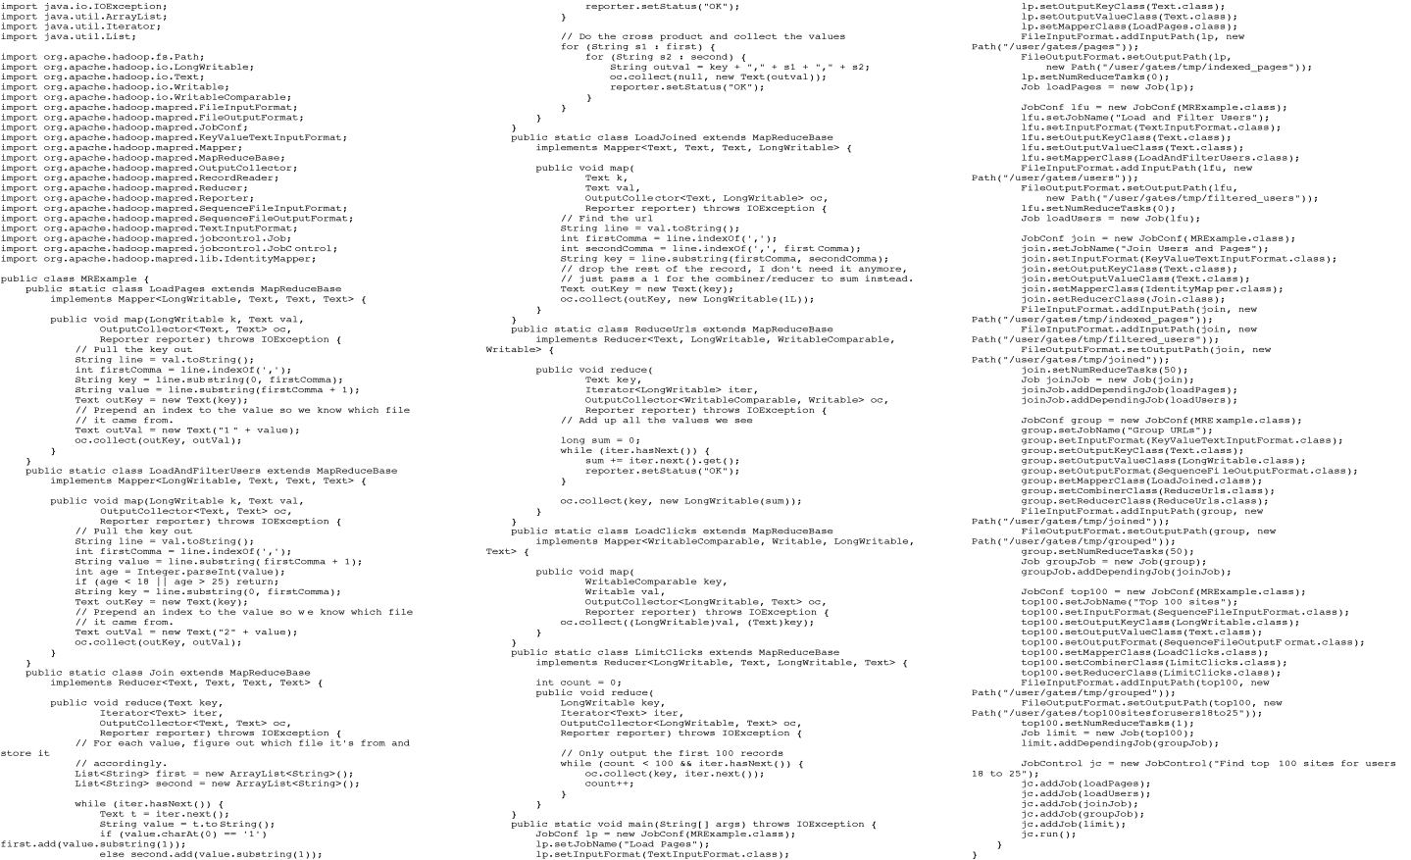
In MapReduce
Example from http://wiki.apache.org/pig-data/attachments/PigTalksPapers/attachments/ApacheConEurope09.ppt
Notes:
My point in putting in the java code isn’t too actually walk through it. It’s just to show that you have to hand code a fair amount of java. That way I can just point and say “look how much java you’d have to write to accomplish this”

Slide 71
In Pig Latin
Users = load ‘users’ as (name, age); Filtered = filter Users by age >= 18 and age <= 25; Pages = load ‘pages’ as (user, url); Joined = join Filtered by name, Pages by user; Grouped = group Joined by url; Summed = foreach Grouped generate group, count(Joined) as clicks; Sorted = order Summed by clicks desc; Top5 = limit Sorted 5;
store Top5 into ‘top5sites’;
Example from http://wiki.apache.org/pig-data/attachments/PigTalksPapers/attachments/ApacheConEurope09.ppt
Notes:
Rather than using capital letters, which makes Pig Latin look like SQL, I added Eclipse style highlighting instead. Hopefully this makes clear what are the key words without making it look like a Matisse painting.

Slide 72

Hive
Developed at Facebook
Relational database built on Hadoop
Maintains table schemas
SQL-like query language (which can also call Hadoop Streaming scripts)
Supports table partitioning, complex data types, sampling, some query optimization
Used for most Facebook jobs
Less than 1% of daily jobs at Facebook use MapReduce directly!!! (SQL – or PIG – wins!)
Note: Google also has several SQL-like systems in use.

Slide 73
DATAspaces – What are they?

Slide 74
Dataspaces
Inclusive
Deal with all the data of interest – in whatever form
Co-existence not Integration
No integrated schema, no single warehouse, no ownership required
Pay-as-you-go
Keyword search is bare minimum.
More function and increased consistency as you add work.
Notes:
“Data everywhere”
autonomous data sources
Some identifiable scope, perhaps defined by requirements
Contact information on my cellphone and sensor readings off the Oregon coast aren’t a dataspace…

Slide 75
Compare to Data Integration
A quintessential schema-first approach.
Mediated Schema
Semantic mappings
wrapper
wrapper
wrapper
wrapper
wrapper
Courtesy of Alon Halevy

Slide 76
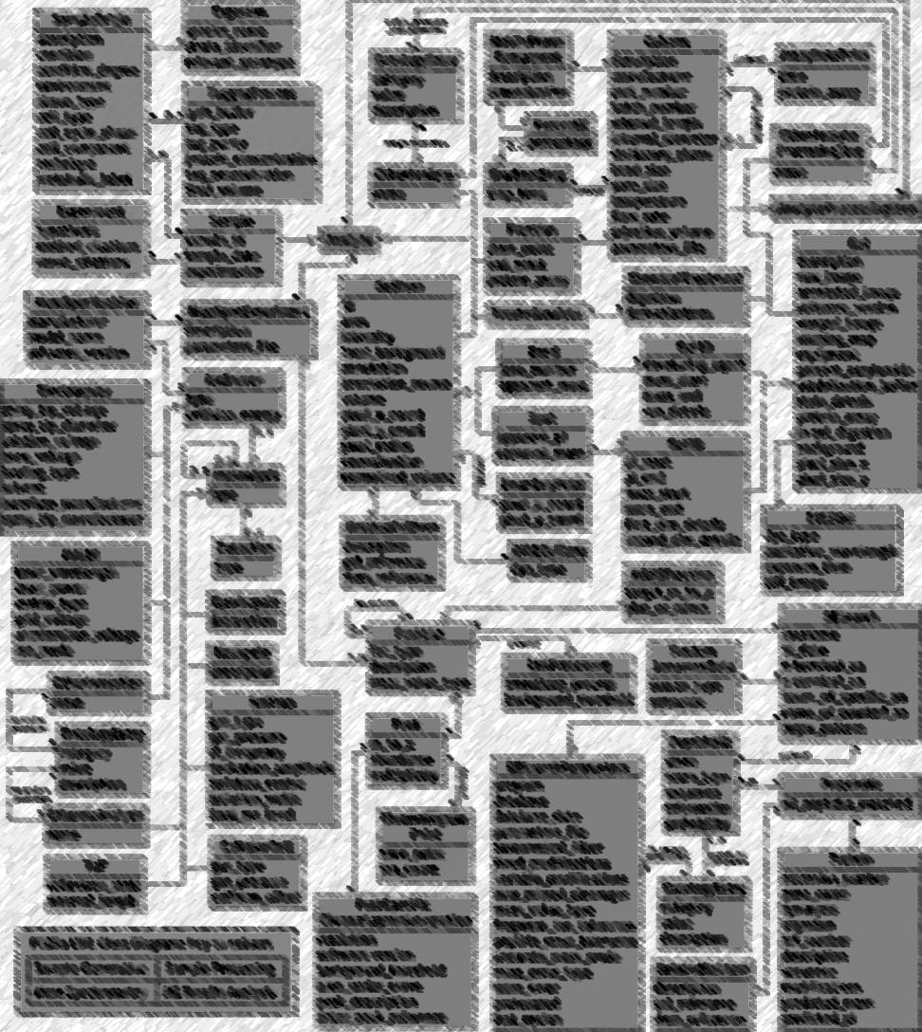
Whither Structured Data?
Conventional Wisdom:
only 20% of data is structured.
Decreasing due to:
Consumer applications
Enterprise search
Media applications

Slide 77
An Alternative View
Weak
Web Search
Virtual Organization
Administrative
Control
Federated DBMS
Desktop Search
Strong
DBMS
Strong
Weak
Semantic Integration

Slide 78
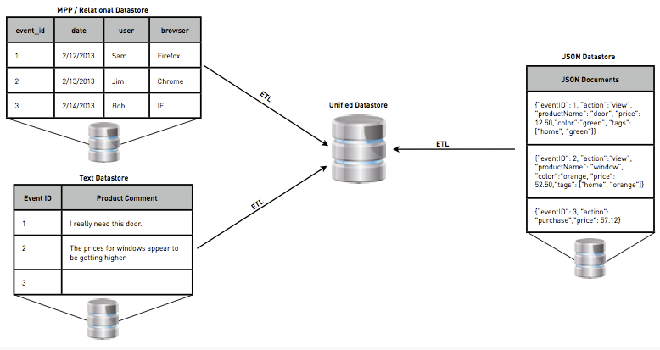
A Recent Example
Hadapt’s “Schemaless SQL”

Slide 79
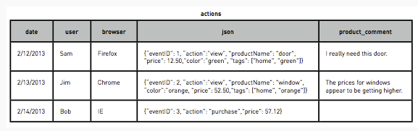
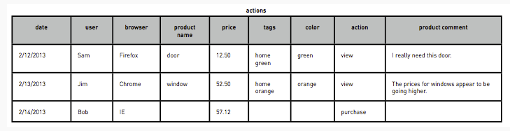
A Recent Example
Hadapt’s “Schemaless SQL”

Slide 80
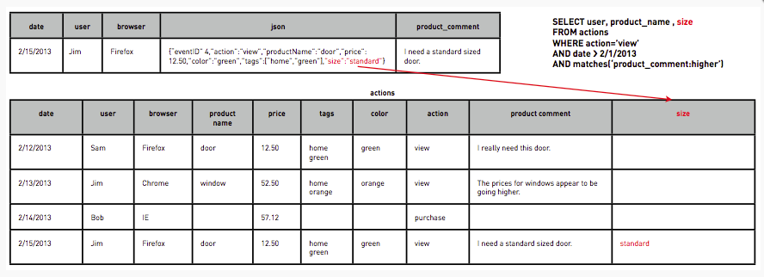
“Schemaless SQL”
Schema Evolution – adding a column

Slide 81
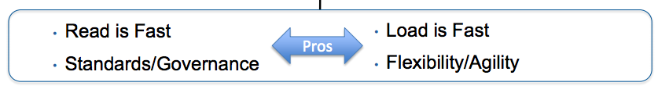
Not “IF” But “WHEN”?
“Schema on Write”
Traditional Approach
“Schema on Read”
Data is simply copied to the file store, no transformation is needed.
A SerDe (Serializer/Deserlizer) is applied during read time to extract the required columns (late binding)
New data can start flowing anytime and will appear retroactively once the SerDe is updated to parse it.

Slide 82
Summary
Data Models, Tables, Structure, etc.
SQL
NoSQL
Schema on Read vs. Schema on Write
Pandas lab

