Slide 1
Artificial Intelligence

Slide 2
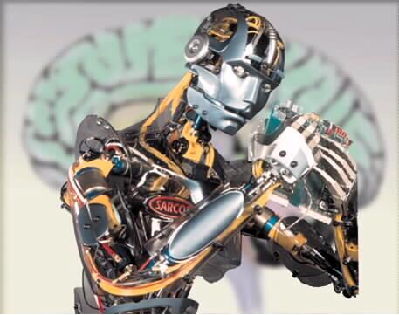
Machine Learning
Machine learning involves adaptive mechanisms that enable computers to:
  Learn from experience
  Learn by example
  Learn by analogy
Learning capabilities improve the performance
of intelligent systems over time

Slide 3
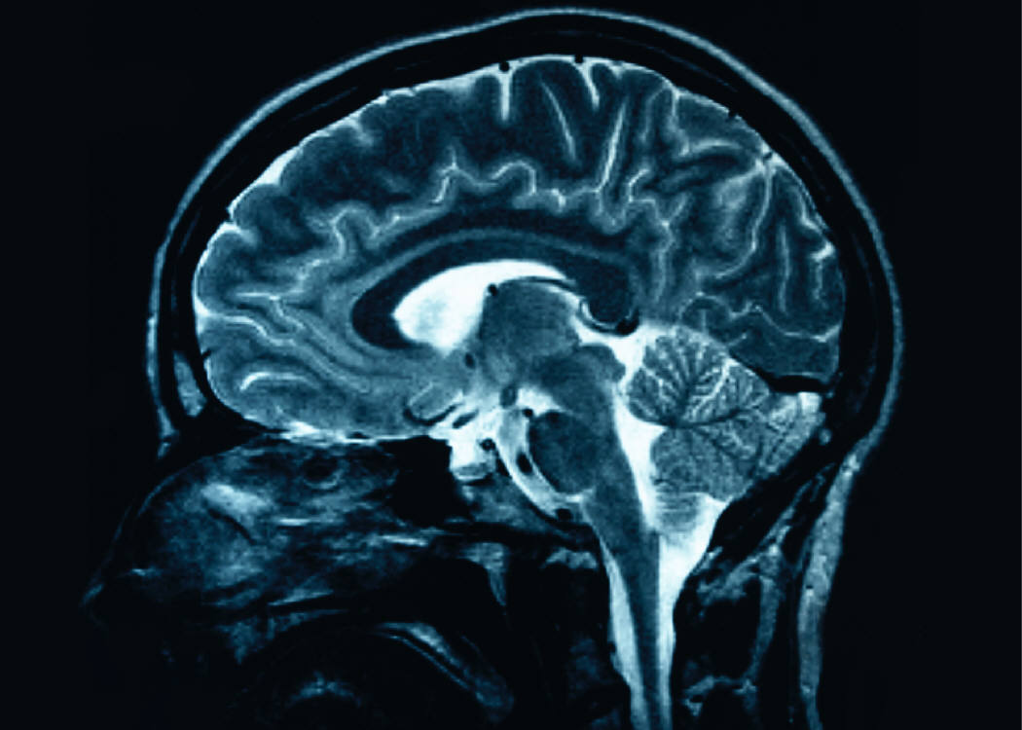
The Brain
How do brains work?
  How do human brains differ from that
  of other animals?
Can we base models of
artificial intelligence on
the structure and inner
workings of the brain?

Slide 4
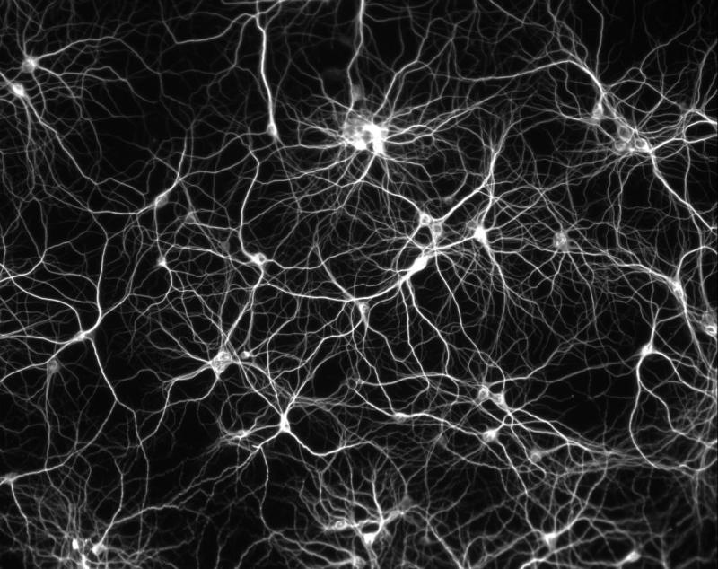
The Brain
The human brain consists of:
  Approximately 10 billion neurons
  …and 60 trillion connections
The brain is a highly complex, nonlinear,
parallel information-processing system
  By firing neurons simultaneously, the brain performs faster than the fastest computers in existence today

Slide 5
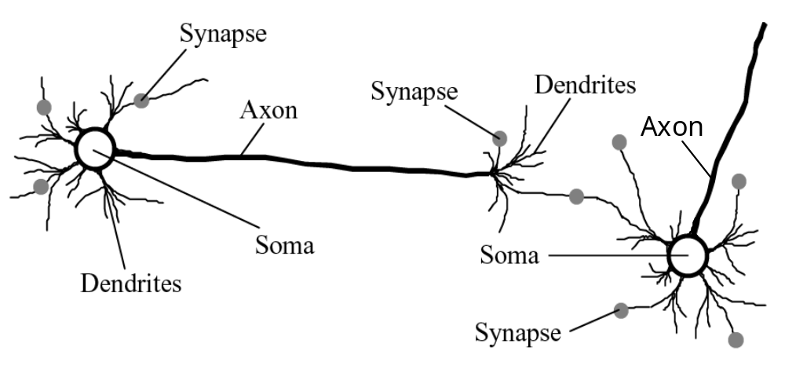
The Brain
Building blocks of the human brain:

Slide 6
The Brain
An individual neuron has a very simple structure
  Cell body is called a soma
  Small connective fibers are called dendrites
  Single long fibers are called axons
An army of such elements constitutes tremendous processing power

Slide 7
Artificial Neural Networks
An artificial neural network consists of a number
of very simple processors called neurons
  Neurons are connected
  by weighted links
  The links pass signals from
  one neuron to another based
  on predefined thresholds

Slide 8
Artificial Neural Networks
An individual neuron (McCulloch & Pitts, 1943):
  Computes the weighted sum of the input signals
  Compares the result with a threshold value, θ
  If the net input is less than the threshold,
  the neuron output is –1 (or 0)
  Otherwise, the neuron becomes activated
  and its output is +1

Slide 9
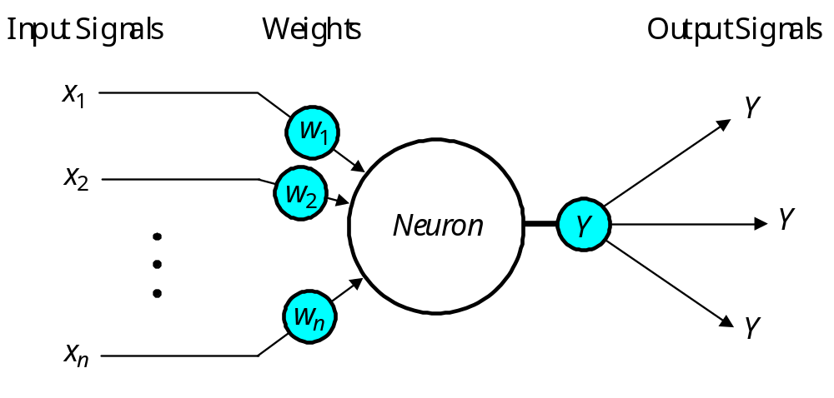
Artificial Neural Networks
Θ
X = x₁w₁ + x₂w₂ + ... + x_{n}w_{n}
threshold

Slide 10
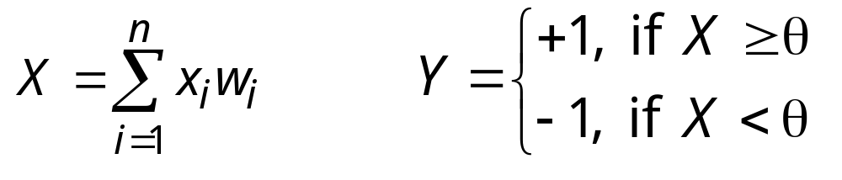
Activation Functions
Individual neurons adhere to an activation function, which determines whether they propagate their signal (i.e. activate) or not:
  Sign Function

Slide 11
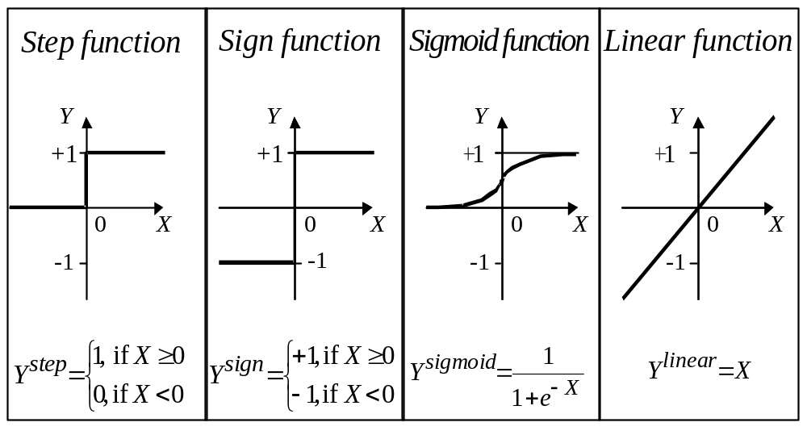
Activation Functions
hard limit functions

Slide 12

Activation Functions
Write functions or methods for the
activation functions on the previous slide
The step, sign, and sigmoid activation functions
are also often called hard limit functions
We use such functions in
decision-making neural networks
  Support classification and
  other pattern recognition tasks

Slide 13
Perceptrons
Can an individual neuron learn?
  In 1958, Frank Rosenblatt introduced a
  training algorithm that provided the
  first procedure for training a
  single-node neural network
  Rosenblatt’s perceptron model consists
  of a single neuron with adjustable
  synaptic weights, followed by a hard limiter

Slide 14
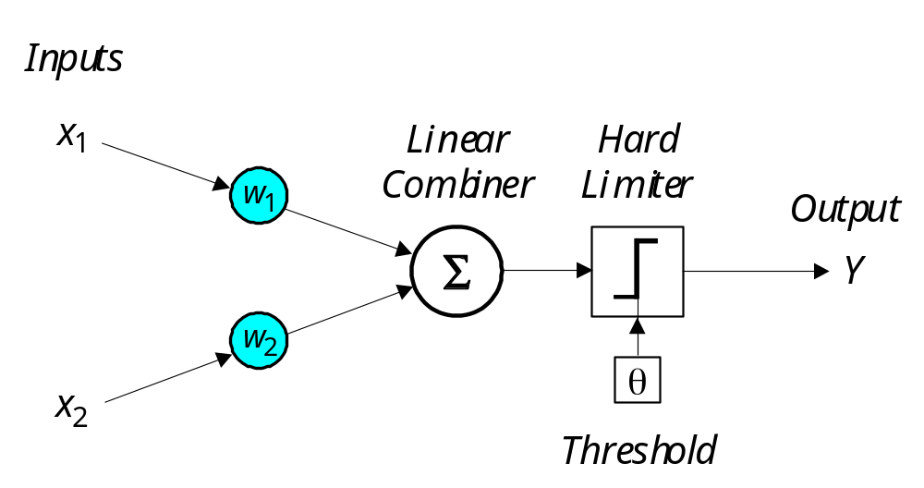
Perceptrons
Write code for a single two-input neuron – (see below)
Set w₁, w₂, and Θ through trial and error
to obtain a logical AND of inputs x₁ and x₂
X = x₁w₁ + x₂w₂
Y = Y^{step}

Slide 15
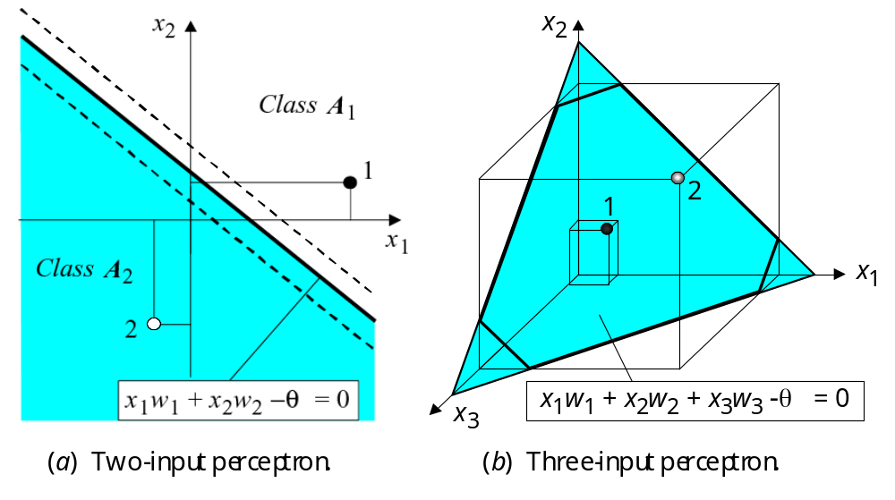
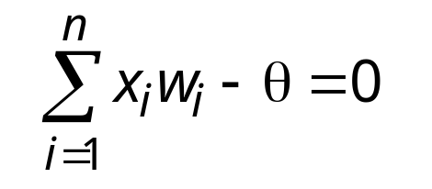
Perceptrons
A perceptron:
  Classifies inputs x₁, x₂, ..., x_{n}
  into one of two distinct
  classes A₁ and A₂
  Forms a linearly separable
  function defined by:

Slide 16
Perceptrons
Perceptron with three
inputs x₁, x₂, and x₃
classifies its inputs
into two distinct
sets A₁ and A₂

Slide 17

Perceptrons
How does a perceptron learn?
  A perceptron has initial (often random) weights typically in the range [-0.5, 0.5]
  Apply an established training dataset
  Calculate the error as
  expected output minus actual output:
    error e = Y_{expected} – Y_{actual}
  Adjust the weights to reduce the error

Slide 18

Perceptrons
How do we adjust a perceptron’s
weights to produce Y_{expected}?
  If e is positive, we need to increase Y_{actual} (and vice versa)
  Use this formula:
  , where and
    α is the learning rate (between 0 and 1)
    e is the calculated error
w_{i} = w_{i} + Δw_{i}
Δw_{i} = α x x_{i} x e

Slide 19
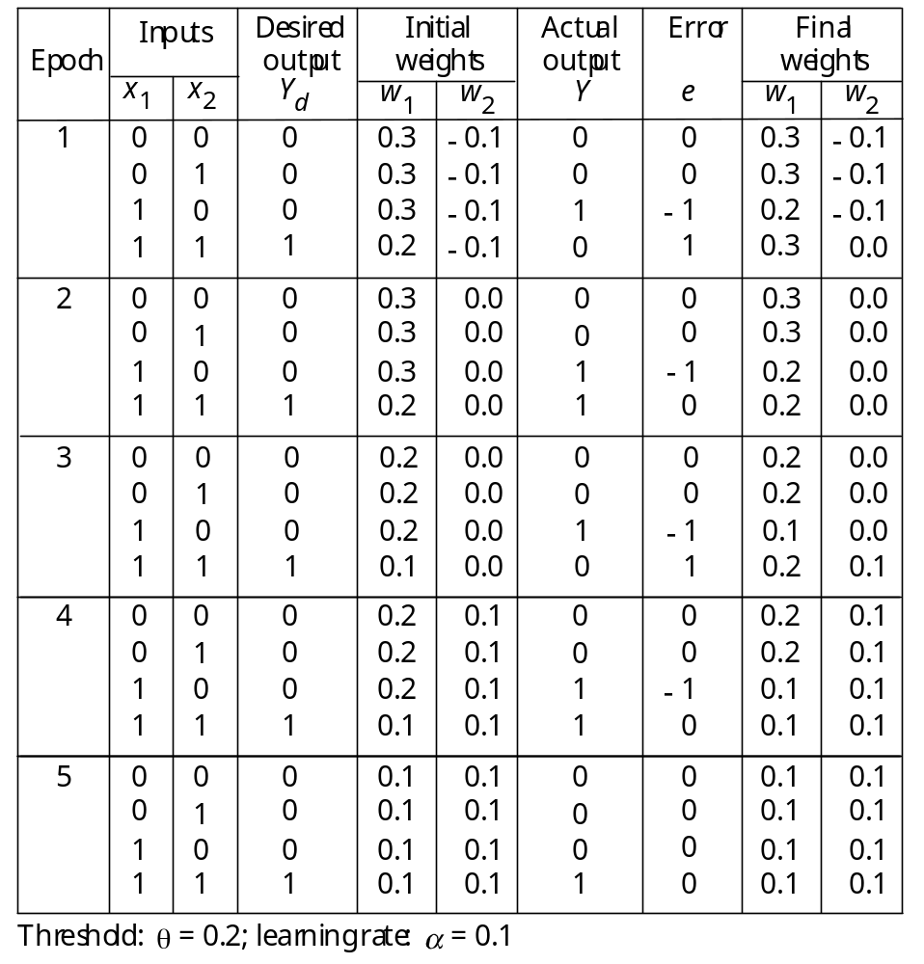
Perceptron Example – AND
Use threshold Θ = 0.2 and
learning rate α = 0.1
Train a perceptron to recognize logical AND

Slide 20
Perceptron Example – AND
Use threshold Θ = 0.2 and
learning rate α = 0.1
Train a perceptron to recognize logical AND

Slide 21
Perceptron Example – AND
Use threshold Θ = 0.2 and
learning rate α = 0.1
Repeat until convergence
  i.e. final weights do not change and no error

Slide 22
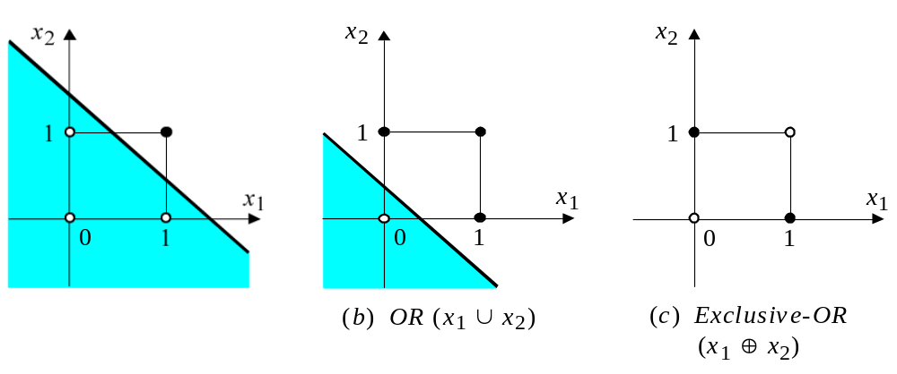
Perceptron Example – AND
Two-dimensional plot
of logical AND operation:
A single perceptron can
be trained to recognize
any linear separable function
  Can we train a perceptron to
  recognize logical OR?
  How about logical exclusive-OR (i.e. XOR)?

Slide 23


Perceptron – OR and XOR
Two-dimensional plots of logical OR and XOR:

Slide 24

Perceptron Coding Exercise
Modify your code to:
  Calculate the error at each step
  Modify weights, if necessary
    i.e. if error is non-zero
  Loop until all error values are zero
  for a full epoch
Modify your code to learn to recognize the logical OR operation
  Try to recognize the XOR operation....

Slide 25
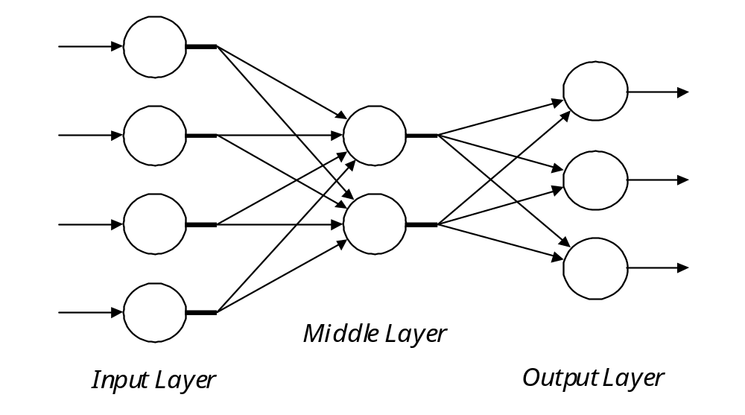
Multilayer Neural Networks
Multilayer neural networks consist of:
  An input layer of source neurons
  One or more hidden layers of
  computational neurons
  An output layer of more
  computational neurons
Input signals are propagated in a
layer-by-layer feedforward manner

Slide 26
Multilayer Neural Networks
I n p u t S i g n a l s
O u t p u t S i g n a l s

Slide 27
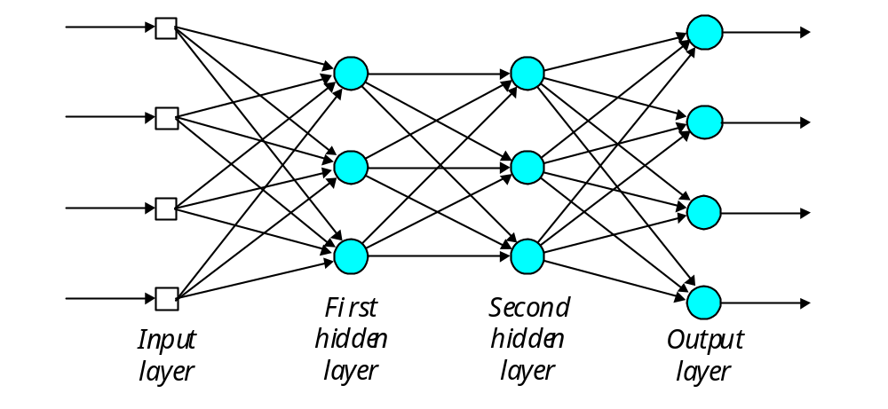
Multilayer Neural Networks
I n p u t S i g n a l s
O u t p u t S i g n a l s

Slide 28
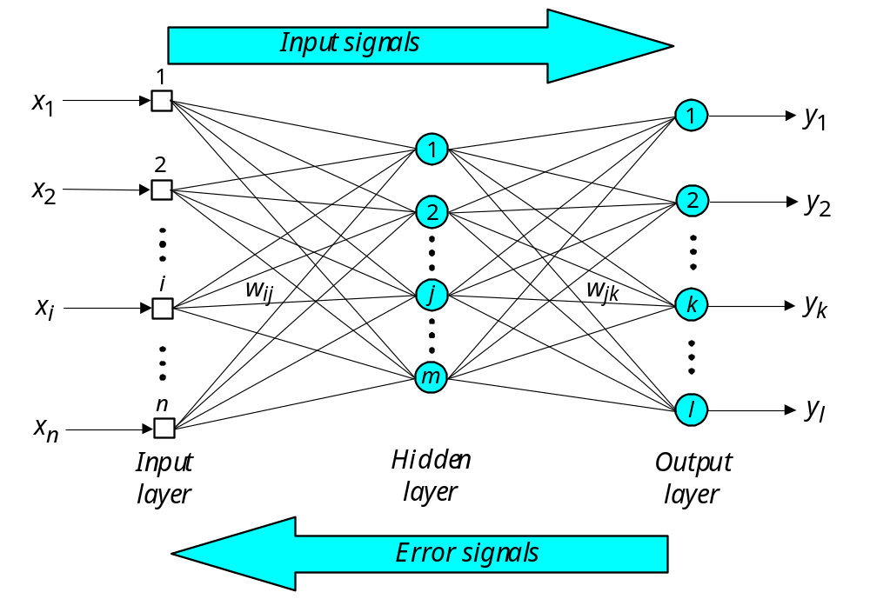
Multilayer Neural Networks
X_{OUTPUT} = y_{H1}w₁₁ + y_{H2}w₂₁ + ... + y_{Hj}w_{j1} + ... + y_{Hm}w_{m1}
X_{INPUT} = x₁
X_{H} = x₁w₁₁ + x₂w₂₁ + ... + x_{i}w_{i1} + ... + x_{n}w_{n1}

Slide 29
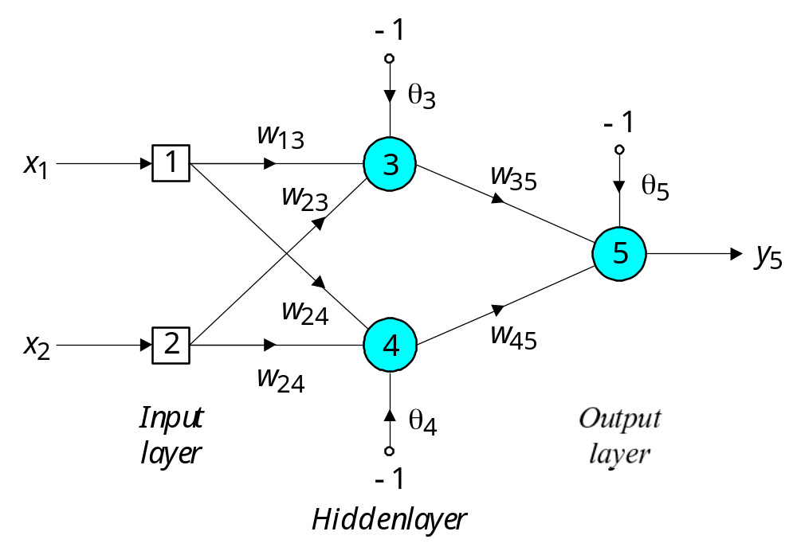
Multilayer Neural Networks
Three-layer network:
w₁₄

Slide 30

Multilayer Neural Networks
Commercial-quality neural networks often incorporate 4 or more layers
  Each layer consists of
  about 10-1000 individual neurons
Experimental and research-based neural networks often use 5 or 6 (or more) layers
  Overall, millions of individual neurons may be used

Slide 31

Back-Propagation NNs
A back-propagation neural network is a multilayer neural network that propagates error backwards through the network as it learns
  Weights are modified based on the calculated error
  Training is complete when the error is
  below a specified threshold
    e.g. less than 0.001

Slide 32
Back-Propagation NNs

Slide 33
Back-Propagation NNs
Write code for the three-layer neural network below
Use the sigmoid activation function; and
apply Θ by connecting fixed input -1 to weight Θ
w₁₄

Slide 34
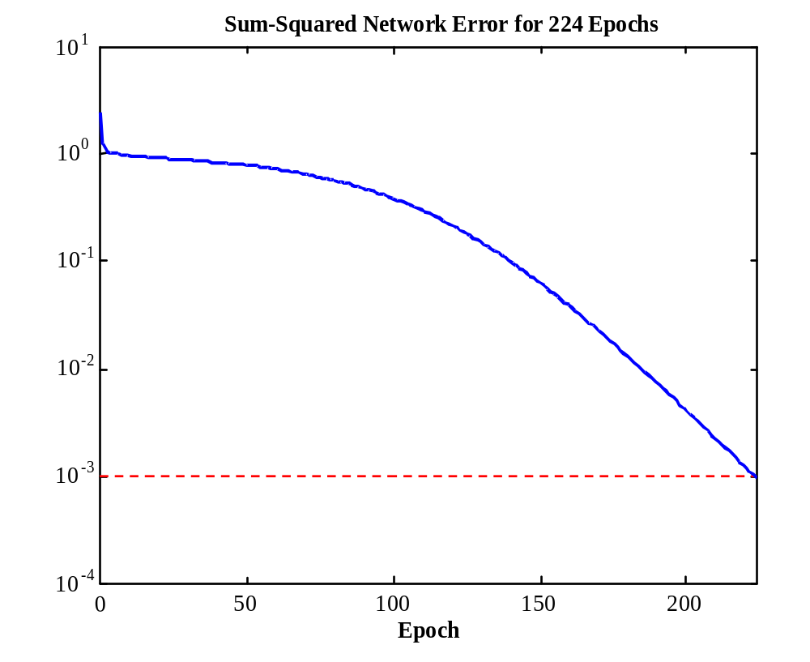
Back-Propagation NNs
Start with
random weights
  Repeat until
  the sum of the
  squared errors
  is below 0.001
  Depending on
  initial weights,
  final converged
  results may vary
Sum-Squared Error

Slide 35
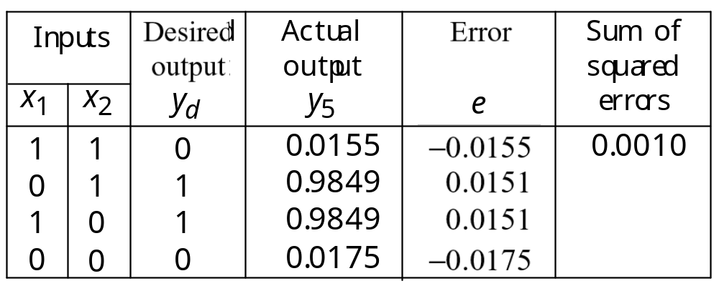
Back-Propagation NNs
After 224 epochs (896 individual iterations),
the neural network has been trained successfully:

Slide 36
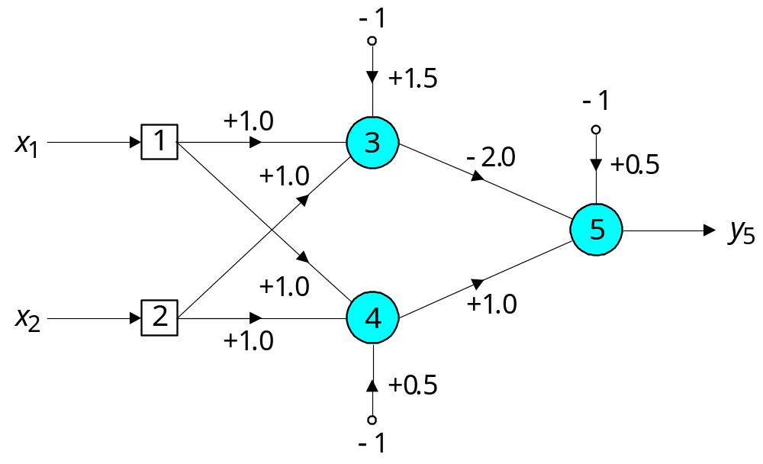
Back-Propagation NNs
No longer limited to linearly separable functions
Another solution:
  Isolate neuron 3,
  then neuron 4....

Slide 37
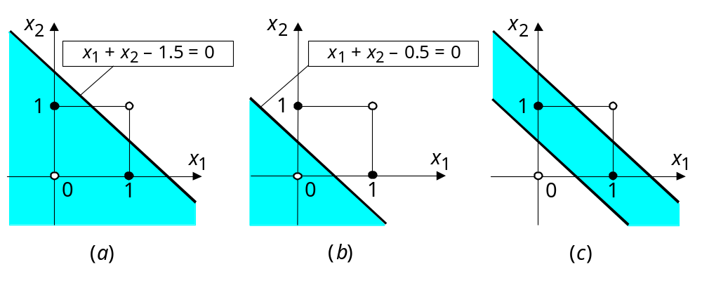
Back-Propagation NNs
Combine linearly separable functions of neurons 3 and 4:

Slide 38
Using Neural Networks
Handwriting recognition
0
4
4
A
1
0100 => 4
0
0101 => 5
0110 => 6
0111 => 7
etc.
0

Slide 39
Using Neural Networks
Advantages of neural networks:
  Given a training dataset, neural networks learn
  Powerful classification and pattern matching applications
Drawbacks of neural networks:
  Solution is a “black box”
  Computationally intensive

