Slide 2
Data: numbers with context
Degrees: today’s highest temperature
Year old: age of a cancer patient when the cancer was diagnosed
Kilograms: weight of an adult
Seconds: how long a study participant can hold the plank position
70

Slide 3

An individual in a study: from individuals to statistics
Gender: Male
Q: Is it a good time to find a job? “yes”
height: 70 inches
Education, income, social behaviors

Slide 4

An individual in a study: from individuals to statistics
Variables
individual | Gender | Height | Education
1 | Male | 70 | College
2 | Female | 68 | College
3 | Male | 69 | High School
…

Slide 5
Data: numbers with context
Categorical: the values represent different categories for the individuals’ do not have arithmetical meaning
Quantitative: the values represent numerical quantities that can be ordered and averaged
Ordinal: the values represent ordered categories: such as “How often do you exercise?”: Everyday, frequently, sometimes, rarely, never.

Slide 6
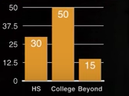
An individual in a study: from individuals to statistics
Variables
individual | Gender | Height | Education
1 | Male | 70 | College
2 | Female | 68 | College
3 | Male | 69 | High School
…
High school | college | Beyond college
20 | 50 | 15

Slide 7
Statistics are
Summaries of numerical data
Do NOT tell the whole story
Useful and meaningful

Slide 8
Displaying Categorical variable
For categorical variables, we summarize the data using the counts of observed occurrences of each value
Alternatively we can use percentage or proportion

Slide 9
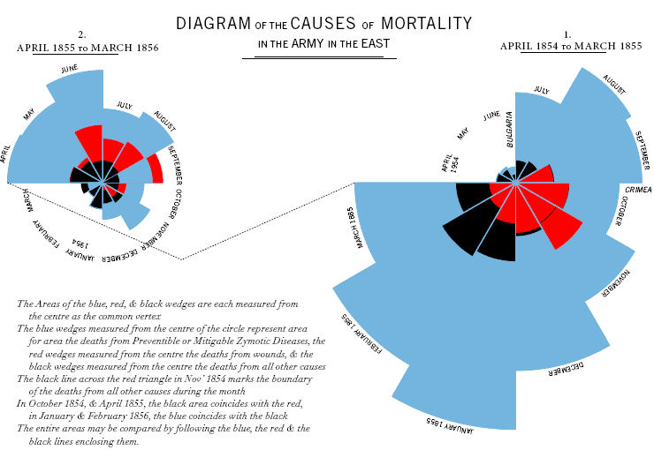
Pie chart

Slide 10
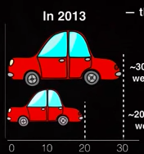
Area Principle
In 2013
The size of the area correlates with the data summaries
30% of accidental deaths of males were due to automobile accidents
20% of accidental deaths of females were due to automobile accidents.

Slide 11
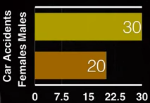
Area Principle
In 2013
The size of the area correlates with the data summaries
30% of accidental deaths of males were due to automobile accidents
20% of accidental deaths of females were due to automobile accidents.

Slide 12
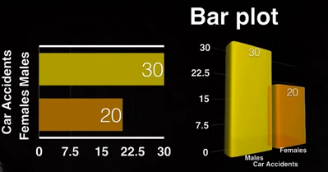
Bar Plot

Slide 13
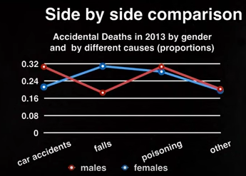
Side by side comparison

Slide 14
Displaying quantitative variable
For quantitative variables, we also summarize the data using the counts of observed occurrences of values
Different from categorical variables, we may count occurrences within intervals rather than individual values
We also use percentage or proportion

Slide 15
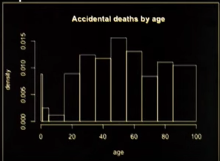
Displaying quantitative variable
Area of each bar
(the height of the bar multiplied by the width of the interval)
The proportion of death in the corresponding age interval
This is a histogram area principle also applies

