Slide 1
Statistics & probability 1
Summarize numerical data

Slide 2
Data: Center of variation
Summarizing center of variation
Mean (numerical average)
Median (mid-point)
When the data come with a few extremely large values
Mean is more affected by them than median.
Sensitive to outliers.

Slide 3
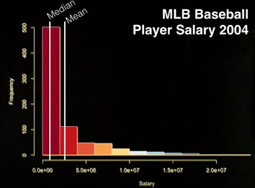
An individual in a study: from individuals to statistics

Slide 4


Standard Deviation as a yard stick
Abed is making 25k a year. The income in his city has a mean 20k and standard deviation of 4k
Abed is 1.25 standard deviation above the mean in his city
Mohamad is also making 25k a year. The income in his city has a mean 30k and a standard deviation of 5k.
Mohammad is 1 standard deviation below the mean in his city

Slide 5
Summarizing variation: Quantiles
Quantiles (or percentile): a value threshold of a variable that is defined to have a percent of data below it.
TOFEL critical reading, a score 600 is the 79th percentile.
A set of special percentiles are called quartiles, which corresponds to 25%, 50% and 75% percentiles.
Quartiles divide data into quarters

Slide 6
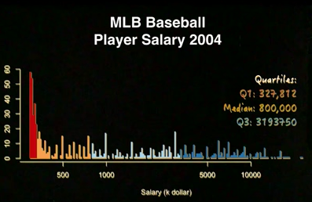
Summarizing variation: Quantiles

Slide 7
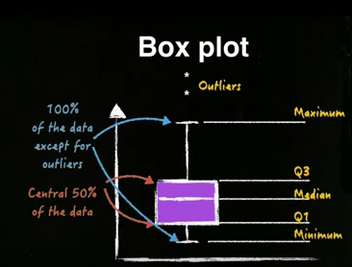
Summarizing variation: Quantiles

Slide 8
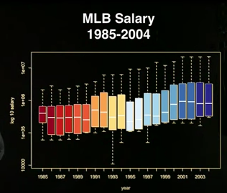
Summarizing variation: Quantiles

