Slide 1
Numerical Data: Association

Slide 2
Data: Measuring Association
Young adults: 96% use internet
Senior adults: 85% use internet
Difference in proportions
Relative risks
Odds ratio

Slide 3
Association: Categorical variable versus quantitative variable
Can be summarized by
  Distribution of the quantitative variable(Y)
  Given (or conditioning) on each value of the categorical variable(x)
If the two variables are associated, the distribution of y will be dependent on value x.

Slide 4
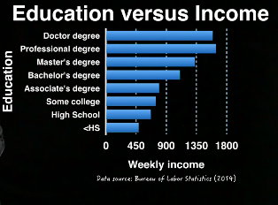
Measuring association
  <HS: on average $488 a week
  HS: on average $668 a week
Difference of the averages
Factor to consider in this comparison
Sampling variation

Slide 5
Association: quantitative variables
Pattern in the joint occurrence of values from the two variables
  Scatter plot
  Correlation
    No distinction between x and y
    Between -1 and 1
    Value 0 indicates weak linear association
    Correlation measures direction and strength for linear relations

