Slide 1
INTELLISHIFT SUMMIT · DATA ANALYTICS PROJECT
Retail Supply Chain
Business Intelligence System
From Fragmented Flat Files → Centralized BI Platform
Project Team
AbdelAziz Tantawi
Ahmed Ashraf
Ask
Prepare
Process
Analyze
Share
Act

Slide 2
01 ASK
Business Problem Statement
System & Data Integrity
Operational Blind Spots
Marketing Analytics Gap
Fragmented flat files & Excel spreadsheets create performance bottlenecks. Excessive data duplication in every transaction risks severe integrity failures and update inconsistencies.
No real-time visibility into shipping efficiency. Variance between Order Date and Ship Date across shipping modes is untracked, leading to reactive — not proactive — fulfillment management.
Unable to track Customer Lifetime Value or dynamically segment customers. Prevents targeted, data-driven campaigns and behavioral insight across 793 unique customers.
💡 Strategic Solution
Transition from manual flat-file management to a centralized relational database with automated ETL pipelines. This establishes a reliable single source of truth — enabling real-time BI, proactive marketing, and optimized operational efficiency.

Slide 3

02 PREPARE
Data Architecture & Schema Design
Fact_Sales
Sales_ID, Order_ID, Customer_ID, Location_ID, Product_ID, Ship_Mode, Order_Date, Ship_Date, Shipping_Days, Sales_Amount
Dim_Customer
Customer_ID (PK), Customer_Name, Segment
Dim_Product
Product_ID (PK), Product_Name, Category, Sub_Category
Dim_Location
Location_ID (PK), Postal_Code, City, State, Region
9,800 Source Rows
18 Original Columns
Star Schema Type
11 Null Rows Dropped

Slide 4
03 PROCESS
Python ETL Pipeline & Feature Engineering
1
Ingest & Inspect
4
Feature Engineering — CLV Segmentation
df = pd.read_csv('Data.csv')
df.info() # 9,800 rows × 18 cols
clv_df = df.groupby(['Customer ID'])['Sales'].sum()
# VIP >$5K | Regular $1K–$5K | Occasional <$1K
Loaded raw flat file. Identified mixed data types and missing Postal Code values.
Classified 793 customers: 113 VIP, 501 Regular, 179 Occasional based on lifetime spend.
2
Cleanse
5
Export
df.dropna(subset=['Postal Code'], inplace=True)
df['Order Date'] = pd.to_datetime(df['Order Date'], dayfirst=True)
df_segmented.to_csv('Cleaned_Data.csv', index=False)
Dropped 11 null rows. Converted Order Date & Ship Date from object → datetime.
Exported enriched dataset with Shipping_Days and Customer_Segment columns ready for Power BI.
3
Feature Engineering — Shipping Days
df['Shipping Days'] = (df['Ship Date'] - df['Order Date']).dt.days
Derived Shipping Days per order. Identified 214-day outlier (Wyoming) and computed true avg of 4.12 days.

Slide 5
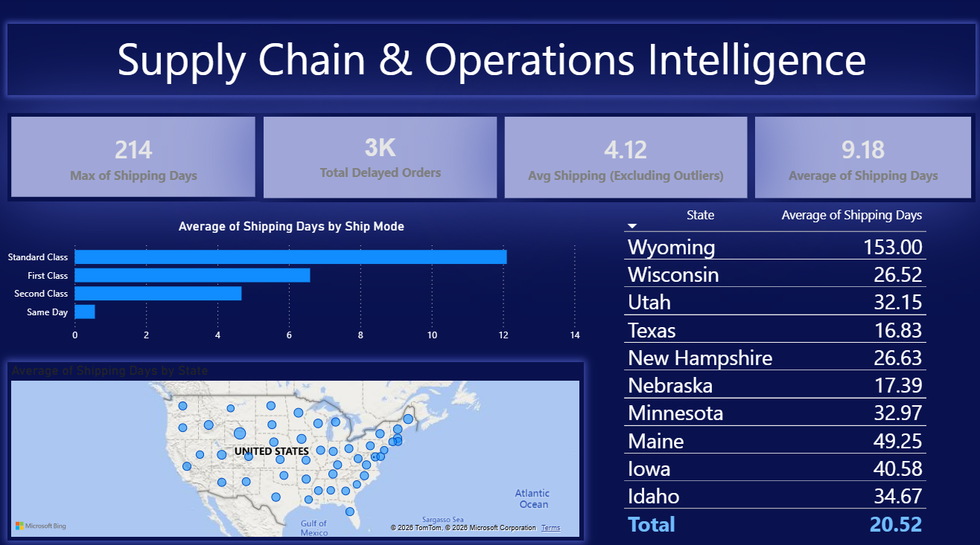
04 ANALYZE
Supply Chain & Operations Intelligence
🚨 214 Days Max
Wyoming outlier — requires immediate operational audit
✅ 4.12 Days True Avg
Accurate operational avg after excluding statistical outliers
⚡ Same Day: 0.04 Days
Fast-track fulfillment pipeline is working perfectly
~3K · Delayed Orders
9.18 · Avg Days Overall
153 · Wyoming Avg Days
Same Day · Fastest Mode

Slide 6
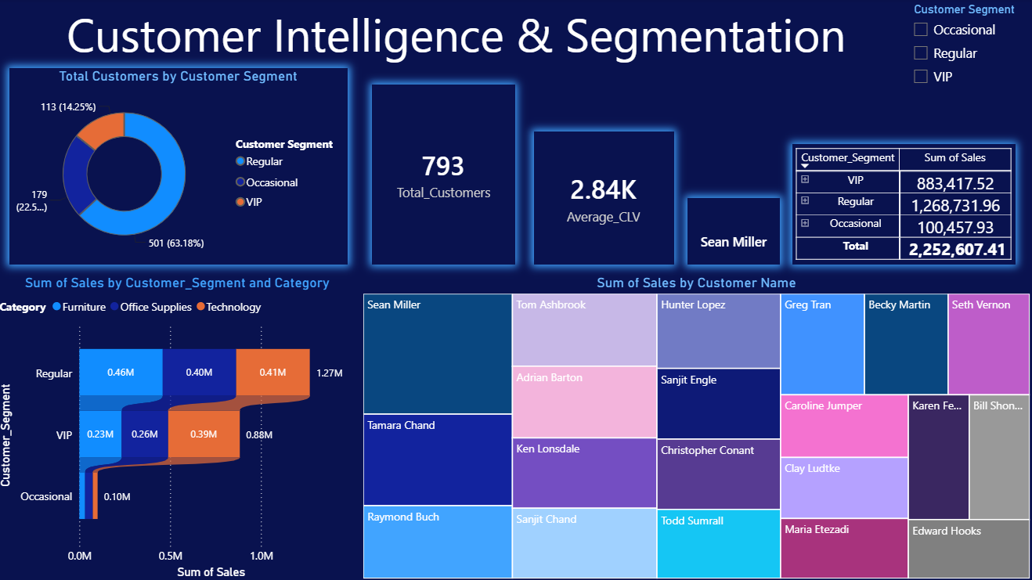
04 ANALYZE
Customer Intelligence & Segmentation
Regular
63.18%
501 customers · $1K – $5K CLV
VIP
14.25%
113 customers · CLV > $5K
Occasional
22.57%
179 customers · CLV < $1K
🏆 Top Whale: Sean Miller — $25,043.05

Slide 7
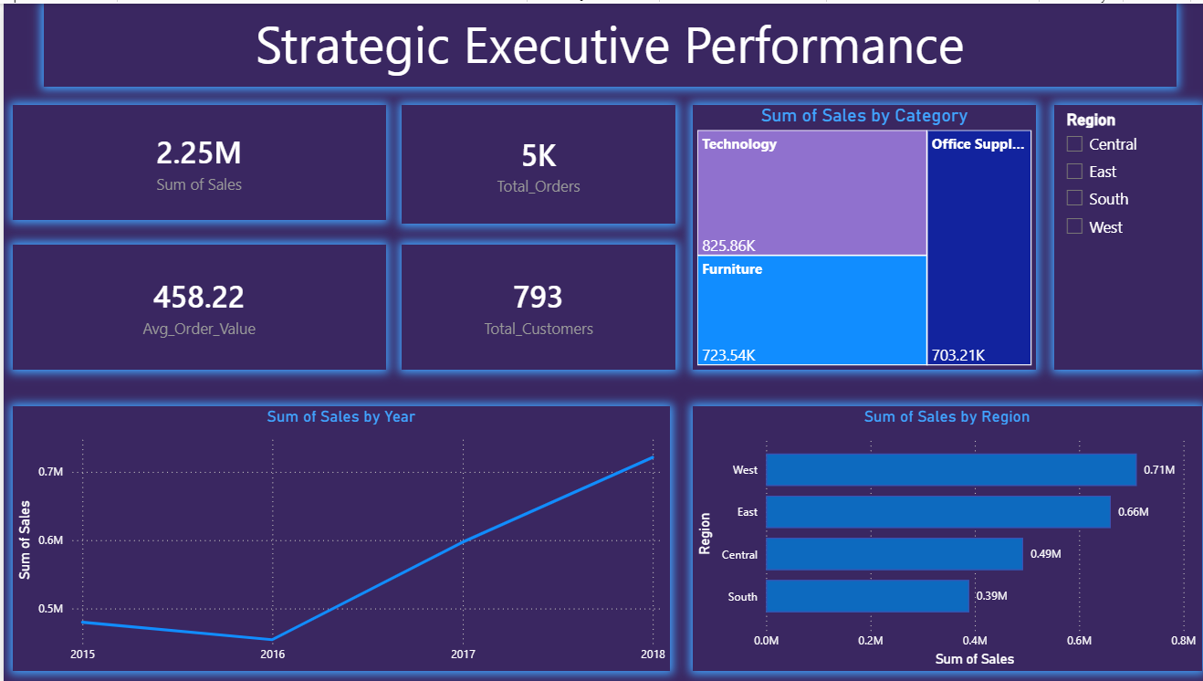
04 ANALYZE
Strategic Executive Performance
📈 Revenue Growth
+31.4%
2017 spike after 2016 contraction (-5.3%)
🌍 West + East
60%+
Combined regional dominance of total sales
💰 Total Revenue
$2.25M
Across 4,916 unique orders
⚖️ Balanced Mix
3 Cats
Tech / Furniture / Office — low concentration risk
DAX: Avg_Order_Value = DIVIDE(SUM(Sales), DISTINCTCOUNT(Order ID))

Slide 8
05 SHARE
Power BI Dashboard — Design & Delivery
Premium Dark Mode
3 Targeted Pages
Dark Navy/Black backgrounds with Electric Blue & Neon Purple glowing shadows for a modern tech / enterprise aesthetic aligned with IntelliShift brand.
Page 1: Supply Chain Ops · Page 2: Customer Intelligence · Page 3: Executive Performance — each built for a different audience.
Advanced Visuals
DAX Measures
Treemaps, Ribbon/Sankey-style charts, Geographic Bubble Map, Donut chart, interactive Slicers with Tile format, and hierarchical Drill-Down on Line Chart (Year → Month).
Custom DAX formulas for Total_Customers, Average_CLV, Total_Orders, and Avg_Order_Value — enabling dynamic, context-aware KPI cards.
All dashboards feature cross-page slicers by Region and Customer Segment for fully interactive executive storytelling

Slide 9
06 ACT
Strategic Recommendations
1
[Supply Chain] Audit Wyoming & High-Delay States
2
[Supply Chain] Optimize Standard Class Fulfillment
Launch immediate operational review for Wyoming (153-day avg) and the 5 states exceeding 30-day averages. Identify root causes: lost shipments, carrier failures, or data anomalies.
Standard Class (highest volume, 12+ day avg) is the single biggest drag on customer satisfaction. Renegotiate carrier SLAs or redistribute to regional warehouses.
Target: ≤7 day avg nationwide
Target: <5 day Standard avg
3
[Marketing] Activate VIP Retention Program
4
[Marketing] Re-engage Occasional Buyers
Deploy dedicated account managers and exclusive offers for 113 VIP customers ($883K revenue). Technology bundles (Machines + Phones) are their proven purchase drivers.
179 Occasional customers represent untapped revenue. Target with bundle incentives and cross-sell campaigns anchored on Office Supplies → Technology upgrade paths.
Goal: 0% VIP churn rate
Goal: Convert 20% to Regular
5
[Infrastructure] Deploy Full ETL Automation
6
[Strategy] Expand West & East Investment
Productionize the Python pipeline as a scheduled ETL job feeding the SQL star schema. Eliminate all manual Excel transfers and establish a single source of truth.
West ($710K) and East ($660K) drive 60%+ of revenue. Prioritize marketing spend and inventory positioning in these regions to sustain the 2018 growth trajectory.
Timeline: Q3 deployment
Goal: Grow share +15% YoY

Slide 10
INTELLISHIFT SUMMIT · DATA ANALYTICS PROJECT
Thank You
From Flat Files to Full Intelligence
Ask
Prepare
Process
Analyze
Share
Act
Defined 3 core business pain points
Designed star schema ERD
Python ETL + Feature Engineering
3-page Power BI dashboard suite
Premium dark-mode UX delivery
6 strategic recommendations
AbdelAziz Tantawi · Ahmed Ashraf · Mohamed Elsaid
Retail Supply Chain BI · IntelliShift Summit 2026

