Slide 1
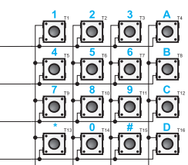

Slide 2
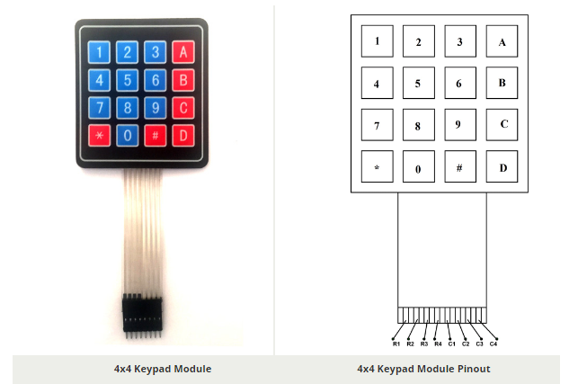

Slide 3
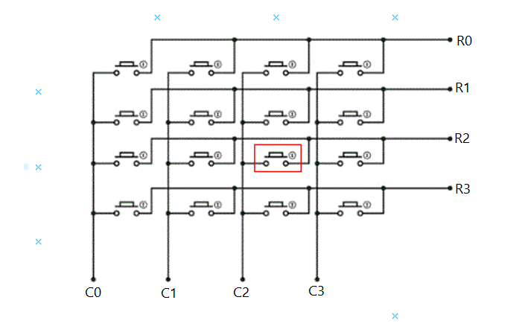

Slide 4
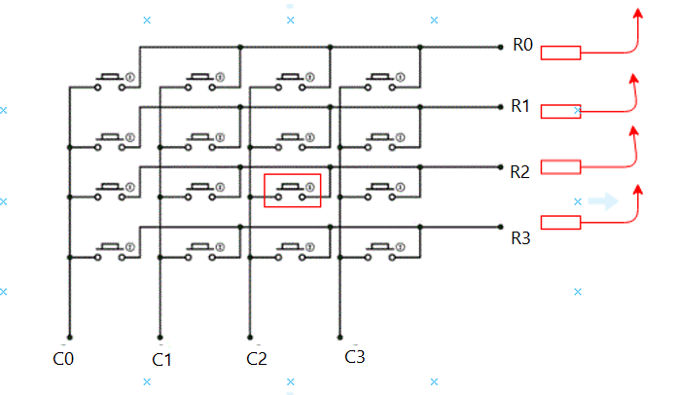

Slide 5
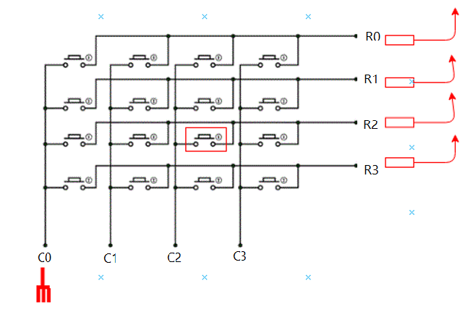

Slide 6
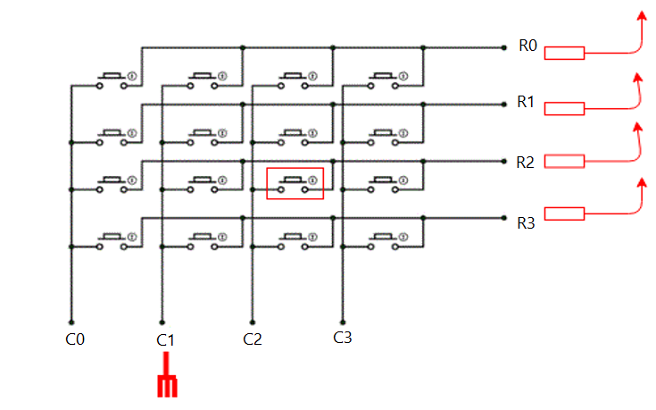

Slide 7
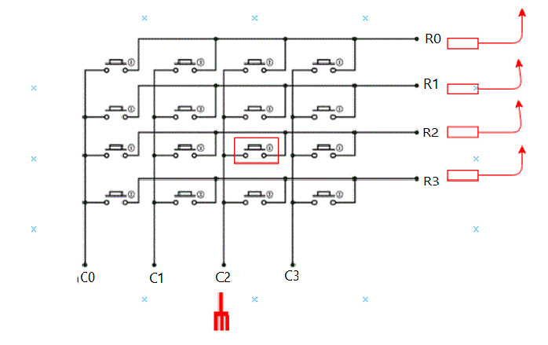

Slide 8
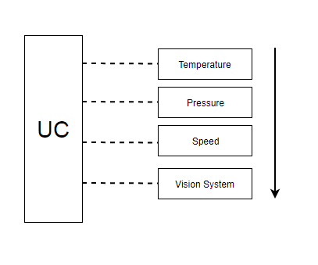

Slide 9
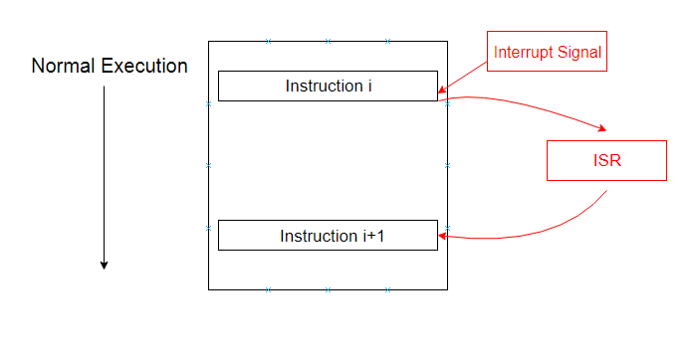
Polling
Interrupt
While (1)
{
Get_Device_Status();
if(Service_Required)
{
Service_Routine();
}
Normal_Execution();
}

Slide 10
Interrupt Handling:
1- A Device Issues an Interrupt
2- CPU Finishes the Current Instruction
3- CPU Acknowledges the Interrupt
4- CPU Saves its States and PC onto Stack
[Push PC, Push CPU Registers, Status Register]
5- CPU Loads the address of the ISR onto PC
6- CPU Executes the ISR
7- CPU Retrieves its states and PC from Stack
8- Normal Execution Resumes

Slide 11
