Slide 1
© Pearson Education 2013
4-<number>

Slide 2
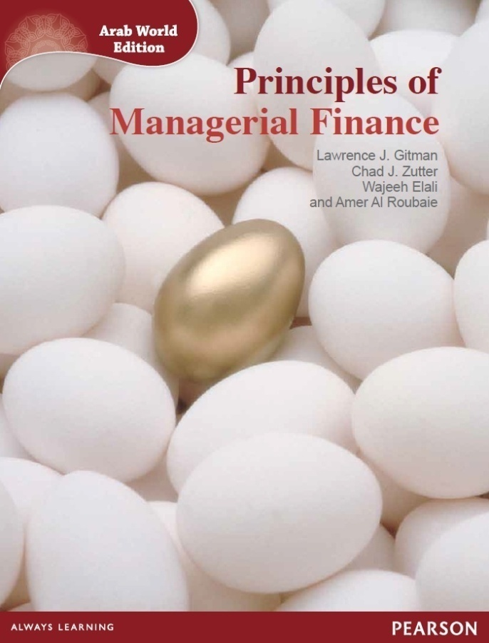
Principles of Managerial Finance
Arab World Edition
Gitman, Zutter, Elali, Al Roubaie
Chapter 4: Time Value of Money
Lecturer: [Insert your name here]
© Pearson Education 2013
4-<number>

Slide 3
Learning Goals
LG1: Discuss the role of time value in finance, the use of computational aids, and the basic patterns of cash flow.
LG2: Understand the concept of future value and present value, their calculation for single amounts, and the relationship between them.
LG3: Find the future value and the present value of both an ordinary annuity and an annuity due, and the present value of a perpetuity.
(continued)
© Pearson Education 2013
4-<number>

Slide 4
Learning Goals (cont’d)
LG4: Calculate both the future value and the present value of a mixed stream of cash flows.
LG5: Understand the effect that compounding interest more frequently than annually has on future value and the effective annual rate of interest.
LG6: Describe the procedures involved in (1) determining deposits needed to accumulate to a future sum, (2) loan amortization, (3) finding interest or growth rates, and (4) finding an unknown number of periods.
© Pearson Education 2013
4-<number>

Slide 5
The Role of Time Value in Finance
Most financial decisions involve costs & benefits that are spread out over time.
Time value of money allows comparison of cash flows from different periods.
Question: Your father has offered to give you some money and asks that you choose one of the following two alternatives:
    US$1,000 today, or
    US$1,100 one year from now.
What do you do?
© Pearson Education 2013
4-<number>

Slide 6
The Role of Time Value in Finance (cont.)
The answer depends on what rate of interest you could earn on any money you receive today.
For example, if you could deposit the US$1,000 today at 12% per year, you would prefer to be paid today.
Alternatively, if you could only earn 5% on deposited funds, you would be better off if you chose the US$1,100 in one year.
© Pearson Education 2013
4-<number>

Slide 7
Future Value Versus Present Value
Suppose a firm has an opportunity to spend US$15,000 today on some investment that will produce US$17,000 spread out over the next five years as follows:
Is this a wise investment?
To make the right investment decision, managers need to compare the cash flows at a single point in time.
Year | Cash flow
1 | US$3,000
2 | US$5,000
3 | US$4,000
4 | US$3,000
5 | US$2,000
© Pearson Education 2013
4-<number>

Slide 8
Future Value Versus Present Value:
Basic Concepts
Future Value: compounding or growth over time
Present Value: discounting to today’s value
Single cash flows & series of cash flows can be considered
Time lines are used to illustrate these relationships
© Pearson Education 2013
4-<number>

Slide 9
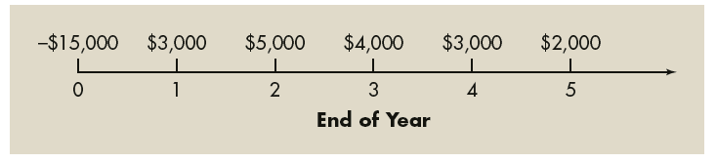
Future Value Versus Present Value:
Time line
Figure 4.1
Time line depicting an investment’s cash flows
© Pearson Education 2013
4-<number>

Slide 10
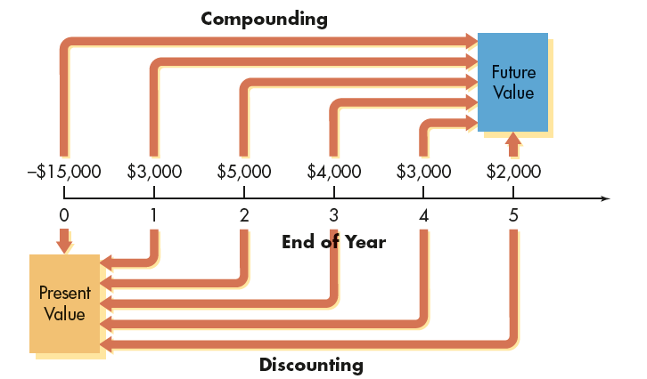
Future Value Versus Present Value:
Compounding and Discounting
Figure 4.2
Compounding and Discounting:
Time line showing compounding to find future value and discounting to find present value
© Pearson Education 2013
4-<number>

Slide 11
Computational Tools
Finding present and future values can involve time-consuming calculations.
Although you should understand the concepts and mathematics underlying these calculations, financial calculators and spreadsheets streamline the application of time value techniques.
© Pearson Education 2013
4-<number>

Slide 12
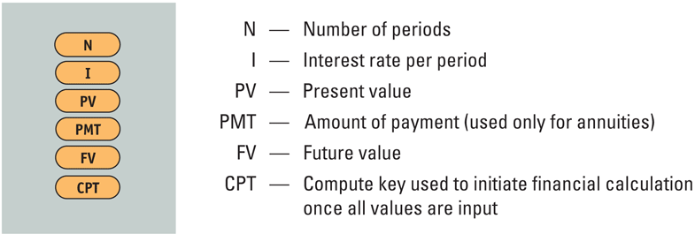
Computational Tools:
Financial Calculators
Financial calculators include numerous preprogrammed financial routines.
Learning how to use these routines can make present and future values calculations much easier.
Figure 4.3
Calculator Keys
© Pearson Education 2013
4-<number>

Slide 13
Computational Tools:
Electronic Spreadsheets
Like financial calculators, electronic spreadsheets have built-in routines that simplify time value calculations.
The ability to use electronic spreadsheets has become a prime skill for today’s managers.
© Pearson Education 2013
4-<number>

Slide 14
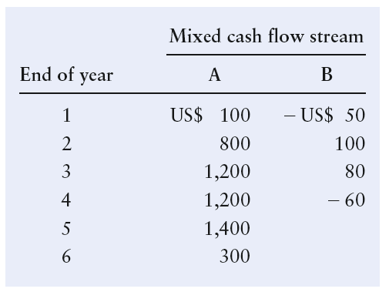
Basic Patterns of Cash Flow
The cash inflows and outflows of a firm can be described by its general pattern.
The three basic patterns include a single amount, an annuity, or a mixed stream:
© Pearson Education 2013
4-<number>

Slide 15
Single Amounts:
Future Value of a Single Amount
Future value is the value at a given future date of an amount placed on deposit today and earning interest at a specified rate. Found by applying compound interest over a specified period of time.
Compound interest is interest that is earned on a given deposit and has become part of the principal at the end of a specified period.
Principal is the amount of money on which interest is paid.
© Pearson Education 2013
4-<number>

Slide 16
Single Amounts:
Example: Future Value
If Fahmi Hamada places US$100 in a savings account paying 8 percent interest compounded annually, how much will he have at the end of 1 year?
  Future value at end of year 1 = US$100 × (1 + 0.08) = US$108
If Fahmi were to leave this money in the account for another year, how much would he have at the end of the second year?
  Future value at end of year 2 = US$100 × (1 + 0.08) × (1 + 0.08)
  = US$116.64
© Pearson Education 2013
4-<number>

Slide 17
Single Amounts:
The Equation for Future Value
We use the following notation for the various inputs:
  FV_{n} = future value at the end of period n
  PV = initial principal, or present value
  i = annual rate of interest paid. (Note: On financial
  calculators, I is typically used to represent this
  rate.)
  n = number of periods (typically years) that the
  money is left on deposit
The general equation for the future value at the end of period n is
© Pearson Education 2013
4-<number>

Slide 18
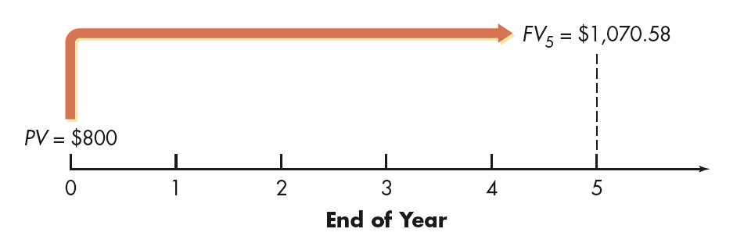
Future Value of a Single Amount:
The Equation for Future Value
Jannett Maher places US$800 in a savings account paying 6 percent interest compounded annually. She wants to know how much money will be in the account at the end of five years.
This analysis can be depicted on a time line as follows:
© Pearson Education 2013
4-<number>

Slide 19
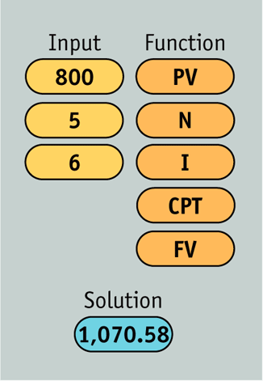
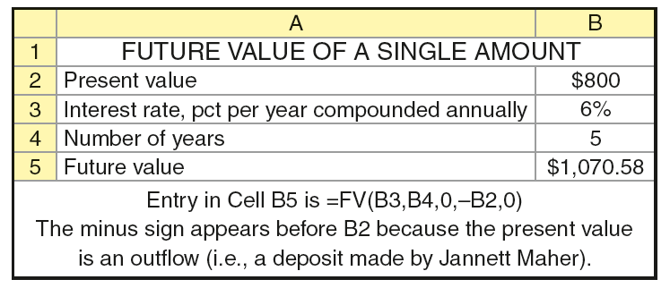
Future Value of a Single Amount:
Using Computations Tools to Find Future Value
© Pearson Education 2013
4-<number>

Slide 20
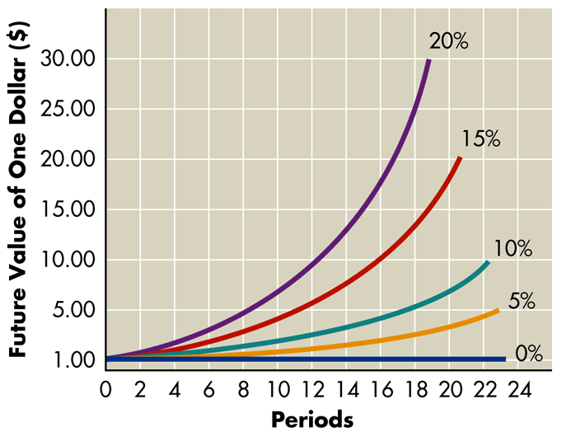
Future Value of a Single Amount:
A Graphical View of Future Value
Figure 4.4
Future Value Relationship
© Pearson Education 2013
4-<number>

Slide 21
Present Value of a Single Amount
Present value is the current dollar value of a future amount—the amount of money that would have to be invested today at a given interest rate over a specified period to equal the future amount.
It is based on the idea that a dollar today is worth more than a dollar tomorrow.
Discounting cash flows is the process of finding present values; the inverse of compounding interest.
The discount rate is often also referred to as the opportunity cost, the discount rate, the required return, or the cost of capital.
© Pearson Education 2013
4-<number>

Slide 22
Present Value of a Single Amount:
An Example
Bader Hassan has an opportunity to receive US$300 one year from now. If he can earn 6 percent on his investments, what is the most he should pay now for this opportunity?
PV × (1 + 0.06) = US$300
PV = US$300/(1 + 0.06) = US$283.02
© Pearson Education 2013
4-<number>

Slide 23
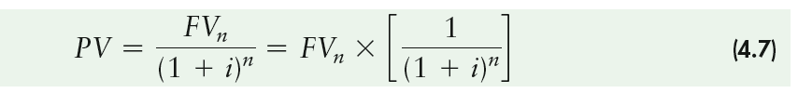
Present Value of a Single Amount:
The Equation for Present Value
The present value, PV, of some future amount, FV_{n}, to be received n periods from now, assuming an interest rate (or opportunity cost) of i, is calculated as follows:
© Pearson Education 2013
4-<number>

Slide 24
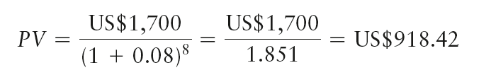
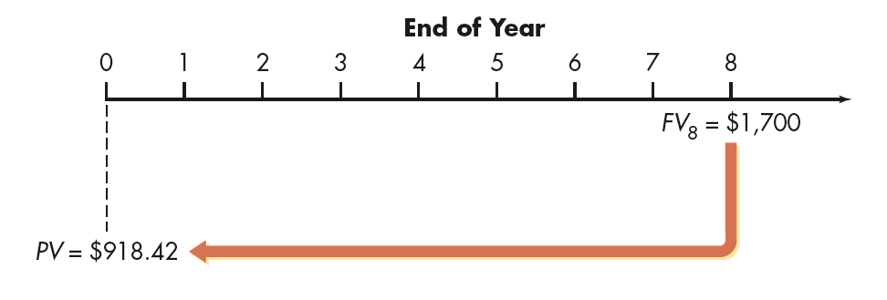
Present Value of a Single Amount:
The Equation for Present Value
Pola Abdo wishes to find the present value of US$1,700 that will be received 8 years from now. Pola’s opportunity cost is 8 percent.
This analysis can be depicted on a time line as follows:
© Pearson Education 2013
4-<number>

Slide 25
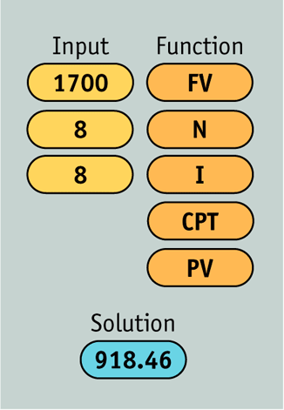
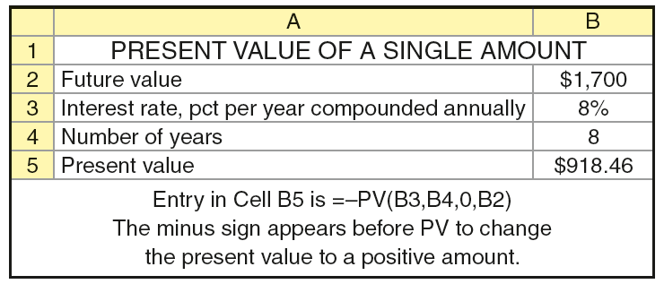
Present Value of a Single Amount:
Using Computations Tools to Find Present Value
© Pearson Education 2013
4-<number>

Slide 26
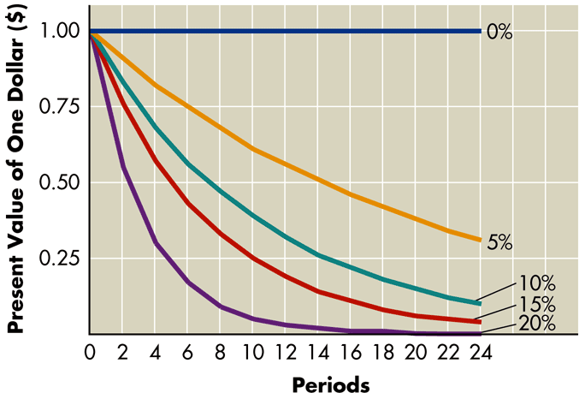
Present Value of a Single Amount:
A Graphical View of Present Value
Figure 4.5
Present Value Relationship
© Pearson Education 2013
4-<number>

Slide 27
Annuities
Annuities are equally-spaced cash flows of equal size.
Annuities can be either inflows or outflows.
An ordinary (deferred) annuity has cash flows that occur at the end of each period.
An annuity due has cash flows that occur at the beginning of each period.
An annuity due will always be greater than an otherwise equivalent ordinary annuity because interest will compound for an additional period.
© Pearson Education 2013
4-<number>

Slide 28
Types of Annuities:
An Example
Fadia Ibrahim is choosing which of two annuities to receive. Both are 5-year US$1,000 annuities; annuity A is an ordinary annuity, and annuity B is an annuity due. Fadia has listed the cash flows for both annuities as shown in Table 4.1 on the following slide.
Note that the amount of both annuities totals US$5,000.
© Pearson Education 2013
4-<number>

Slide 29
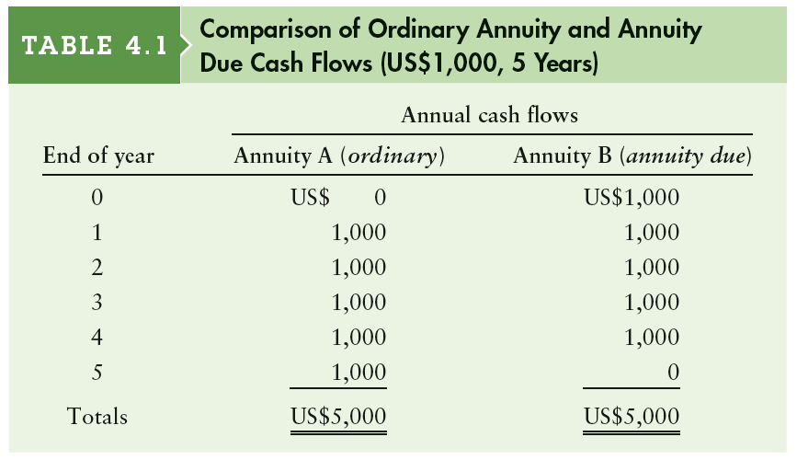
Types of Annuities:
An Example (cont’d)
© Pearson Education 2013
4-<number>

Slide 30
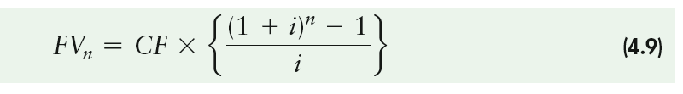
Finding the Future Value of an Ordinary Annuity
You can calculate the future value of an ordinary annuity that pays an annual cash flow equal to CF by using the following equation:
As before, in this equation i represents the interest rate
and n represents the number of payments in the annuity (or equivalently, the number of years over which the annuity is spread).
© Pearson Education 2013
4-<number>

Slide 31

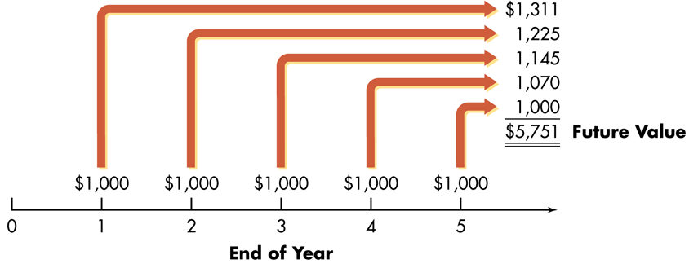
Finding the Future Value of an Ordinary Annuity:
An Example
Fadia Ibrahim wishes to determine how much money she will have at the end of 5 years if he chooses annuity A, the ordinary annuity and it earns 7 percent annually. Annuity A is depicted graphically below:
This analysis can be depicted on a time line as follows:
© Pearson Education 2013
4-<number>

Slide 32
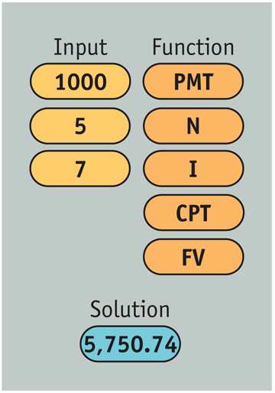
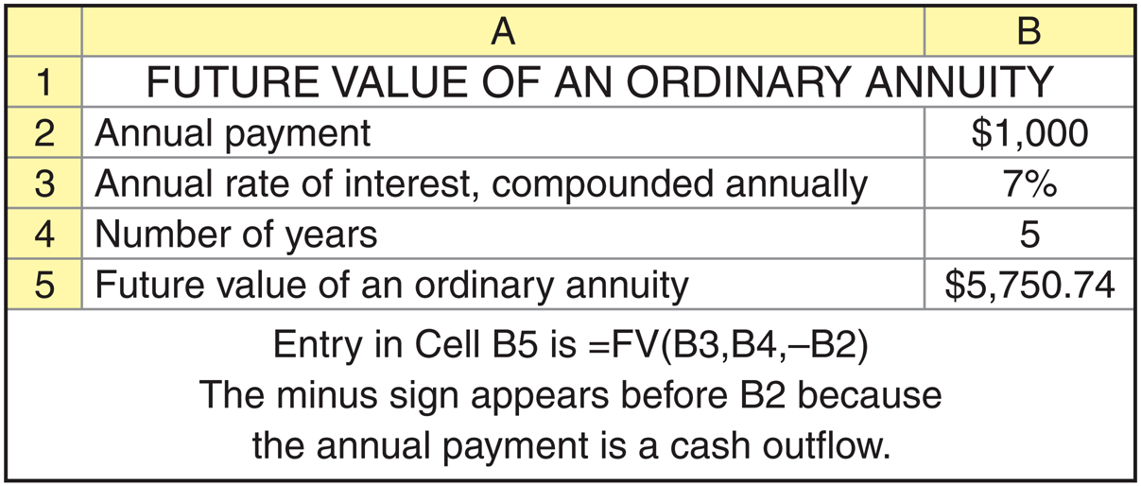
Finding the Future Value of an Ordinary Annuity:
An Example
© Pearson Education 2013
4-<number>

Slide 33

Finding the Present Value of an Ordinary Annuity
You can calculate the present value of an ordinary annuity that pays an annual cash flow equal to CF by using the following equation:
As before, in this equation i represents the interest rate and
n represents the number of payments in the annuity (or equivalently, the number of years over which the annuity is spread).
© Pearson Education 2013
4-<number>

Slide 34
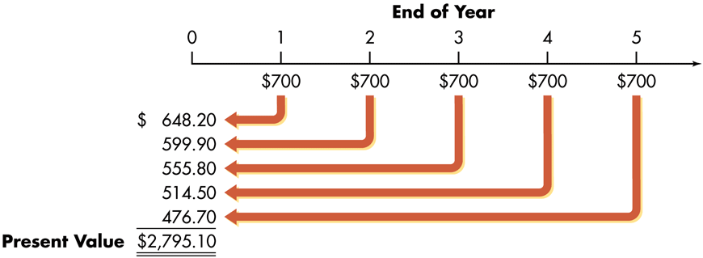
Finding the Present Value of an Ordinary Annuity: An Example
Rasha Company, a small producer of plastic toys, wants to determine the most it should pay to purchase a particular annuity. The annuity consists of cash flows of US$700 at the end of each year for 5 years. The required return is 8 percent.
© Pearson Education 2013
4-<number>

Slide 35
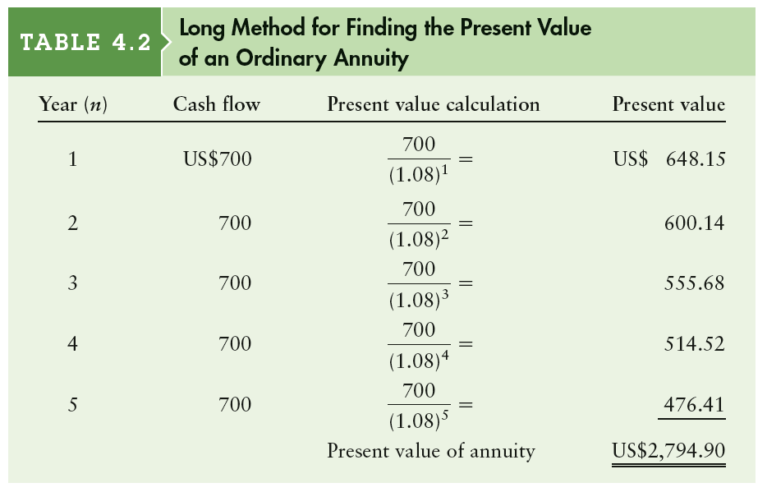
Present Value of an Ordinary Annuity:
An Example (cont’d) - The Long Method
© Pearson Education 2013
4-<number>

Slide 36
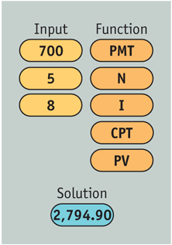
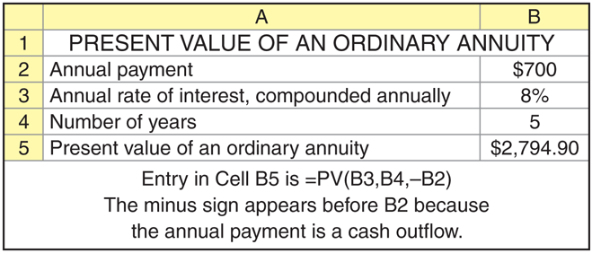
Present Value of an Ordinary Annuity:
An Example (cont’d)
© Pearson Education 2013
4-<number>

Slide 37
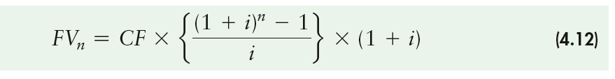
Finding the Future Value of an Annuity Due:
An Example
You can calculate the present value of an annuity due that pays an annual cash flow equal to CF by using the following equation:
As before, in this equation i represents the interest rate and n represents the number of payments in the annuity (or equivalently, the number of years over which the annuity is spread).
© Pearson Education 2013
4-<number>

Slide 38
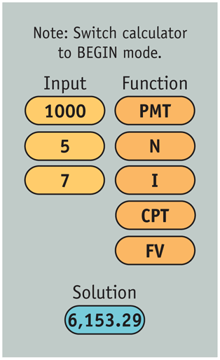
Finding the Future Value of an Annuity Due:
An Example
Fadia Ibrahim now wishes to calculate the future value of an annuity due for annuity B in Table 4.1. Recall that annuity B was a 5 period annuity with the first annuity beginning immediately.
Note: Before using your calculator to find the future value of an annuity due, depending on the specific calculator, you must either switch it to BEGIN mode or use the DUE key.
© Pearson Education 2013
4-<number>

Slide 39
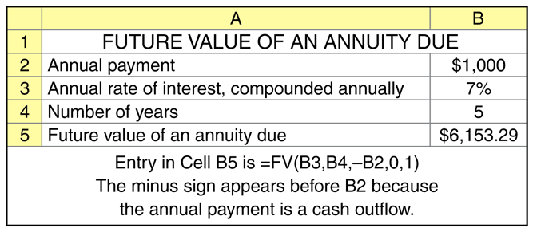
Finding the Future Value of an Annuity Due:
An Example
© Pearson Education 2013
4-<number>

Slide 40
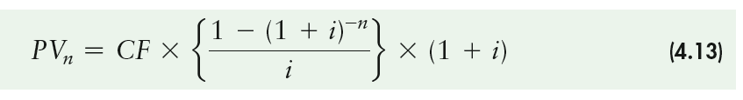
Finding the Present Value of an Annuity Due
You can calculate the present value of an ordinary annuity that pays an annual cash flow equal to CF by using the following equation:
As before, in this equation r represents the interest rate and n represents the number of payments in the annuity (or equivalently, the number of years over which the annuity is spread).
© Pearson Education 2013
4-<number>

Slide 41
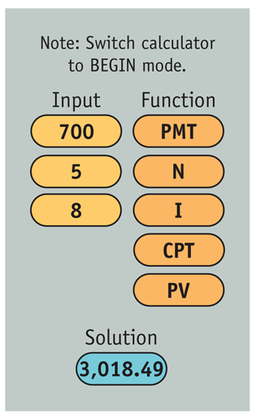

Finding the Present Value of an Annuity Due:
An Example
© Pearson Education 2013
4-<number>

Slide 42
Finding the Present Value of a Perpetuity
A perpetuity is an annuity with an infinite life, providing continual annual cash flow.
If a perpetuity pays an annual cash flow of CF, starting one year from now, the present value of the cash flow stream is:
© Pearson Education 2013
4-<number>

Slide 43
Mixed Streams
Two basic types of cash flow streams are possible: the annuity and the mixed stream.
Whereas an annuity is a pattern of equal periodic cash flows, a mixed stream is a stream of unequal periodic cash flows that reflect no particular pattern.
© Pearson Education 2013
4-<number>

Slide 44
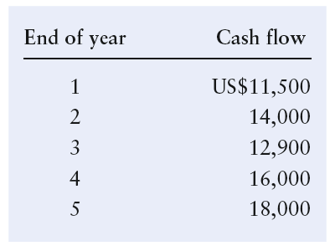
Future Value of a Mixed Stream:
An Example
Steel Industries, a cabinet manufacturer, expects to receive the following mixed stream of cash flows over the next 5 years from one of its small customers.
© Pearson Education 2013
4-<number>

Slide 45
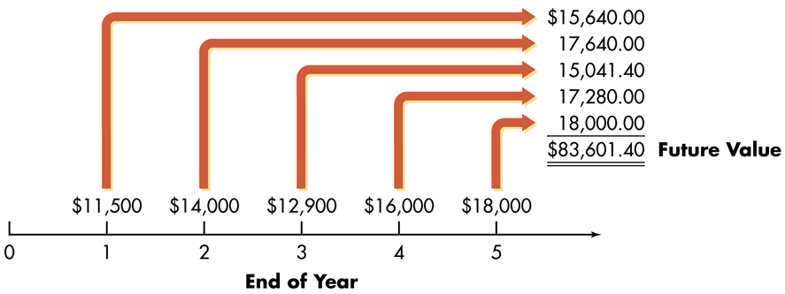
Future Value of a Mixed Stream:
An Example (cont’d)
If Steel Industries expects to earn at least 8 percent on its investments, how much will it accumulate by the end of year 5 if it immediately invests these cash flows when they are received?
This situation is depicted on the following time line.
© Pearson Education 2013
4-<number>

Slide 46
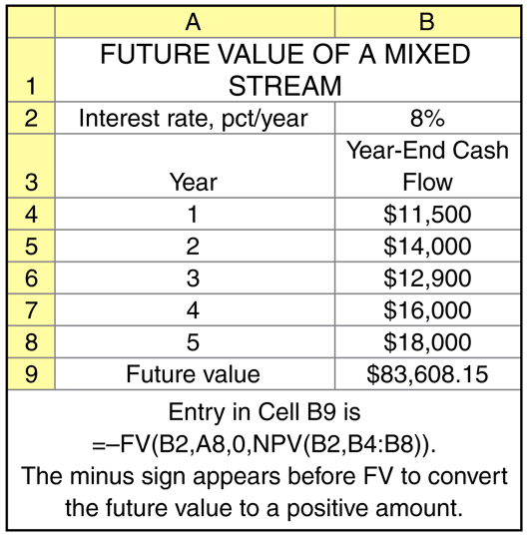
Future Value of a Mixed Stream:
An Example (cont’d)
© Pearson Education 2013
4-<number>

Slide 47
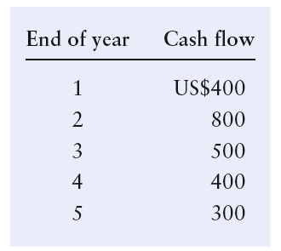
Present Value of a Mixed Stream:
An Example
Faris Company, a shoe manufacturer, has been offered an opportunity to receive the following mixed stream of cash flows over the next 5 years.
© Pearson Education 2013
4-<number>

Slide 48
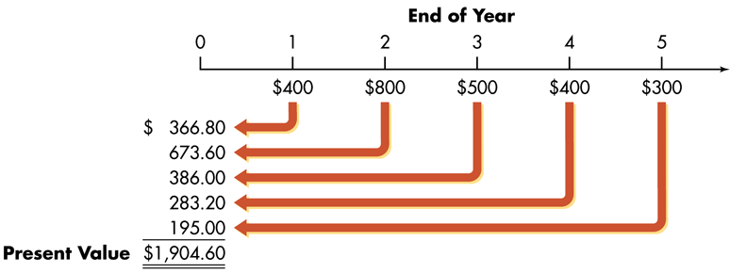
Present Value of a Mixed Stream:
An Example (cont’d)
If the firm must earn at least 9 percent on its investments, what is the most it should pay for this opportunity?
This situation is depicted on the following time line.
© Pearson Education 2013
4-<number>

Slide 49
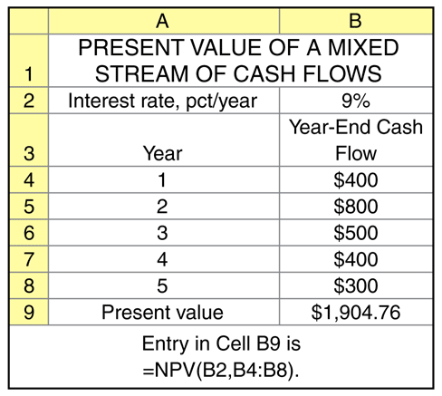
Present Value of a Mixed Stream:
An Example (cont’d)
© Pearson Education 2013
4-<number>

Slide 50
Compounding Interest More Frequently Than Annually
Compounding more frequently than once a year results in a higher effective interest rate because you are earning on interest on interest more frequently.
As a result, the effective interest rate is greater than the nominal (annual) interest rate.
Furthermore, the effective rate of interest will increase the more frequently interest is compounded.
© Pearson Education 2013
4-<number>

Slide 51
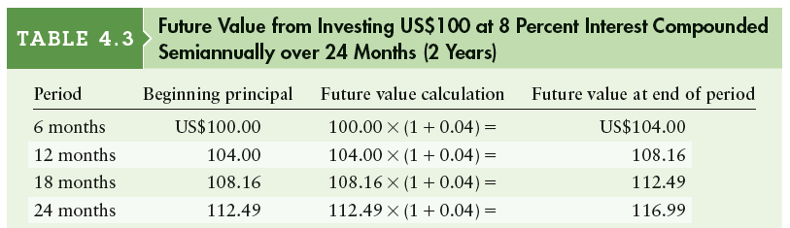
Compounding Interest More Frequently Than Annually: An Example
Fahmi Hamada has decided to invest US$100 in a savings account paying 8 percent interest compounded semiannually. If he leaves his money in the account for 24 months, he will be paid 4 percent interest compounded over 4 periods.
© Pearson Education 2013
4-<number>

Slide 52
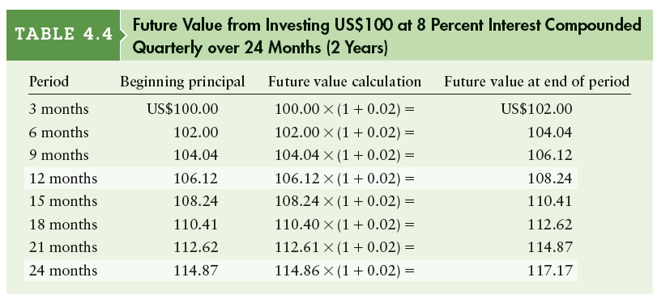
Compounding Interest More Frequently Than Annually: An Example (cont’d)
Fahmi Hamada has found an institution that will pay him 8 percent annual interest, compounded quarterly. If he leaves the money in the account for 24 months (2 years), he will be paid 2 percent interest compounded over 8 periods.
© Pearson Education 2013
4-<number>

Slide 53
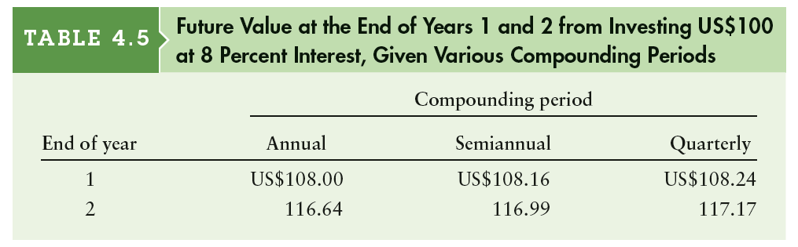
Compounding Interest More Frequently Than Annually: An Example (cont’d)
Table 4.5 compares values for Fahmi’s US$100 at the end of years 1 and 2 given annual, semiannual and quarterly compounding periods at the 8 percent rate.
As shown, the more frequently interest is compounded, the greater the amount of money accumulated.
© Pearson Education 2013
4-<number>

Slide 54

Compounding Interest More Frequently Than Annually
A general equation for compounding more frequently than annually:
© Pearson Education 2013
4-<number>

Slide 55
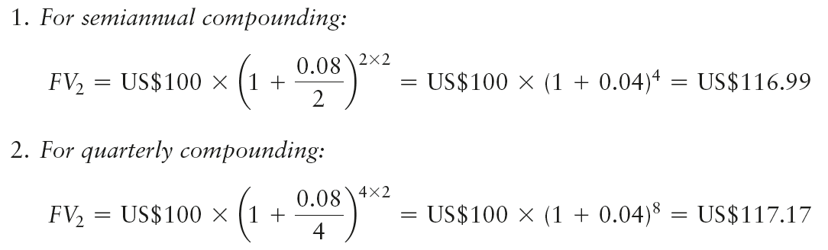
Compounding Interest More Frequently Than Annually
Recalculate the example for Fahmi Hamada, assuming:
(1) semiannual compounding and (2) quarterly compounding.
© Pearson Education 2013
4-<number>

Slide 56
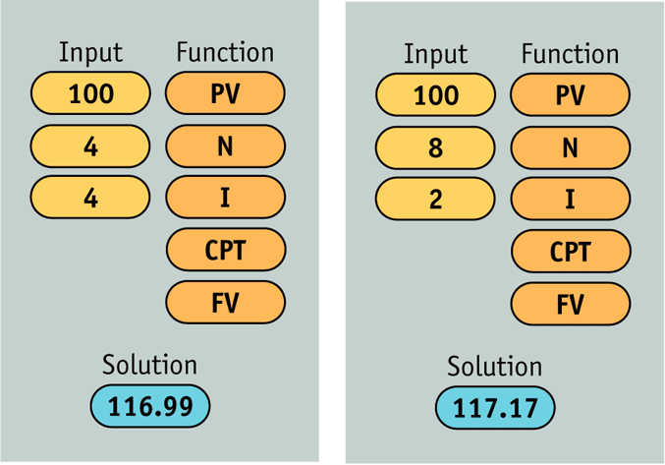
Compounding Interest More Frequently Than Annually:
Using a Financial Calculator
© Pearson Education 2013
4-<number>

Slide 57
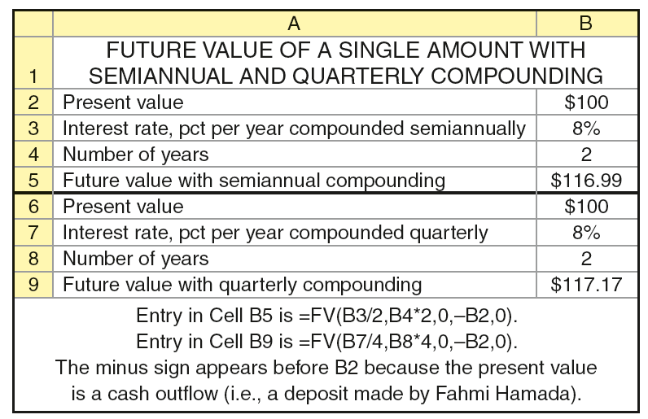
Compounding Interest More Frequently Than Annually:
Using a Spreadsheet
© Pearson Education 2013
4-<number>

Slide 58
Continuous Compounding
Continuous compounding involves the compounding of interest an infinite number of times per year at intervals of microseconds.
A general equation for continuous compounding:
where e is the exponential function, which has a value of 2.7183.
© Pearson Education 2013
4-<number>

Slide 59
Continuous Compounding:
An Example
Find the value at the end of 2 years (n = 2) of Fahmi Hamada’s US$100 deposit (PV = US$100) in an account paying 8 percent annual interest (i = 0.08) compounded continuously.
FV₂ (continuous compounding) = $100 × e^{0.08 × 2}
= $100 × 2.7183^{0.16}
= $100 × 1.1735 = $117.35
© Pearson Education 2013
4-<number>

Slide 60
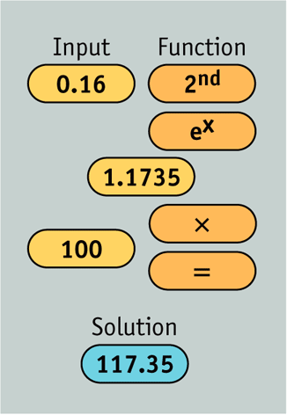
Continuous Compounding:
Example (cont’d), Using a Financial Calculator
© Pearson Education 2013
4-<number>

Slide 61
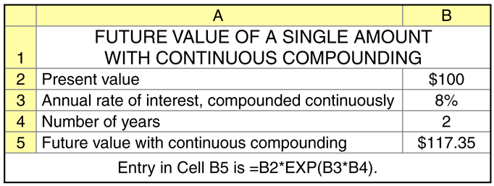
Continuous Compounding:
Example (cont’d), Using a Spreadsheet
© Pearson Education 2013
4-<number>

Slide 62

Nominal & Effective Annual Rates of Interest
The nominal (stated) interest rate is the contractual rate of interest charged by a lender or promised by a borrower.
The effective (true) interest rate (EAR) is the rate actually paid or earned.
In general, the effective rate > nominal rate whenever compounding occurs more than once per year.
© Pearson Education 2013
4-<number>

Slide 63
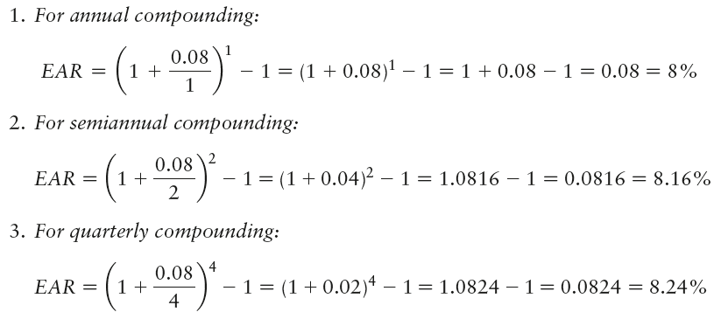
Nominal & Effective Annual Rates of Interest: An Example
Fahmi Hamada wishes to find the effective annual rate associated with an 8 percent nominal annual rate (i = 0.08) when interest is compounded (1) annually (m=1);
(2) semiannually (m=2); and (3) quarterly (m=4).
© Pearson Education 2013
4-<number>

Slide 64

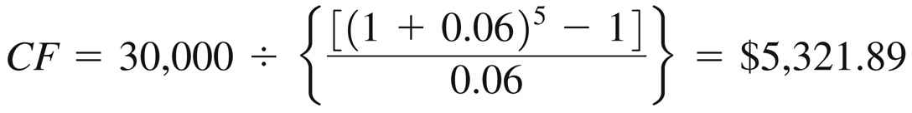
Special Applications of Time Value:
Deposits Needed to Accumulate to a Future Sum
The following equation calculates the annual cash payment (CF) that we’d have to save to achieve a future value (FV_{n}):
Suppose you want to buy a house 5 years from now, and you estimate that an initial down payment of US$30,000 will be required at that time. How much would you need to deposit at the end of each year for the next 5 years to accumulate US$30,000 if you can earn 6 percent on your deposits?
© Pearson Education 2013
4-<number>

Slide 65
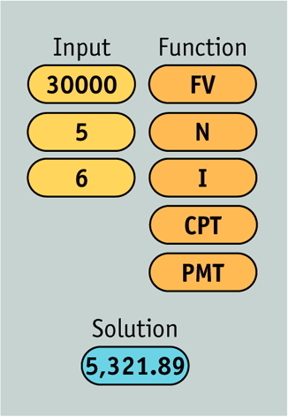
Special Applications of Time Value:
Deposits Needed to Accumulate to a Future Sum
© Pearson Education 2013
4-<number>

Slide 66
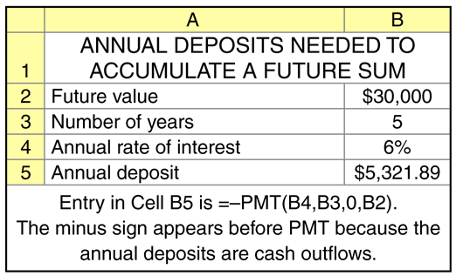
Special Applications of Time Value:
Deposits Needed to Accumulate to a Future Sum
© Pearson Education 2013
4-<number>

Slide 67
Special Applications of Time Value:
Loan Amortization
Loan amortization is the determination of the equal periodic loan payments necessary to provide a lender with a specified interest return and to repay the loan principal over a specified period.
The loan amortization process involves finding the future payments, over the term of the loan, whose present value at the loan interest rate equals the amount of initial principal borrowed.
A loan amortization schedule is a schedule of equal payments to repay a loan. It shows the allocation of each loan payment to interest and principal.
© Pearson Education 2013
4-<number>

Slide 68

Special Applications of Time Value:
Loan Amortization
The following equation calculates the equal periodic loan payments (CF) necessary to provide a lender with a specified interest return and to repay the loan principal (PV) over a specified period:
© Pearson Education 2013
4-<number>

Slide 69
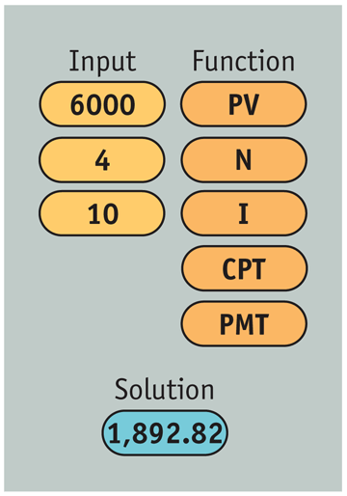
Special Applications of Time Value:
Loan Amortization – An Example
Say you borrow US$6,000 at 10 percent and agree to make equal annual end-of-year payments over 4 years. To find the size of the payments, the lender determines the amount of a 4-year annuity discounted at 10 percent that has a present value of US$6,000.
Calculator Use
© Pearson Education 2013
4-<number>

Slide 70
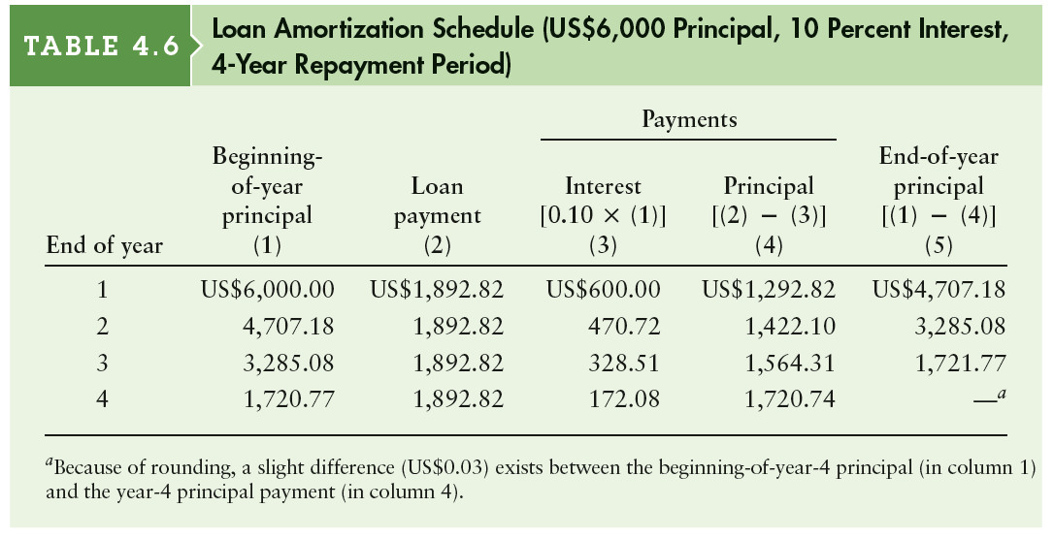
Special Applications of Time Value:
Loan Amortization – An Example (cont’d)
© Pearson Education 2013
4-<number>

Slide 71
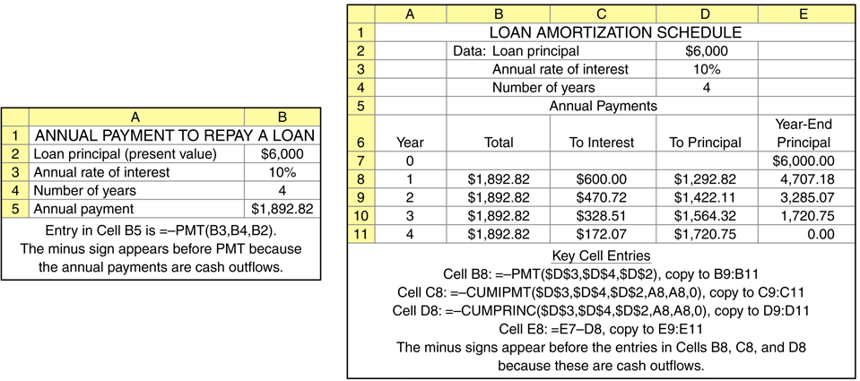
Special Applications of Time Value:
Loan Amortization – An Example (cont’d)
Spreadsheet Use
© Pearson Education 2013
4-<number>

Slide 72

Special Applications of Time Value:
Finding Interest or Growth Rates
It is often necessary to calculate the compound annual interest or growth rate (that is, the annual rate of change in values) of a series of cash flows.
The following equation is used to find the interest rate (or growth rate) representing the increase in value of some investment between two time periods.
© Pearson Education 2013
4-<number>

Slide 73

Special Applications of Time Value:
Finding Interest or Growth Rates – An Example
Zamil Kareem wishes to find the rate of interest or growth reflected in the stream of cash flows he received from a real estate investment over the period from 2005 through 2009 as shown in the table below:
© Pearson Education 2013
4-<number>

Slide 74

Special Applications of Time Value:
Finding Interest or Growth Rates – An Example
We can see that Zamil’s investment four years ago was US$1,250. Now it is worth US$1,520. What compound annual rate of return has Zamil earned on this investment? Plugging the appropriate values into Equation 4.20, we have:
© Pearson Education 2013
4-<number>

Slide 75

Special Applications of Time Value:
Finding Interest or Growth Rates – An Example
Calculator Use
© Pearson Education 2013
4-<number>

Slide 76

Special Applications of Time Value:
Finding Interest or Growth Rates – An Example
Spreadsheet Use
© Pearson Education 2013
4-<number>

Slide 77
Special Applications of Time Value:
Finding an Unknown Number of Periods
Sometimes it is necessary to calculate the number of time periods needed to generate a given amount of cash flow from an initial amount.
This simplest case is when a person wishes to determine the number of periods, n, it will take for an initial deposit, PV, to grow to a specified future amount, FV_{n}, given a stated interest rate, i.
© Pearson Education 2013
4-<number>

Slide 78

Special Applications of Time Value:
Finding an Unknown Number of Periods
Amal Basil wishes to determine the number of years it will take for her initial US$1,000 deposit, earning 8 percent annual interest, to grow to equal US$2,500. Simply stated, at an 8 percent annual rate of interest, how many years, n, will it take for Amal’s US$1,000 (PV_{n}) to grow to US$2,500 (FV_{n})?
Calculator Use
© Pearson Education 2013
4-<number>

Slide 79

Special Applications of Time Value:
Finding an Unknown Number of Periods
Spreadsheet Use
© Pearson Education 2013
4-<number>

Slide 80
Time Value of Money in Islamic Finance
In conventional finance, money is a commodity, the price of which is the interest rate paid by users as a compensation for the time involved, i.e. the time value of money is measured by the amount of interest paid by borrowers for making use of other people’s money.
Islamic Shari’ah is against hoarding money and thus it cannot function as a store of value. In the Islamic economy, the demand for money is a derived demand needed to serve as a medium of exchange for facilitating market transactions.
In other words, money has no intrinsic value of its own and, therefore, it cannot be used to earn more money in the form of a fixed interest payment.
Money becomes capital only when it is invested in creating value but not when it is obtained as a business debt.
© Pearson Education 2013
4-<number>

Slide 81
Time Value of Money in Islamic Finance
In Islamic finance, both lenders and entrepreneurs share both the profit and loss.
In this respect, the return on investment comes from money being actually realized and not paid in advance in the form of predetermined fixed interest on an uncertain future outcome. The return on investment is a product of money used in the creation of real assets.
This renders the time value of money irrelevant under the system of Islamic financing.
© Pearson Education 2013
4-<number>

Slide 82
Time Value of Money in Islamic Finance
The prohibition of riba in Islam makes time’s monetary valuation based on a predetermined fixed amount unacceptable as a basis for computing return on investment.
However, in contractual sales, Islamic finance allows the future price of a commodity to differ from the spot price to compensate for the time value involved.
Islamic finance does not object to earning return from money obtained through lending, but it objects to “making money’s time value an element of any lending relationship that considers it to have a predetermined value.”
© Pearson Education 2013
4-<number>

Slide 83
© Pearson Education 2013
4-<number>

