Slide 1
Water Heater System Design
Dynamic Design
Time Triggered Cyclic Executive(non preemptive)
Time
System Tick

Slide 2
Static Architecture
EEPROM
TIMER
Timer0 Over Flow
Interrupt
I2C
I2c Read-Write
On-off Button Pressed
Tick Increment
COOLER
DownButton
Off-On Mode
SET
TEMP
BUTTONS
ELEMENTS
Display Set Temp
HEATER
Up Button
Scheduler
Up/Down
Pressed
Change Set Temp
LED
On-Off Button
MODE
MANAGER
Elements Off
SSD
ADC Off
SSD Off
\\
TEMP SENSOR
ADC
TEMP
CALC
Volt to Temp
Average
Control Elements
ADC READ
Display Temp

Slide 3
Detailed Design
SSD
SSD_Init
SSD_MainFunction
SSD_SelectDisplay
SSD_SelectDigit
SSD_BLINK
Scheduler
Scheduler_Init
Scheduler_ActivateTask
Scheduler_Start
Task
Scheduler_Task1
Scheduler_Task2
Scheduler_Task3
ADC
ADC_Init
ADC_Start_Conv
ADC_Get_Value
Interrupt
myISR
ELEMENTS
Elements_Init
Elements_MainFunction
LED_Control
LED_BLINK
Timer
Timer0_Init
Timer0_CallBack
I2C
I2c_Init
I2c_Write
I2c_Read
I2c_Start
I2c_Stop
I2c_WaitAck
I2c_Send_NAck
MODE
ModeManager_Init
ModeManage_MainFunction
Mode_Setting_Timer
Temperature
Temperature_Calc
Temperature_MainFunction
Average
Average_Value
Buttons
Buttons_MainFunction
Buttons_Init
EXTI_On_Off_CallBack
EEPROM
Get_EEPROM_Data
Set_EEPROM_Data
EEPROM_Write
EEPROM_Read
Gpio
GPIO_Init

Slide 4
Timing Analysis
Task | Actions | BCET (ms) | WCET(ms) | Period of Action (ms) | Period of task (ms)
SSD | Update SSD SSD_SelectDisplay SSD_SelectDigit SSD_Blink | ~0 ~0 ~0 ~0 | ~0 ~0 ~0 ~0 | 20 20 20 1000 | 20
Buttons | Read Buttons | ~0 | ~0 | 60 | 20
Temperature | Read ADC Temperature_Calc Get_Average | ~0 ~0 ~0 | ~0 ~0 ~0 | 100 100 100 | 100
Elements | Update Elements LED_Control LED_Blink | ~0 ~0 ~0 | ~0 ~0 ~0 | 100 100 1000 | 100
MODE | Update Mode Mode Setting Timer | ~0 ~0 | ~0 ~0 | 500 500 | 500
EEPROM | EEPROM_Write | ~0 | ~0 | 500 | 500
Tick (ms) |  |  |  |  | 20
Major Cycle (ms) |  |  |  |  | 500

Slide 5
Schedulability Check
SSD Task @20ms
Buttons Task @20ms
Temperature Task @100ms
Elements Task @100ms
ModeManager Task @500ms
EEPROM Task @500ms
20ms
40ms
………………………..
500ms
Time

Slide 6
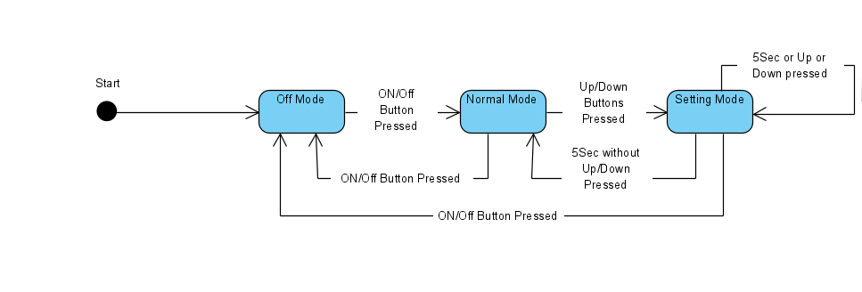
Water Heater System State Machine

Slide 7
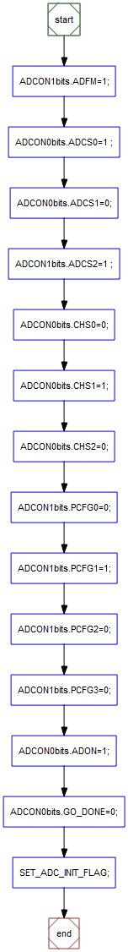
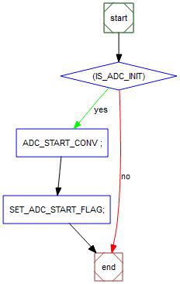
Water Heater System Flowcharts
ADC
ADC_Init
ADC_Start_Conv

Slide 8
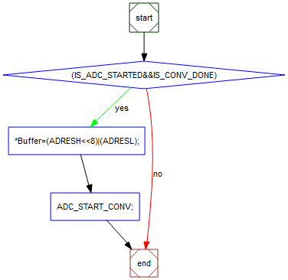
ADC_Get_Value

Slide 9
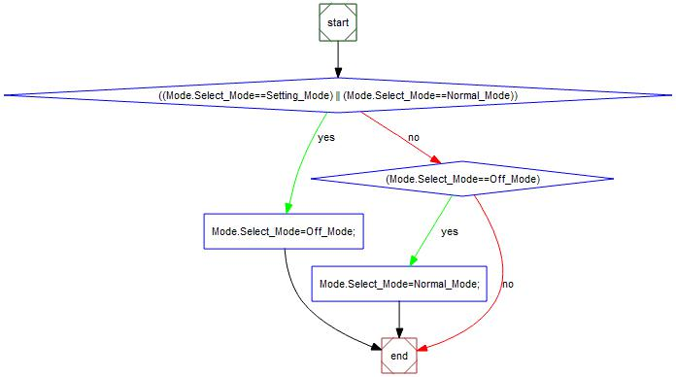
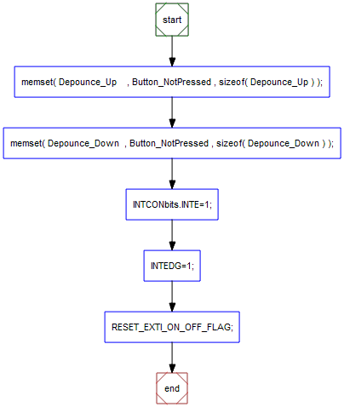
Buttons
Buttons_Init
EXTI_On_Off_CallBack

Slide 10
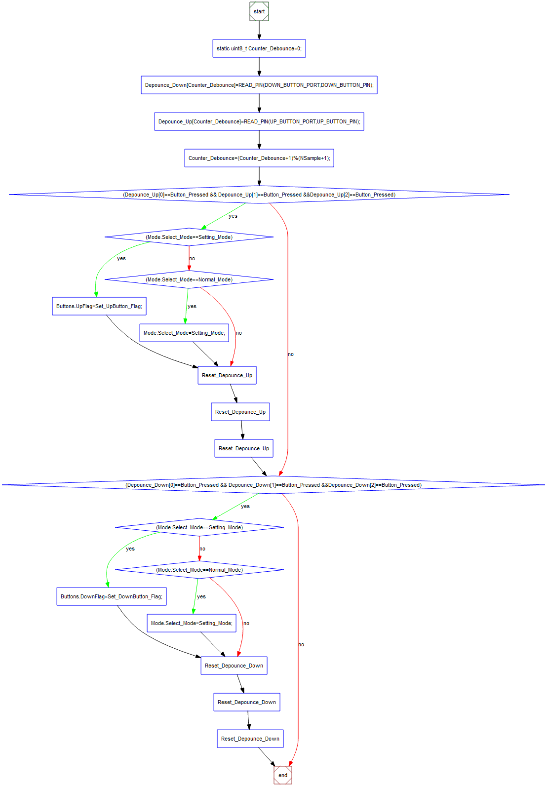
Buttons_MainFunction

Slide 11
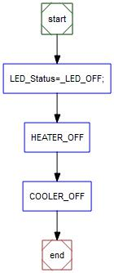
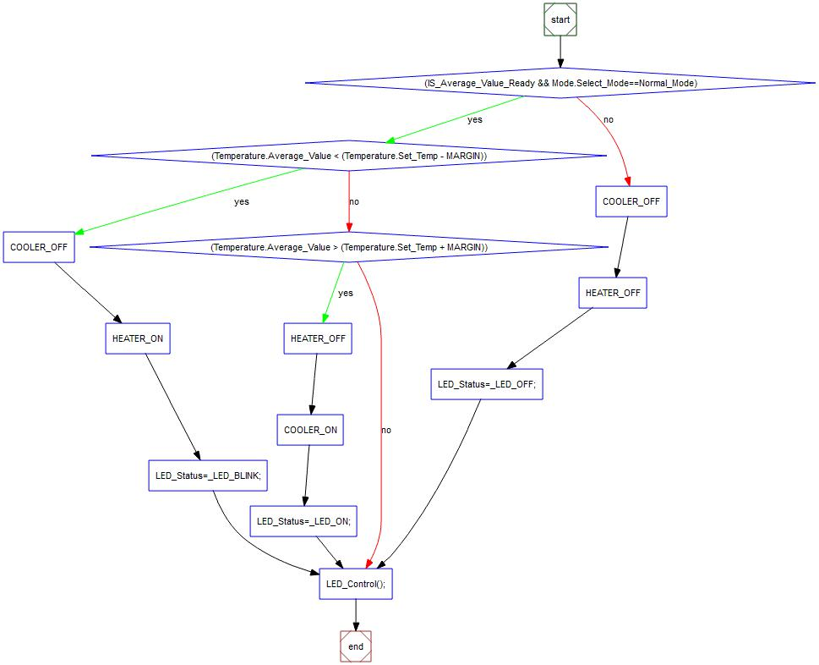
Elements
Elements_Init
Elements_MainFunction

Slide 12
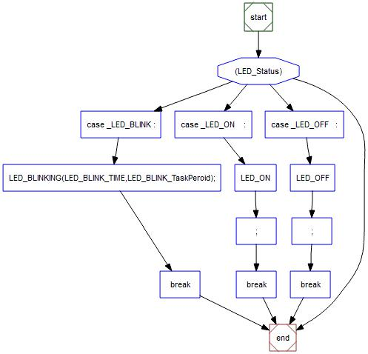
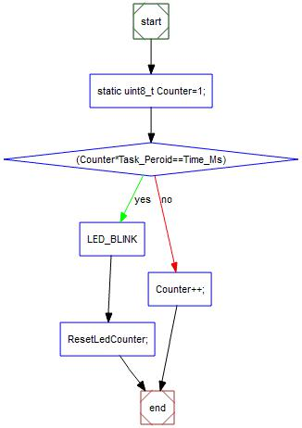
LED_Control
LED_BLINKING

Slide 13
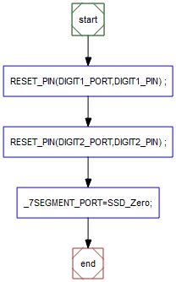
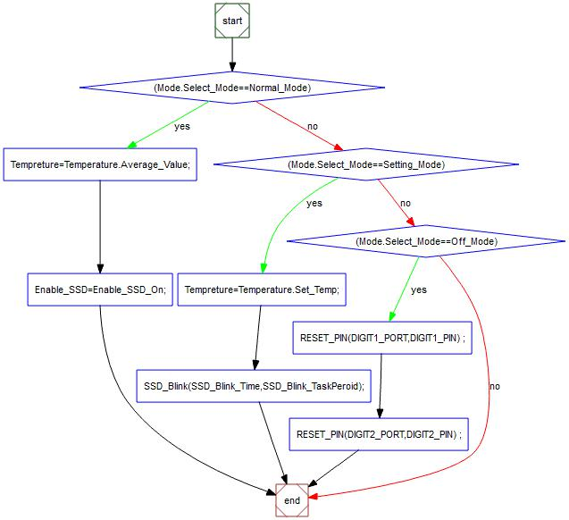
SSD
SSD_Init
SSD_SelectDisplay

Slide 14
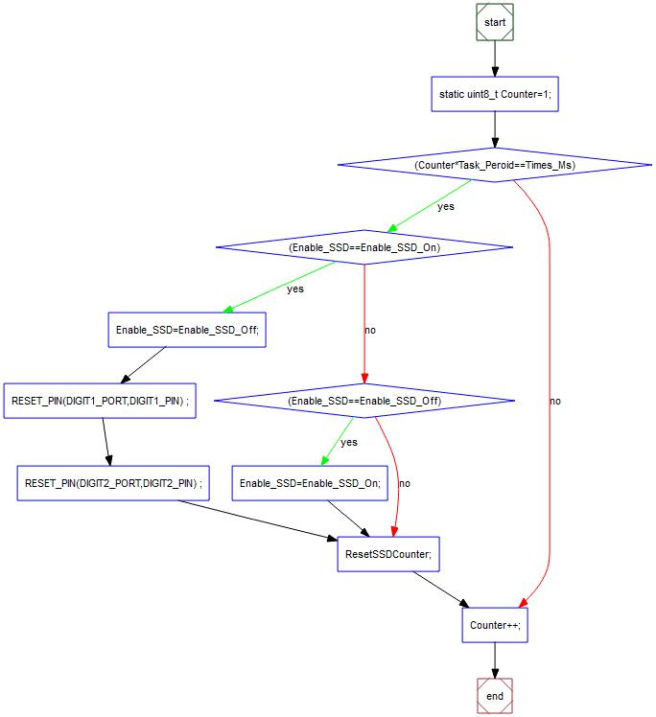
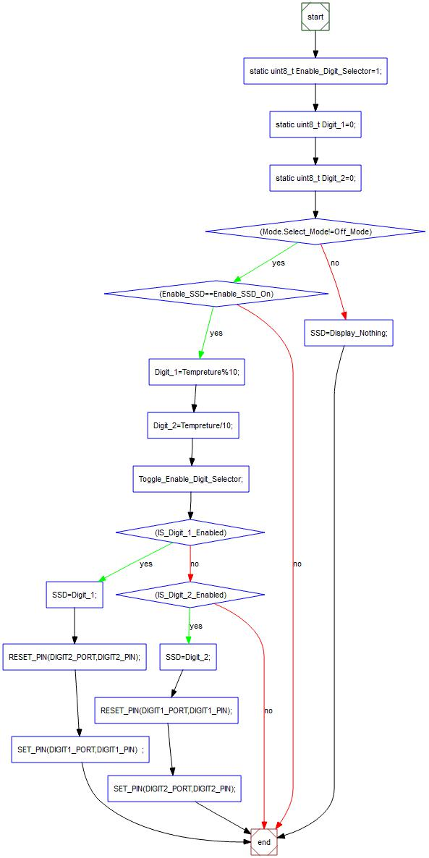
SSD_Blink
SSD_SelectDigit

Slide 15
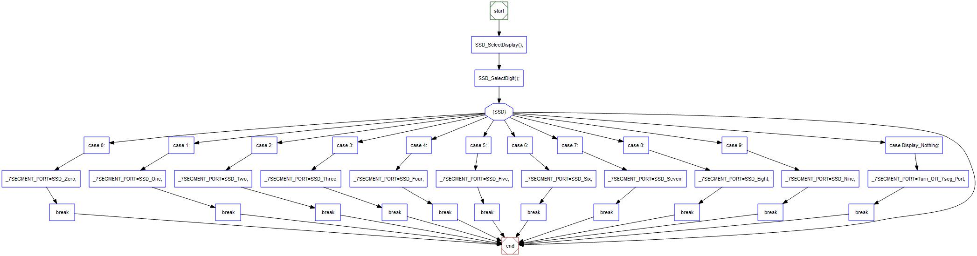
SSD_MainFunction

Slide 16
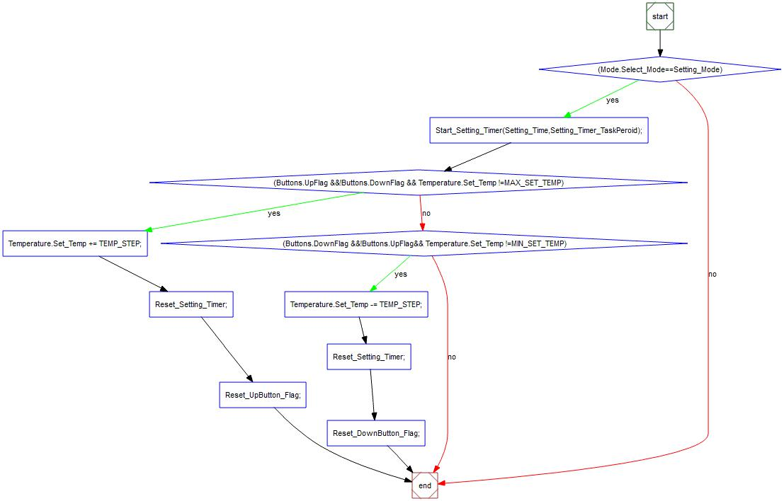
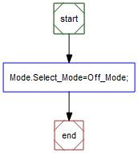
Water Heater Mode
Mode_Init
Mode_MainFunction

Slide 17
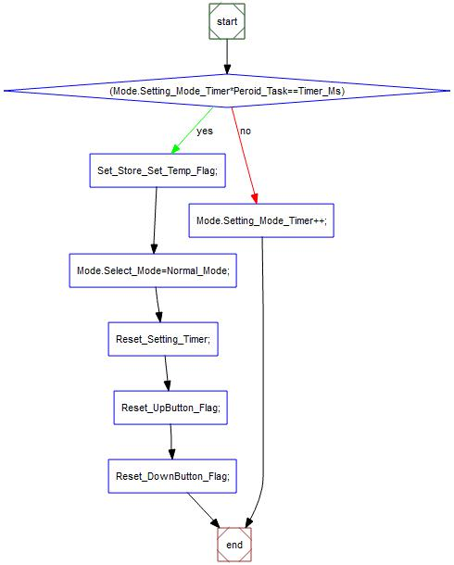
Mode_Setting_Timer

Slide 18
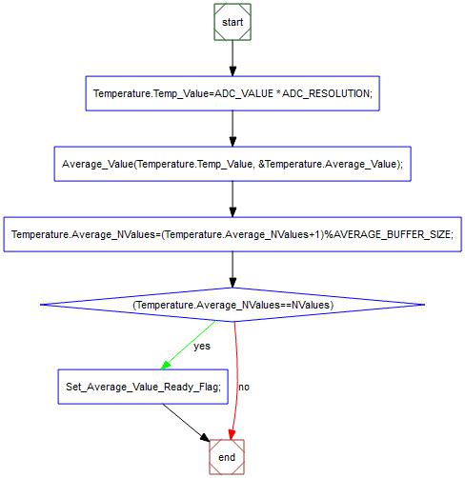
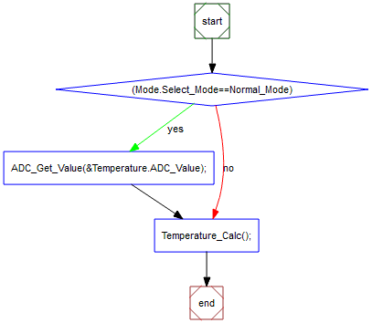
Temperature
Temperature_Calc
Temperature_MainFunction

Slide 19
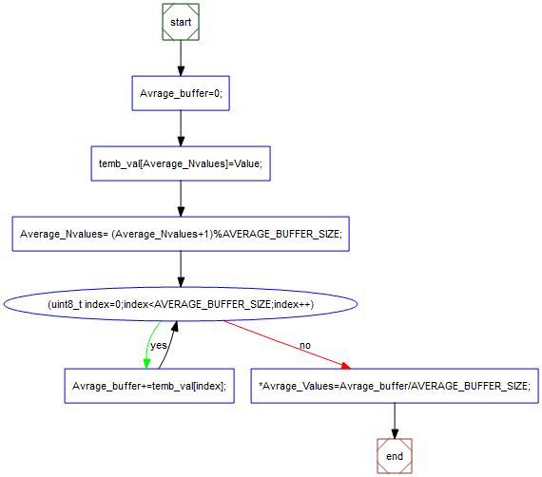
Average
Average_Value

Slide 20
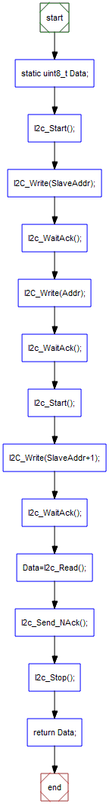
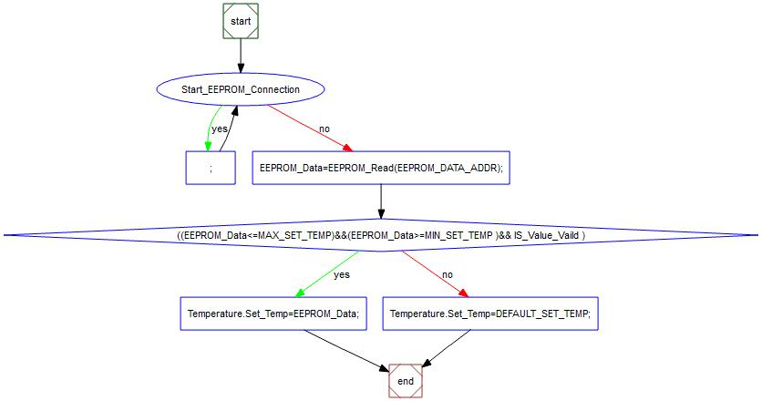
EEPROM
Get_EEPROM_Data
EEPROM_Read

Slide 21
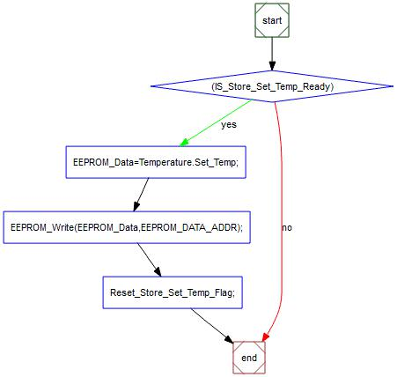
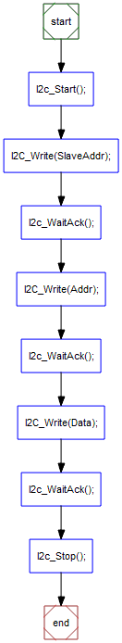
Set_EEPROM_Data
EEPROM_Write

Slide 22
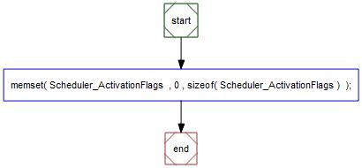
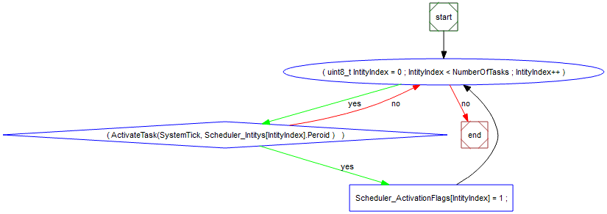
Scheduler
Scheduler_Init
Scheduler_ActivateTask

Slide 23
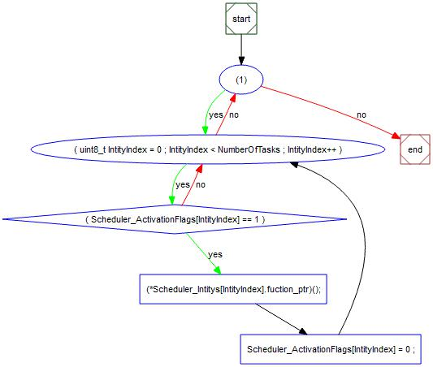
Scheduler_Start

Slide 24
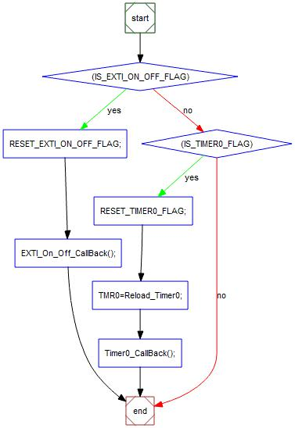
Interrupt
__interrupt() myISR

Slide 25
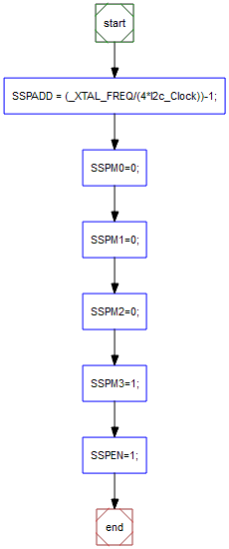
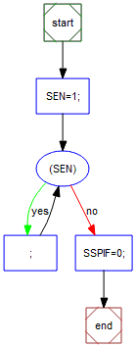
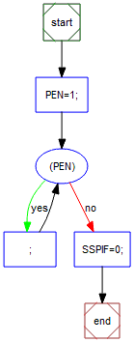
I2C
I2c_Init
I2c_Start
I2c_Stop

Slide 26
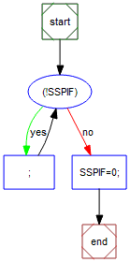
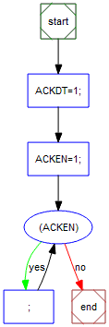
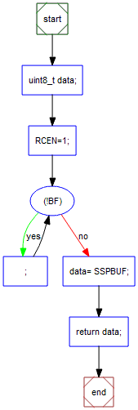

I2c_WaitAck
I2c_Send_NAck
I2c_Read
I2c_Write

