Slide 1
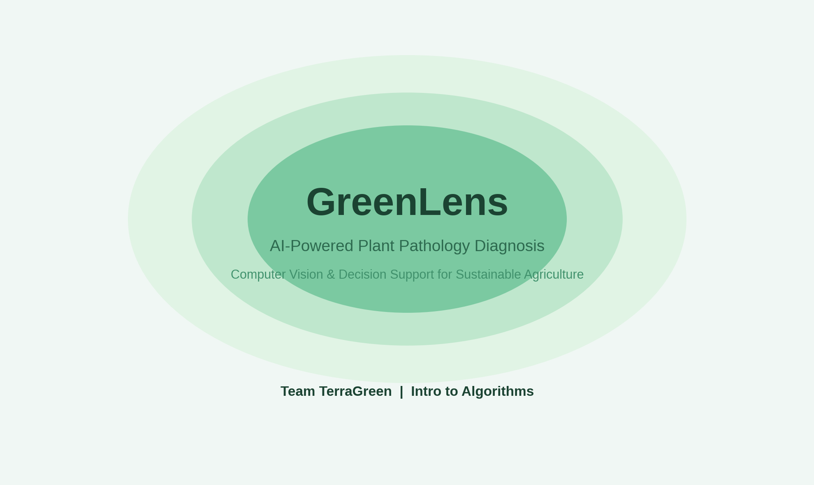
INTRODUCTION TO ALGORITHMS | FINAL PROJECT
GreenLens
Intelligent Plant Pathology Diagnosis
& Actionable Decision Support
Deep Learning Classification & Treatment Recommendation
for Sustainable Agriculture
Author / Presenter: Abdelaziz Ahmed Elbanna
Team: TerraGreen
Supervisor: Dr. Fatma Talaat
Course: Introduction to Algorithms (Year 3, Semester 1)
Repository: https://github.com/AbdelazizElbanna/greenlens

Slide 2
CONTEXT & IMPACT
Agricultural Pathology: The Problem & Motivation
Severe Crop Yield Losses
- Plant pathogens (fungi, bacteria, viruses) cause an estimated 20% to 40% loss of global agricultural production annually.
- Smallholder farmers and amateur growers frequently lack rapid access to plant pathology experts or agricultural extension services.
- Early leaf symptoms are often subtle, easily confused with physiological stress or nutrient deficiencies.
Chemical Overuse & Impact
- Misdiagnosis leads to inappropriate pesticide selection (e.g., applying fungicides against bacterial or viral pathogens).
- Excessive and broad-spectrum chemical application contaminates soil biomes and groundwater reservoirs.
- Improper chemical regimens accelerate pesticide resistance in pathogen populations and elevate farmer input costs.
The GreenLens Objective
- Deliver instant, high-accuracy disease diagnosis from simple mobile leaf photographs.
- Formulate an edge-capable deep learning algorithm capable of rapid inference on constrained hardware.
- Bridge the gap between detection and action by generating automated, actionable treatment and prevention protocols.
Goal: Reduce diagnosis time from days to milliseconds while achieving over 98% diagnostic accuracy.

Slide 3
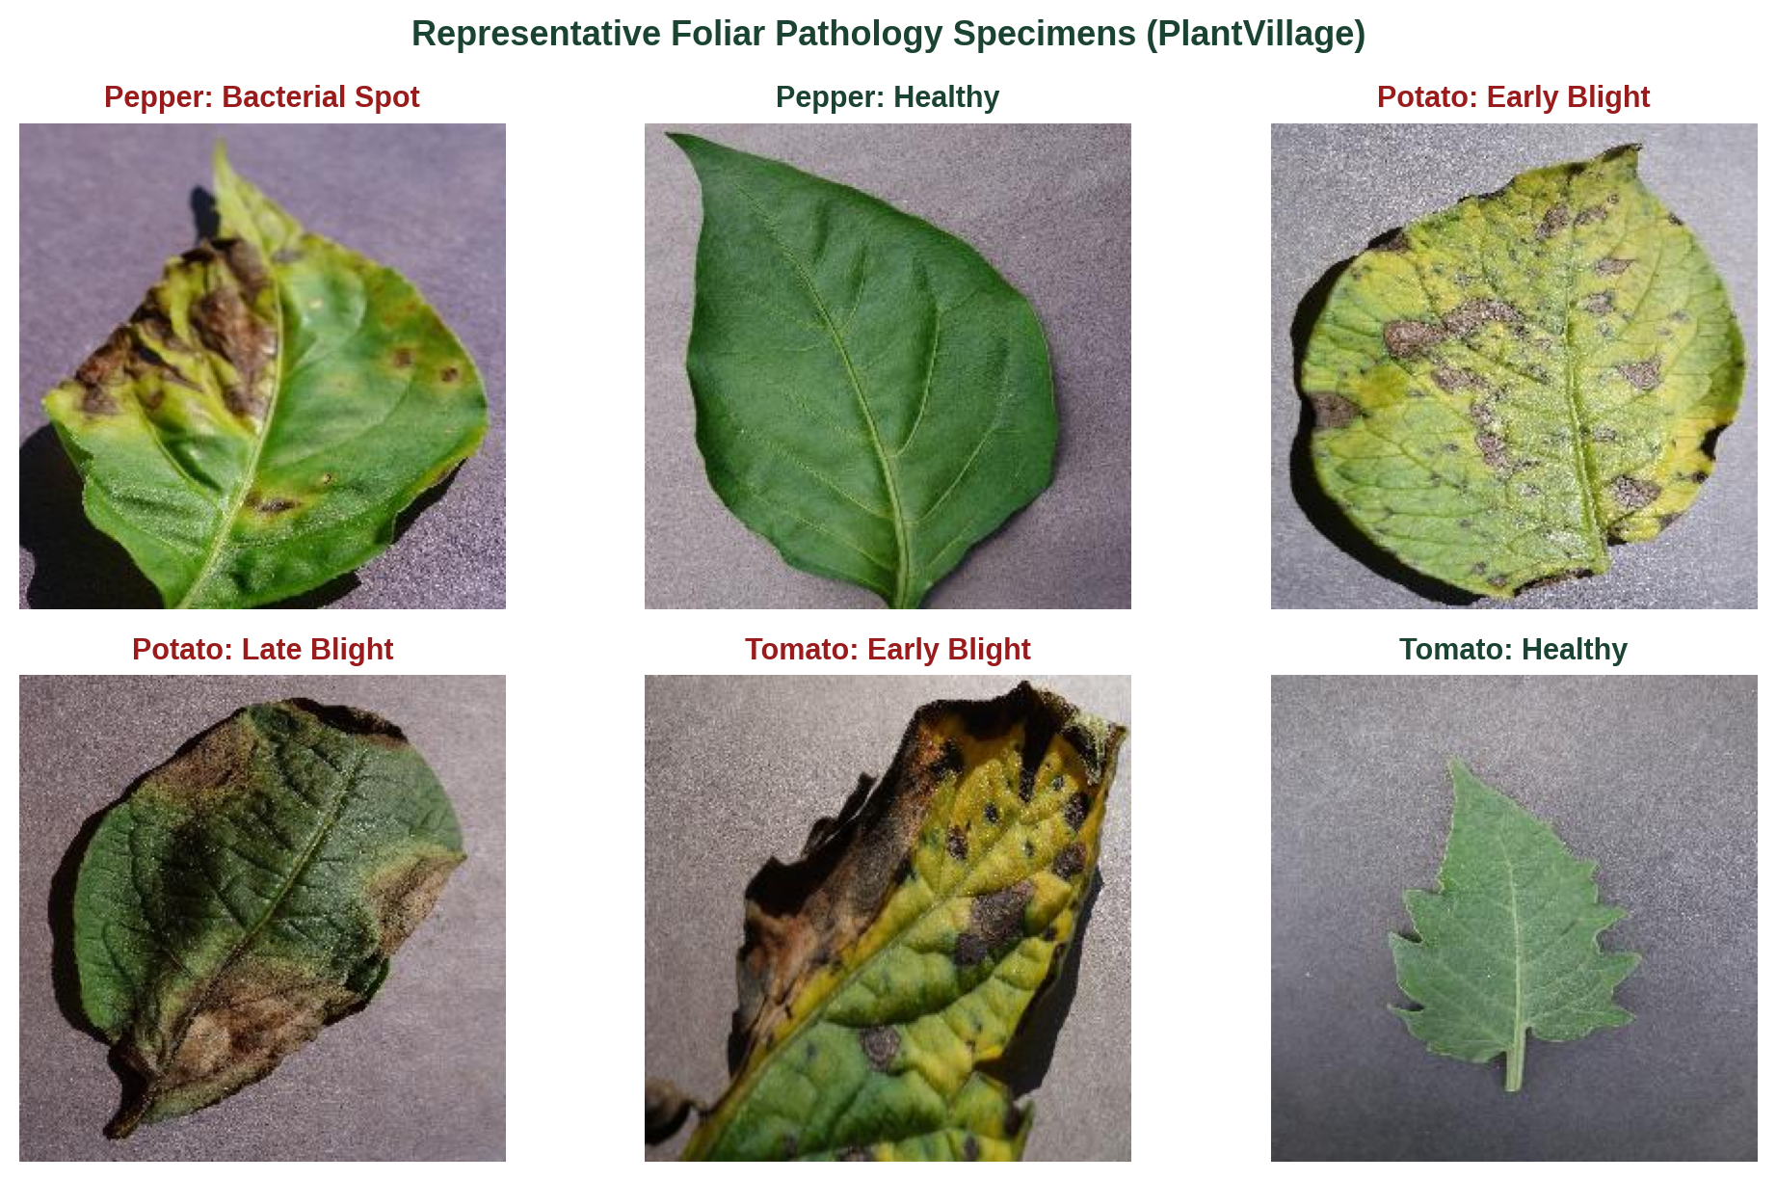
DATA UNDERSTANDING
Dataset Corpus & Exploratory Data Analysis
PlantVillage Benchmark Dataset
Total Images Cataloged: 20,639 high-resolution leaf images (256x256 RGB).
Target Pathology Classes: 15 distinct conditions across 3 vital staple crops:
- Pepper (Bell): Bacterial Spot, Healthy (2 classes).
- Potato: Early Blight, Late Blight, Healthy (3 classes).
- Tomato: 8 Disease conditions + Healthy foliage (10 classes).
Data Distribution: 86.7% diseased specimens, 13.3% healthy baseline leaves.
Class Cardinality: Ranges from 152 samples (Potato Healthy) to 3,209 samples (Tomato Yellow Leaf Curl Virus).
Rigorous Partitioning: Stratified 80% Train (16,511), 10% Val (2,064), 10% Test (2,064) ensuring exact class ratios.
Stratified sampling ensures balanced evaluation so that minority disease classes are represented equally in the test set.

Slide 4
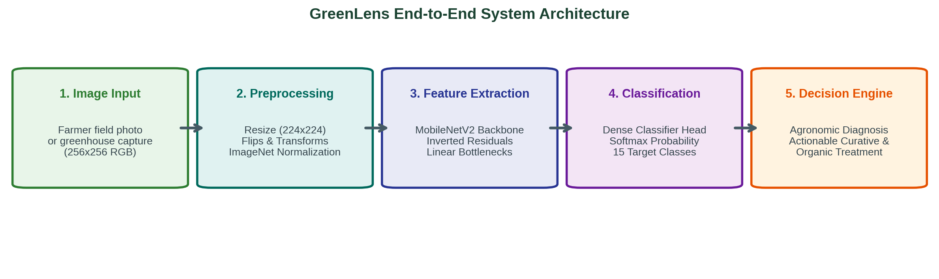
SYSTEM SOLUTION
GreenLens Closed-Loop Diagnostic Architecture
1. Preprocessing & Augmentation
- Geometric Transforms: Random Horizontal & Vertical Flips (p=0.5).
- Spatial Scaling: Standardized to 224x224 RGB.
- Color Normalization: ImageNet channel mean and variance alignment.
2. Deep Representation Learning
- Pretrained Feature Extractor: MobileNetV2 with inverted residual bottlenecks.
- Automatic Mixed Precision (AMP): Fast FP16/FP32 training with low memory usage.
- Optimization: AdamW with Cosine Annealing learning rate schedule.
3. Agronomic Decision Engine
- Clinical Mapping: Instant lookup from predicted class to agronomic regimen.
- Three-Tier Protocols: Immediate curative chemical, cultural prevention, and organic bio-control.
- Actionable Output: Direct confidence score and diagnostic treatment card.

Slide 5
ALGORITHM DESIGN
Algorithmic Modeling: From Scratch vs. Transfer Learning
Model 1: Custom CNN (From Scratch)
- Architecture: 4-stage sequential Convolutional network.
- Layer Hierarchy: Conv2D(32) -> Conv2D(64) -> Conv2D(128) -> Conv2D(256) with BatchNorm, ReLU, and 2x2 MaxPool.
- Classifier Head: AdaptiveAvgPool(4x4) -> Flatten -> Dropout(0.4) -> Dense(256) -> Dropout(0.3) -> Dense(15).
- Trainable Parameters: ~1.39 Million parameters.
- Inductive Bias: Learned strictly from 16,511 agricultural images without external priors.
- Baseline Test Accuracy: 84.25% (Macro F1: 77.47%).
- Bottleneck: Prone to lower sensitivity on rare classes (<200 samples).
Model 2: MobileNetV2 (Transfer Learning)
- Pretrained Backbone: ImageNet feature representation (1.4M natural images).
- Core Innovation: Depthwise Separable Convolutions & Inverted Residuals with linear bottlenecks.
- Algorithmic Efficiency: Reduces computational complexity from O(Dk^2 * M * N * Df^2) to O(Dk^2 * M * Df^2 + M * N * Df^2).
- Compute Savings: 8x to 9x fewer multiply-accumulate operations (MACs).
- Trainable Parameters: ~2.24 Million parameters (optimized for edge devices).
- Convergence Speed: Reaches 98.69% in epoch 1, 99.37% in epoch 2.
- Final Test Accuracy: 99.13% across all 15 classes (Macro F1: 99.13%).
Key Algorithmic Finding: Transfer learning resolves data scarcity in minority pathology classes by leveraging generalized low-level visual priors.

Slide 6
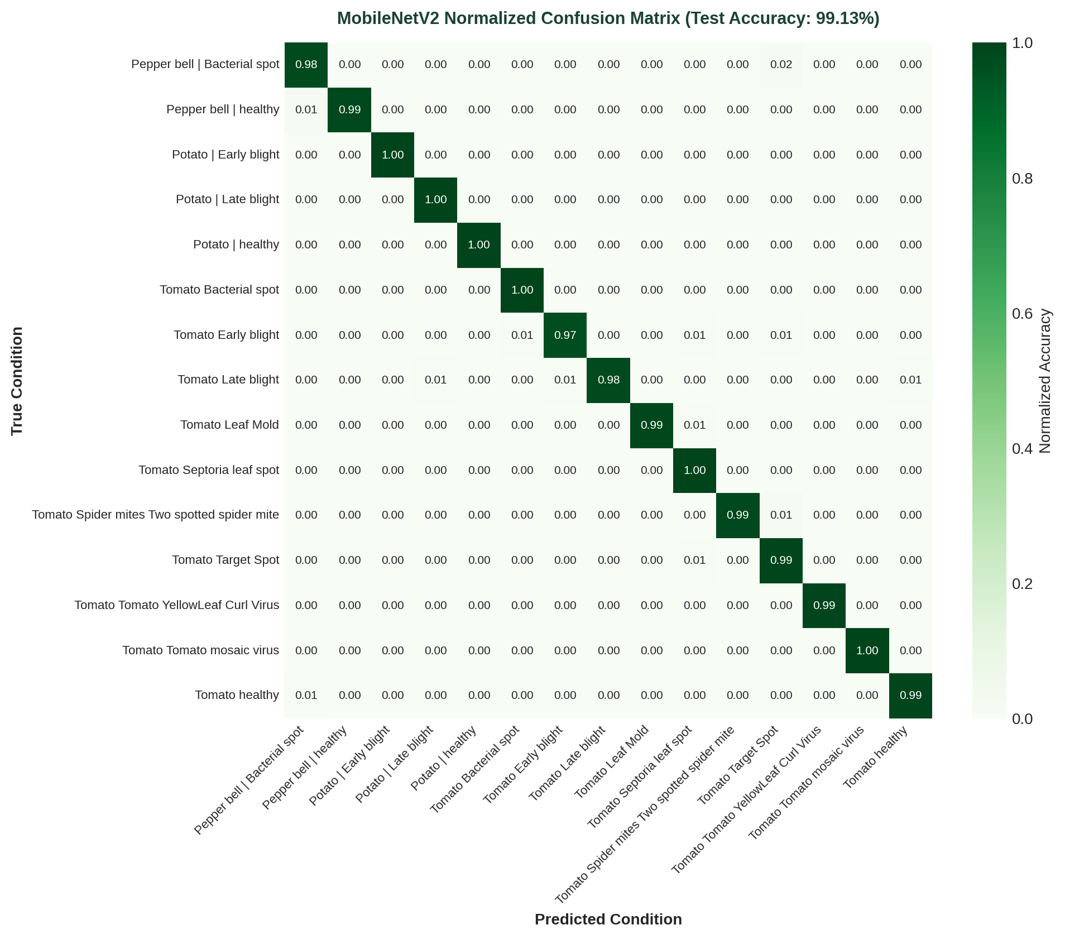
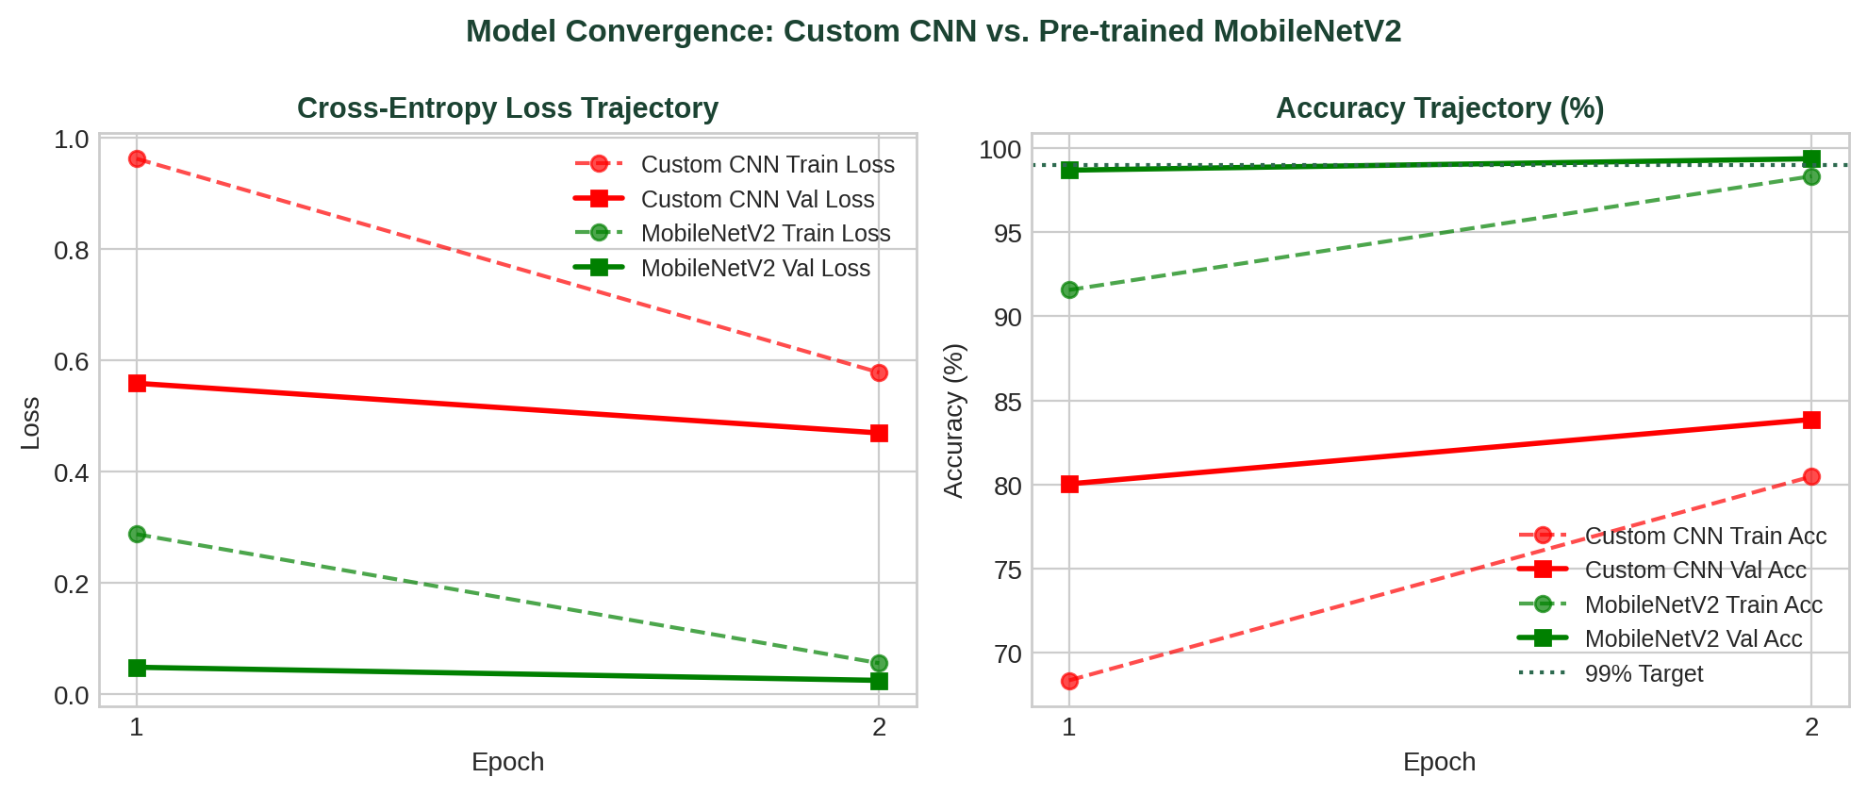
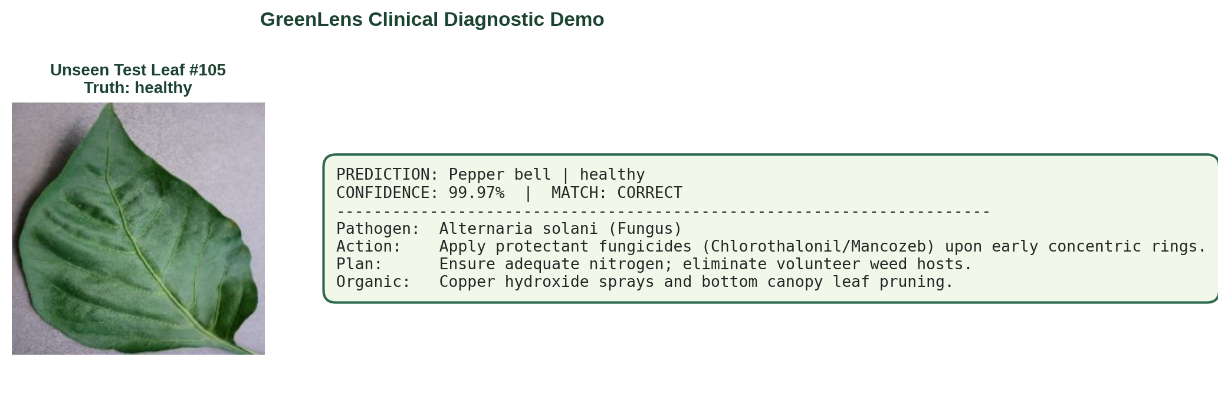
RESULTS & INFERENCE
Experimental Evaluation & Clinical Diagnostic Demo
Unseen Test Set Benchmark (2,064 Samples)
Overall Test Accuracy: Custom CNN: 84.25% | MobileNetV2: 99.13%
Macro-Averaged Precision: Custom CNN: 87.35% | MobileNetV2: 99.12%
Macro-Averaged Recall: Custom CNN: 76.19% | MobileNetV2: 99.16%
Macro-Averaged F1-Score: Custom CNN: 77.47% | MobileNetV2: 99.13%

Slide 7
SUMMARY & CLOSE
Conclusion, Algorithmic Takeaways & Next Steps
Key Project Achievements
- Developed GreenLens, an end-to-end plant disease diagnosis pipeline for 15 foliar conditions.
- Achieved 99.13% test accuracy and 99.13% macro F1-score across 2,064 unseen test images.
- Seamlessly integrated automated diagnostic decision support offering tailored treatment protocols.
Algorithmic Insights
- Complexity Reduction: Depthwise separable convolution achieves 8-9x FLOP savings, proving ideal for mobile deployment.
- Inductive Bias Transfer: Pretrained representations eliminate class imbalance penalties on minority pathology classes.
- Convergence Velocity: Reached near-optimal validation performance in just 2 epochs of fine-tuning.
Future Roadmap
- Edge Mobile App: Package model into ONNX / TFLite for real-time offline field inference.
- Multi-Leaf Segmentation: Integrate YOLO/Mask R-CNN to localize multiple diseased leaves per plant.
- Continuous Learning: Implement active learning pipeline from farmer feedback and verified field samples.
Thank You! Questions & Discussion
GreenLens | Team TerraGreen | Presenter: Abdelaziz Ahmed Elbanna | Supervisor: Dr. Fatma Talaat

