Slide 1

Screen 1: User can sign up easily by Google

Slide 2
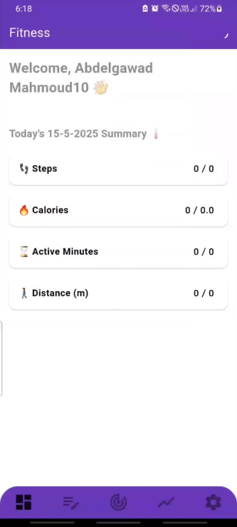
Screen 2: Today's Summary (Initial Setup)
Purpose
This screen appears during the initial setup or when goals are not yet set, showing a summary with all metrics at zero.
Key Elements
Header: Shows the app name "Fitness" and the current time (e.g., 6:19).
Welcome Message: Greets the user by name (e.g., "Welcome, Abdelgawad MAHMOUD10") with a waving hand emoji.
Date: Displays the current date (e.g., "TODAY'S 15-5-2025 SUMMARY").
Summary Section:
Steps: 0 / 0
Calories: 0 / 0.0
Active Minutes: 0 / 0
Distance (m): 0 / 0
Navigation Bar: At the bottom, includes icons for different app sections.
Functionality
Indicates that no goals or activity data have been set or logged yet.
Encourages the user to set goals or log activities to start tracking progress.
Allows navigation to other app sections via the bottom navigation bar.

Slide 3
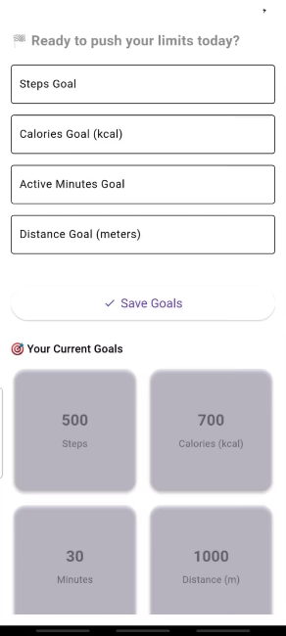
Screen 3: Set Goals (Updated Goals)
Purpose
This screen allows the user to set new fitness goals, showing updated current goals compared to Screen 2.
Key Elements
Header: Displays the app name "Fitness" and the current time (e.g., 6:19).
Prompt: "Ready to push your limit today?" encourages the user to set new goals.
Input Fields:
Steps Goal: A text field to input the desired steps goal.
Calories Goal (kcal): A text field to input the desired calories goal.
Active Minutes Goal: A text field to input the desired active minutes goal.
Distance Goal (meters): A text field to input the desired distance goal.
Save Goals Button: A purple button labeled "Save Goals" to confirm the entered values.
Current Goals Section:
Displays the user's updated current goals:
Steps: 500
Calories: 700 kcal
Active Minutes: 30
Distance: 1000 meters
Navigation Bar: At the bottom, includes icons for different app sections.
Functionality
Similar to Screen 2 but shows updated current goals, indicating that the user has previously set new goals.
Users can input and save new fitness goals.
The "Your Current Goals" section reflects the most recent goals set by the user.
Navigation to other app sections is available via the bottom navigation bar.

Slide 4
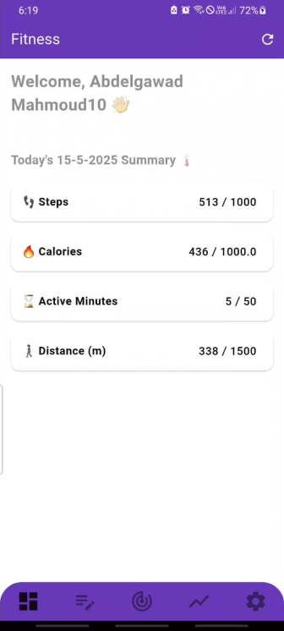
Screen 4: Today's Summary (Welcome Screen)
Purpose
This screen welcomes the user and provides a summary of their fitness activity for the current day (May 15, 2025).
Key Elements
Header: Shows the app name "Fitness" and the current time (e.g., 6:19).
Welcome Message: Greets the user by name (e.g., "Welcome, Abdelgawad MAHMOUD10") with a waving hand emoji.
Date: Displays the current date (e.g., "TODAY'S 15-5-2025 SUMMARY").
Summary Section:
Steps: Shows steps taken (e.g., 513) out of the goal (e.g., 1000).
Calories: Shows calories burned (e.g., 436) out of the goal (e.g., 1000.0).
Active Minutes: Shows active minutes (e.g., 5) out of the goal (e.g., 50).
Distance (m): Shows distance covered (e.g., 338) out of the goal (e.g., 1500).
Navigation Bar: At the bottom, includes icons for different app sections.
Functionality
Welcomes the user and provides a quick overview of their daily fitness progress.
Displays the same metrics as the "Daily Progress" screen but in a list format with icons (e.g., a shoe for steps, a flame for calories).
Allows navigation to other app sections via the bottom navigation bar.

Slide 5
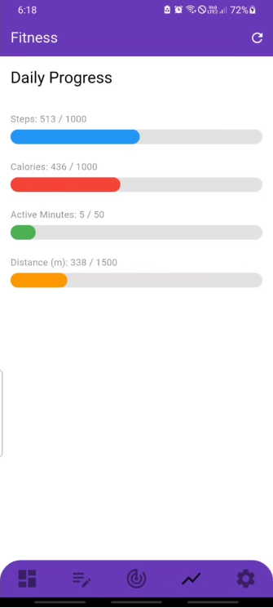
Screen 5: Daily Progress
Purpose
This screen displays the user's daily fitness progress toward their set goals for steps, calories burned, active minutes, and distance covered.
Key Elements
Header: Shows the app name "Fitness" and the current time (e.g., 6:18).
Title: "Daily Progress" indicates the focus of the screen.
Progress Bars:
Steps: Displays current steps (e.g., 513) out of the goal (e.g., 1000) with a blue progress bar.
Calories: Shows calories burned (e.g., 436) out of the goal (e.g., 1000) with a red progress bar.
Active Minutes: Indicates active minutes (e.g., 5) out of the goal (e.g., 50) with a green progress bar.
Distance (m): Shows distance covered (e.g., 338 meters) out of the goal (e.g., 1500 meters) with an orange progress bar.
Navigation Bar: At the bottom, includes icons for different app sections (e.g., home, progress, settings).
Functionality
Provides a visual representation of the user's daily fitness achievements.
Progress bars update dynamically as the user logs activity.
Allows navigation to other app sections via the bottom navigation bar.

Slide 6
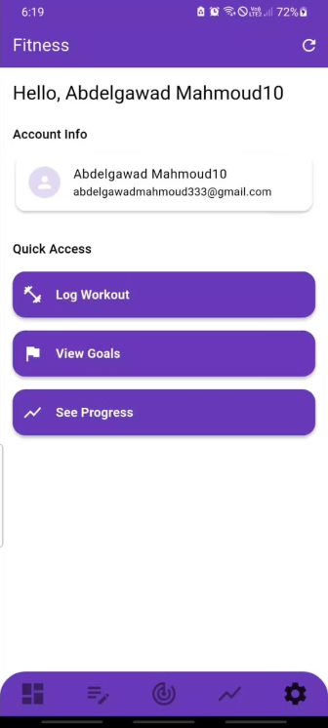
Screen 6: Account Info
Purpose
This screen displays the user's account information and provides quick access to key app features.
Key Elements
Header: Shows the app name "Fitness" and the current time (e.g., 6:19).
Welcome Message: Greets the user by name (e.g., "Hello, Abdelgawad MAHMOUD10").
Account Info Section:
Displays the user's name (e.g., "Abdelgawad MAHMOUD10") and email (e.g., "abdelgawadmahmoud333@gmail.com") with a user icon.
Quick Access Section:
Log Workout: A purple button to log a workout.
View Goals: A purple button to view current fitness goals.
See Progress: A purple button to view fitness progress.
Navigation Bar: At the bottom, includes icons for different app sections.
Functionality
Displays the user's account details for reference.
Provides quick access to key features like logging workouts, viewing goals, and seeing progress.
Allows navigation to other app sections via the bottom navigation bar.

Slide 7
Screen 7: Daily Progress
Purpose
This screen displays the user's daily fitness progress toward their set goals for steps, calories burned, active minutes, and distance covered.
Key Elements
Header: Shows the app name "Fitness" and the current time (e.g., 6:18).
Title: "Daily Progress" indicates the focus of the screen.
Progress Bars:
Steps: Displays current steps (e.g., 513) out of the goal (e.g., 1000) with a blue progress bar.
Calories: Shows calories burned (e.g., 436) out of the goal (e.g., 1000) with a red progress bar.
Active Minutes: Indicates active minutes (e.g., 5) out of the goal (e.g., 50) with a green progress bar.
Distance (m): Shows distance covered (e.g., 338 meters) out of the goal (e.g., 1500 meters) with an orange progress bar.
Navigation Bar: At the bottom, includes icons for different app sections (e.g., home, progress, settings).
Functionality
Provides a visual representation of the user's daily fitness achievements.
Progress bars update dynamically as the user logs activity.
Allows navigation to other app sections via the bottom navigation bar.

