Slide 1

Using NIST Tools for Evaluation of Immunization Clinical Decision Support Systems
FITS – Forecasting for Immunization Test Suite
Robert Snelick
National Institute of Standards and Technology (NIST)
Eric Larson, Nathan Bunker
American Immunization Registry Association (AIRA)
April 13th, 2017
Contact: robert.snelick@nist.gov

Slide 2
Agenda
Why are we doing this?
FITS Overview
Test Case Creation
Test Case Execution
FHIR Interface
FITS Demonstration
Plans for Assessment
What’s next
Resources and Wrap up

Slide 3
Acknowledgements
Collaborative Effort
AIRA
CDC
NIST
NIST Team
Mike Indovina – Lead, Analyst, and IG Development
Hossam Tamri – Tool Architect and Developer
Andrew McCaffrey – FHIR Implementation

Slide 4
Purpose and Need
Current Challenges
CDSi Test Cases use primitive tooling
Time consuming
Easy to make an error
Difficult to keep timely
Only published in one format
Benefits of Future Tooling
Fixes the current challenges
Available for all to use and develop their own CDS test cases
Shareable test cases
Allows for real time execution
Useable by AIRA for CDS Assessment

Slide 5
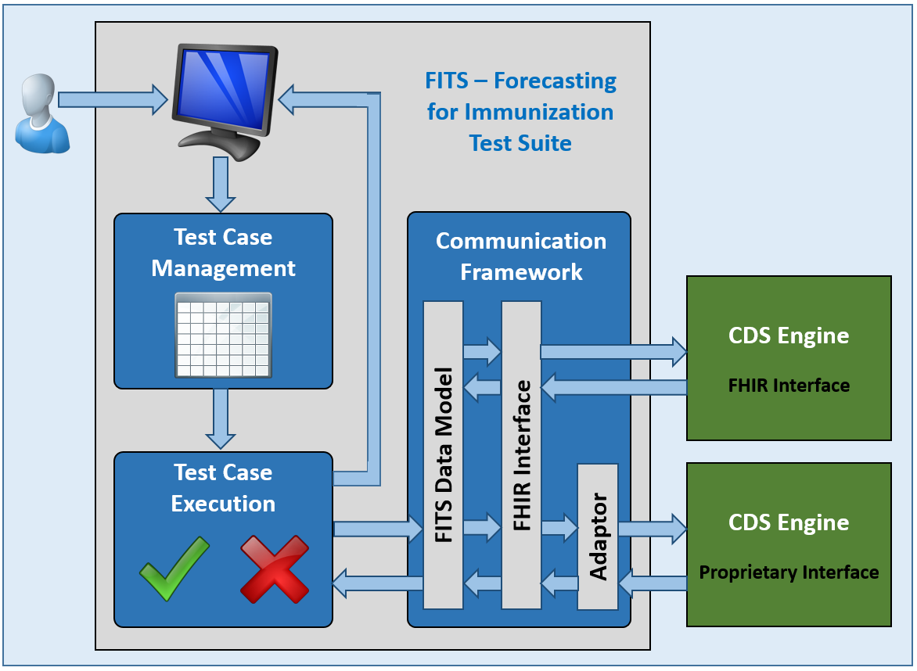
FITS Overview
Measures immunization CDS engines against the ACIP recommendations
Create and manage immunization CDS test cases
Validates test cases and reports the results in a standardized format
Standardize FHIR interface

Slide 6
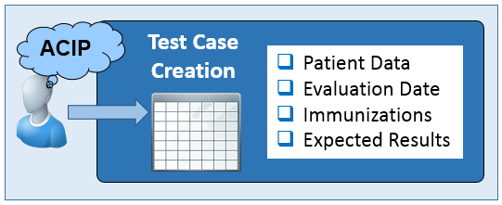
Test Cases
Allows user to create test cases
Users provide the expertise based on ACIP recommendations
FITS Provides:
Organization
Management
Look-up Assistance
Test Case Summaries
Import and Export Capabilities
Import CDC Excel Spreadsheet Format
Export XML format and CDC Excel Spreadsheet Format
Export PDF of test cases

Slide 7
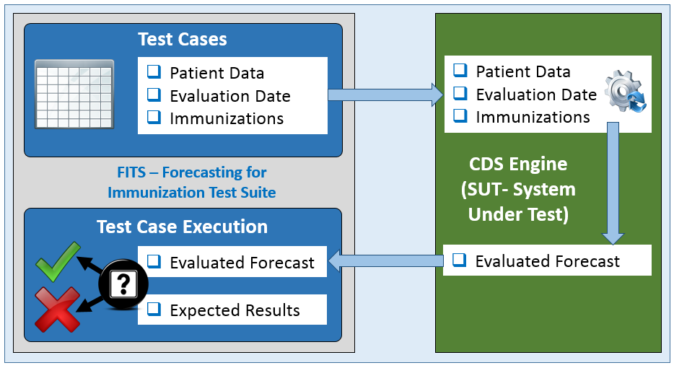
Validation
Executes test cases
Provides summary and detail validation reports
Maintains history of validation reports

Slide 8
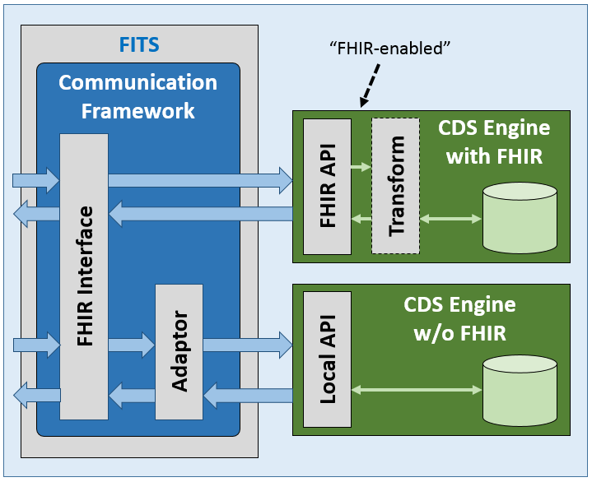
Standardize API for Immunization CDS Engines
Current CDS engines use proprietary interfaces
Standardized interface using HL7 FHIR
FHIR – Fast Healthcare Interoperability Resources
Data formats and elements (known as "resources") and an API for exchanging healthcare data using HTTP-based RESTful protocol
Based on:
Patient base resource
Immunization base resource
Immunization Recommendation base resource
Profiled for testing Immunization CDS Engines
Patient resource for Gender and DOB
Immunization resource for history
Immunization recommendation for evaluation
Organized as a FHIR Implementation Guide
Describes scope and purpose
Describes how to use the FHIR API
Notes:
Compare resources to v2 segments, profiled resources to profiling in v2 (base standard to IG)
Adapter with FHIR can (likely will) be the native (local) API.
NIST Adaptor is a stop-gap solution. We will want all CDS engines to implement the FHIR interface.
Important to have FHIR interface when considering the many CDS engines.
Importance of standards—any updates locally will break NIST adaptor.

Slide 9
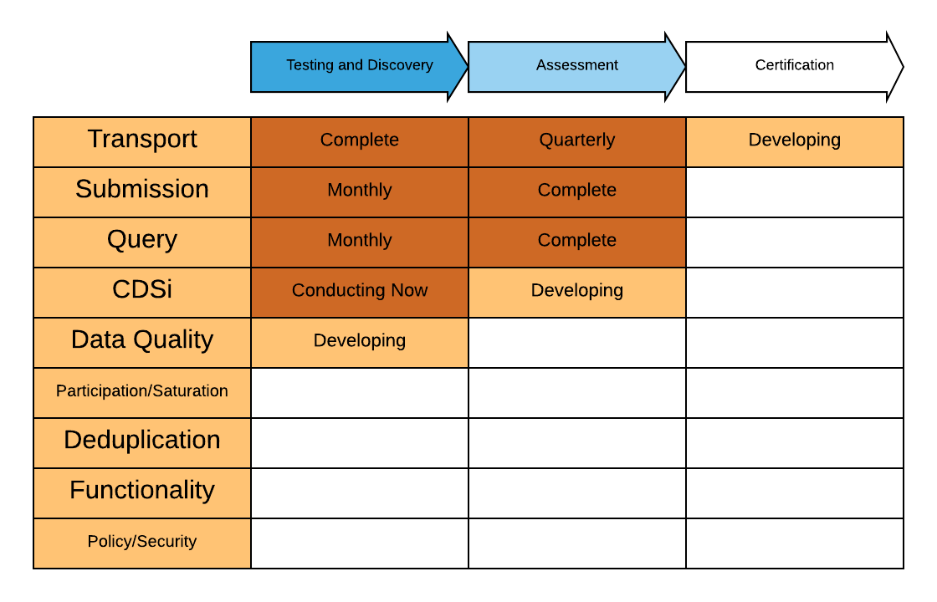
AIRA Assessment Process
MACAW
Measurement for Assessment and Certification Advisory Workgroup
Responsible for
providing direction
creating measures
AART
Aggregate Analysis Reporting Tool
Maintained by AIRA
Community uses to access reports

Slide 10
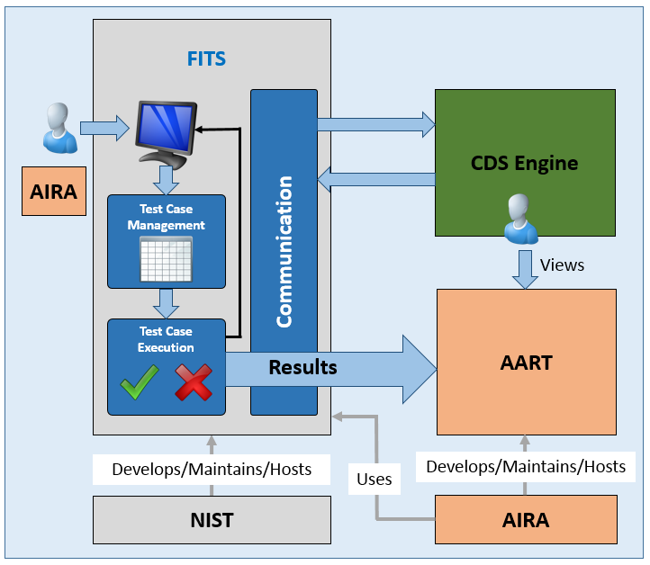
AIRA Assessment of Forecasting Engines
NIST provides platform for self-testing or test programs
MACAW to develop test cases for assessment
AIRA uses FITS to conduct CDS Engine testing
Community will access results via AART
CDS Engine developers can view assessment results
AART maintains history and progress reports
Notes:
CDS engine in the context of the IIS as opposed to the CDS engine in isolation. FITS can be for the engine evaluation for IIS, EHR-S, or the generic engine.

Slide 11
What’s Next?
Beta release available now—1st official release by mid-Summer
Give it a try!
Create test cases
Evaluate your engine
Build a FHIR interface to your engine
Operationalize
Plan for creating and managing test cases
Updates and versioning
Adopted by the CDSi project
Future capabilities
Test Case Verification Assistance
Support for collaboration
HL7 v2 End-to-end Testing

Slide 12


Resources
Tool Link:
https://fits.nist.gov
Google Group – List Server for Discussion/Questions
Google Group Site Link:
https://groups.google.com/d/forum/fits-immunization-testing
Send messages to:
fits-immunization-testing@googlegroups.com

