Slide 1
Creating a Test Case For a Newborn (age 0) with no vaccination history

Slide 2
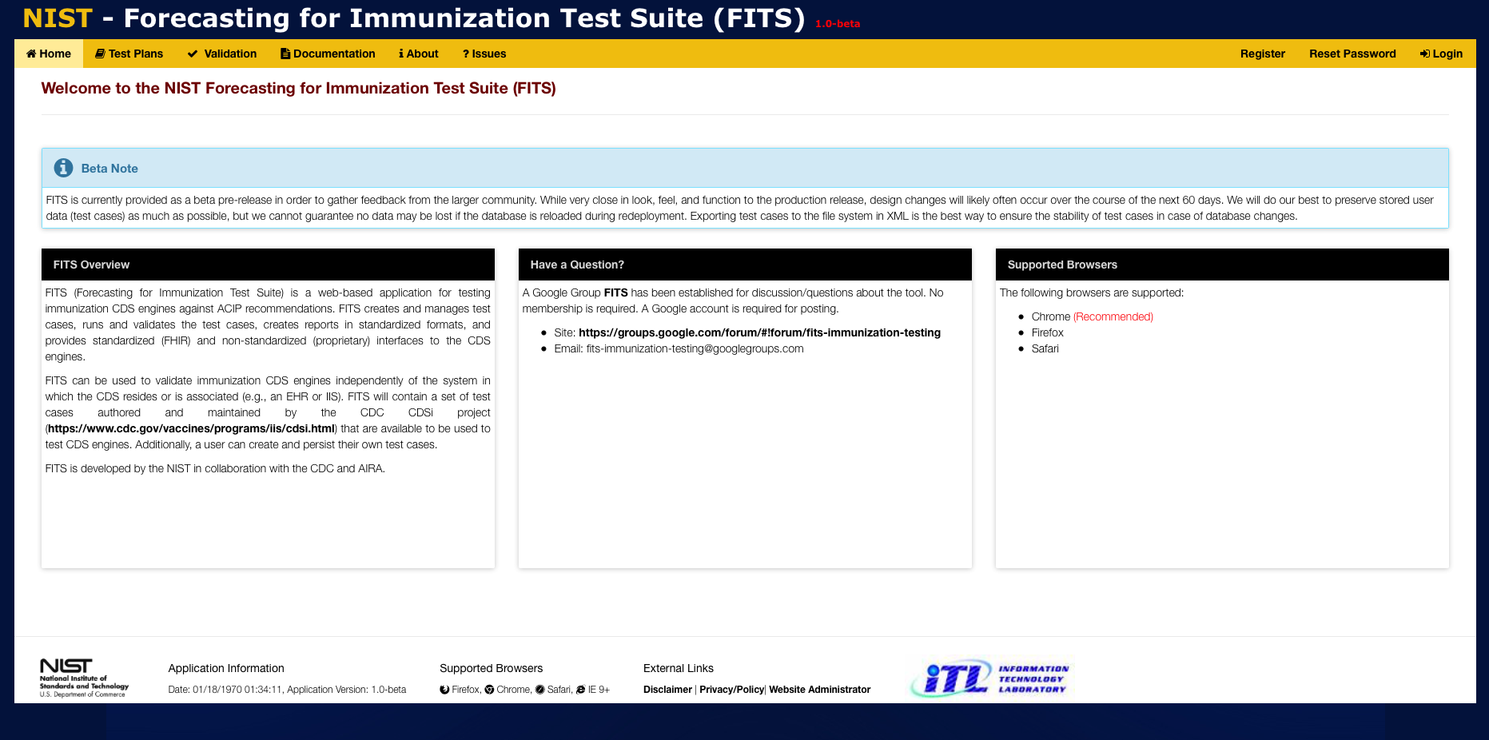
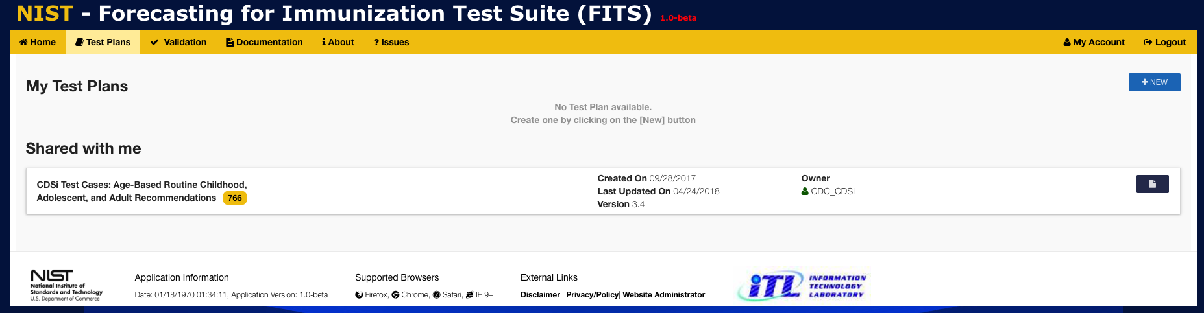
1
Click on Test Plans to display the Test Plans window
2
Click on +NEW to create a new Test Plan

Slide 3
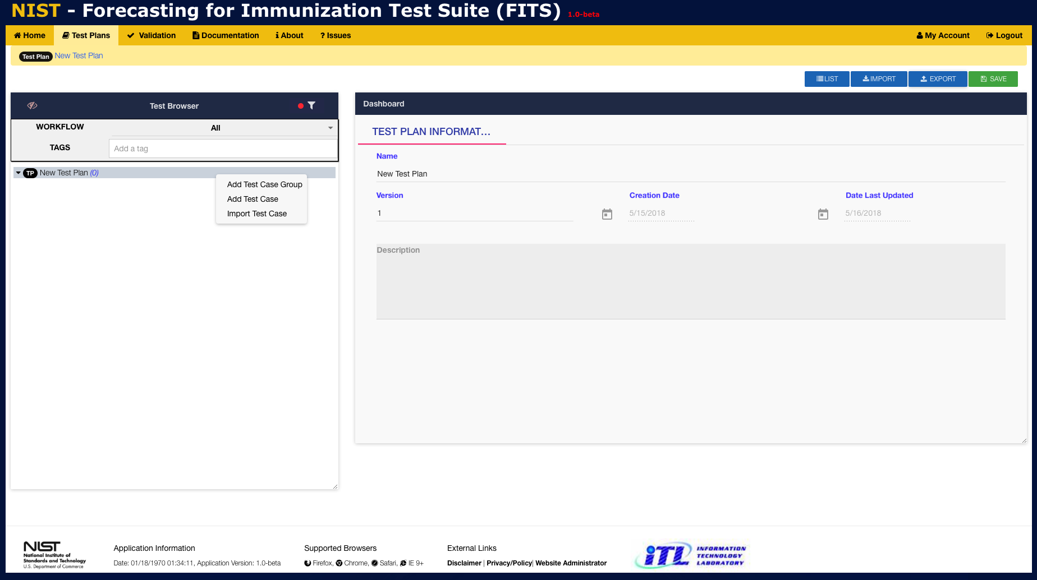
3
Enter the Name, Version, and Description into the provided fields.
4
Right-click to display context-menu
5
Select Add Test Case

Slide 4
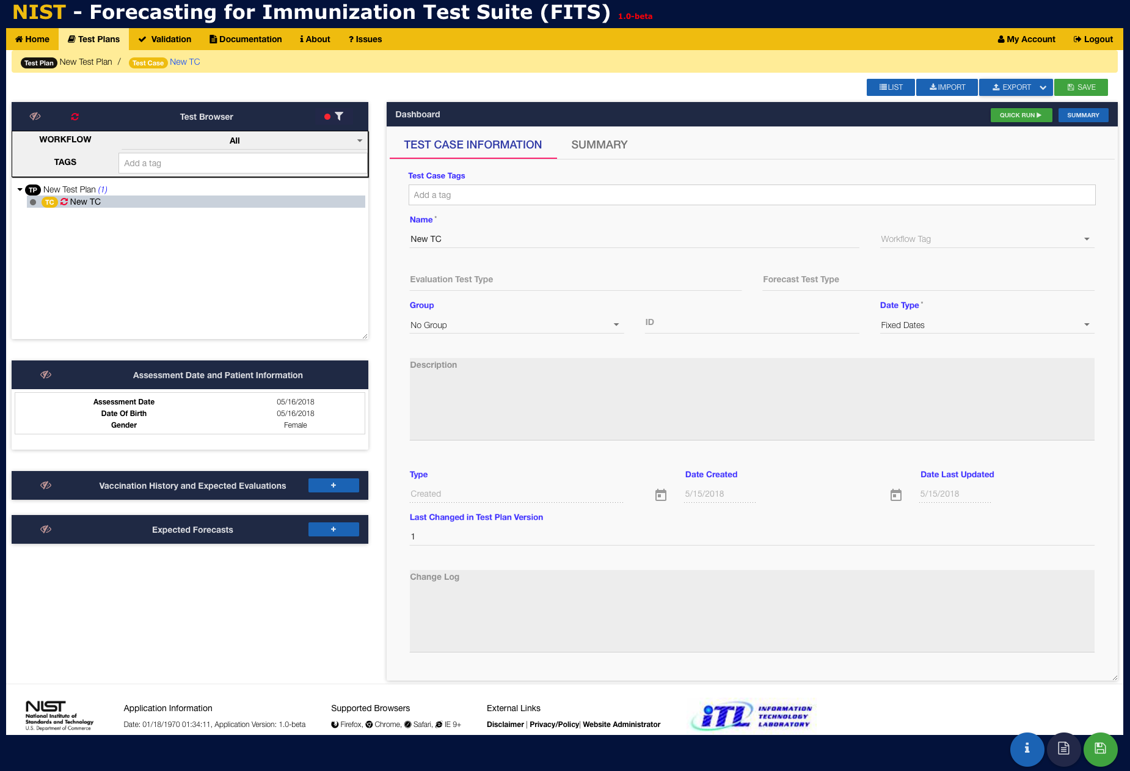
7
Enter Test Case information as appropriate into the provided fields
6
A new Test Case called ”New TC” is created under the Existing Test Plan

Slide 5
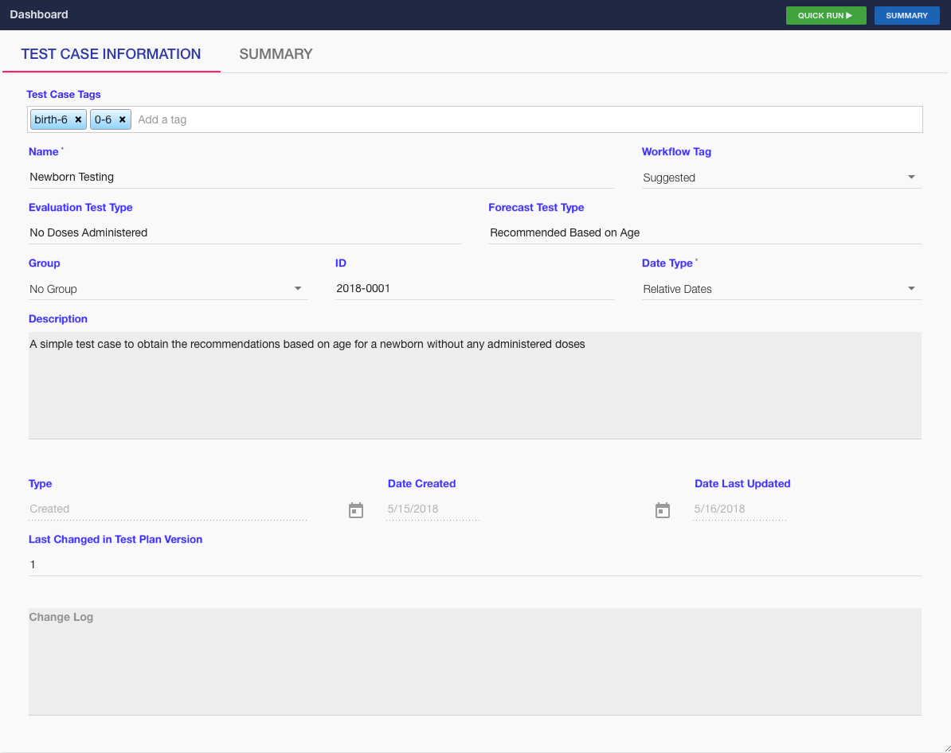
8
Example Test Case Metadata
9
Click here to display the Assessment Date and Patient Information entry window

Slide 6
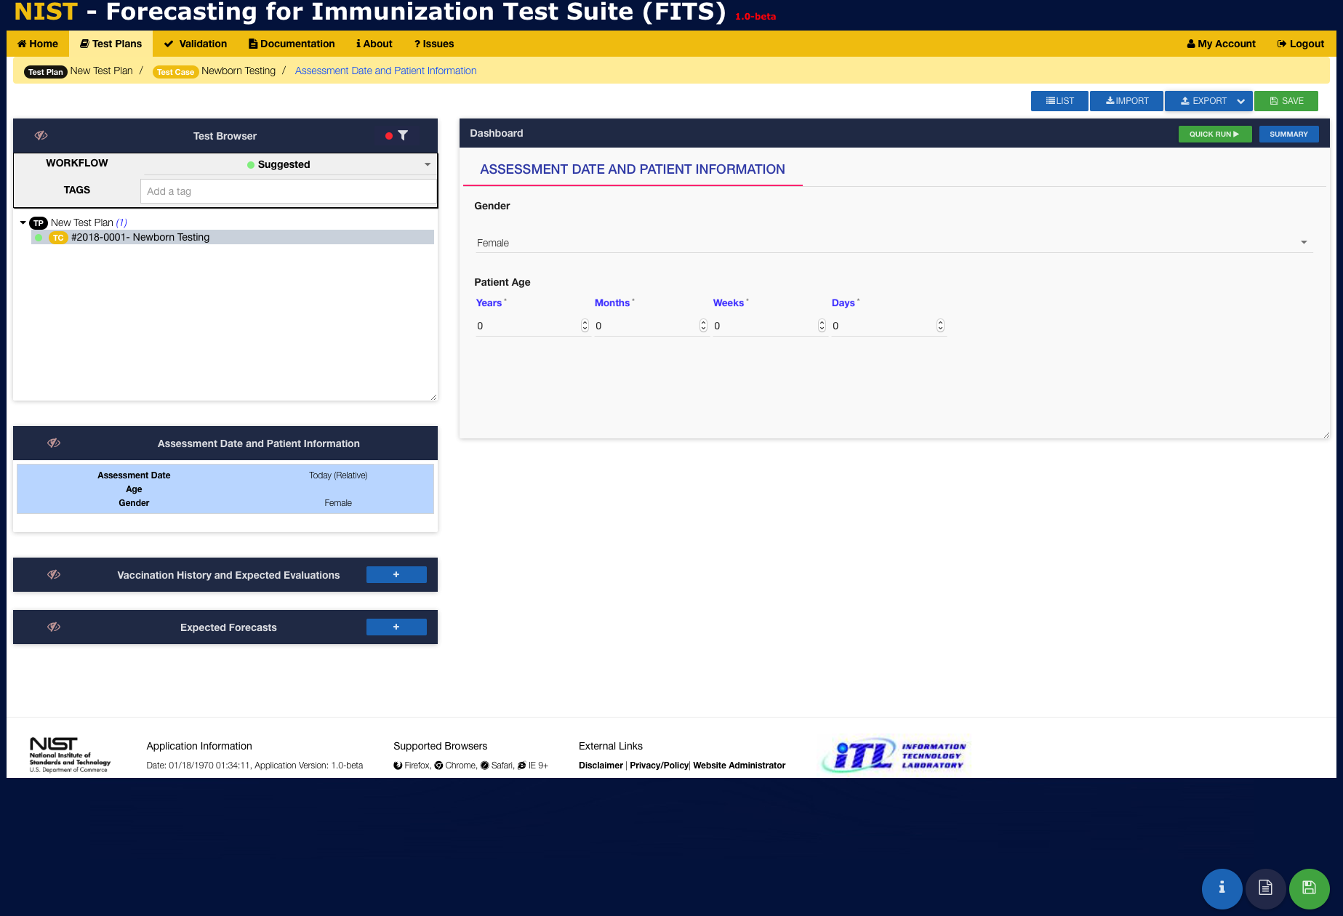
*NOTE: Since we selected Date Type -> Relative Dates in the previous Test Case Information window, there is no place to enter the Assessment Date It will always be set to the current date!
10
Select the Patient’s Gender from a drop-down menu
11
Enter the Patient’s Age
12
Patient has no vaccination history (no need to enter)
13
Click the + to enter an Expected Forecast for each vaccine or vaccine group

Slide 7
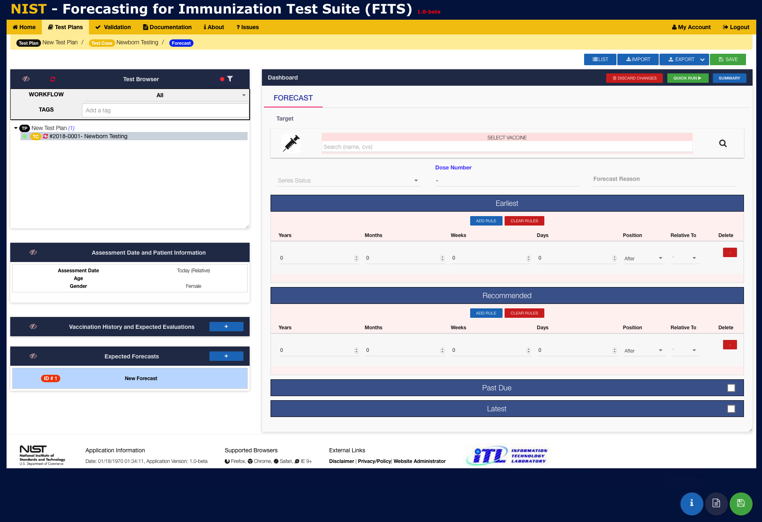
Enter the name or CVX code for a vaccine or vaccine group
OR
Use the Vaccine Browser by clicking on the magnifying glass
14
Enter expected Series Status and Dose Number [REQUIRED]
15
16
Enter expected Earliest and Recommended
dates for the forecast [REQUIRED]
17
Enter expected Past Due and Latest
dates for the forecast [OPTIONAL]

Slide 8
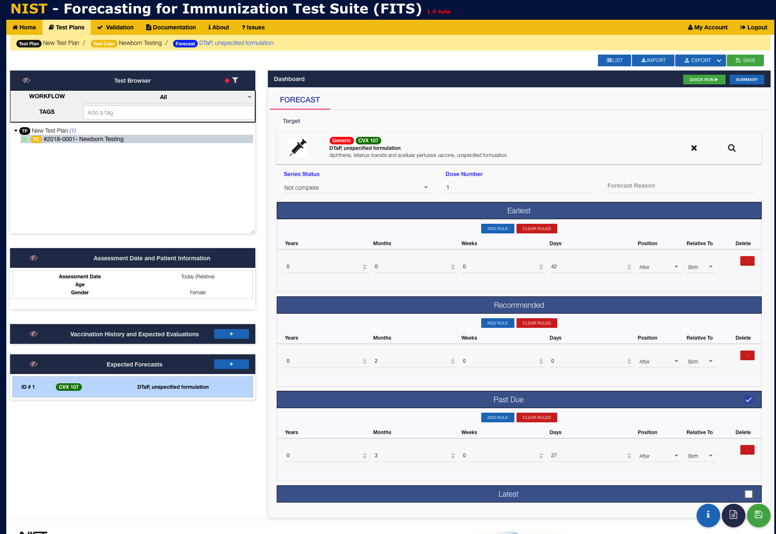
19
Click SAVE to save newly entered Test Case information
20
Example Forecast Information for DTaP, unspecified with
Patient Age & Gender, and Earliest, Recommended, &
Past Due (relative) dates
Click SUMMARY to view all test case information (Data & Metadata)
18

Slide 9
