Slide 1
Test Case Execution Executing a group of test cases

Slide 2
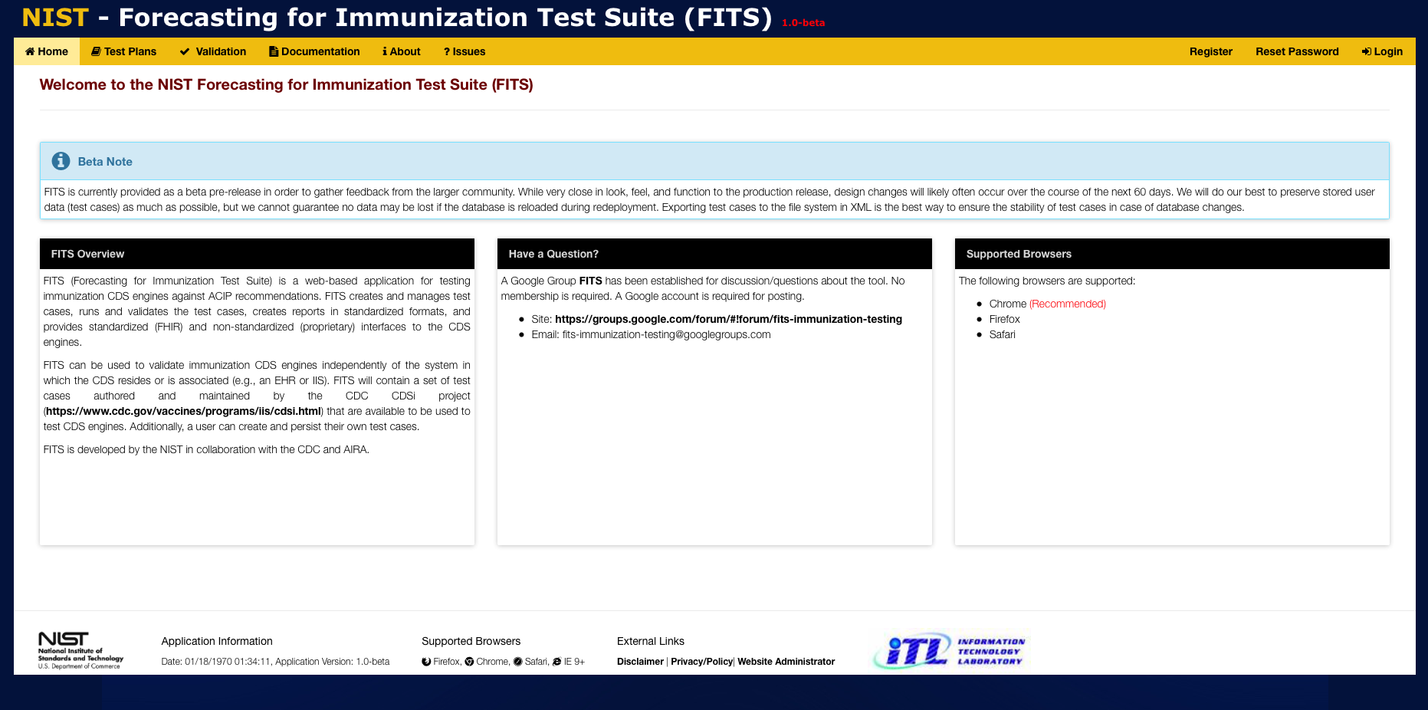
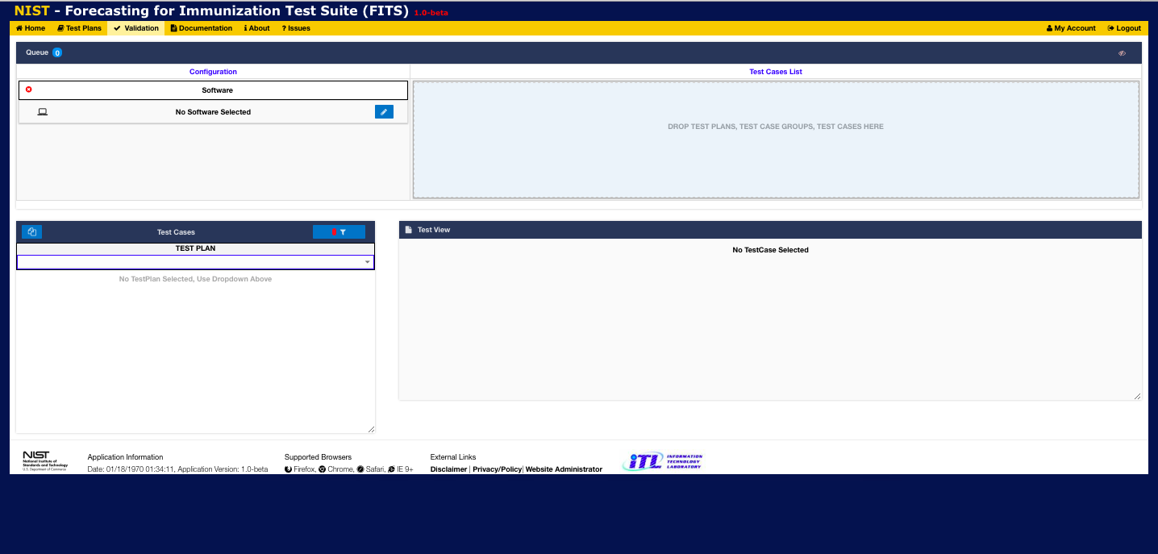
1
Click on Validation to display the Validation Window

Slide 3
2
Select the Test Plan from the drop-down list

Slide 4
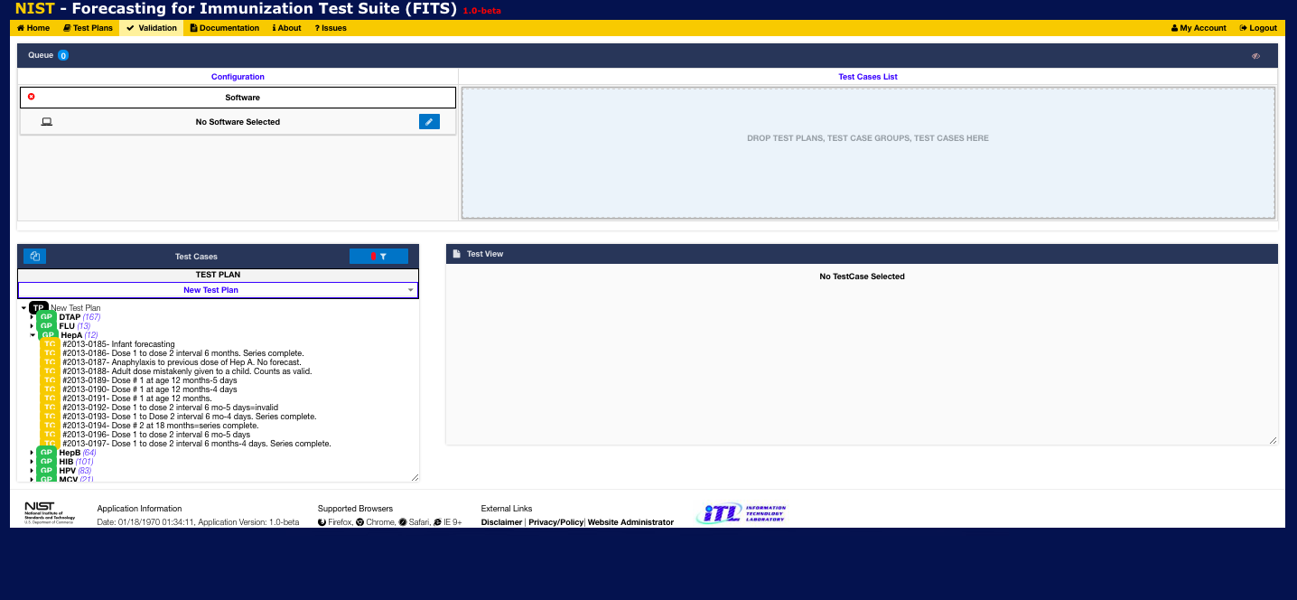
3
View Test Plan organized by test groups.
Click on arrow to left of group name to expand and view the test cases in that gorup

Slide 5
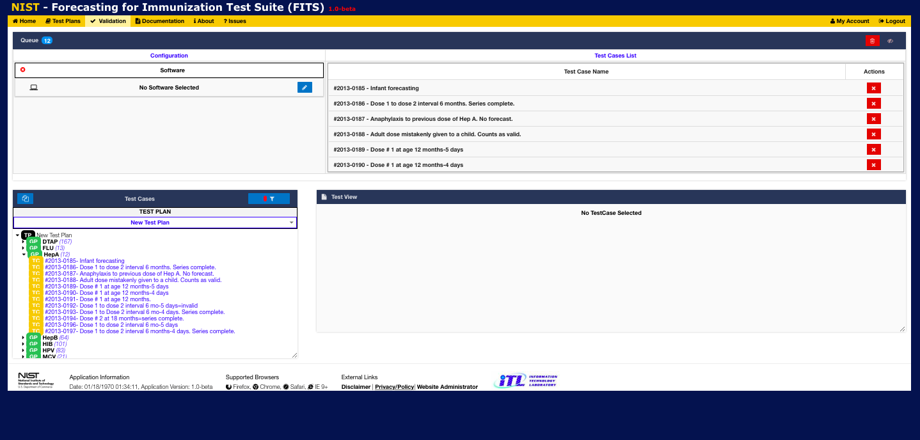
4
Drag and drop the test group name into the Test Cases List window
All test cases from that group will appear in the Test Cases List window

Slide 6
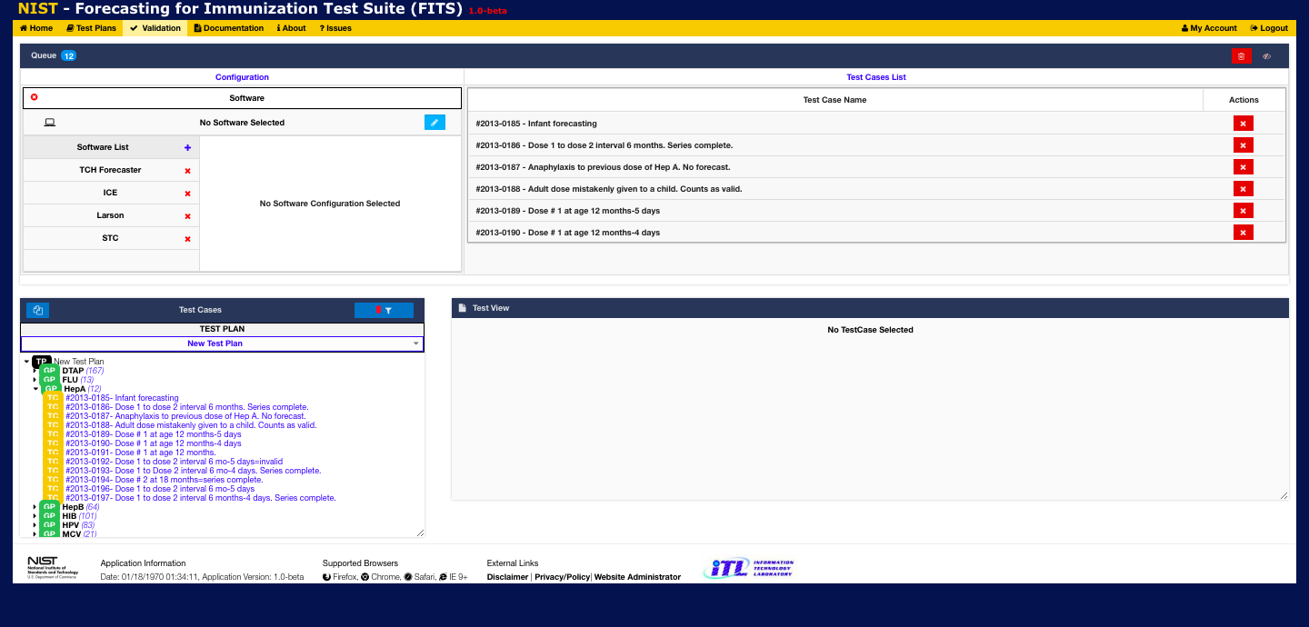
5
Click the pencil icon in the Configuration window to view/select/add/delete CDS software to execute tests cases against Clicking on the + icon allows the user to define new CDS software by defining its name, endpoint address, and interface type Clicking on the name of a CDS engine in the Software List will select that CDS engine for test case execution and display its configuration details

Slide 7
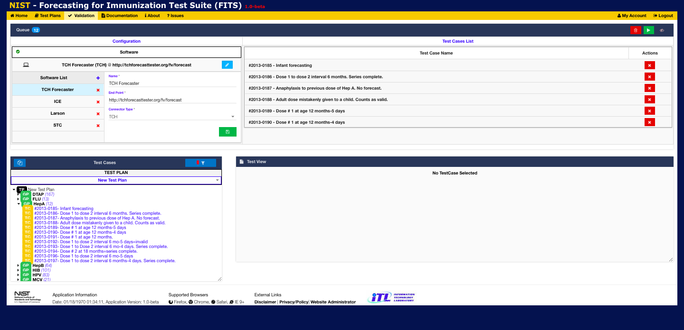
7
Click on the Save icon to save this configuration if any changes were made
8
6
Select a CDS software type execute against
NOTE: After the Test Cases List has been populated and a CDS Software has been selected, the Play/Execute button will appear
Click the Play/Execute button to display the Execution Window and initiate execution of the test case(s) in the Test Cases List

Slide 8
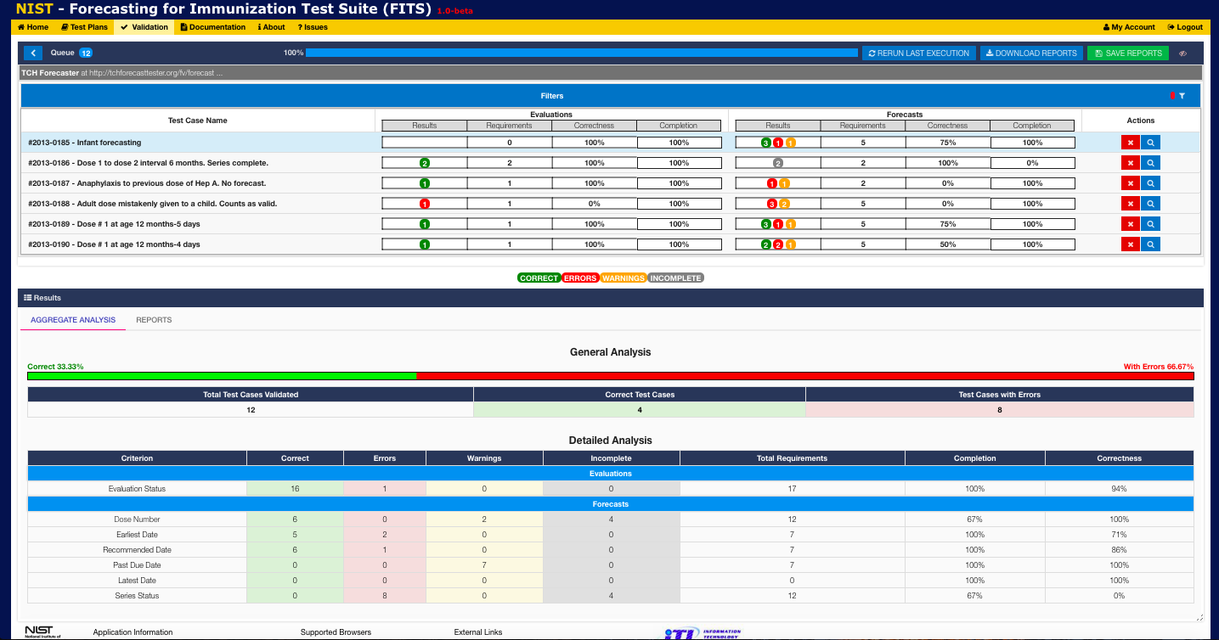
Selecting Play/Execute displays the Execution Window and begins test case execution.
During execution the results for each test case are displayed in the Queue pane and a progress ba at the top of that pane shows the % of test cases which have been completed
9
11
Click the Reports tab to view individual test case results
After execution completes the overall results are displayed in the Results pane (by default the results are aggregated).
10

Slide 9
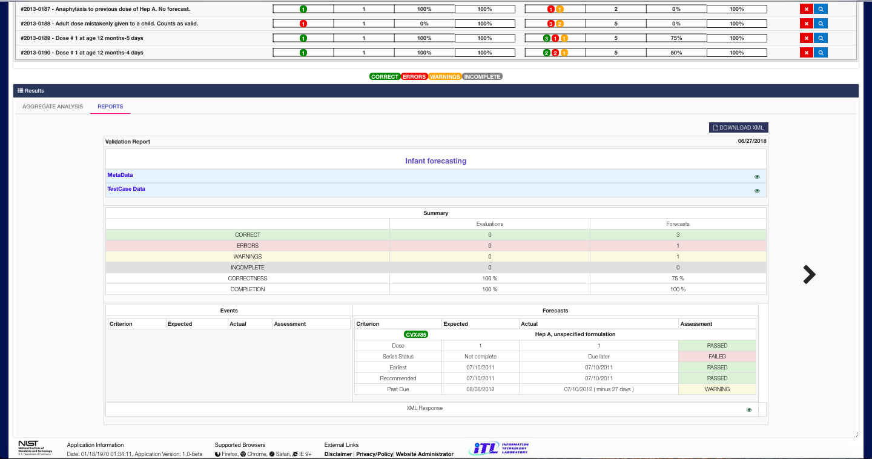
Click the arrows to view individual test case results
12

Slide 10
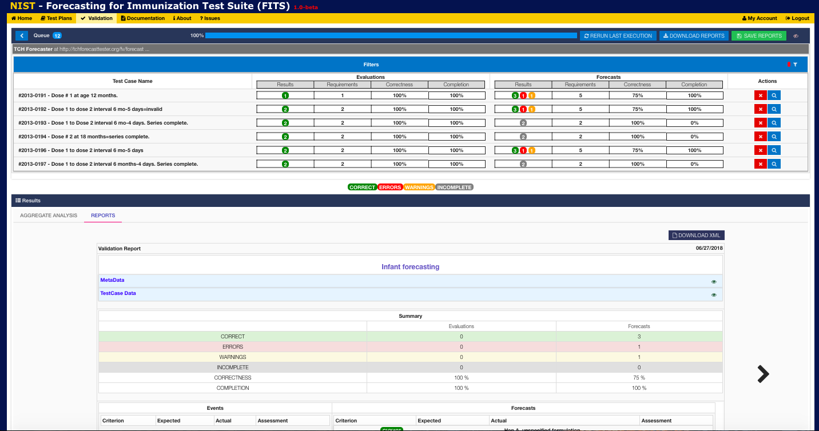
14
13
Click the < button to return to the Validation Window
Click Save Reports to save the results of all recently executed test cases
. Note that past test case results are viewable from the Test Cases pane of the Validation Window

Slide 11
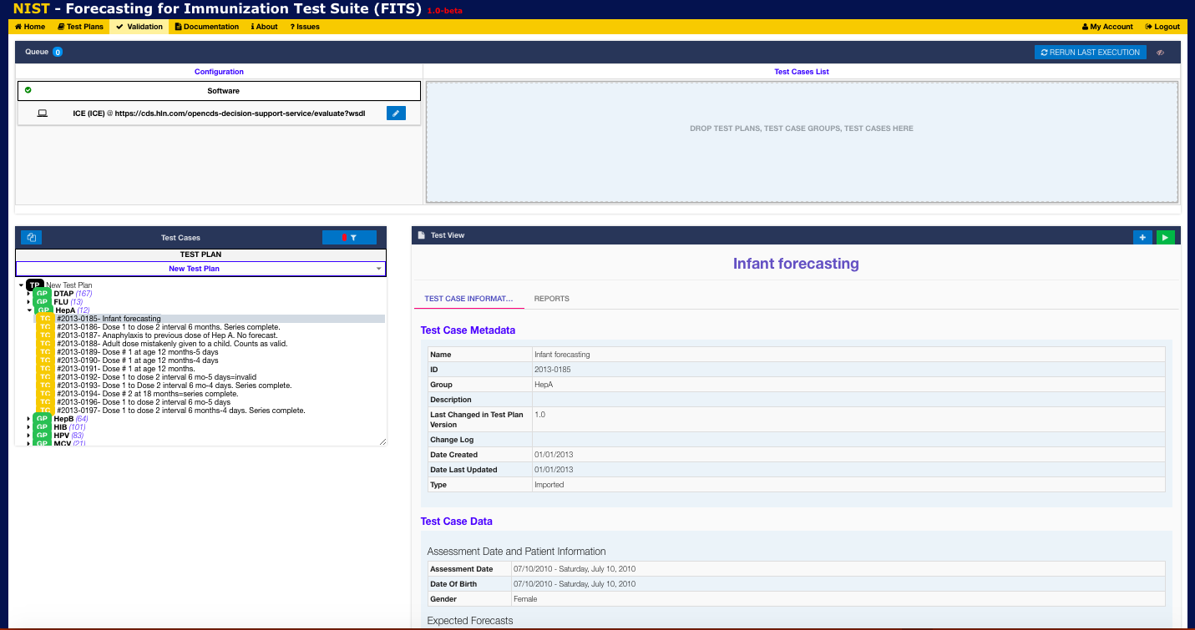
16
Select the Reports tab in order to view past execution results for this test case
15
Select a test case from the Test Cases pane
Information about that test case will be displayed by default in the Test View pane

Slide 12
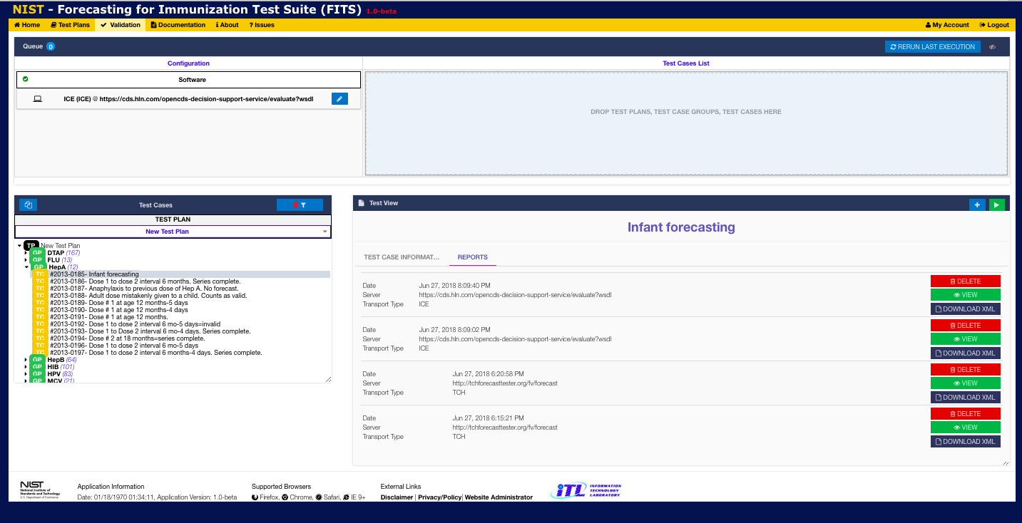
19
You can re-run the last set of test cases executed by clicking on the Rerun Last Execution button
17
View past test case execution dates (and the CDS software endpoints used)
18
For each past test case execution you may View the detailed results, Download them in XML format or Delete them

