Slide 1
Importing a Test Case CDC CDSI test cases

Slide 2
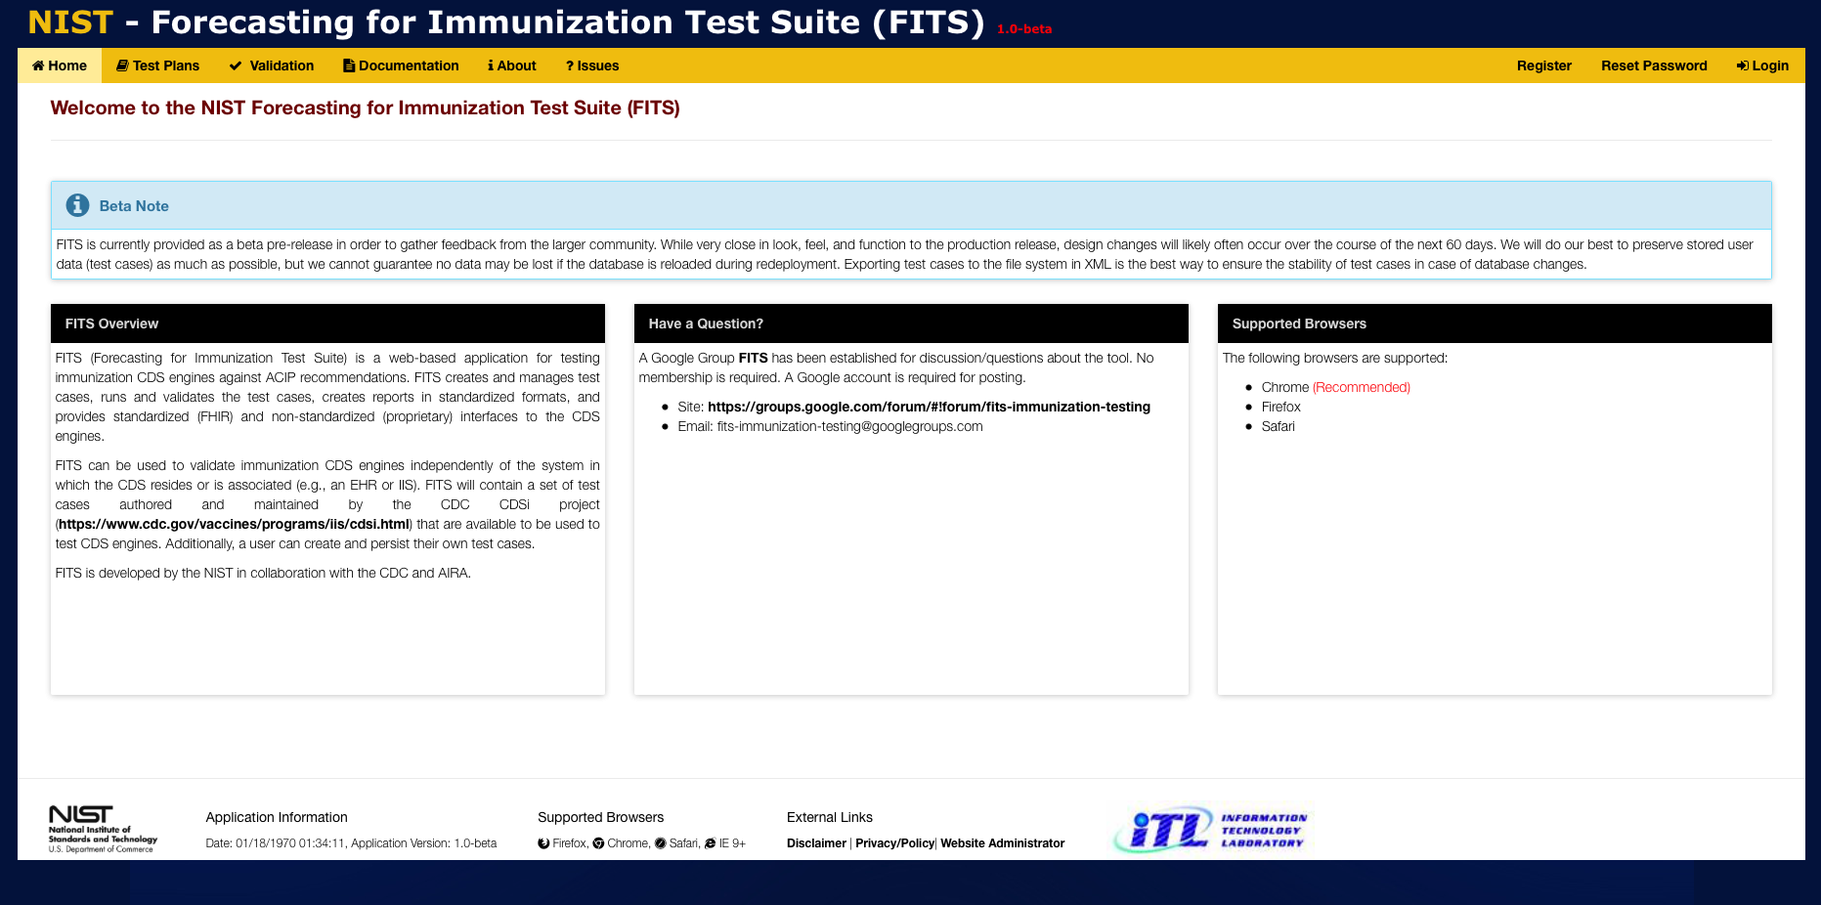
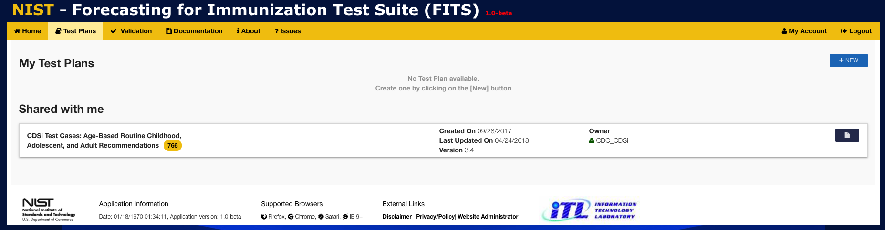
1
Click on Test Plans to display the Test Plans window
2
Click on +NEW to create a new Test Plan

Slide 3
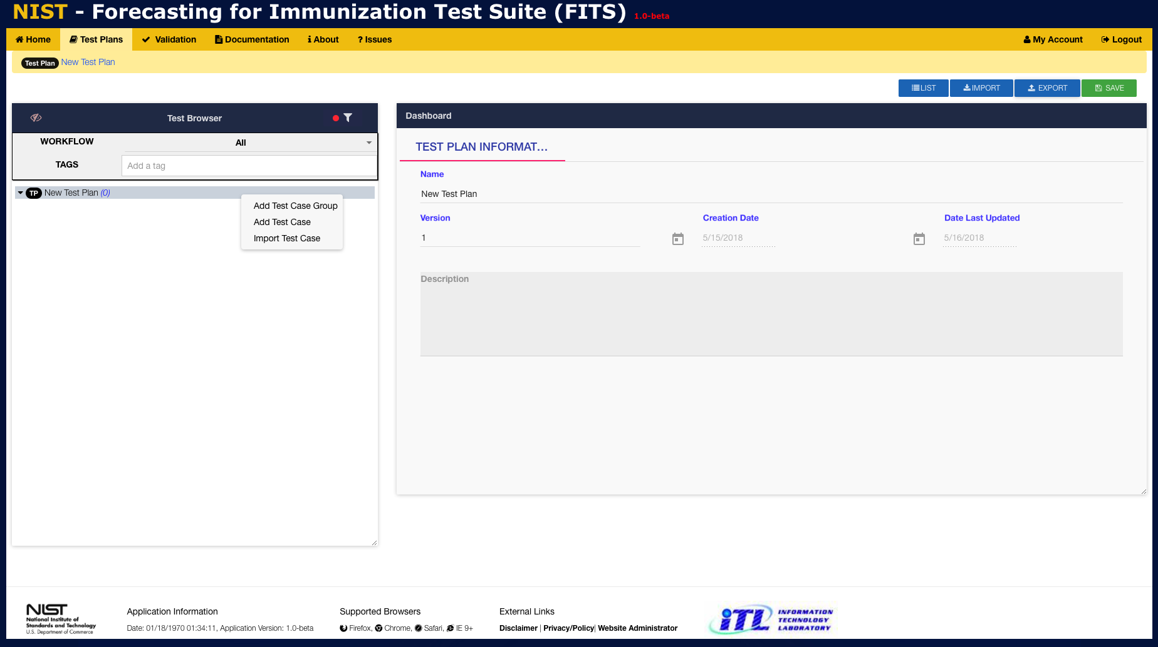
3
Enter the Name, Version, and Description into the provided fields.
4
Right-click to display context-menu
5
Click IMPORT to import previously saved Test Cases

Slide 4
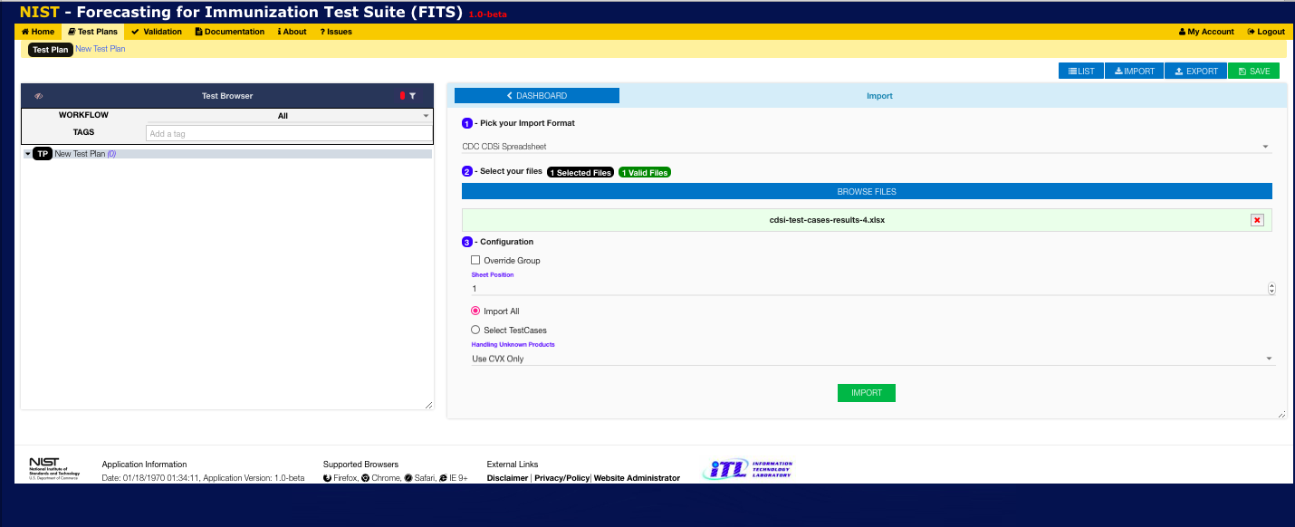
6
Select the CDC CDSi Spreadsheet import format from the drop-down
7
Accept the default configuration to import the entire the CDC CDSi Spreadsheet and organize test plan groups by the vaccine groups listed in the spreadsheet
8
Click on Import

Slide 5
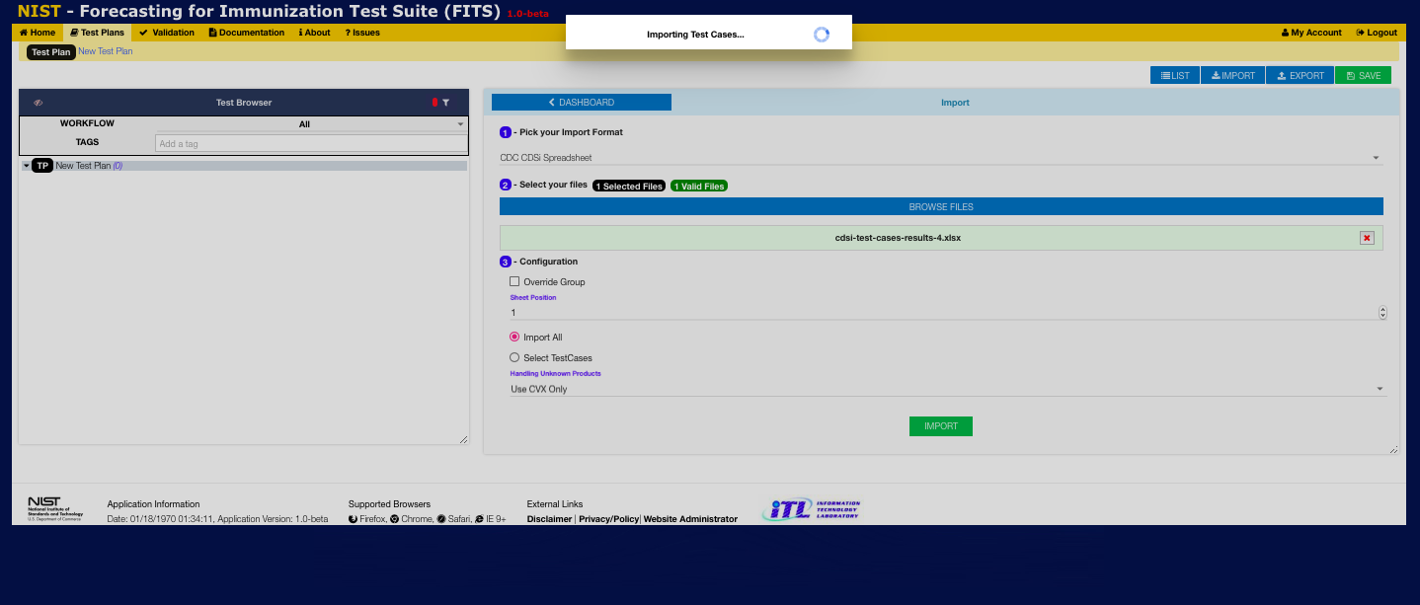
9
Wait while the test cases are imported into the current Test Plan

Slide 6
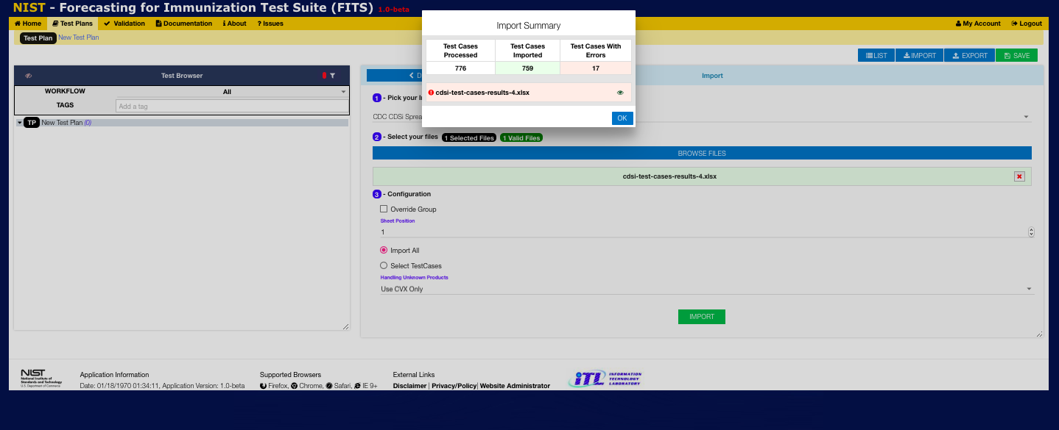
10
View the Import Summary and click OK

Slide 7
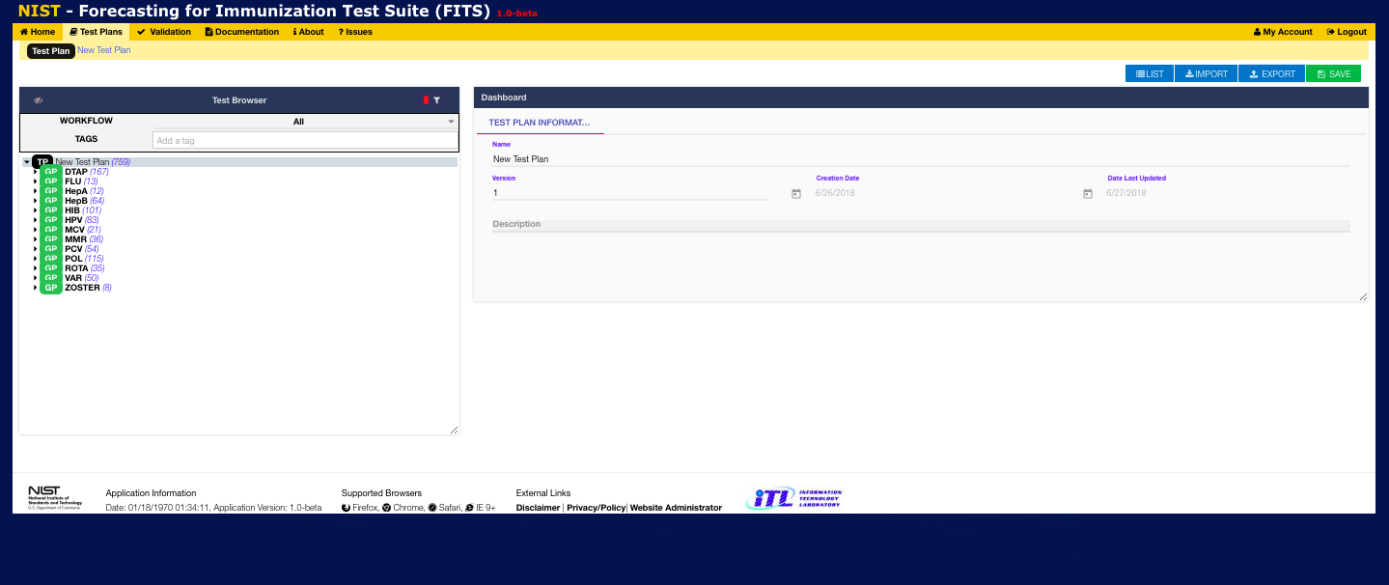
11
View the newly Imported test cases organized by vaccine group.
Click on group name to view group metadata
Right-click on group name to delete group or add a test case to the group
Click on arrow to left of group name to expand and
view test cases
- Click on a test case to view test case information and/or edit the test case
- Right-click on a test case to clone or delete it

