Slide 1
FITS User’s Guide
FITS Overview
Test Case Management
Creating a Test Case
For a Newborn (age 0) with no vaccination history
Importing Test Cases
CDC CDSI test cases
Exporting Test Cases (TBD)
Cloning/Deleting/Sharing Test Cases (TBD)
Test Case Execution
Executing a group of test cases
Viewing and Downloading the Results

Slide 2
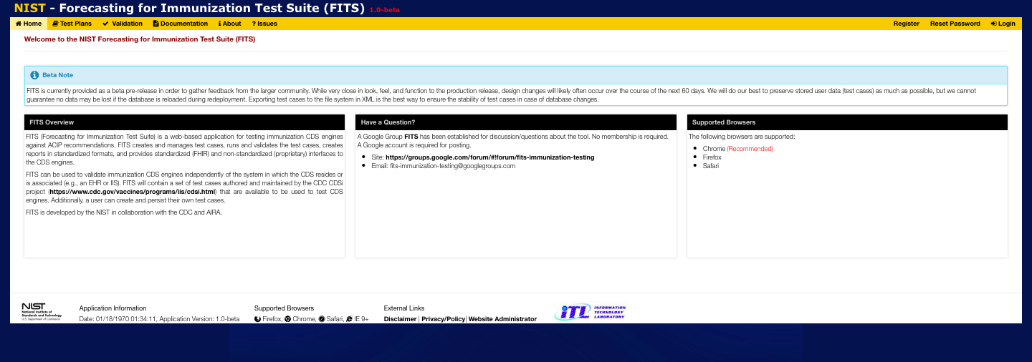
FITS Overview
(1) The Home Page tab is the first thing you’ll see after connecting to fits.nist.gov. To use the FITS (by clicking on any of the other tabs) you must first (2) Login -- but only after you have first obtained a FITS account by clicking on (3) Register.
i
2
3
1
User-level documentation is provided on the Documentation tab
i
Information about the FITS software and any issues are located on the About and Issues tabs.
5
The Validation tab is where you will be able to execute individual or selected collections of Test Cases, Test Groups, or whole Test Plans. Currently FITS supports execution against CDS Engines which conform to the proposed FHIR “CDS-Immunization Forecast Implementation Guide” -> http://hl7.org/fhir/uv/immds/2018Jan/index.html.
Or one of 4 supported proprietary CDS interfaces: ICE, STC, TCH Forecaster, or State of Massachusetts.
4
The Test Plans tab is where you will be able to create, edit, share and delete Test Plans. Test Plans are collections of Test Cases, which may be further organized within Test Plans as Test Groups. Note that any Test Plans shared with you by other FITS users may be “cloned” and edited by you.

Slide 3
Creating a Test Case For a Newborn (age 0) with no vaccination history

Slide 4
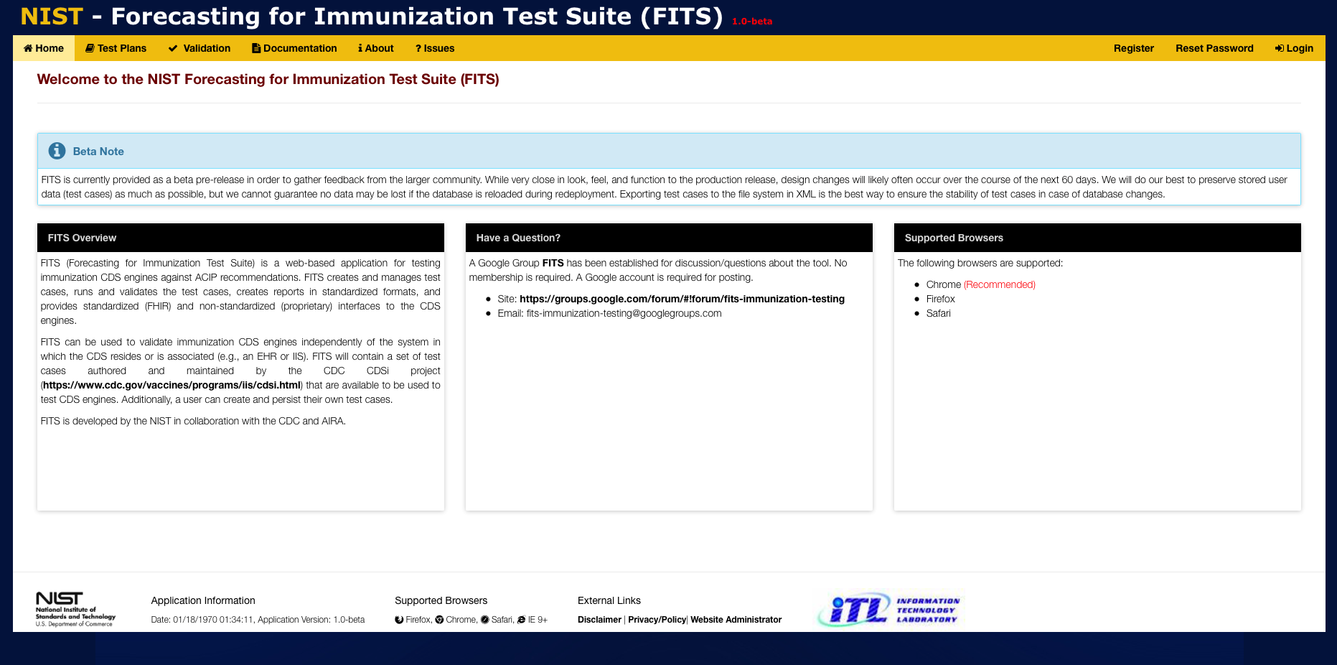
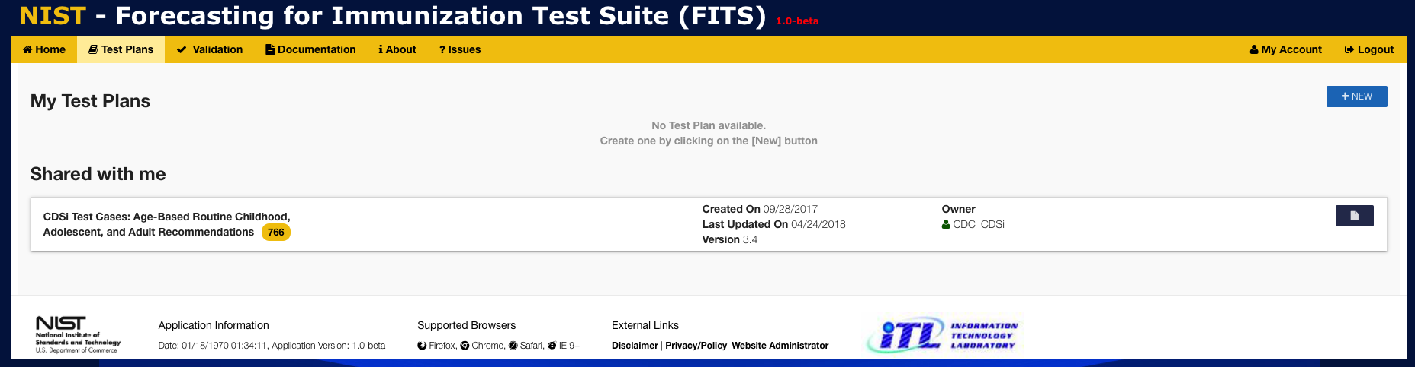
1
Click on Test Plans to display the Test Plans window
2
Click on +NEW to create a new Test Plan

Slide 5
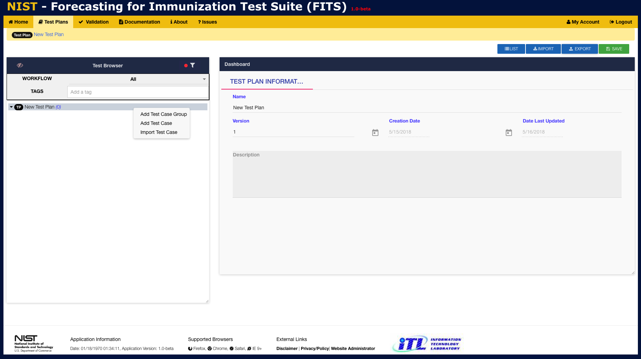
3
Enter the Name, Version, and Description into the provided fields.
4
Right-click to display context-menu
5
Select Add Test Case

Slide 6
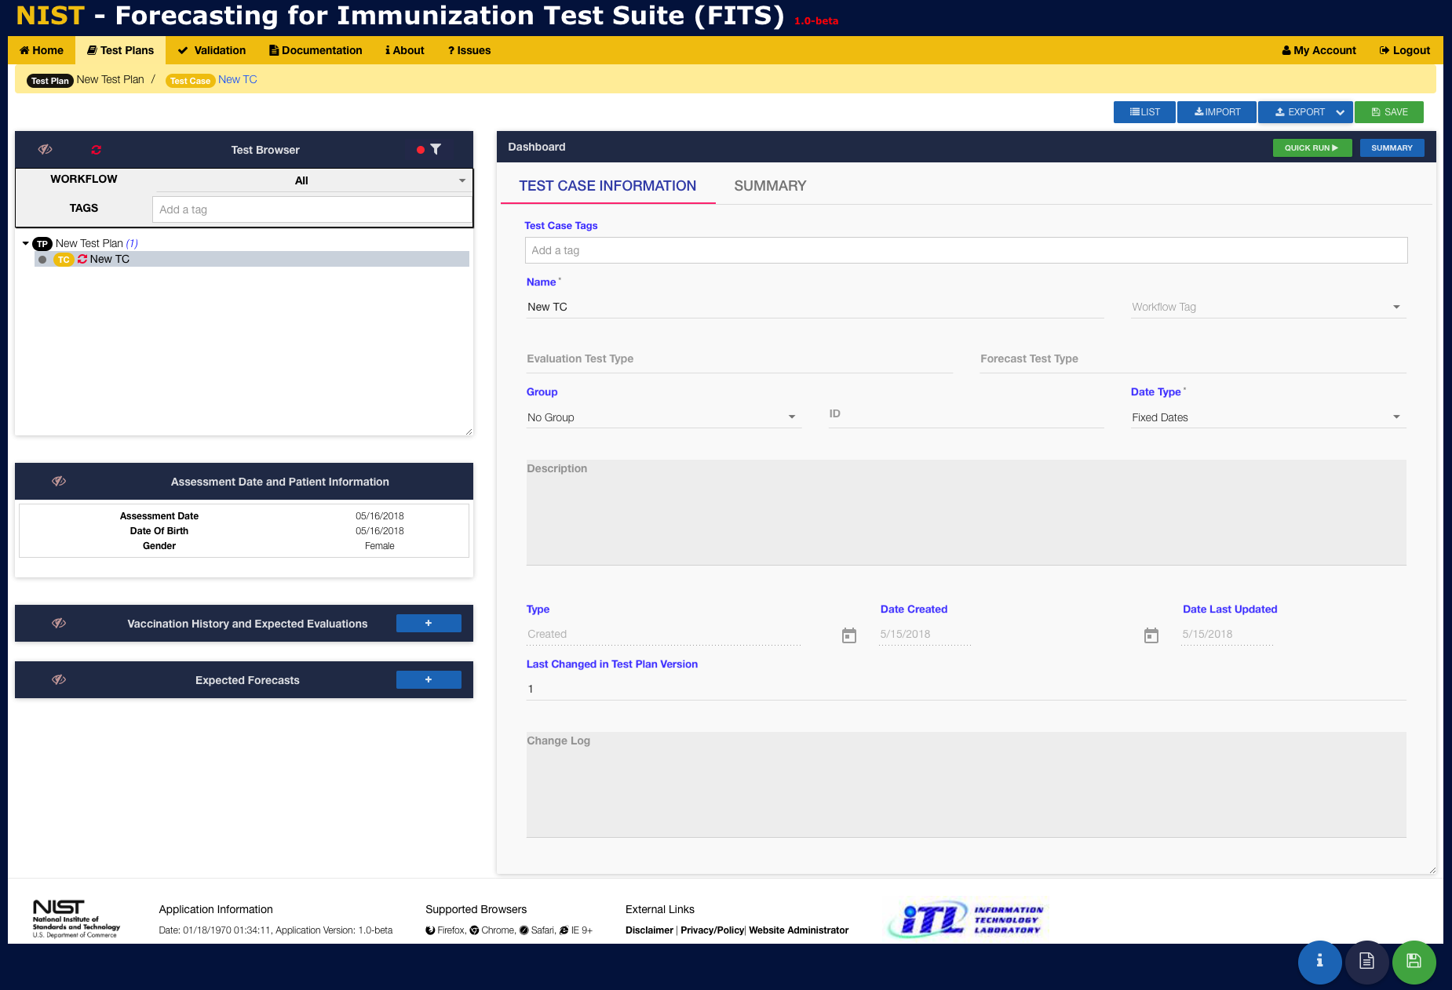
7
Enter Test Case information as appropriate into the provided fields
6
A new Test Case called ”New TC” is created under the Existing Test Plan

Slide 7
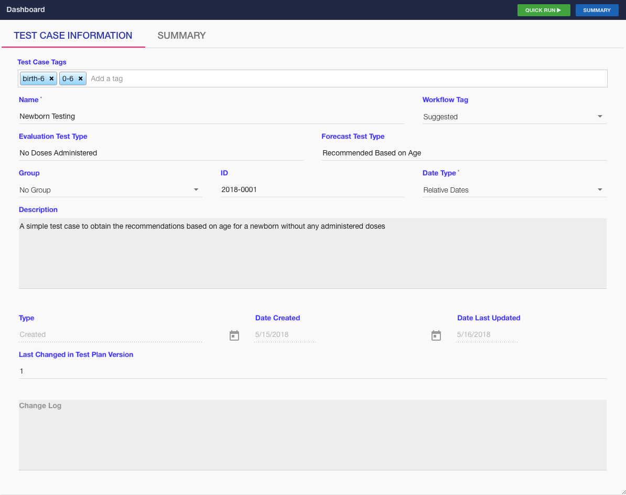
8
Example Test Case Metadata
9
Click here to display the Assessment Date and Patient Information entry window

Slide 8
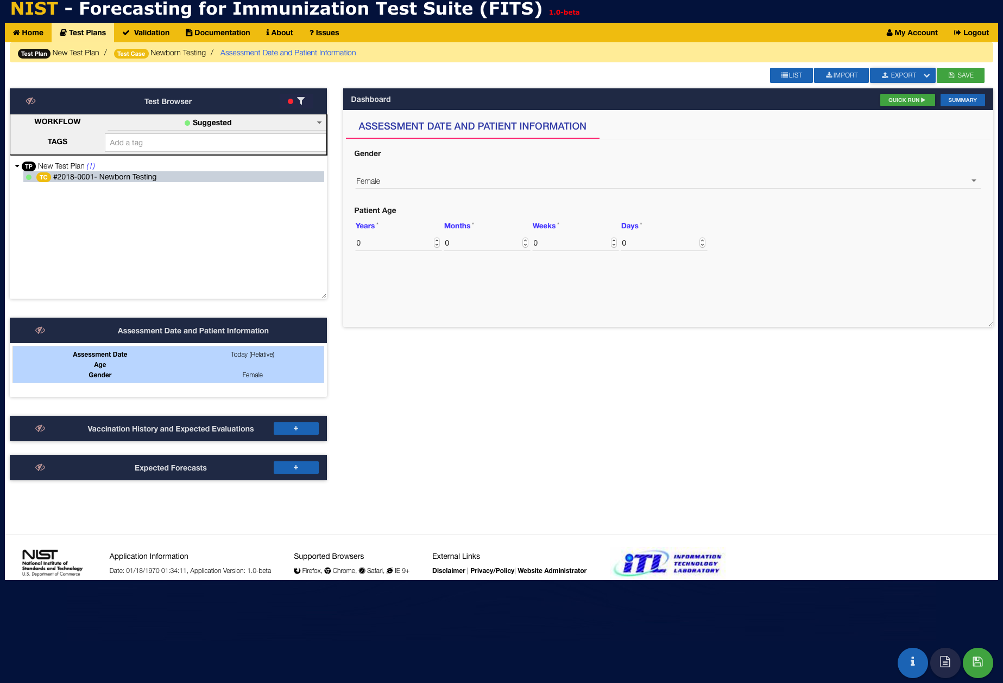
*NOTE: Since we selected Date Type -> Relative Dates in the previous Test Case Information window, there is no place to enter the Assessment Date It will always be set to the current date!
10
Select the Patient’s Gender from a drop-down menu
11
Enter the Patient’s Age
12
Patient has no vaccination history (no need to enter)
13
Click the + to enter an Expected Forecast for each vaccine or vaccine group

Slide 9
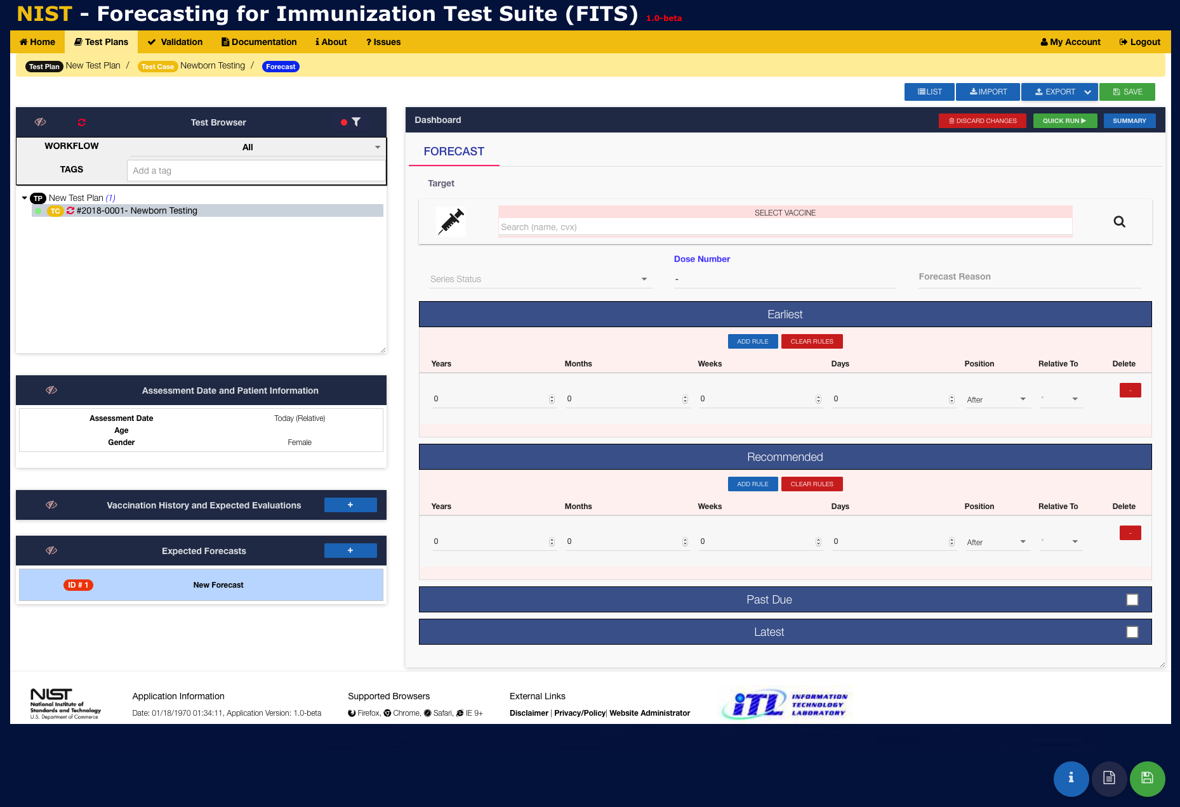
Enter the name or CVX code for a vaccine or vaccine group
OR
Use the Vaccine Browser by clicking on the magnifying glass
14
Enter expected Series Status and Dose Number [REQUIRED]
15
16
Enter expected Earliest and Recommended
dates for the forecast [REQUIRED]
17
Enter expected Past Due and Latest
dates for the forecast [OPTIONAL]

Slide 10
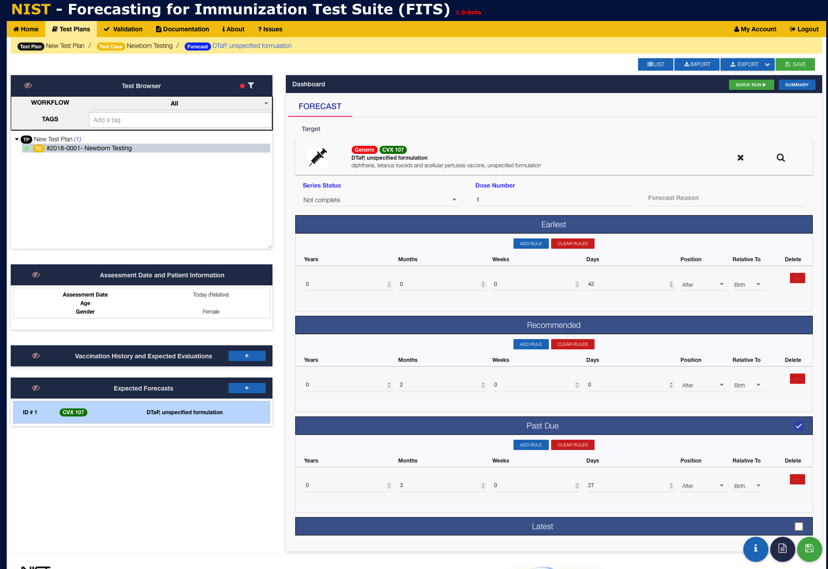
19
Click SAVE to save newly entered Test Case information
20
Example Forecast Information for DTaP, unspecified with
Patient Age & Gender, and Earliest, Recommended, &
Past Due (relative) dates
Click SUMMARY to view all test case information (Data & Metadata)
18

Slide 11
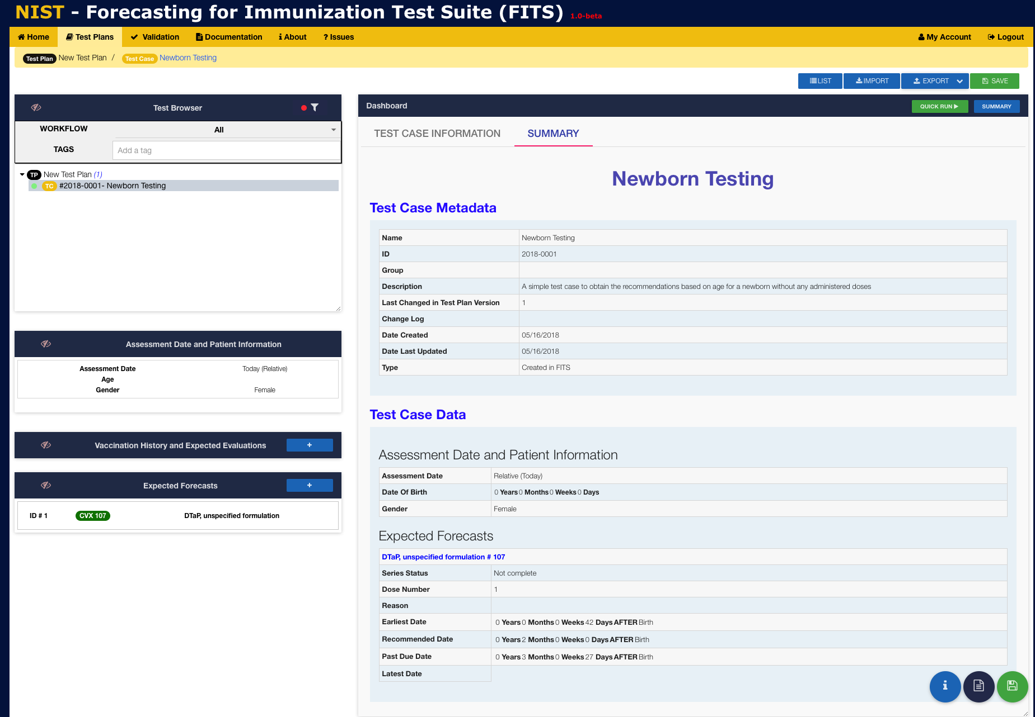

Slide 12
Importing a Test Case CDC CDSI test cases

Slide 13
1
Click on Test Plans to display the Test Plans window
2
Click on +NEW to create a new Test Plan

Slide 14
3
Enter the Name, Version, and Description into the provided fields.
4
Right-click to display context-menu
5
Click IMPORT to import previously saved Test Cases

Slide 15
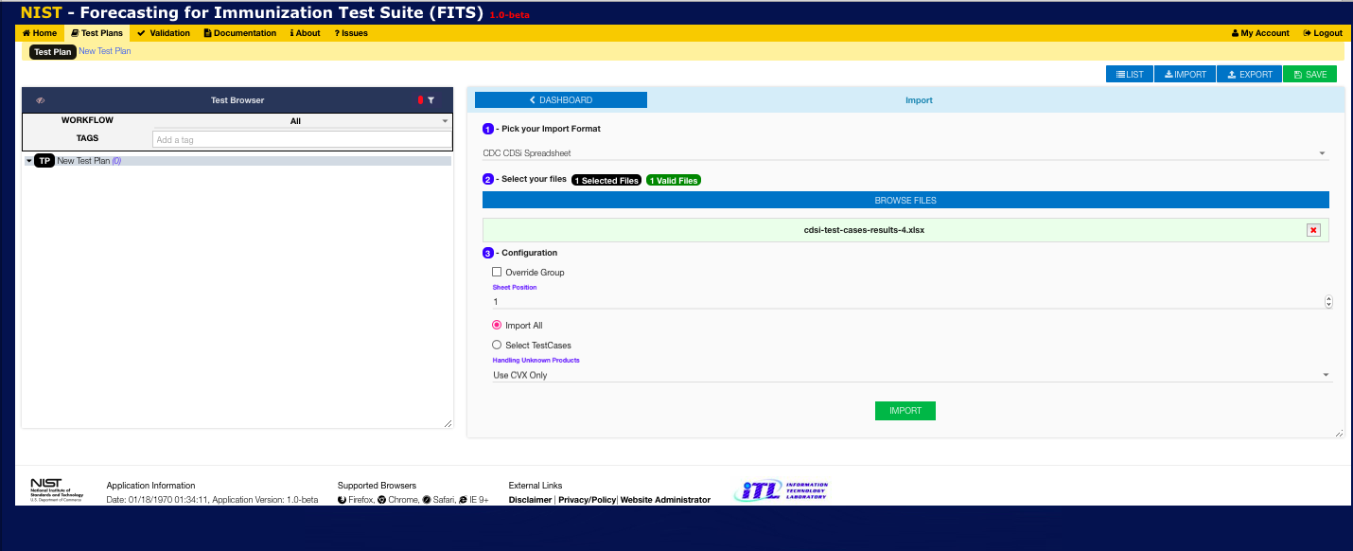
6
Select the CDC CDSi Spreadsheet import format from the drop-down
7
Accept the default configuration to import the entire the CDC CDSi Spreadsheet and organize test plan groups by the vaccine groups listed in the spreadsheet
8
Click on Import

Slide 16
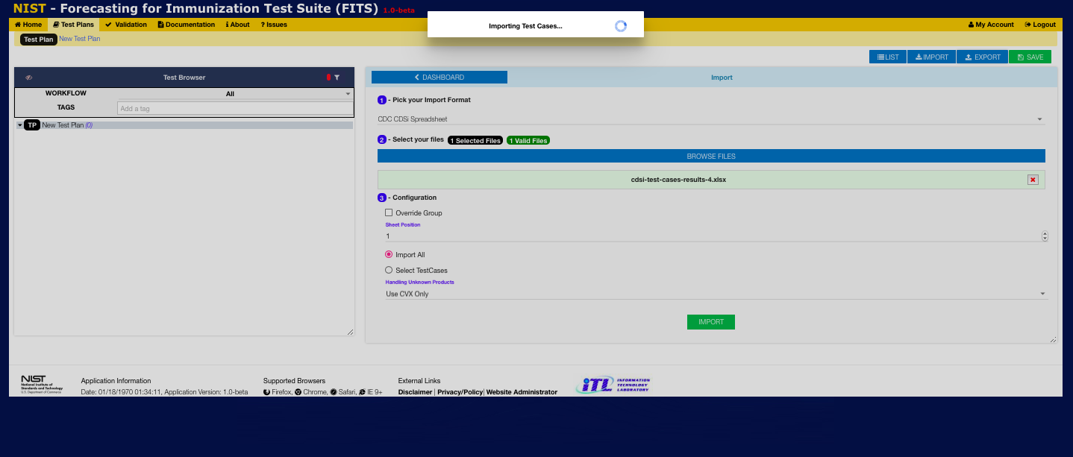
9
Wait while the test cases are imported into the current Test Plan

Slide 17
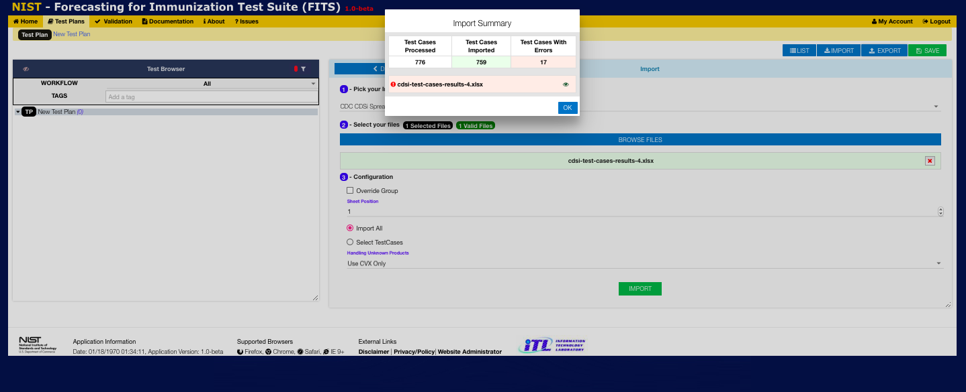
10
View the Import Summary and click OK

Slide 18
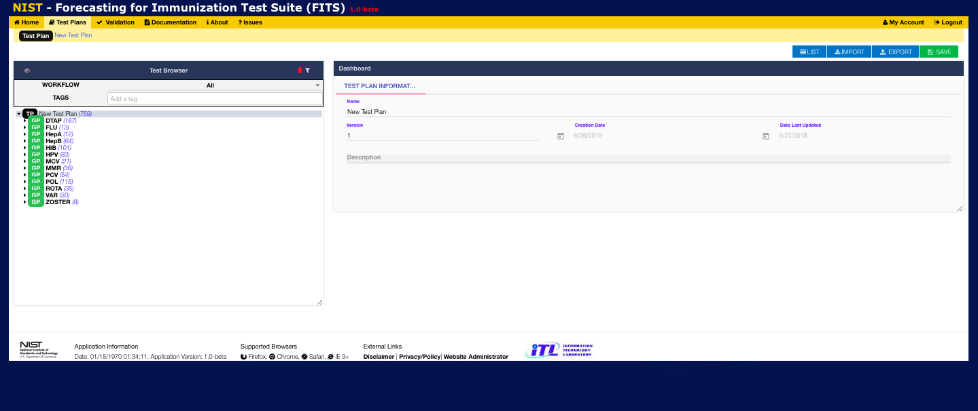
11
View the newly Imported test cases organized by vaccine group.
Click on group name to view group metadata
Right-click on group name to delete group or add a test case to the group
Click on arrow to left of group name to expand and
view test cases
- Click on a test case to view test case information and/or edit the test case
- Right-click on a test case to clone or delete it

Slide 19
Test Case Execution Executing a group of test cases

Slide 20
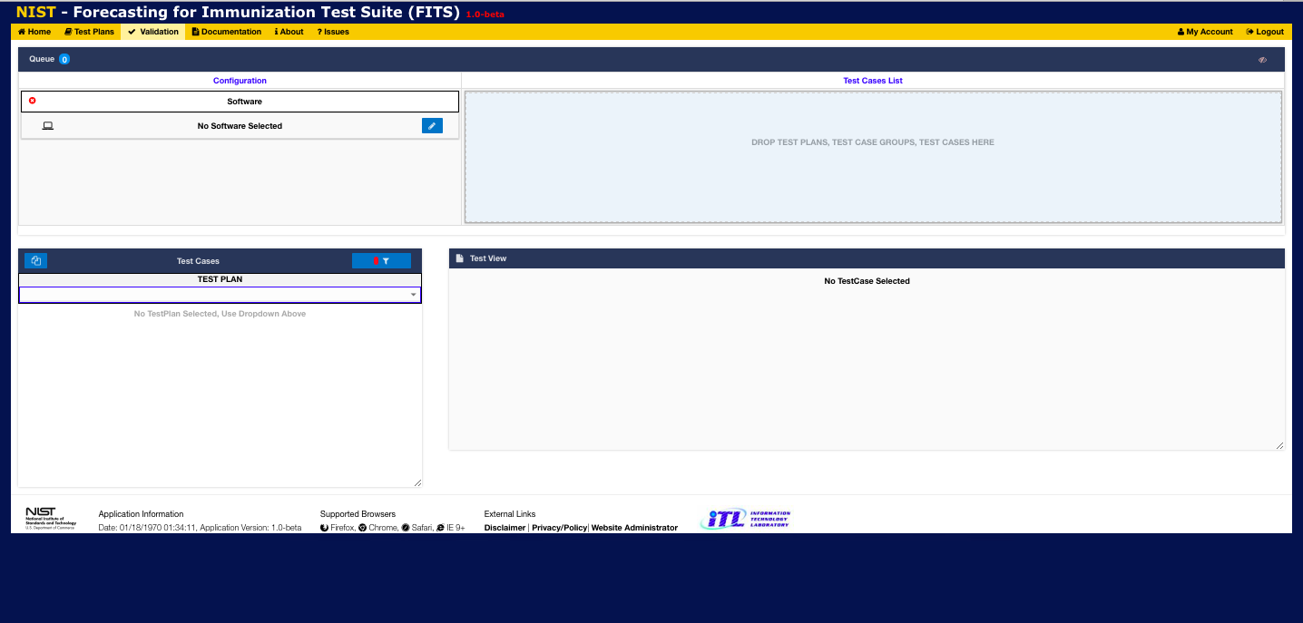
1
Click on Validation to display the Validation Window

Slide 21
2
Select the Test Plan from the drop-down list

Slide 22
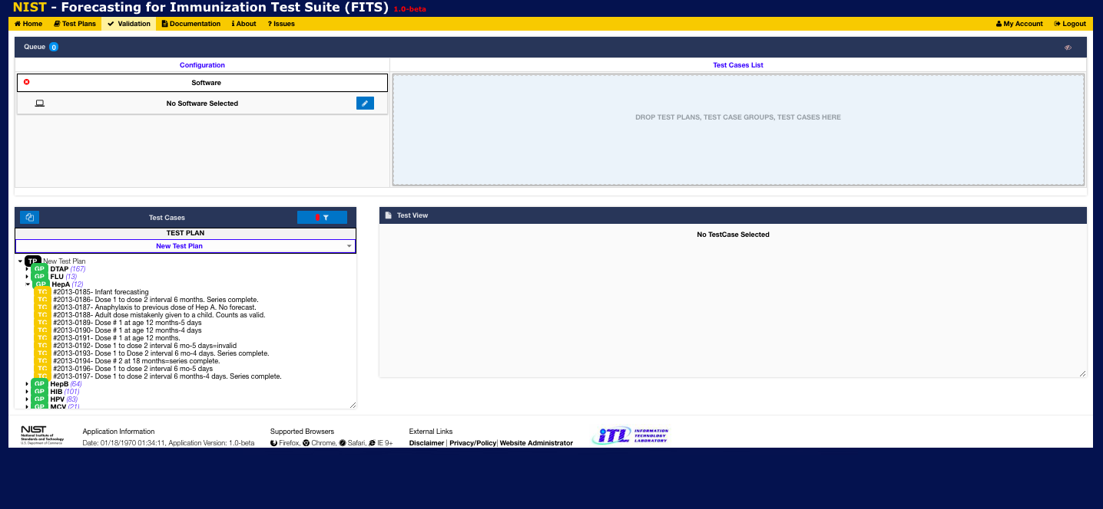
3
View Test Plan organized by test groups.
Click on arrow to left of group name to expand and view the test cases in that gorup

Slide 23
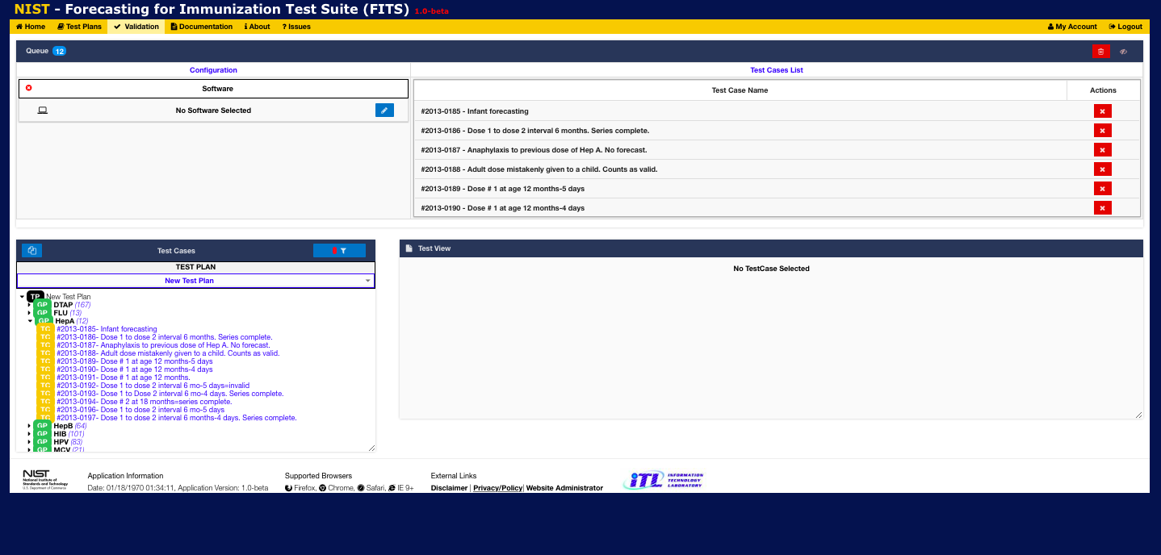
4
Drag and drop the test group name into the Test Cases List window
All test cases from that group will appear in the Test Cases List window

Slide 24
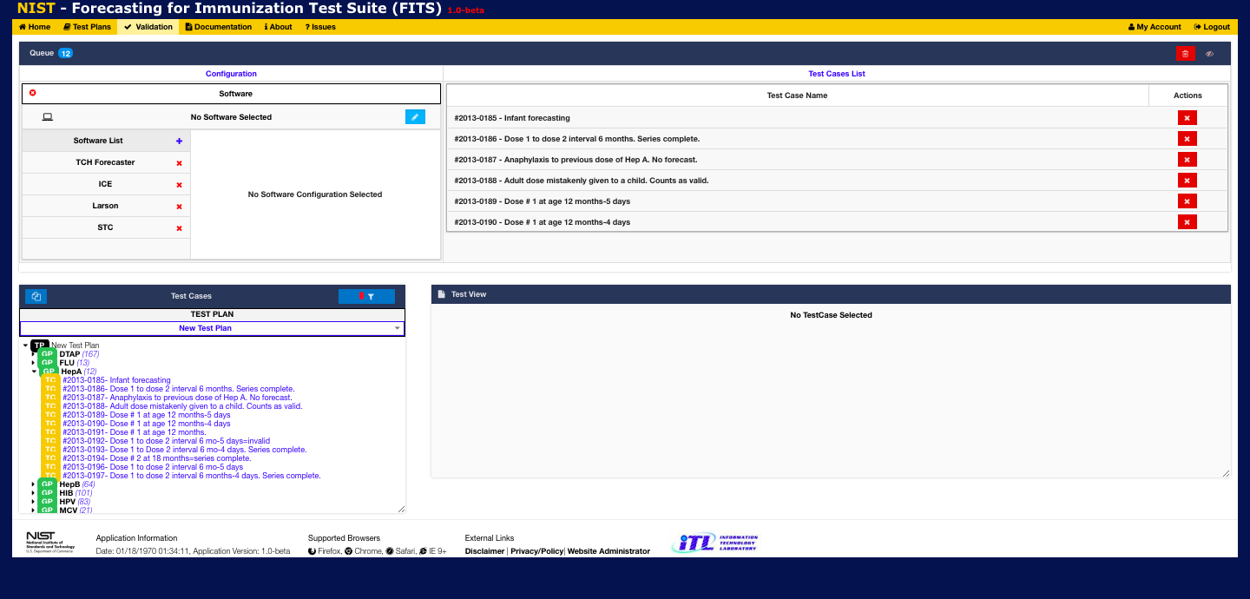
5
Click the pencil icon in the Configuration window to view/select/add/delete CDS software to execute tests cases against Clicking on the + icon allows the user to define new CDS software by defining its name, endpoint address, and interface type Clicking on the name of a CDS engine in the Software List will select that CDS engine for test case execution and display its configuration details

Slide 25
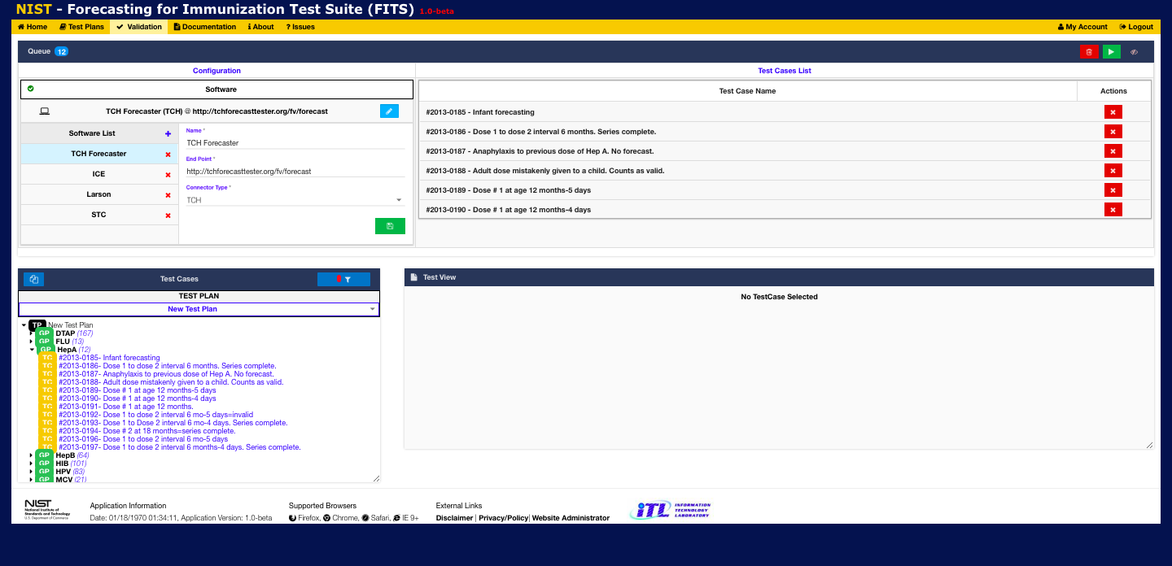
7
Click on the Save icon to save this configuration if any changes were made
8
6
Select a CDS software type execute against
NOTE: After the Test Cases List has been populated and a CDS Software has been selected, the Play/Execute button will appear
Click the Play/Execute button to display the Execution Window and initiate execution of the test case(s) in the Test Cases List

Slide 26
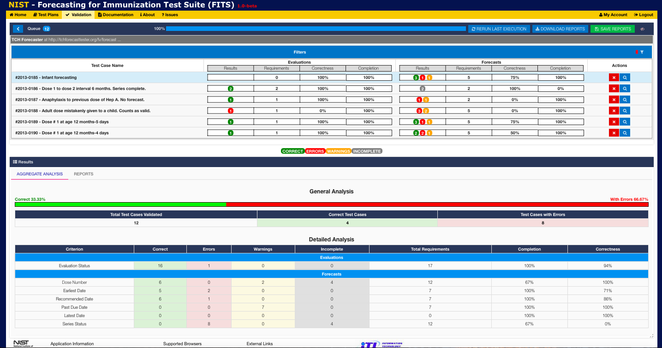
Selecting Play/Execute displays the Execution Window and begins test case execution.
During execution the results for each test case are displayed in the Queue pane and a progress ba at the top of that pane shows the % of test cases which have been completed
9
11
Click the Reports tab to view individual test case results
After execution completes the overall results are displayed in the Results pane (by default the results are aggregated).
10

Slide 27
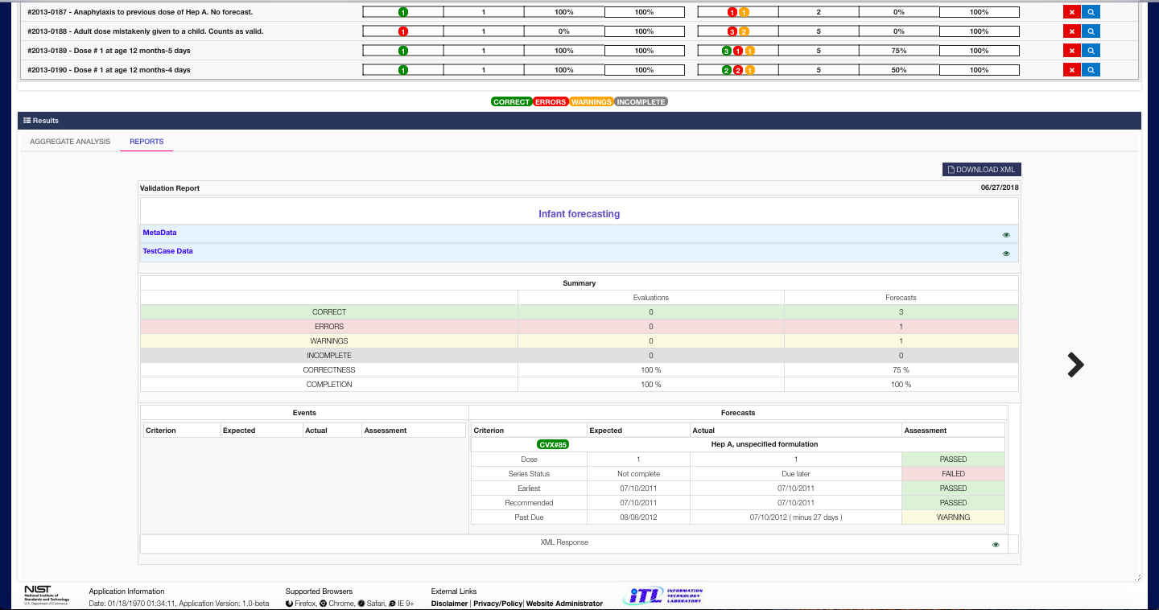
Click the arrows to view individual test case results
12

Slide 28
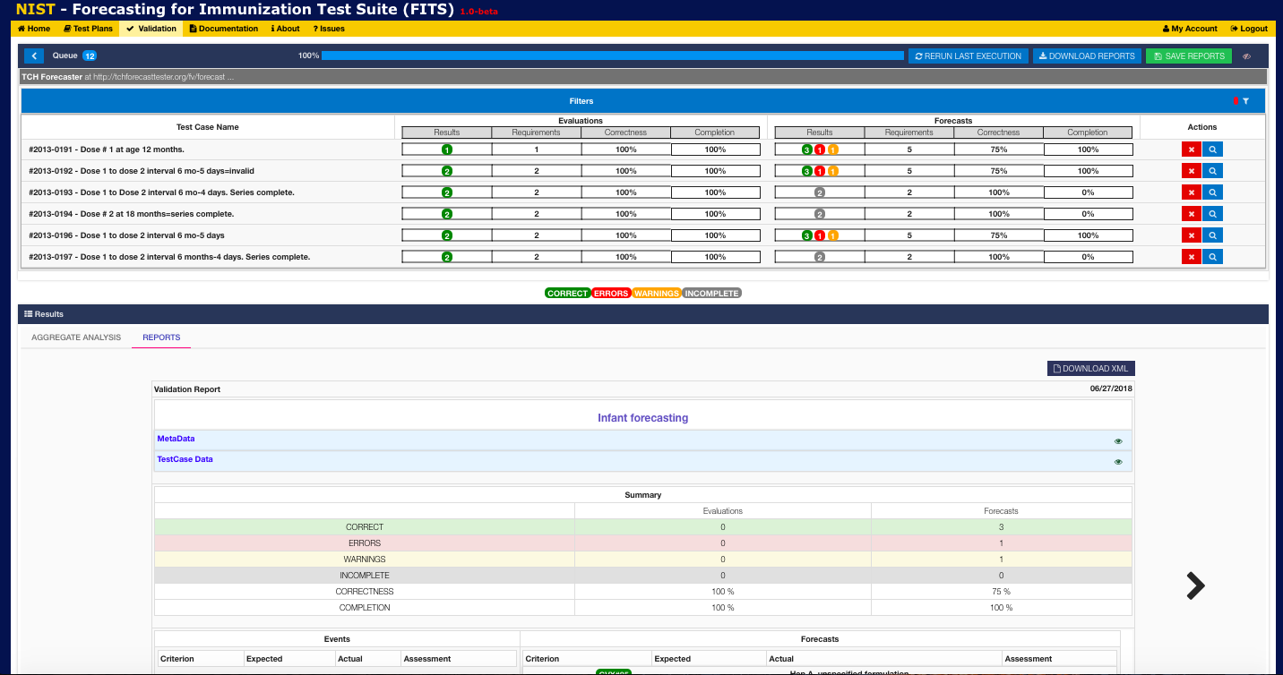
14
13
Click the < button to return to the Validation Window
Click Save Reports to save the results of all recently executed test cases
. Note that past test case results are viewable from the Test Cases pane of the Validation Window

Slide 29
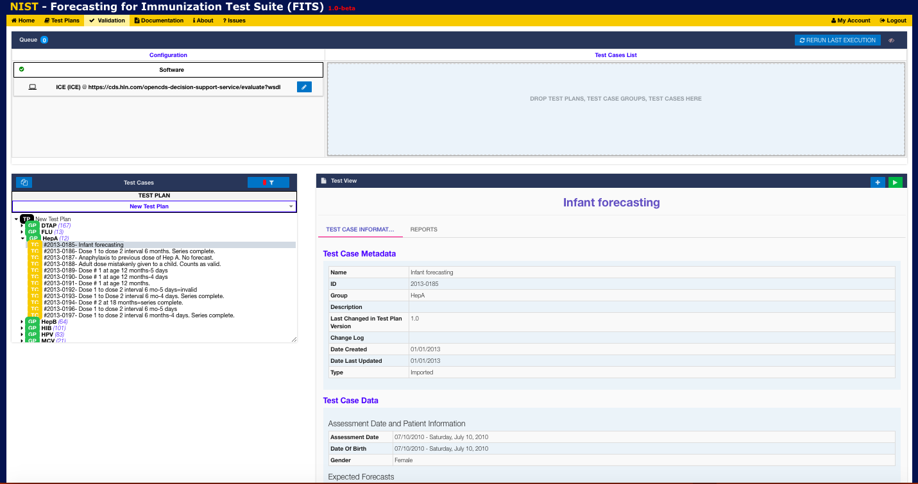
16
Select the Reports tab in order to view past execution results for this test case
15
Select a test case from the Test Cases pane
Information about that test case will be displayed by default in the Test View pane

Slide 30
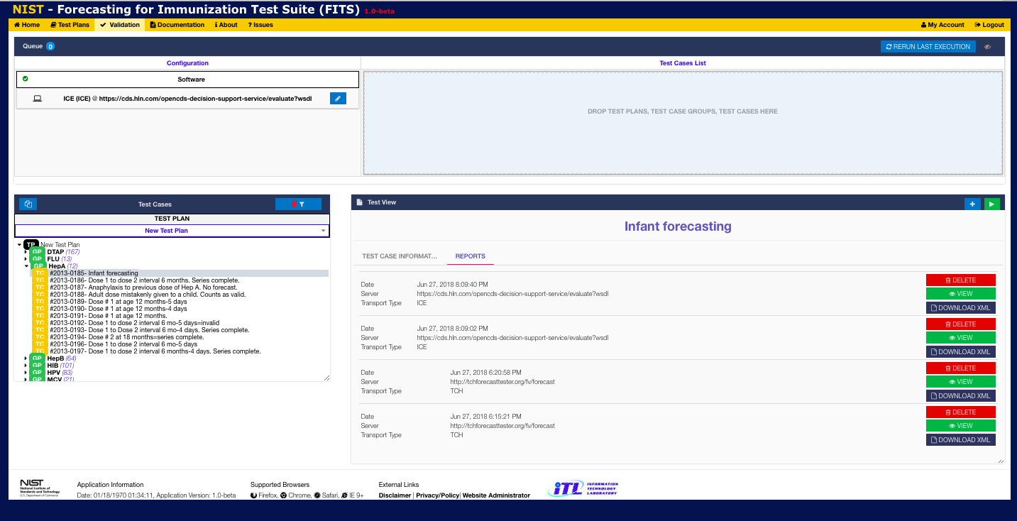
19
You can re-run the last set of test cases executed by clicking on the Rerun Last Execution button
17
View past test case execution dates (and the CDS software endpoints used)
18
For each past test case execution you may View the detailed results, Download them in XML format or Delete them

