Slide 1








WattWise
An Intelligent Home Energy Management and Monitoring System
TEAMWORK

Slide 2







Background & Problem Statement
Key challenges in household electricity monitoring and tariff management
Rising Costs & Tier Tariffs
Lack of Appliance Visibility
Egyptian households face tier-based electricity tariffs and prepaid meters without clear visibility of consumption breakdown.
Prepaid meters show total energy usage but fail to identify which individual appliances draw the most power.
Unexpected Credit Exhaustion
Unaware of Abnormalities
Users react to high bills or sudden credit depletion after it happens rather than preventing it.
Electrical degradation, wiring issues, or standby power drain go unnoticed due to lack of real-time monitoring.

Slide 3





Proposed IoT Solution
An end-to-end intelligent architecture for domestic energy optimization
IoT Monitoring Nodes
Central Intelligence Platform
Smart outlets installed at selected power sockets continuously measure Voltage, Current, Power, and Energy.
Aggregates data, stores historical records, analyzes consumption patterns, and estimates costs.
Interactive Dashboard
Proactive Recommendations
Presents real-time appliance-level and house-level analytics to users.
Notifies users before reaching higher tariff tiers and flags abnormal electrical behavior.

Slide 4



Project Objectives & Scope
Defining system capabilities and boundaries
Core Objectives
Scope Boundaries (Included)
Develop an intelligent IoT system to monitor, analyze, and optimize household electricity usage.
Smart monitoring nodes, cloud/local backend, analytics & recommendation engine, real-time alerts.
Target Capabilities
Track V, I, P, E per appliance, estimate daily/monthly cost, predict tariff transitions, and support remote relay control.
Scope Exclusions
Direct integration with official provider meters
certified revenue billing
3-phase industrial systems.

Slide 5
Layered System Architecture
Multi-tier design pattern from physical sensing to user intelligence
Physical Layer
Household appliances, outlets, and electrical wiring.
Sensing Layer
Voltage (V) and Current (I) sensors measuring electrical parameters.
Edge Computing Layer
ESP32 microcontroller performing sampling, power calculations, and MQTT publishing.
Communication Layer
Wi-Fi & MQTT broker transferring JSON data payloads.
Backend & Analytics Layer
Device manager, analytics engine, recommendation engine, and database.
User Intelligence Layer
Interactive Web/Mobile Dashboard for control and insights.

Slide 6
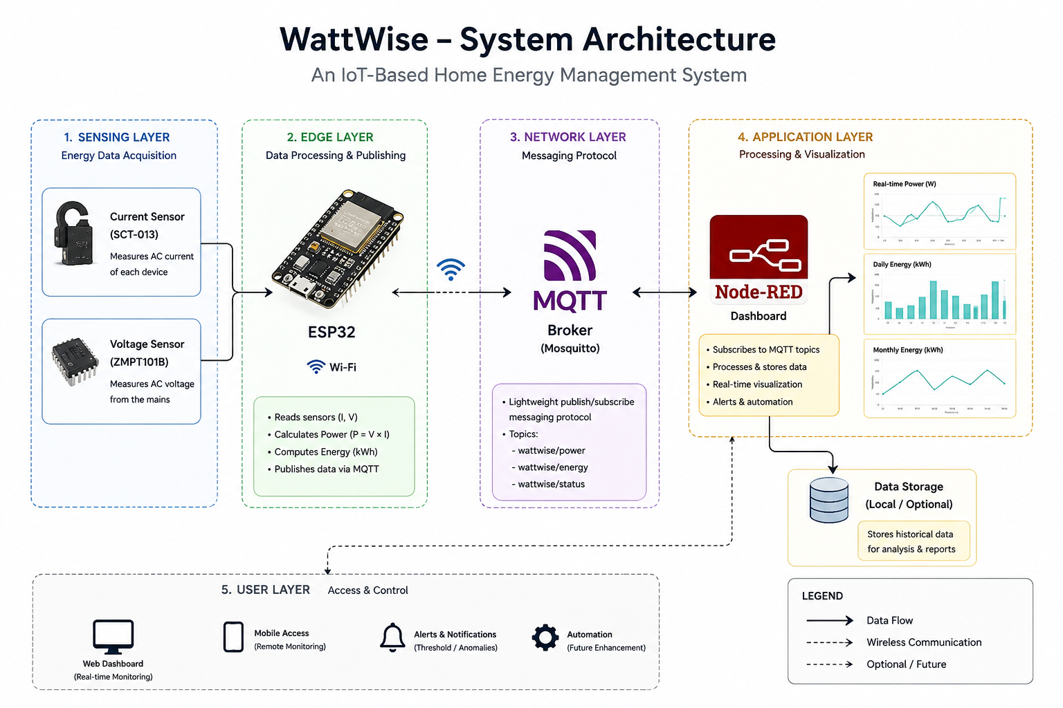
Layered System Architecture

Slide 7


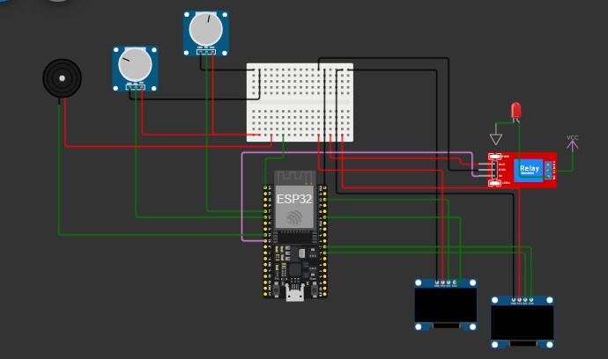



Hardware Design & Smart Nodes
Component selection for precise edge sampling and safety
Microcontroller (ESP32)
Built-in Wi-Fi, dual-core processing, ADC/GPIO interfaces for rapid sensor reading.
Voltage & Current Sensors
Measures instantaneous AC voltage quality and appliance load current.
Relay Control Module
Enables optional remote ON/OFF control and scheduled automated operations.
Power Supply & Status LEDs
Regulates AC to DC power and provides visual Wi-Fi/Relay status indicators.

Slide 8


Node-Red Flow Design
Go to Wokwi …

Slide 9



Communication Protocol & MQTT
Data telemetry structure and QoS delivery model
Publish / Subscribe Model
Hierarchical Topic Naming
Lightweight MQTT protocol ensures low bandwidth usage, minimal latency, and high scalability.
Structured topic tree for scalable message routing:
JSON Data Payload
Quality of Service (QoS)
Transmits nodeId, timestamp, voltage, current, power, energy, and relayState.
QoS 0 for high-frequency measurements; QoS 1 for reliable delivery of control commands and configuration.

Slide 10
Node-Red Flow Design
Go to Node-red …

Slide 11


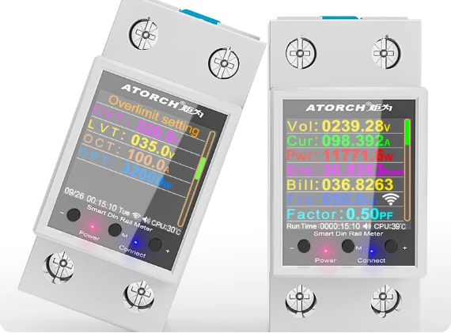



Software & Intelligent Analytics
User controls, predictive insights, and anomaly detection
Appliance & House Dashboards
Displays live V, I, P, E, highest-consuming appliance, peak hours, and historical trends.
Tariff & Cost Estimation
Tracks current tariff tier, calculates daily/monthly cost, and predicts next tier jump.
Fault & Anomaly Detection
Flags unusual current spikes, voltage drops, and excessive standby power drain.
Automation & Scheduling
Allows users to set timers, remote ON/OFF rules, and energy-saving schedules.

Slide 12
Software & Intelligent Analytics
User controls, predictive insights, and anomaly detection
Go to the dashboard …

Slide 13
Testing the project …

Slide 14





Future Expansion & Roadmap
Scaling capabilities towards next-generation Home Energy Management Systems
Smart Meter Sync
AI Analytics
Direct integration with official smart electricity meters for real-time credit syncing.
Machine learning models for predictive maintenance, load forecasting, and habit learning.
Native Mobile App
Solar & Renewable Support
Android & iOS apps with push notifications, widgets, and voice assistant integration.
Extending system to monitor photovoltaic systems, batteries, and EV chargers.

Slide 15

Conclusion
Summary of key impacts and project takeaways
Key Takeaways:
Actionable Decision Support: Transforms passive energy monitoring into proactive cost reduction and safety management.
Tailored for Egyptian Market: Addresses tier-based tariffs and prepaid meter challenges directly.
Scalable & Modular Architecture: Launches as an IoT prototype while serving as a scalable foundation for full Home Energy Management Systems (HEMS).

