Slide 1
Databases checkpoint
Realised by :
Labyadh ABDELHAK

Slide 2
MySQL
MySQL is an open-source relational database management system (RDBMS).
Its name is a combination of "My", the name of co-founder Michael Widenius's daughter, and "SQL", the abbreviation for Structured Query Language.
A relational database organizes data into one or more data tables in which data types may be related to each other; these relations help structure the data. SQL is a language programmers use to create, modify and extract data from the relational database, as well as control user access to the database.
In addition to relational databases and SQL, an RDBMS like MySQL works with an operating system to implement a relational database in a computer's storage system, manages users, allows for network access and facilitates testing database integrity and creation of backups.

Slide 3
MySQL has stand-alone clients that allow users to interact directly with a MySQL database using SQL, but more often, MySQL is used with other programs to implement applications that need relational database capability. MySQL is a component of the LAMP web application software stack (and others), which is an acronym for Linux, Apache, MySQL, Perl/PHP/Python. MySQL is used by many database-driven web applications, including Drupal, Joomla, phpBB, and WordPress. MySQL is also used by many popular websites, including Facebook,^{[10][11]} Flickr,^{[12]} MediaWiki,^{[13]} Twitter,^{[14]} and YouTube.

Slide 4

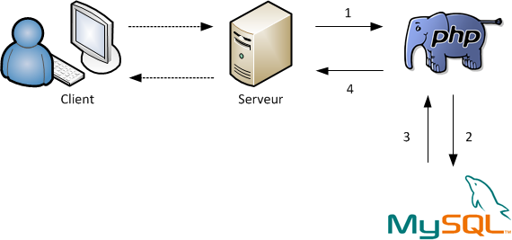


Slide 5
PostgreSQL
also known as Postgres, is a free and open-source relational database management system (RDBMS) emphasizing extensibility and SQL compliance.
It was originally named POSTGRES, referring to its origins as a successor to the Ingres database developed at the University of California, Berkeley. In 1996, the project was renamed to PostgreSQL to reflect its support for SQL. After a review in 2007, the development team decided to keep the name PostgreSQL and the alias Postgres.
PostgreSQL features transactions with Atomicity, Consistency, Isolation, Durability (ACID) properties, automatically updatable views, materialized views, triggers, foreign keys, and stored procedures.^{[17]} It is designed to handle a range of workloads, from single machines to data warehouses or Web services with many concurrent users. It is the default database for macOS Server and is also available for Windows, Linux, FreeBSD, and OpenBSD.

Slide 6
PostgreSQL manages concurrency through multiversion concurrency control (MVCC), which gives each transaction a "snapshot" of the database, allowing changes to be made without affecting other transactions. This largely eliminates the need for read locks, and ensures the database maintains ACID principles. PostgreSQL offers three levels of transaction isolation: Read Committed, Repeatable Read and Serializable. Because PostgreSQL is immune to dirty reads, requesting a Read Uncommitted transaction isolation level provides read committed instead. PostgreSQL supports full serializability via the serializable snapshot isolation (SSI) method

Slide 7
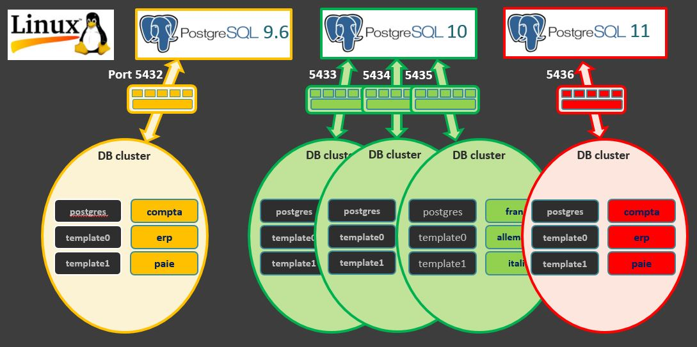

Slide 8
SQL server
Microsoft SQL Server est un système de gestion de base de données (SGBD) en langage SQL incorporant entre autres un SGBDR (SGBD relationnel ») développé et commercialisé par la société Microsoft. Il fonctionne sous les OS Windows et Linux (depuis mars 2016), mais il est possible de le lancer sur Mac OS via Docker, car il en existe une version en téléchargement sur le site de Microsoft.
Le moteur OLTP de SQL Server est doté de très nombreuses fonctionnalités qu'il serait difficile de toutes énumérer. En voici quelques-unes qui font la différence avec des SGBD plus légers comme MySQL ou PostGreSQL...
Like other RDBMS software, Microsoft SQL Server is built on top of SQL, a standardized programming language that database administrators (DBAs) and other IT professionals use to manage databases and query the data they contain. SQL Server is tied to Transact-SQL (T-SQL), an implementation of SQL from Microsoft that adds a set of proprietary programming extensions to the standard language

Slide 9
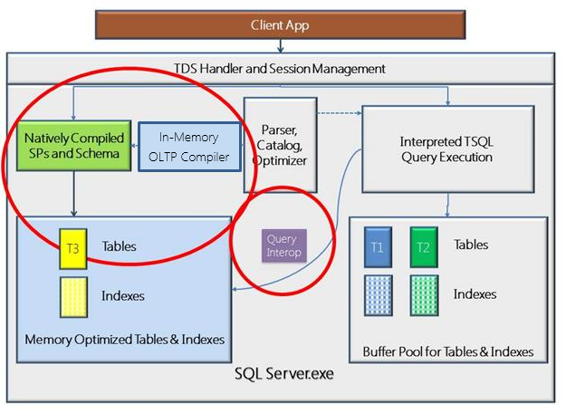

Slide 10
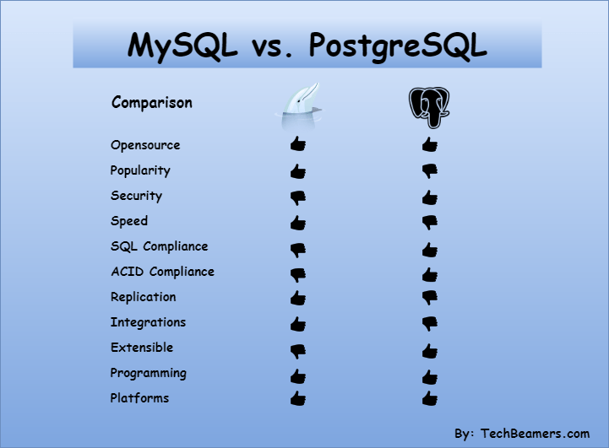

Comparaisonbetween MySQL & PostgreSQL

