Slide 1






Diamonds Prices Analysis
Using machine learning linear regression model
Name : Abdelhamid Khaled
ID:18100523

Slide 2

Introduction
The pricing of diamonds is a complex and multifaceted task that involves considering a variety of factors such as carat, cut, color, and clarity. Accurately determining the price of a diamond is critical for industry professionals, as it can have significant financial implications.
In this project, we aim to develop a machine learning model that can automate and improve the diamond pricing process. By using a dataset containing information about almost 54,000 diamonds, we hope to build a model that can accurately predict the prices of diamonds based on their characteristics and provide insights about the factors that influence diamond prices.
Our goal is to create a model that will be able to assist industry professionals in making more informed and accurate pricing decisions, and to contribute to a more efficient and effective diamond market.

Slide 3
Data
Description of the dataset:
Number of diamonds: almost 54,000
Attributes: price, carat, cut, color, clarity, width, depth, etc.
Range of values for each attribute (e.g., price: $326-$18,823, carat: 0.2-5.01)

Slide 4
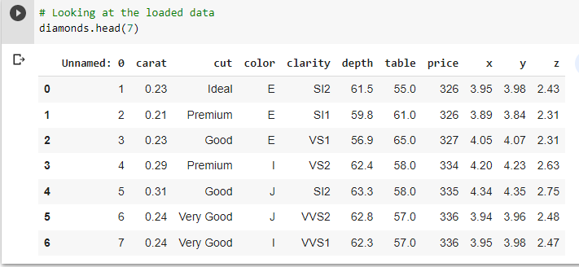
Data
Visualizations

Slide 5
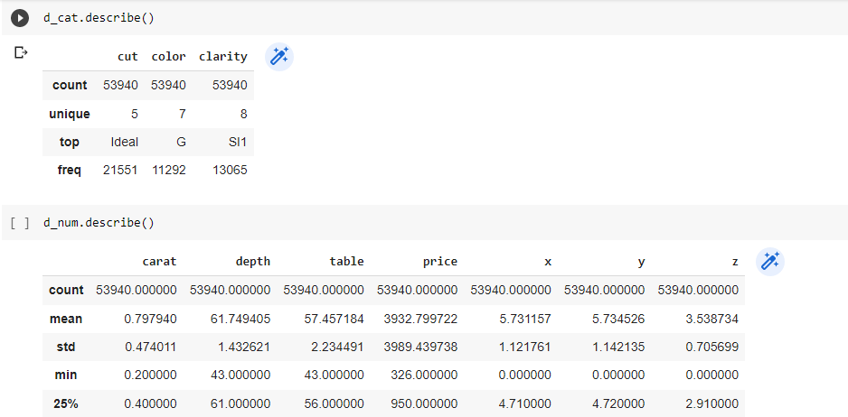
Data
Then I splatted the data into Categorical Variables : cut, color, clarity Numerical Variables : carat, depth, table, price, x, y, z and defend the Dependent Variable : price Independent Variable : carat, cut, color,
clarity, depth, table, x, y, z

Slide 6
Methods
Machine learning model: linear regression
Linear regression is a type of machine learning model that is used to predict continuous variables such as prices. It is based on the assumption that there is a linear relationship between the input features (e.g., carat, cut, color) and the output (e.g., price). This means that the output can be modeled as a linear function of the inputs, with a slope and an intercept.
Linear regression is suitable for this problem because we are trying to predict the prices of diamonds, which are continuous variables. The model is able to make predictions about the prices based on the values of the input features, and can provide insights about the relative importance of each feature in determining the price.
To build the model, we will need to select the appropriate parameters and hyperparameters. The parameters are the coefficients of the linear function (i.e., the slope and the intercept), and they are learned from the data using an optimization algorithm. The hyperparameters are additional settings that control the model's behavior, such as the learning rate or the regularization term, and they are typically set by the user.
Once the model is trained, we can use it to make predictions about the prices of diamonds based on their characteristics. We can also evaluate the performance of the model using evaluation metrics such as mean absolute error (MAE), mean squared error (MSE), and R-squared (R2). These metrics allow us to quantify the accuracy of the predictions and assess the suitability of the model for the problem at hand.

Slide 7
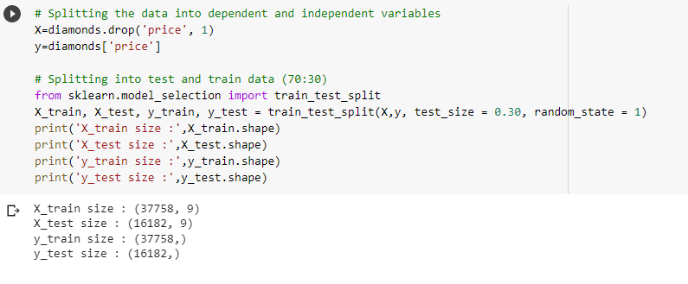
Methods
Then Splitting the data into train and test

Slide 8
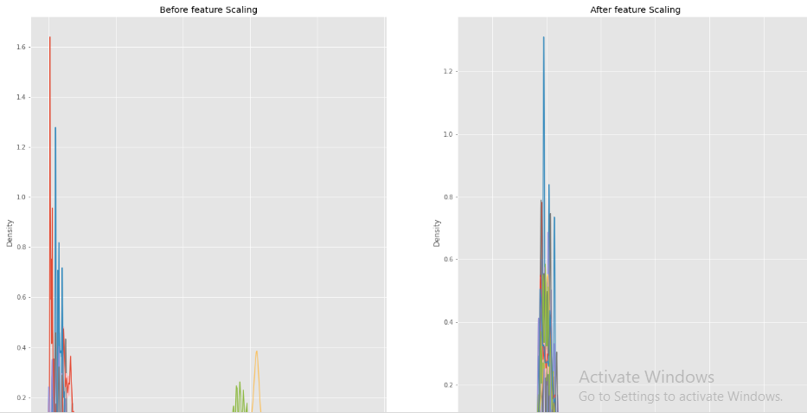
Methods
Then I did a feature scaling

Slide 9
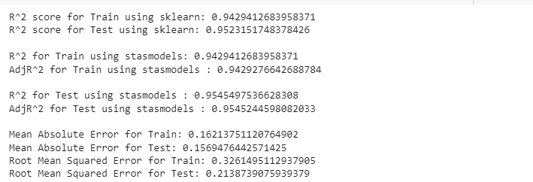
Results
Evaluation metrics:
R2 scores for the training data and the test data
After going for for transformation

Slide 10
conclusion
In conclusion, our machine learning model has shown promising results in predicting the prices of diamonds based on their characteristics. By using linear regression and evaluating the performance using metrics such as R2 scores, MAE, and RMSE, we have been able to demonstrate the effectiveness of the model in predicting diamond prices with a high degree of accuracy.
The model has the potential to be a valuable tool for industry professionals, helping them to make more informed and accurate pricing decisions. It could also contribute to a more efficient and effective diamond market by providing a reliable means of determining prices.
Of course, there are limitations to the model and the data that we used. The data is limited in scope and may not fully capture the complexity of the diamond market. There may also be other factors that influence diamond prices that are not included in the dataset. In the future, it would be interesting to explore other machine learning algorithms or incorporate additional data sources to further improve the model's performance.
Overall, this project has demonstrated the power of machine learning in automating and improving the diamond pricing process, and has opened up new possibilities for analyzing and understanding the factors that influence diamond prices.

