Slide 1
JDBC (Java Database Connectivity)
{
Presented by:
- Adjal Ziad Mahieddine
- ABBES Abdelkader
}
...

Slide 2
Table of contents
01
02
Introduction to JDBC
JDBC Architecture
03
JDBC Drivers
04
Key Components of JDBC
05
Steps to Use JDBC
06
Example Code
07
FINALE PROJECT!!!

Slide 3
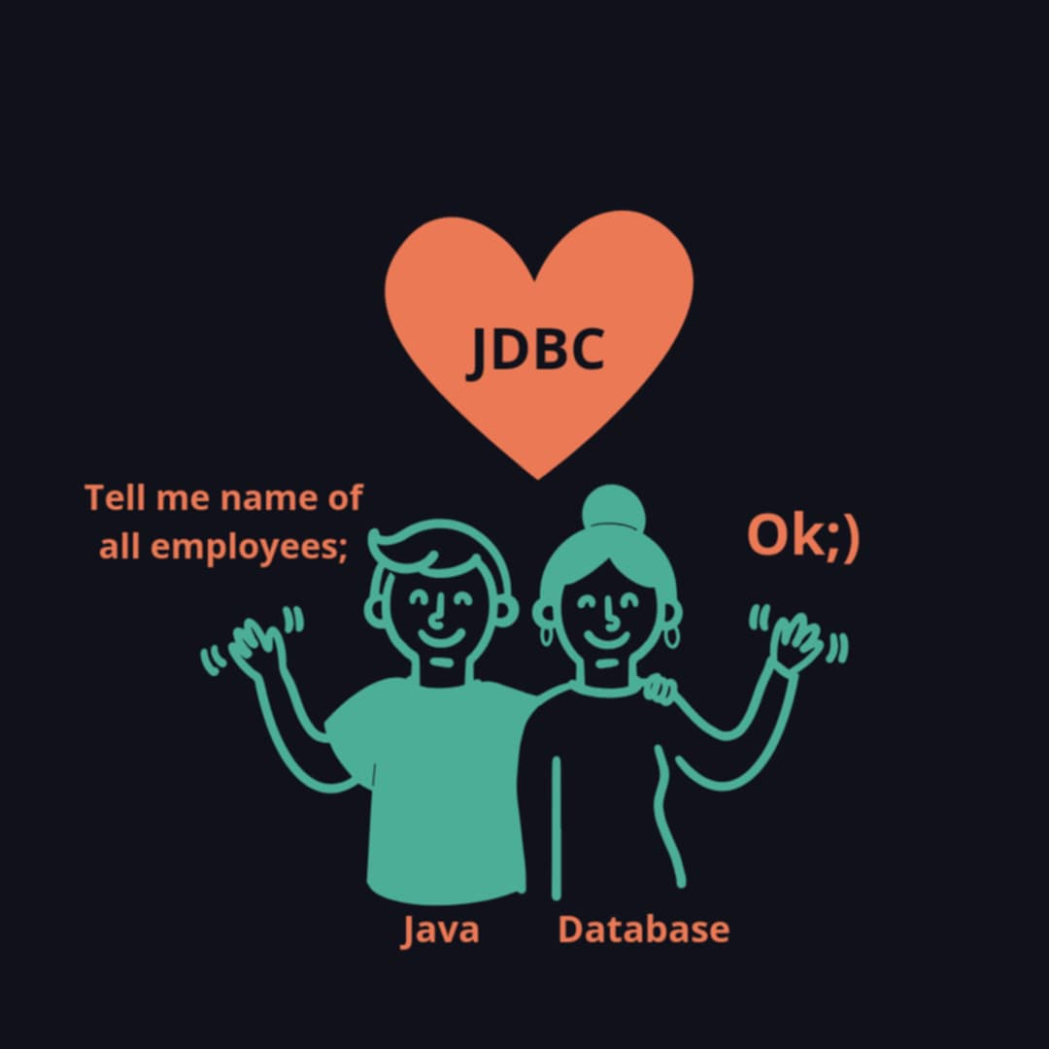
Introduction to JDBC
What is JDBC?
JDBC is an API that allows Java applications to connect to and interact with relational databases using SQL queries.

Slide 4
Introduction to JDBC
Why JDBC?
Database Connectivity
Cross-Platform
SQL Integration
Flexibility
Error Handling & Transaction Management
}
..

Slide 5
JDBC Architecture
{
JAVA Application
JDBC API
JDBC Driver Manager
}
JDBC Driver
JDBC Driver
JDBC Driver
Oracle
PostgreSQL
SQL Server

Slide 6
JDBC Drivers
...
// JDBC-ODBC Bridge
// Native-API
// Network Protocol Driver
// Thin Driver

Slide 7
Key Components of JDBC
// DriverManager
...
// Connection
// Statement/PreparedStatement
// ResultSet
// Exceptions
// Process the results
// Close Resources

Slide 8
Steps to Use JDBC
// Import the Package
...
// Load the JDBC Driver
// Establish Connection
// Create a Statement Object
// Execute SQL Queries
// Process the results
// Close Resources

Slide 9
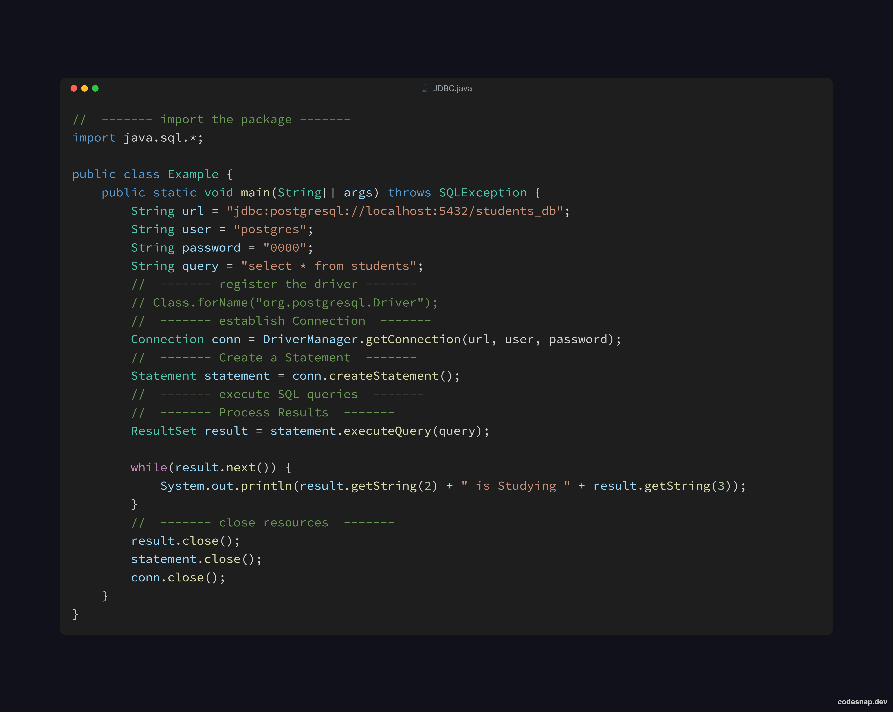
Example Code

Slide 10
FINAL PROJECT!!!

