Slide 1

Sync Agent
Keep a Windows folder in sync with Amazon S3, safely
How it works · How to install it · Why it is safe
Windows 10 / 11 · Amazon S3 · github.com/Abdelkoddous0/sync_agent
Notes:
Sync Agent is a small Windows tray application that keeps one local folder and one Amazon S3 location in sync in both directions. In this talk: the problem it solves, how a user installs it, how it works inside, and the safety rules that make it trustworthy.

Slide 2
The problem
Files are created on PCs, but they need to live safely in the cloud
Files live on PCs
Naive sync loses data
AWS setup is technical
Scans, reports and exports are saved locally. Copying them to S3 by hand is slow and forgotten.
“Newest wins” overwrites a colleague’s edit. A mirror tool deletes files everywhere after one mistake.
AWS CLI commands, profiles and credentials are a barrier for non-technical users.
Sync Agent: a cautious two-way sync that anyone can install in a minute.
Sync Agent — How it works
2
Notes:
Three pain points: manual copying is unreliable; simple sync tools pick winners by timestamp or mirror deletions, which loses data; and AWS tooling is too technical for most office users.

Slide 3
What Sync Agent does
One Windows program, one folder, one S3 location
1
Two-way sync
2
Safe by design
3
One-file installer
New and changed files go up to S3 and come down from S3 automatically.
Never overwrites a file changed on both sides; deletions are off by default.
Double-click SyncAgentSetup.exe, answer four questions, done. No admin rights.
4
Lives in the tray
5
Flexible AWS sign-in
6
Easy to roll out
No windows to manage. The icon shows syncing (amber) or problems (red).
Access keys, company SSO, Roles Anywhere, existing profiles or workload roles.
One prepared settings file next to the installer sets up many PCs.
Sync Agent — How it works
3
Notes:
Six headline features. Emphasize that it is two-way but conservative, and that the whole experience is designed so that a non-technical user can install and run it.

Slide 4
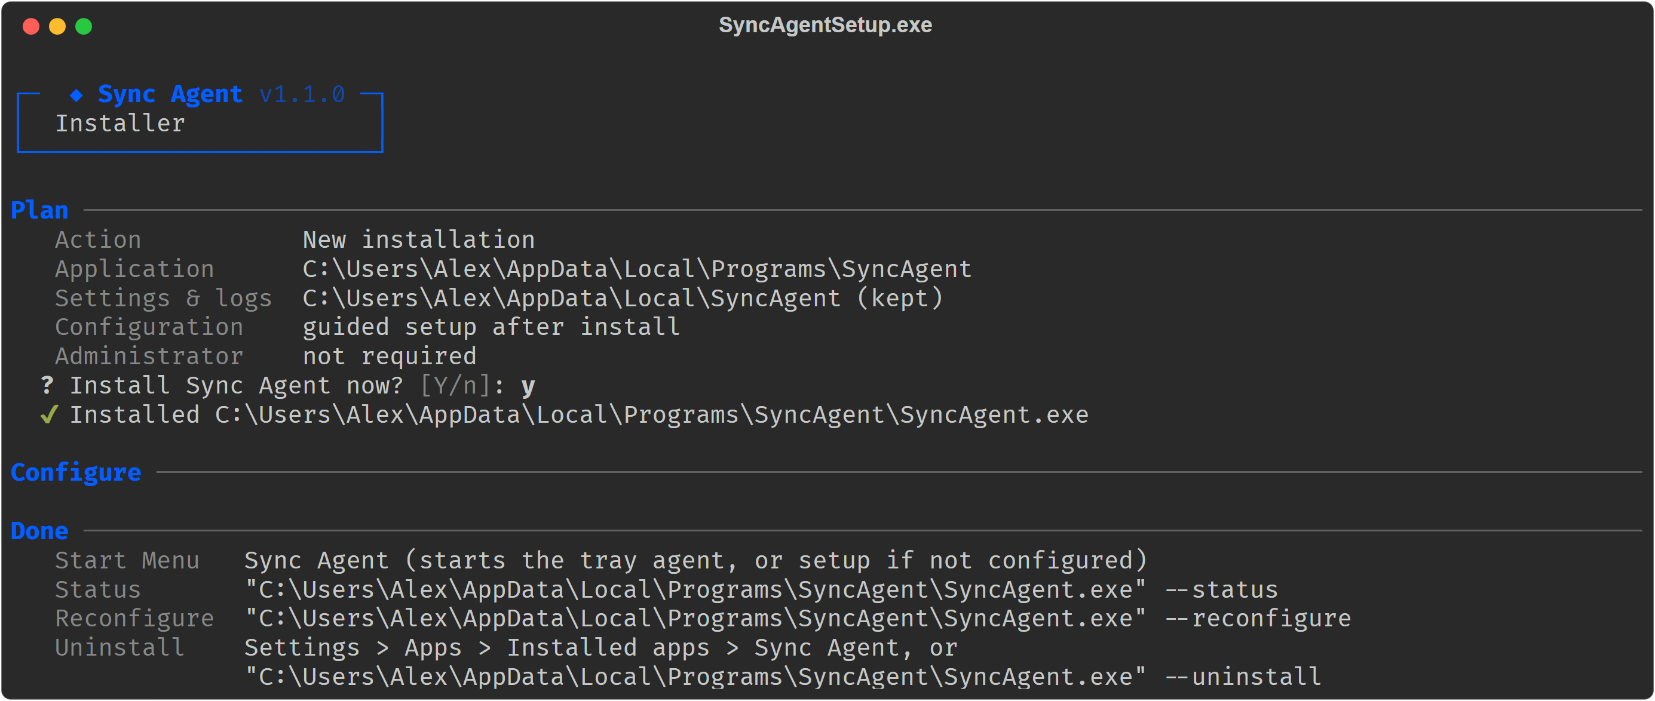
Installing it takes about a minute
Per user · no administrator rights · no Python needed
Double-click installer
Confirm the plan
AWS CLI check
4-step wizard
Running in tray
Sync Agent — How it works
4
Notes:
The single installer file contains the whole application. It shows a plan, installs into the user profile with staging and rollback, checks for the AWS CLI (offering a verified download), and opens the setup wizard. It also adds a Start Menu shortcut and an Installed apps entry.

Slide 5
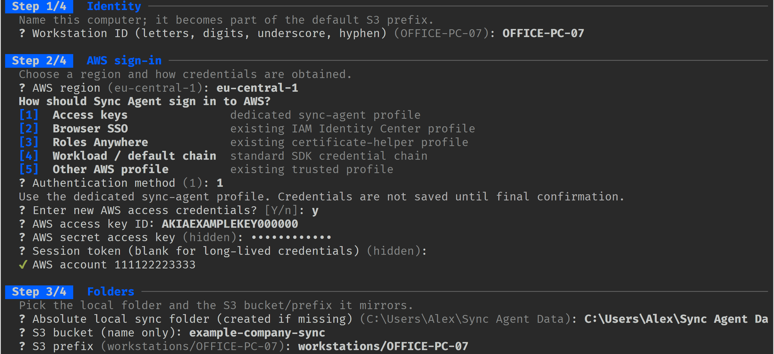
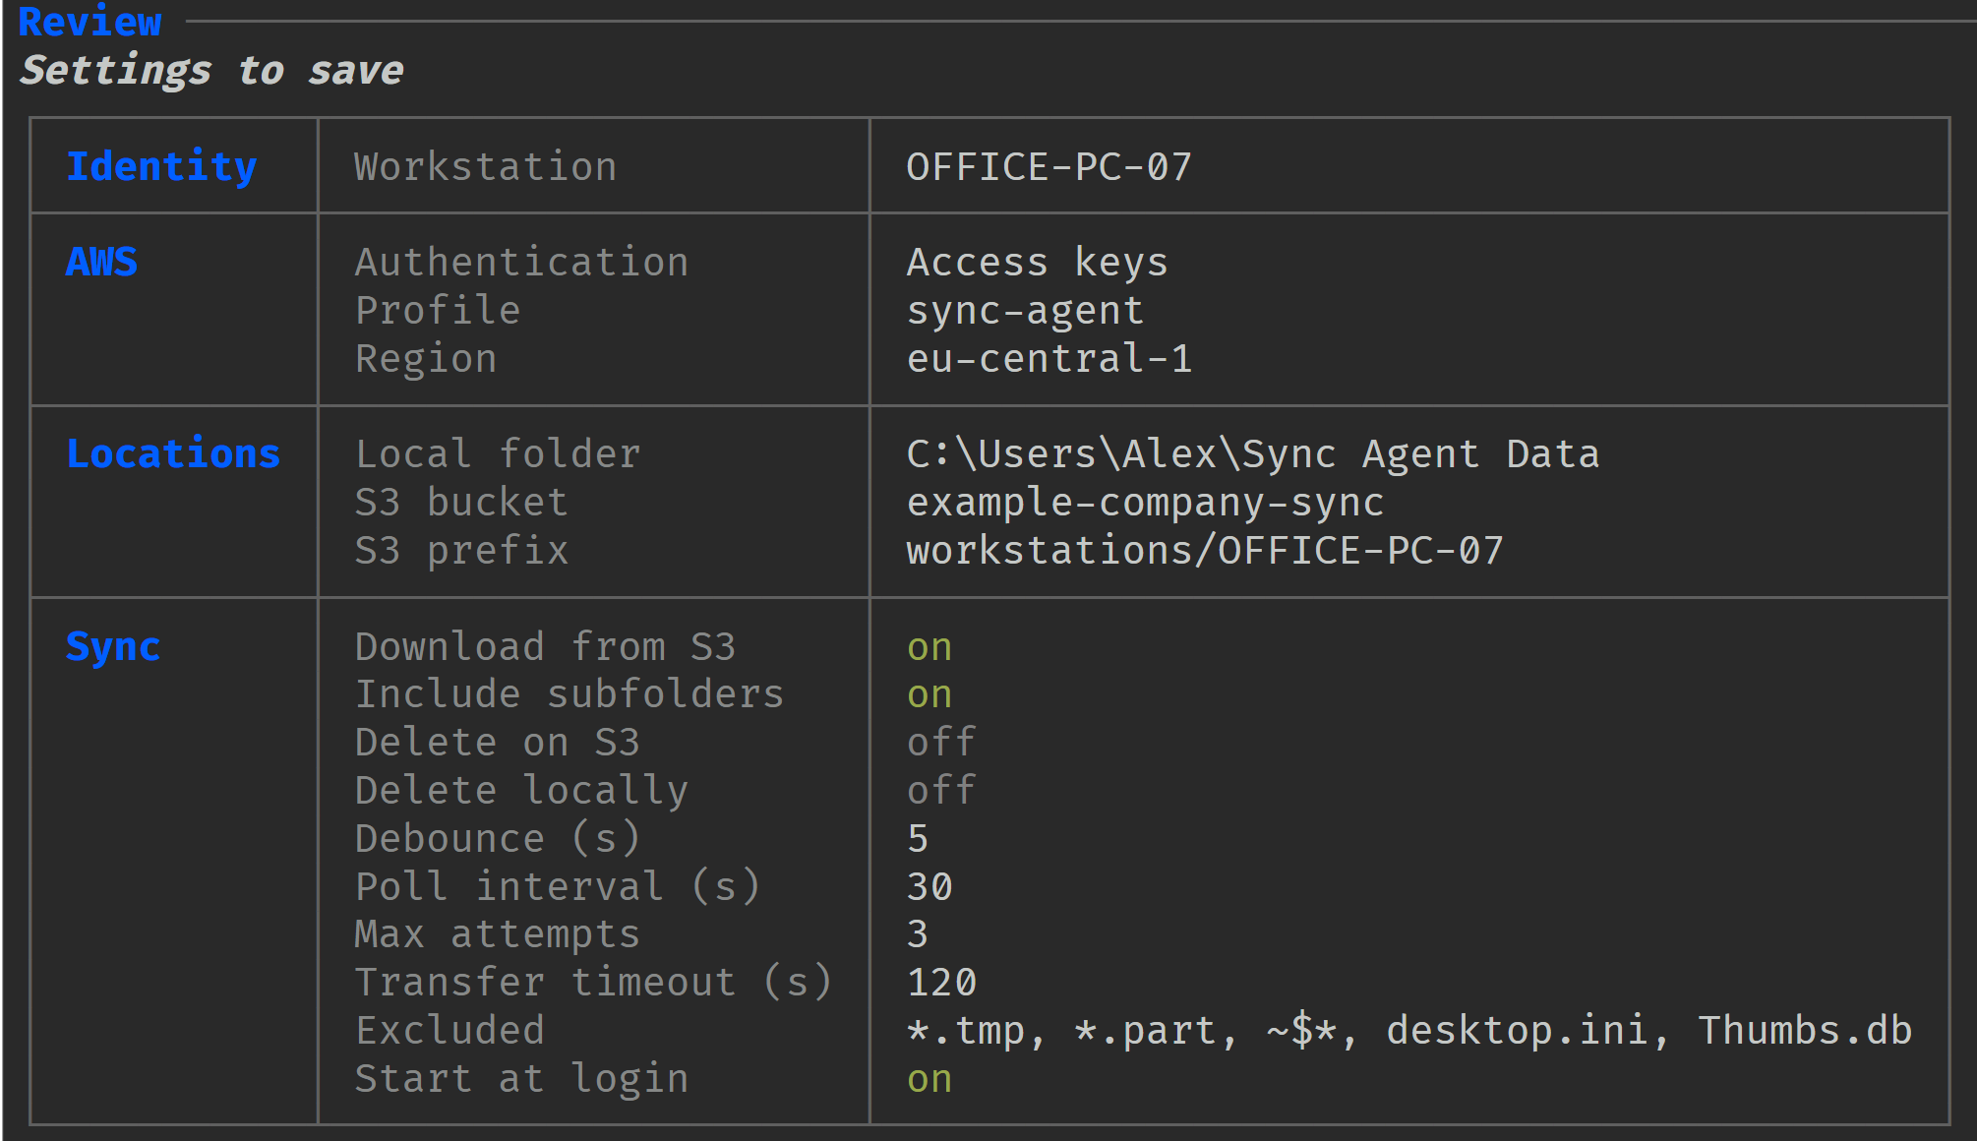
A guided setup in four steps
Defaults are pre-filled; a typo only re-asks that one question
1
Identity
2
AWS sign-in
3
Folders
4
Sync options
Computer name, used for logs and the suggested S3 location.
Region and method: access keys, SSO, Roles Anywhere, profile or workload.
Local folder (created for you), bucket name and prefix inside the bucket.
Timers, downloads on/off, deletions (off), exclusions, start at login.
Nothing is saved until you confirm this review
Sync Agent — How it works
5
Notes:
The wizard has four short steps. Every answer is validated immediately: a wrong bucket name or a relative folder path is reported and only that question is asked again. Access keys are verified against AWS before saving. A final review table shows everything before any change.

Slide 6
Five ways to sign in to AWS
Use whatever your organization already has; credentials never go in the settings file
Method | Use it when | You provide
1 · Access keys | Small setups with a dedicated IAM user | Key ID + secret (checked, then saved to the sync-agent profile)
2 · Browser SSO | Company uses IAM Identity Center | Profile name; browser sign-in after saving
3 · Roles Anywhere | Certificates are issued to computers | Name of the administrator’s certificate profile
4 · Workload chain | Running inside AWS (EC2, WorkSpaces) | Nothing: standard AWS SDK search order
5 · Other profile | A named profile already exists (e.g. assume-role) | Profile name
Least-privilege IAM policy (list, get, put on one prefix) is in docs/authentication.md
Sync Agent — How it works
6
Notes:
Sync Agent does not create AWS infrastructure. It selects a credential source. Access keys are the simplest; SSO is recommended where available. Background sync never opens a browser; when an SSO session expires the user signs in again from the tray menu.

Slide 7
How it works inside
Three triggers feed one sync worker; nothing else touches files or S3
File watcher
local change seen
Sync worker
one pass at a time
Amazon S3
bucket / prefix
Poll timer
every 30 s
Scheduler
debounce 5 s, merge bursts
conditional
requests
Sync now
tray menu
Local folder
your files
Baseline
last synced state
Status + logs
tray dot, --status
Sync Agent — How it works
7
Notes:
File changes, a periodic poll of S3 and the Sync now button only request work. A scheduler merges bursts (debounce) so saving a document ten times becomes one upload. A single worker does all reading, writing and transfers, so passes never overlap. The baseline records what both sides looked like after the last successful sync; it is the key to telling new, changed and deleted apart. Transfers use boto3 directly with conditional requests, not aws s3 sync.

Slide 8
One sync pass, step by step
Triggered by a local change (after 5 s of quiet), every 30 s, or Sync now
1
2
3
4
5
Scan folder
List S3
Safety check
Decide & act
Save
Fingerprint each file (SHA-256). Unchanged files reuse their hash.
Read every object under the prefix with its version tag (ETag).
Skip Windows-invalid, linked or case-clashing names.
Compare both sides with the baseline: upload, download, skip or conflict.
Store the new baseline; publish status for the tray and --status.
Changes that arrive during a pass are kept and handled by the next pass. Two passes never run at the same time.
Sync Agent — How it works
8
Notes:
Every pass follows the same five steps. Hashing is cached by size, modification time and file ID, but recently modified files are always re-read, and every transfer re-checks the full content first.

Slide 9
How each file is decided
Compare both sides with the baseline, never “newest timestamp wins”
Nothing
Skip
What changed since
the last sync?
Edited / new locally
Upload (conditional write)
Each file
Edited / new in S3
Download (atomic replace)
Changed on both sides
Conflict: both copies kept, reported
First sync is cautious: a file already on both sides is a conflict, even if identical.
Deletions are copied only when the matching setting is turned on, and only if the other copy is unchanged.
Deleted on one side
Keep the other copy and remember (default)
Sync Agent — How it works
9
Notes:
This is the heart of the tool. Each side is compared with the baseline, not with each other. One-sided changes are copied. Both-sided changes become conflicts: nothing is overwritten, the user keeps the version they want. Deletions are remembered rather than propagated unless the user opts in.

Slide 10
Safety guarantees
Designed so that a sync tool can never be the reason data is lost
Conditional uploads
Atomic downloads
Conflicts preserved
S3 only accepts the write if the object is still the version we saw. No silent overwrite.
Written to a temporary file, local file re-checked, then swapped in one step.
Both copies stay untouched and are listed until the user resolves them.
Deletions off by default
Unsafe names blocked
No secrets in logs
Opt-in, baseline-confirmed, and only if the other copy is unchanged.
Reserved names, “..”, links/junctions and case-only clashes are skipped.
Only error types are logged; settings never contain keys.
Still recommended: S3 bucket versioning and an independent backup. Sync is not backup.
Sync Agent — How it works
10
Notes:
Every risky operation has a guard, and when a guard trips the operation is reported, never retried in a less safe way. Stopping the agent is cooperative: no process is ever force-killed.

Slide 11
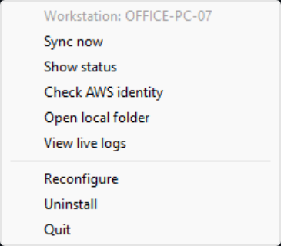

Everyday use
Everything is one right-click away in the system tray
The tray icon is the health indicator
Amber dot: a sync pass is running. Red dot: conflicts or errors (with a Windows notification).
Hover for a summary; Show status for the details.
SyncAgent.exe --status --logs --reconfigure --stop
Same actions from a terminal, for administrators
Status and identity windows stay open until you press Enter.
Sync Agent — How it works
11
Notes:
Users rarely need anything but the tray icon. Show status lists the last pass, any conflicts and all settings. Reconfigure changes one group of settings at a time and restarts the agent safely.

Slide 12
Key settings
Stored per user in %LOCALAPPDATA%\SyncAgent\config.json, never with credentials
Setting | Default | Meaning
local_path | Sync Agent Data | Folder to keep in sync
s3_bucket / s3_prefix | required | Where in S3 the files live
auth_method / aws_profile | access_keys | How Sync Agent signs in
sync_from_s3 | on | Download changes (off = upload-only backup)
delete_on_s3 / delete_local | off | Copy deletions (destructive, opt-in)
exclude_patterns | *.tmp, ~$* … | Files never synced
debounce_secs / poll_interval | 5 s / 30 s | Quiet time after edits / how often S3 is checked
transfer_timeout | 120 s | Abandon a transfer that makes no progress
autostart / notifications | off / on | Start at sign-in / alert on problems
Change them with Reconfigure: validated, reviewed, applied with automatic rollback on failure.
Sync Agent — How it works
12
Notes:
All settings are validated before anything is saved. The full reference with every allowed value is in docs/configuration.md. Changing the folder, bucket or prefix starts a fresh sync history, so the next pass treats files on both sides as conflicts rather than overwriting.

Slide 13
Rolling out to many computers
One prepared settings file replaces the wizard
Prepare
edit SyncAgent.config.json
Share
USB stick or network share
Run
SyncAgentSetup.exe --yes
Done
installed, configured, syncing
No credentials in the file
Same file = same S3 prefix
Paths must exist everywhere
Each PC needs a working AWS profile: SSO, Roles Anywhere or keys.
PCs sharing a file sync with each other. Use one file per PC for separate areas.
Use a fixed folder such as C:\Users\Public\…; %USERPROFILE% is not expanded.
SyncAgent.config.json
{ "local_path": "C:\\Users\\Public\\Sync Agent Data", "s3_bucket": "example-company-sync",
"s3_prefix": "workstations/office", "auth_method": "sso", "aws_profile": "company-sso", "autostart": true }
Sync Agent — How it works
13
Notes:
Administrators can ship SyncAgentSetup.exe with a SyncAgent.config.json next to it. With --yes the installer asks nothing: it installs, validates and applies the settings, and starts the agent. Invalid settings are rejected before the running agent is touched.

Slide 14
Install, upgrade and uninstall safely
Everything is per user: no services, no admin rights, no system changes
Validate
Copy & test
Stop agent
Swap folders
Add shortcuts
Any failure → the previous version and its startup entry are restored automatically
Uninstall removes
Uninstall keeps
• Application folder
• Start Menu shortcut
• Installed apps entry
• Start-at-login entry
• Your sync folder and everything in S3
• Settings, logs and sync history
• AWS CLI and AWS profiles
Sync Agent — How it works
14
Notes:
Upgrades copy the new version to a staging folder and test it before the old one is touched. The running agent is asked to stop; it is never killed. If anything fails, the old version is restored. Uninstall is available from Windows Settings and never deletes user data.

Slide 15
Tested on real Windows
Automated, native and one-command acceptance checks
217
20 / 20
3
automated tests on
every build
acceptance checks passed
on Windows 11
installation blockers found
and fixed during testing
Windows 11
Install, upgrade, uninstall and tray verified
Done
Code signing
Built into build.bat + CI, proven with a test certificate
Needs certificate
Windows 10
One command: acceptance-test.ps1 + SyncAgentSetup.exe
Ready to run
Live S3
Real end-to-end sync against a test bucket, self-cleaning
Passed
Sync Agent — How it works
15
Notes:
Every build runs 217 automated tests and refuses to package on failure. A one-command acceptance script installs, starts, stops, upgrades and uninstalls the real installer in throwaway folders: 20 of 20 checks pass on Windows 11, and the same command is ready for Windows 10. Code signing is wired into the build and CI and was proven with a test certificate; it needs a real certificate. The live S3 tests passed against a real test bucket: conditional writes plus a full end-to-end sync, with every test object cleaned up afterwards.

Slide 16
Summary
✓
Simple one installer, four questions, then it lives in the tray
Next steps
• Run acceptance on Windows 10
• Add a code-signing certificate
• GitHub release, then pilot
✓
Safe conditional writes, conflicts preserved, deletions off by default
✓
Flexible five AWS sign-in methods, one-file rollout to many PCs
✓
Transparent tray status, notifications, --status and logs
Questions?
github.com/Abdelkoddous0/sync_agent · docs/ for installation, configuration and architecture
Notes:
Recap the four takeaways, then the concrete next steps before a wider rollout. Open for questions.

