Slide 1

Sparktech

Slide 2
Our team
Oumou : Analyst
Issam : Packger
Abdelkrim : Tester
Maaro : Developer
Matthieu : Project Manager

Slide 3
Our plan
Concept of the project
It’s cost
Risks

Slide 4
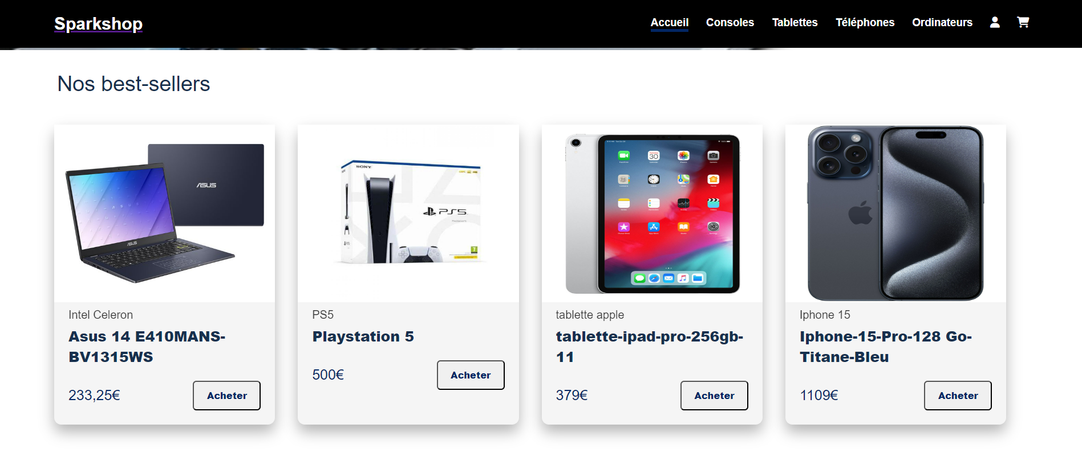
Sparkshop

Slide 5
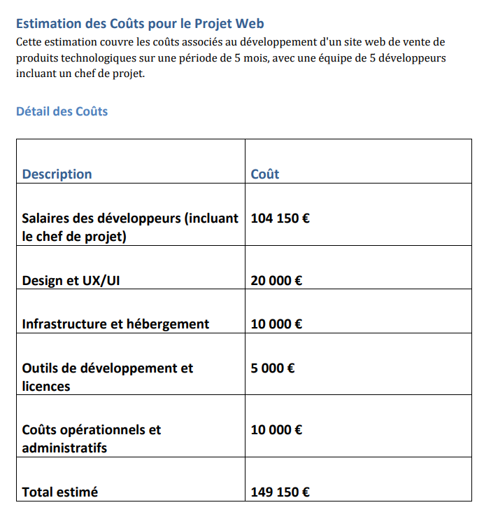
Cost estimated

Slide 6

Risk
Not Secured
Database not linked
We are taking late

Slide 7

Thanks you Any questions ?

