Slide 1

Week Two Progress Update: Enhancements and Task Completion for Readers Haven
Laurent
Abdellah

Slide 2
Project Overview Recap & Week Two Objectives
Implementing additional views and functionalities.
Testing the add, update, and delete book features.
Ensuring data validation and handling errors effectively.

Slide 3
Upgrade Summary
Update the use case and sequence diagrams: Created a sequence diagram for each use case (add book, update book, delete book)
1
Add Book Feature: Successfully implemented a feature to add books directly through the URL
2
Update Book Feature: Created a URL-based function to update book details
3
Delete Book Feature: Added a function to remove a book entry from the inventory with a straightforward URL-based deletion
4

Slide 4
Functionality Enhancements
Diagram updates instead of one global sequence diagram, we created for each use case its sequence diagram.
Enabled book additions through URLs without requiring admin privileges, fixing the previous limitation that restricted adding books only via the admin page. (Demonstration through the project)

Slide 5
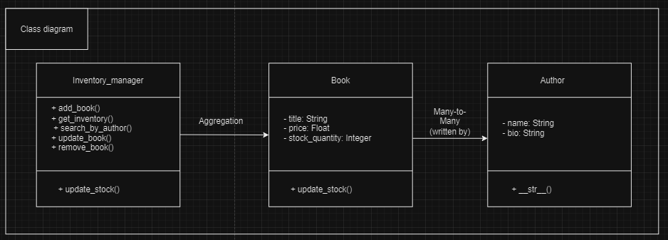
Class diagram

Slide 6
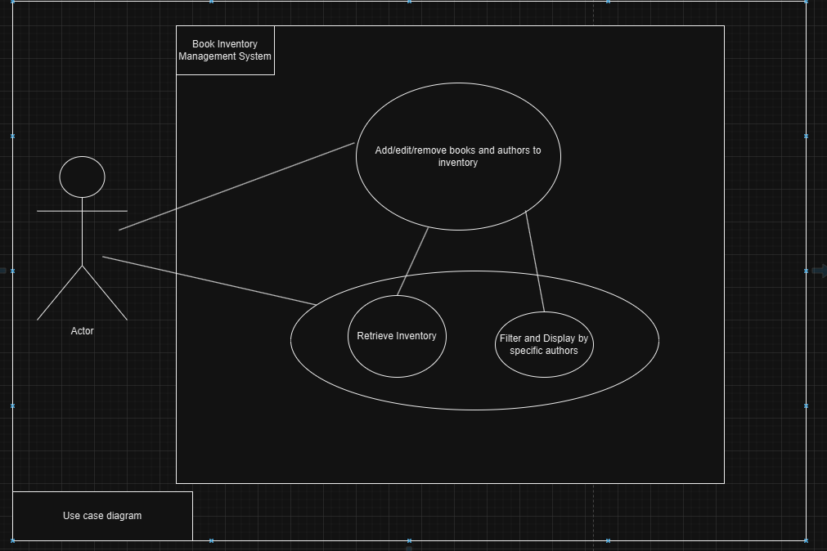
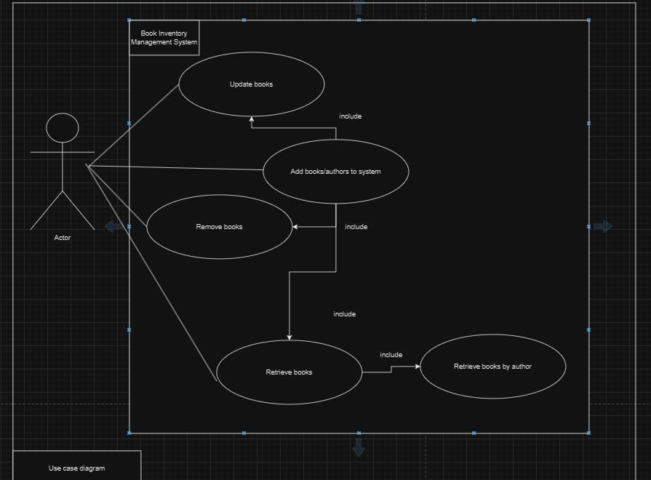
Use case diagram:
Before the update
After the update

Slide 7
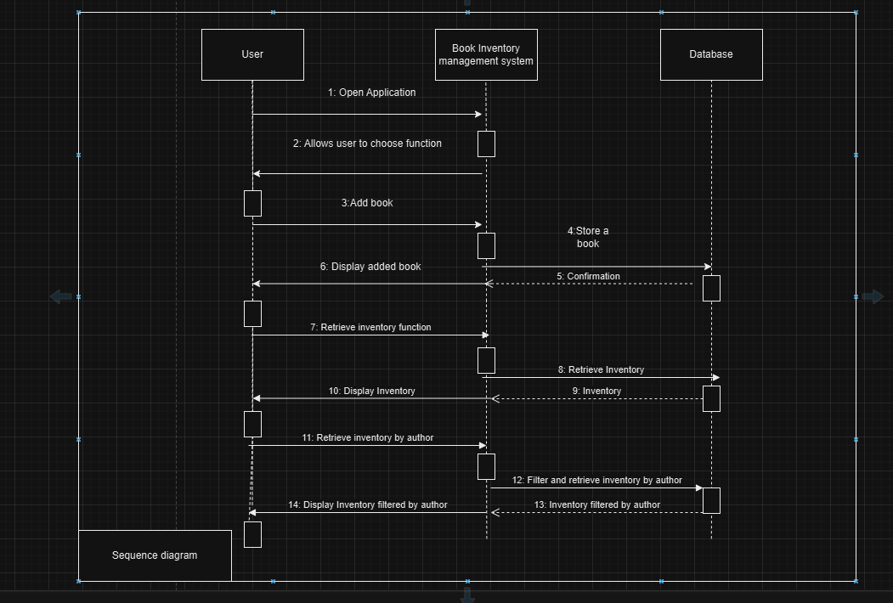
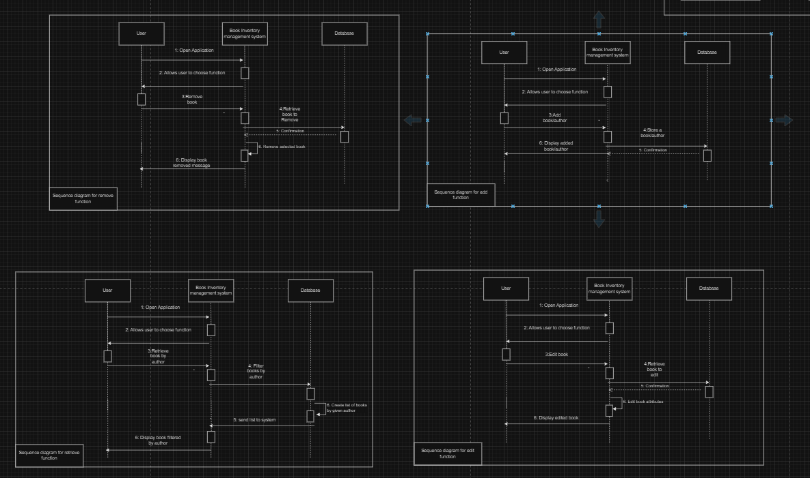
Sequence diagrams
Before the update
After the update

Slide 8
New Feature Added
Create add, update, and delete books functions, allowing direct inventory management without accessing the admin interface.
Demonstration through the project.

Slide 9
Next Steps for Week Three

