Slide 1

Week 4 Progress: Google Books API Integration & Enhancements
Laurent
Abdellah

Slide 2
Project Overview Recap
Previously, books were added only manually.
Allowed searching, updating, and deleting books via URLs.
Improved error messages for invalid inputs.

Slide 3
Week 4 Feedback Integration
Integrated Google Books API to fetch book data online.
New functionality to fetch and add books automatically using the API.
Retained manual book-adding functionality for flexibility.

Slide 4
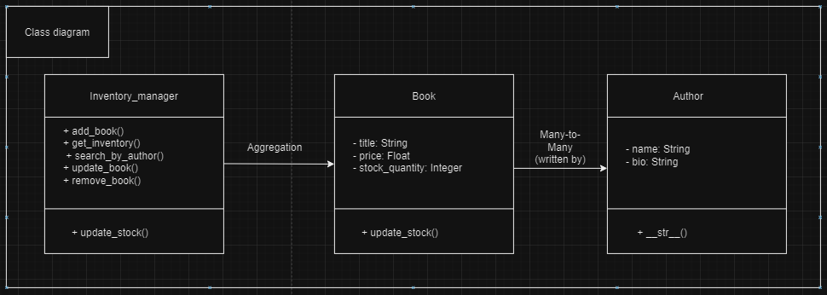
Class diagram

Slide 5
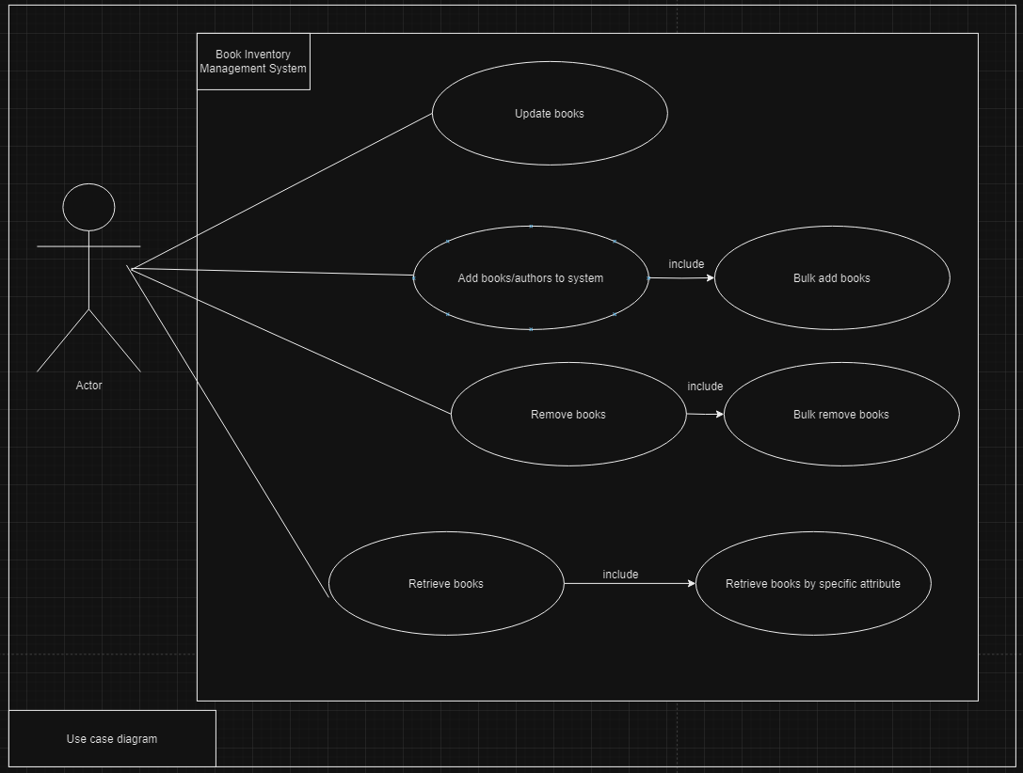
Use case diagram

Slide 6
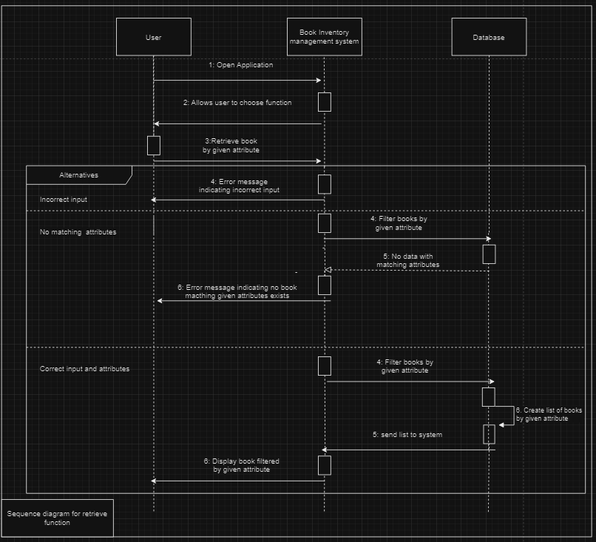
Sequence diagram: Retrieve function

Slide 7
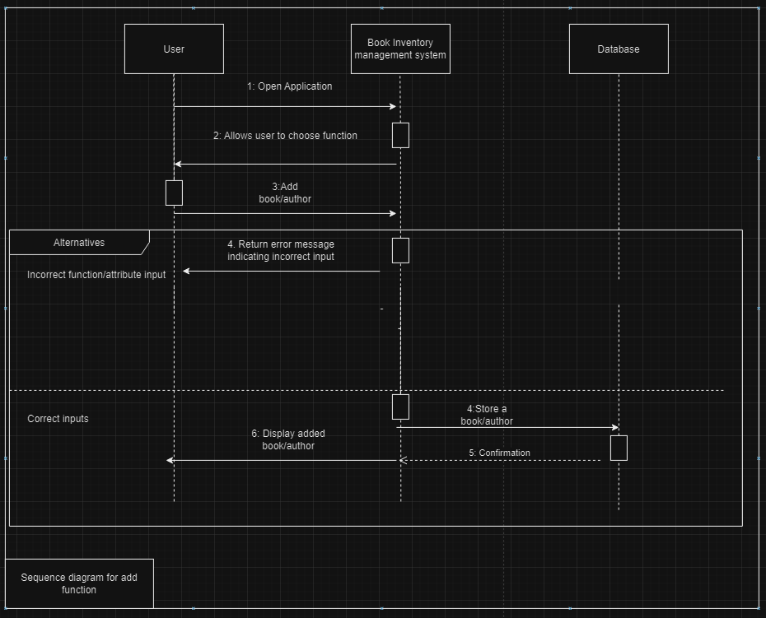
Sequence diagram: Add function

Slide 8
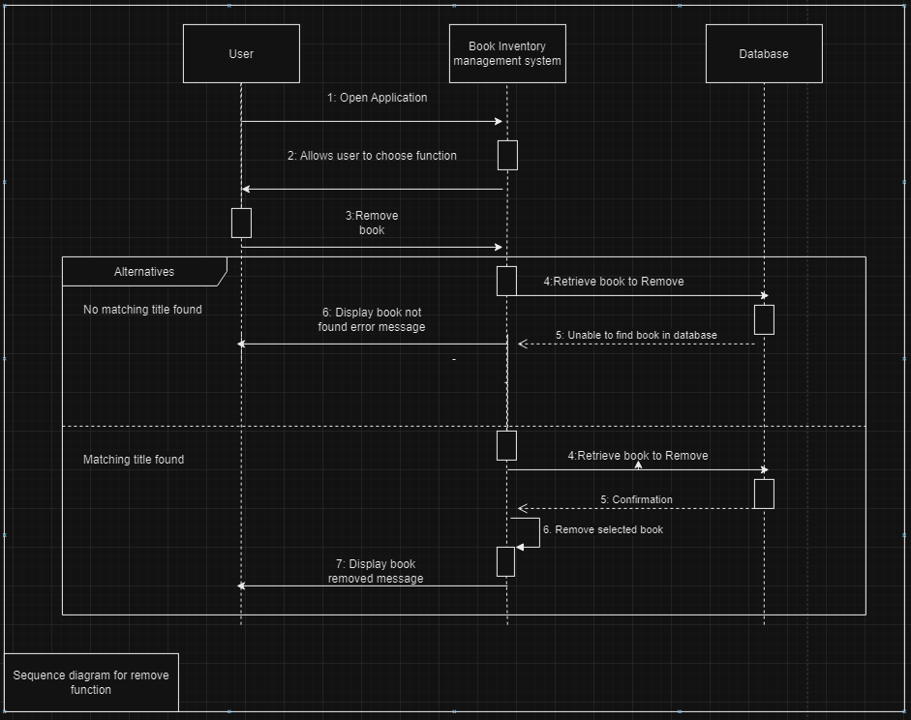
Sequence diagram: Remove function

Slide 9
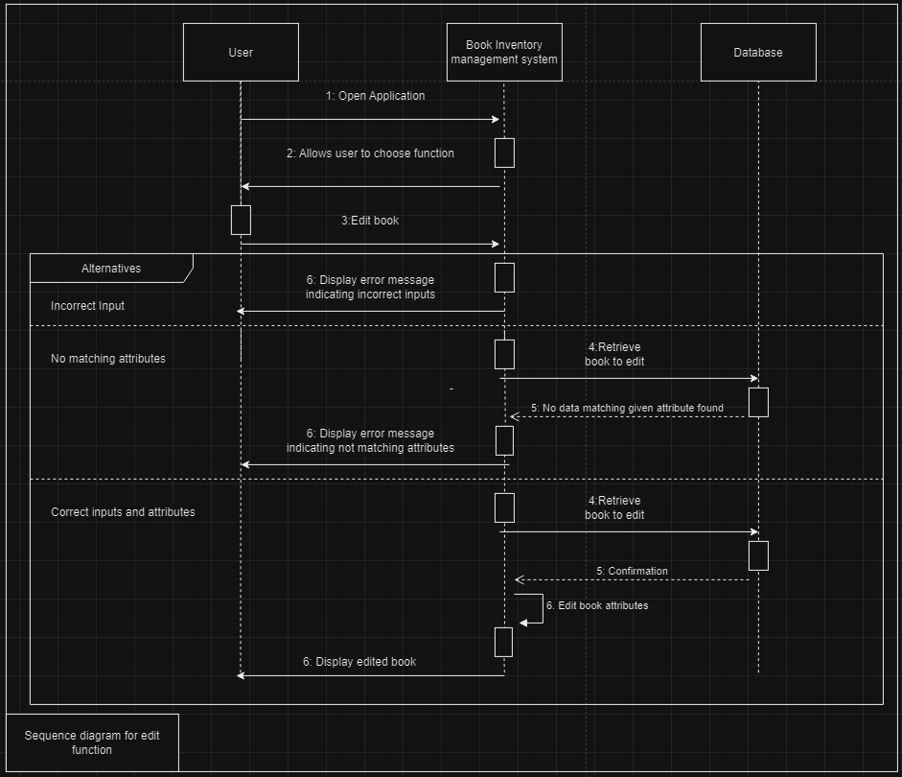
Sequence diagram: Edit function

Slide 10
Functionality Enhancements
Fetch and Add Book:
Added a feature to search and add books from Google Books API by title.
Improved Search:
You can search directly through the API for books by author or title.
Enhanced Workflow:
Results from Google API are integrated into our project seamlessly.

Slide 11
Example of Functionality
Add a Book Using API:
URL: http://127.0.0.1:8000/fetch_and_add_book/?title=Harry Potter
Search for a Book:
URL: http://127.0.0.1:8000/fetch_google_books/?q=Harry Potter
Update a Book:
URL: http://127.0.0.1:8000/update_book/?title=Harry Potter&new_title=HP

