Slide 1

FINAL YEAR DEFENSE · 2025/2026
HMI Stars
University of Kairouan
Faculty of Sciences & Techniques of Sidi Bouzid
A real-time web & mobile ecosystem for expert accounting consulting
PRESENTED BY
SUPERVISED BY
Hassen ABDELLI
Dr. Aymen CHAABOUNI (Academic)
Yassine ELHADJ
Mr. Salem AKLI (Enterprise)
Jury — Dr. DHAHRI (President) · Dr. CHAKROUN (Reviewer) · Dr. CHAABOUNI (Supervisor)
Notes:
yassine
“Good morning, Madam and the members of the jury. Thank you for your time and attention. Today, me and my partner will present our project and explain the work we have done throughout our internship

Slide 2
Where we're headed
01
02
03
04
05
06
Introduction & Context
Requirements Analysis
Methodology & Architecture
System Design & UML
Realization & Sprints
Testing
Notes:
yassine

Slide 3
01
CHAPTER 01
Introduction & Context
Company overview, objectives and the problems we want to solve
Notes:
This Final Year Project focuses on the design and development of a complete web and mobile application ecosystem for HMI Stars Consulting,

Slide 4

Host Company: HMI Stars
◐
Company Profile
Based in Paris, helping client companies manage their administrative paperwork.
▤
Target Clients
A French consulting enterprise that helps small businesses with paperwork and payroll.
Small and medium businesses (SMEs) registered and operating in France.
◷
Main Operations
Handling tax filings, work contract updates, and monthly payroll processing.
◫
Collaborative Team
Company managers work closely with HMI Stars consultants to submit records.

Slide 5
◐
Lost Documents
Problem Statement
& Objectives
Important files (like tax papers or IDs) frequently get lost in long email threads.
▤
Paper Attendance
The main operational problems we found in the company's daily manual work.
Managers log attendance on paper sheets, making it easy to lose and hard to trace.
◷
Slow Notifications
Sending formal warning letters or requests takes 3 to 5 days using regular mail.
◫
Messy Communication
Conversations are scattered across WhatsApp, phone calls, and emails with no central tool.
Notes:
Yassine
Before the implementation of this solution, the company relied mainly on traditional communication methods such as emails, phone calls, messaging applications, and physical documents to exchange information with client companies. This approach often led to delays, loss of important documents, inefficient communication, and difficulties in tracking employees and administrative activities.

Slide 6
The proposed solution : A unified ecosystem
Built as a Flutter monorepo on a single Supabase backend.
▣
▦
◈
Mobile App
Web Platform
Real-Time Backend
Flutter cross-platform for client managers — Android & iOS
For HMI Stars admins and staff
Supabase + PostgreSQL RLS + WebSocket sync
Flutter > React Native — one codebase for Android, iOS & Web · Supabase > Firebase — native Row Level Security

Slide 7
02
CHAPTER 02
Requirements Analysis
Identifying system users and detailing their functional needs
Notes:
hassen
During the requirement analysis phase, we studied the company’s needs, identified existing problems, and defined the requirements necessary to develop an efficient and secure solution.

Slide 8
◐
Client Manager
Managers of client companies who handle their workers list and submit attendance.
System Actors & Scope
▤
HMI Stars Consultant
Defining who uses the application and what parts of the system they can access.
Office advisors who verify records, check documents, and send warnings.
◷
Mobile App Scope
Designed for managers to log attendance, scan files offline, and chat with support.
◫
Web Platform Scope
Designed for consultants to register companies, view logs, and export Excel files.
Notes:
hassen
Client Managers use the Mobile App to track attendance, scan documents offline, and chat with support. HMI Stars Consultants use the Web platform to register companies, review records, and export reports. Each role has dedicated tools matching their responsibilities

Slide 9
Functional Requirements
Detailed features of the mobile application, web portal, and backend server database.
▣
▦
◈
Mobile App Features
Web Portal Features
Database Features
Central page to manage client companies.
Searchable list of all employees.
Exporting attendance logs to Excel sheets.
Viewing PDF files directly on the screen.
Verifying OTP codes for secure sessions.
Linking tables together (companies, workers).
Row Level Security (RLS) to keep data safe and seperated.
WebSocket triggers for instant chat updates.
OTP login and user account settings.
Interactive calendars for attendance.
Scanning documents using the phone camera.
Creating and sending warning templates.
Notes:
This slide presents the core functional requirements across three system layers. The Mobile App provides OTP authentication, attendance tracking with interactive calendars, document scanning via camera, and warning template creation.
The Web platform enables client company management, employee search, attendance export to Excel, and direct PDF preview.
The Backend Database ensures secure OTP verification, relational data linking, Row Level Security (RLS) for data isolation between companies, and WebSocket triggers for real-time chat updates

Slide 10
Non-Functional Requirements
◐
Data Security
Row Level Security (RLS) blocks unauthorized access directly at the database level.
Quality parameters that make the system fast, secure, and easy to maintain.
▤
Offline Support
The mobile app saves attendance logs on the phone memory and syncs when online.
◷
Easy Updates
Structuring the code by features makes it easy to add updates without breaking parts.
◫
App Speed
Database API requests are fast, loading screen pages in less than 200 milliseconds.
Notes:
Here we cover the non-functional requirements that ensure system quality. Data security is enforced through PostgreSQL Row Level Security, blocking unauthorized access at the database level. The mobile app supports offline mode by caching attendance logs locally and syncing when the connection is restored. The codebase is structured by features, making future updates easy without breaking existing modules. Finally, API response times are optimized to load pages in under 200 milliseconds, ensuring a fast user experience."

Slide 11
03
CHAPTER 03
Methodology & Architecture
Using 2TUP methodology, MVC structure, and backend services
Notes:
Yassine
The system follows the 2TUP methodology with an MVC architecture, backed by Supabase for database, real-time WebSocket, and authentication services

Slide 12
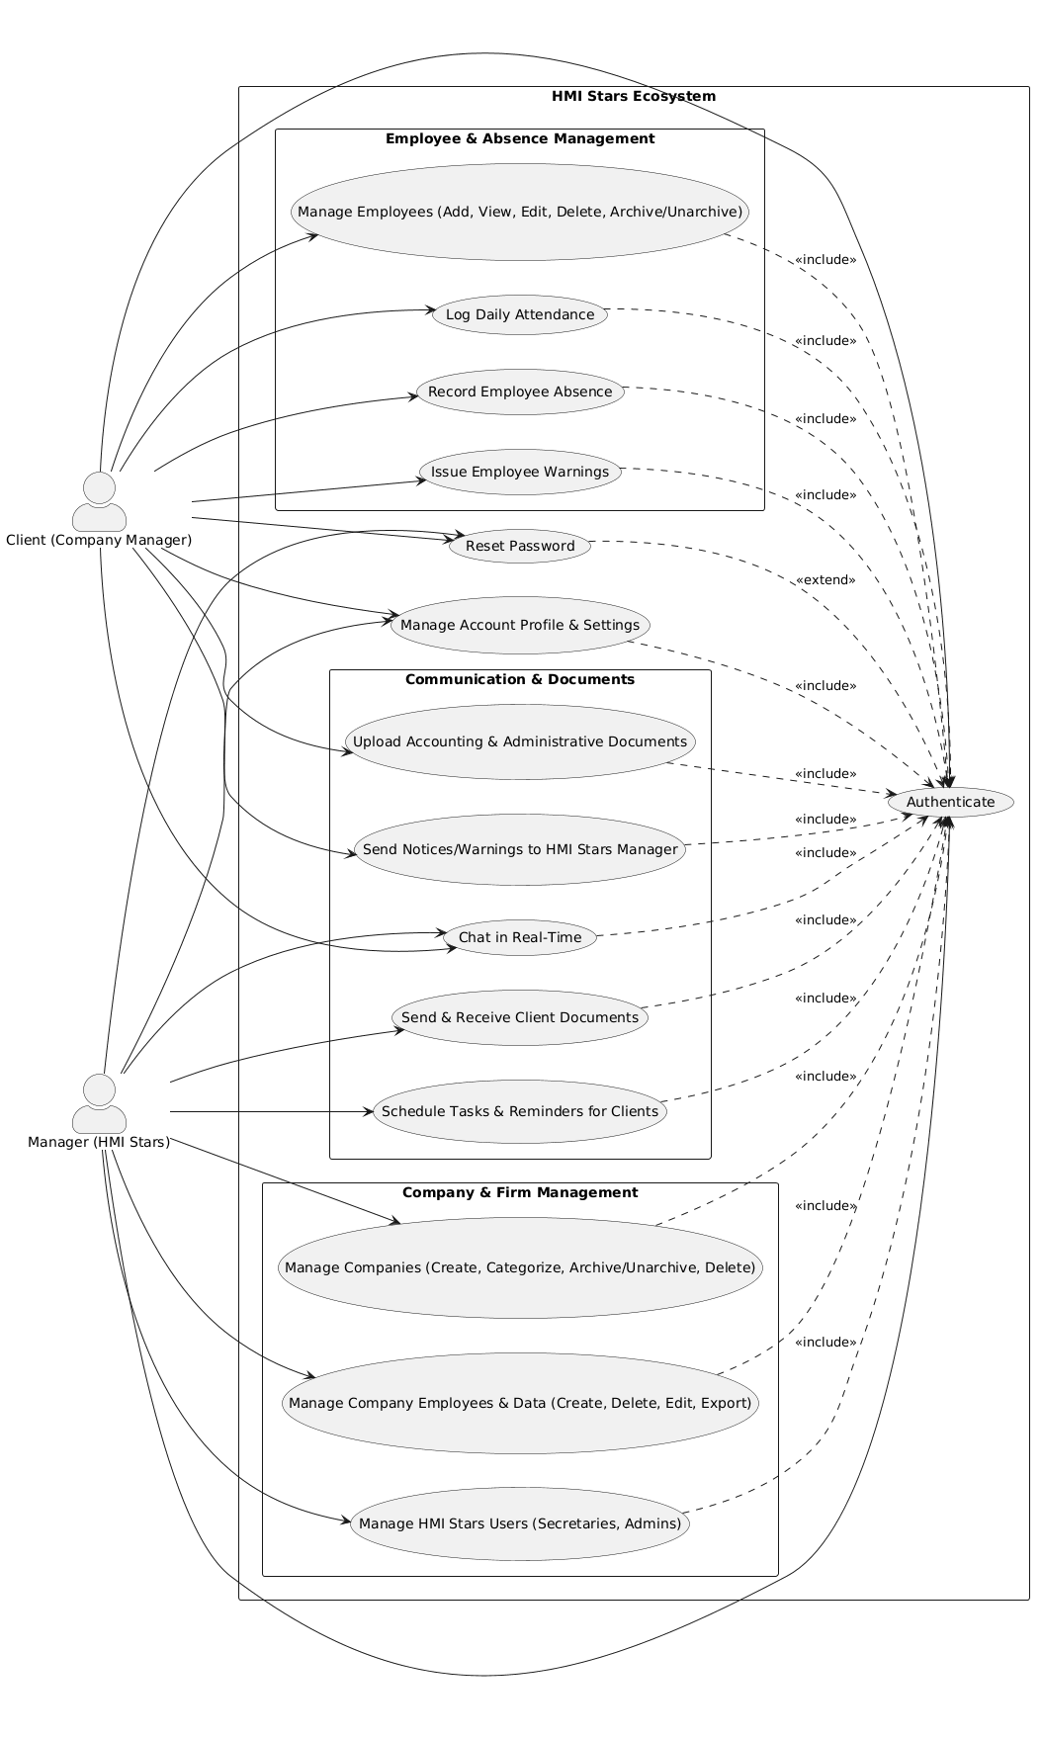
2TUP — two tracks,
one destination
Inception
Actors · use cases · priorities
Elaboration
Sequence & class diagrams
Construction
4 iterations: Auth→Attendance→Chat→Warnings
Transition
Deployment · testing · evaluation
Notes:
The project was developed using the 2TUP methodology in four phases. We began by identifying the actors, use cases, and project priorities, then designed the system through sequence and class diagrams. Development was carried out in four iterations covering authentication, attendance, chat, and warning management.
Finally, the system was deployed, tested, and evaluated.
This is the mobile application use case diagramme
The application includes employees and absence management, attendance tracking, warning management, real-time chat with document sharing, client task scheduling, company management with full CRUD operations, as well as account settings, password recovery, and administrator user management.

Slide 13
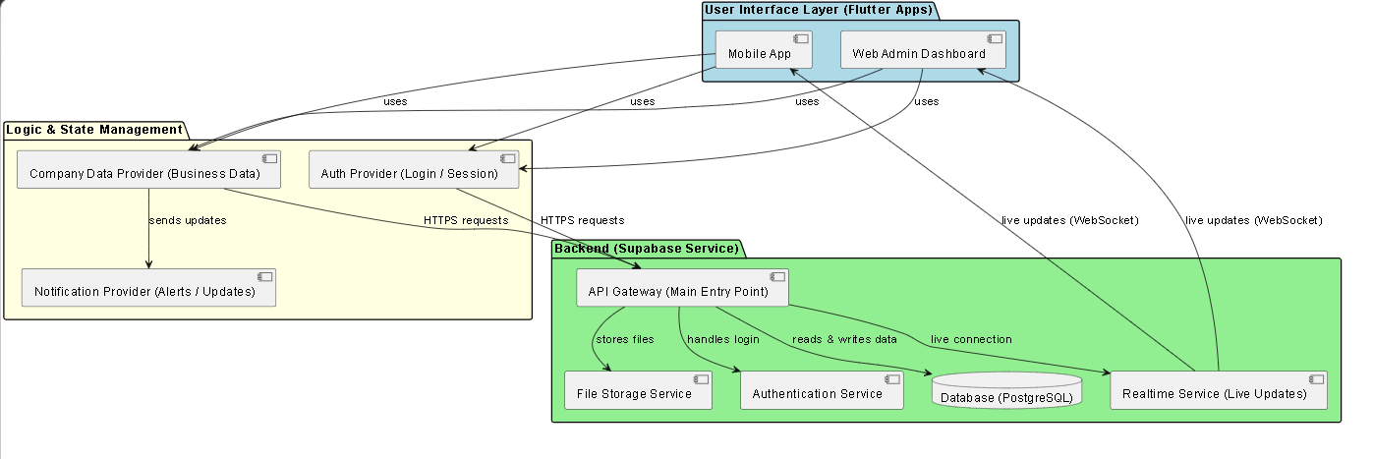
Architecture, layer by layer
BaaS
RLS
Realtime
Offline
REST + WebSocket, zero server code
Per-company isolation via JWT
CDC pushes updates in ms
SQLite cache, auto-sync
Notes:
The system uses a three-layer architecture-Flutter UI (Mobile + Web), Provider-based state management, and Supabase backend (API,
Storage, Auth, PostgreSQL, Realtime) —supported by RLS data isolation, millisecond CDC updates, and offline SQLite sync

Slide 14
MVC Design Pattern
Organizing code by separating data (Model), screens (View), and logic (Controller).
▣
▦
◈
Model (Data)
View (Screens)
Controller (Logic)
Interactive Flutter widgets and screens.
Listens to changes in the controller.
Examples: Attendance calendar, Chat screen, PDF page.
Handles user actions and database API calls.
Manages local storage caching on the phone.
Notifies the screens to update automatically.
Objects that represent our database tables.
Converting data to and from JSON format.
Examples: Employee, Attendance, and Leave models.
Note: This separation makes the app modular and easy to change without breaking other features.
Notes:
"We organized the code using the MVC pattern.
The Model represents database tables and handles JSON data.
The View includes the onterfaces like attendance and chat that react to state changes.
The Controller manages user actions, API calls, and local caching. This separation ensures modularity and simplifies future updates."

Slide 15
04
CHAPTER 04
System Design & UML
UML diagrams showing database structures and user flows
Notes:
hassen“
This chapter covers the system design and UML diagrams. We modeled database structures and user flows using use case, sequence, and class diagrams. These blueprints guided our development from requirements to implementation

Slide 16
Global Use Case Diagram
Mobile Use
Managers log attendance, leaves, employees, and chat
Web Use
Consultants register firms, preview files, and export
Common Use
Secure logins, database rules, and real-time chat
Notes:
"The use case diagram
shows two actors: mobile managers log attendance, leaves, and chat; web consultants register companies, preview, and export.
Common features: login, RLS, real-time chat. The full system includes employee, attendance, warnings, chat, documents, tasks, companies, and user management."

Slide 17
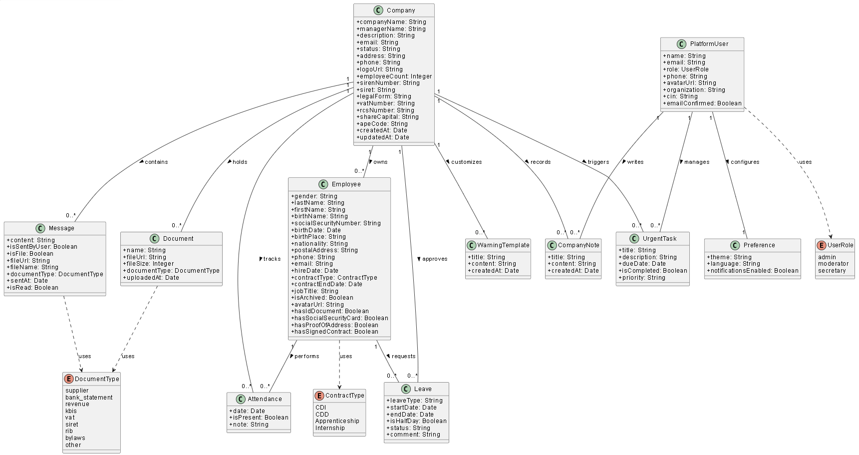
Global Class Diagram
Root Table
Company table holds general client company info
References
Attendance, leaves, and documents link to employees
Rules
Database settings clean up old logs automatically
Notes:
The global class diagram shows Company as the root table, with Employees, Attendance, Leaves, Messages, Documents, and Warnings linked through foreign keys.
RLS ensures per-company data isolation, and automatic cleanup rules manage old logs.

Slide 18
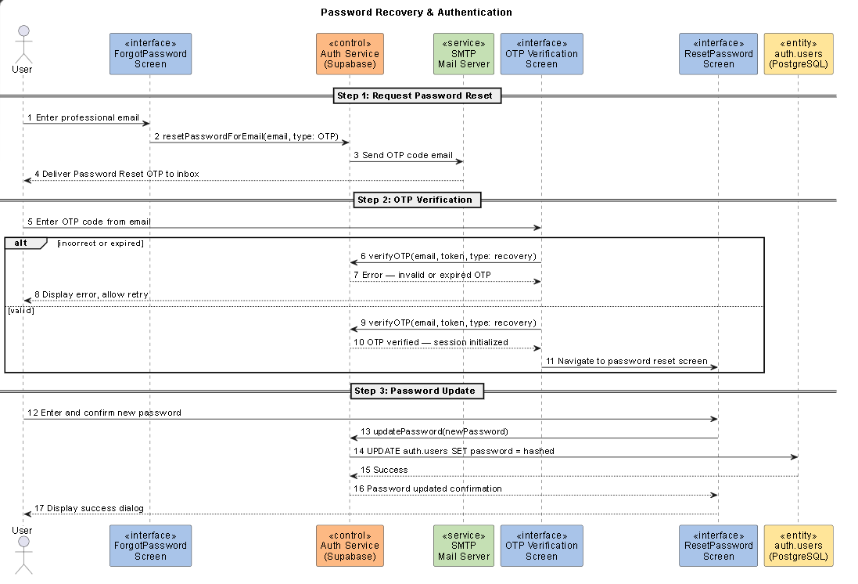
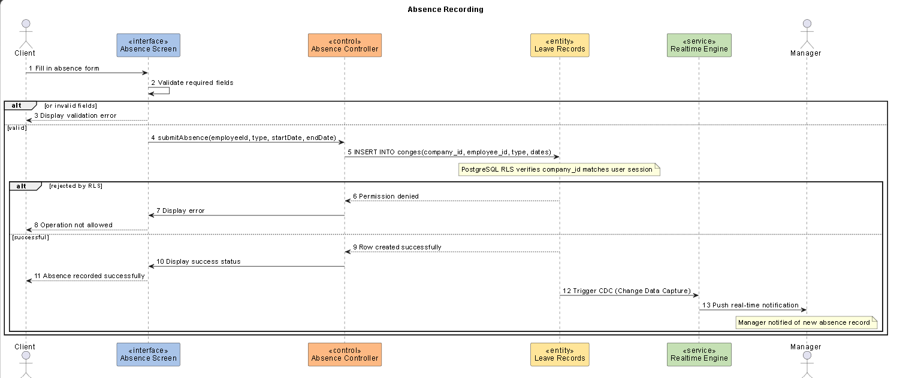
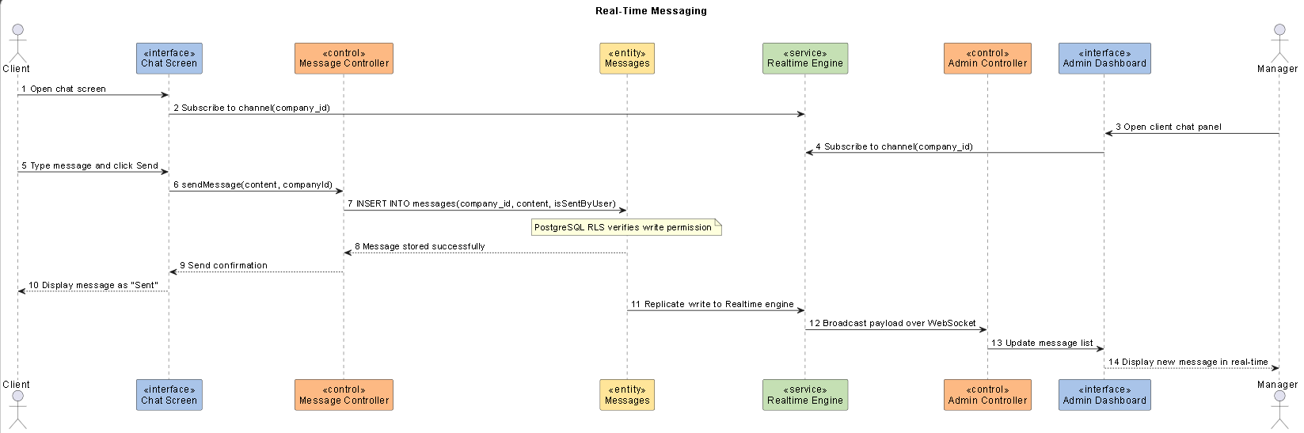
Dynamic Sequence Diagrams
Login Flow
Sending OTP code and logging the user in automatically
Leave Flow
Creating a leave request and checking database security
Chat Flow
Pushing new chat messages to the screens instantly
Notes:
"Sequence diagrams model three critical flows.
Login flow: password reset request → OTP email → verification → password update.
Leave flow: absence request with database security checks.
Chat flow: instant message push via WebSocket.
Each diagram shows the exact step-by-step interaction between screens, controllers, services, and the database."

Slide 19
05
CHAPTER 05
Realization & Sprints
How we built the web and mobile features over 4 sprints
Notes:
“Yassine
This chapter covers the realization phase-how we built all features across four sprints: authentication, attendance, chat, and warnings."

Slide 20
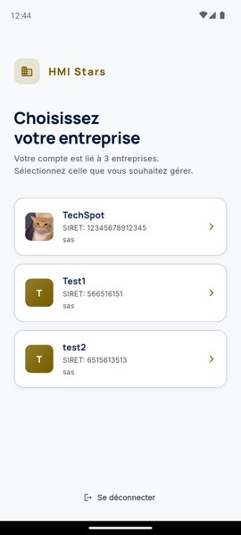
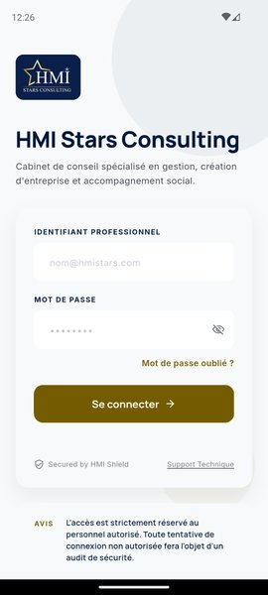
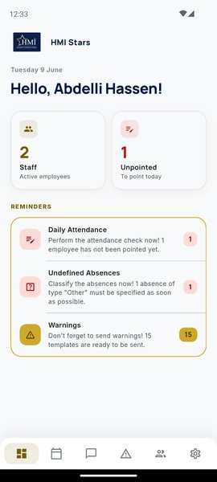
Sign in, select,
see what matters
OTP-based authentication via Supabase Auth
Multi-company selector — one account, many firms
Dashboard surfaces unpointed staff & reminders
Bilingual FR/EN · Light & Dark theme
Notes:
sign in , select , and see what matters
Users authenticate via OTP through Supabase Auth, select their company from a multi-company selector, and access a dashboard showing unpointed staff and reminders. The app supports bilingual FR/EN and Light/Dark themes."

Slide 21
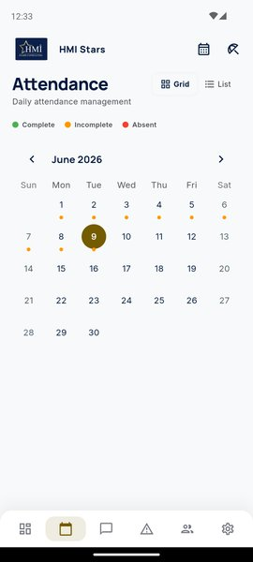
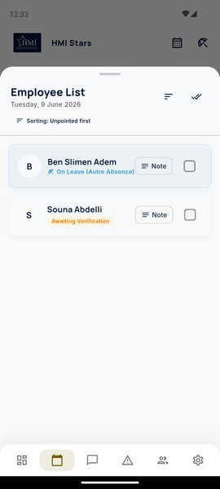
Attendance that works offline
Interactive calendar
100%
Color-coded daily status
Offline-cached
Grid or list view
Inline present/absent + notes
SQLite offline cache
Auto-sync on reconnect
Notes:
"Attendance works 100% offline with a color-coded calendar, grid or list view for marking present or absent with notes, and SQLite cache that auto-syncs when back online."

Slide 22
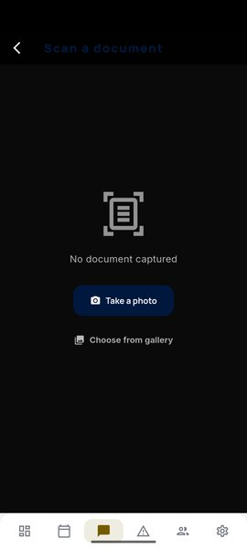
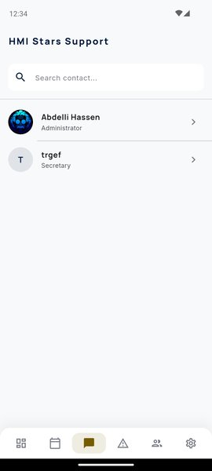
Talk, share, scan —
without leaving the app
Real-Time Chat
◔
WebSocket messaging, instant delivery on both sides
Document Upload
▥
KBIS, VAT, RIB — straight into Supabase Storage
Document Scanner
▧
Camera → crop → filter → PDF, sent as attachment
Notes:
Real-time chat with WebSocket instant delivery,
document upload for KBIS, VAT, RIB directly to Supabase Storage,
and document scanner from camera to cropped PDF attachment."

Slide 23
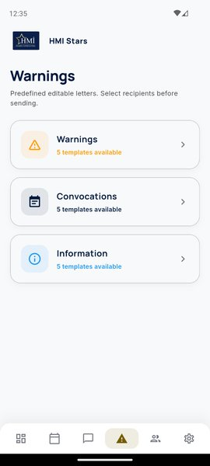
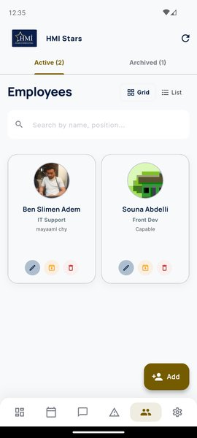
Every employee.
Every warning.
One tap away.
Employee Directory
Full profile: contract, SSN, documents — grid or list.
Disciplinary Warnings
3 categories · 5 templates each. Edit → select recipients → Gmail opens pre-filled.
Notes:
Every employee and every warning, one tap away.
The Employee Directory gives full profiles with contract, SSN, and documents in grid or list view.
Disciplinary Warnings offer 3 categories with 5 templates each-edit, select recipients, and Gmail opens pre-filled.
All managed in one place

Slide 24
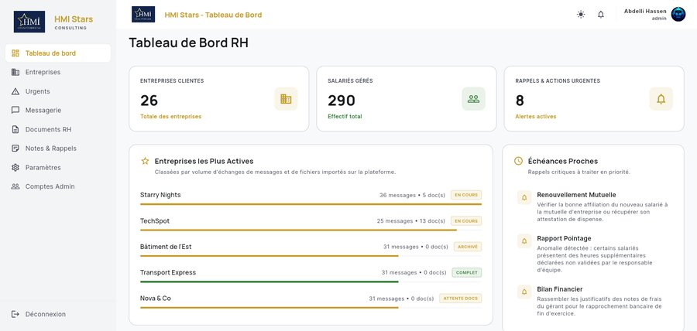
+100 companies , +500 employees, One dashboard.
100+
Companies
500+
Employees
8
Active alerts
Notes:
"One dashboard. 100+ companies, 500+ employees, 8 active alerts. All critical reminders in one place."

Slide 25
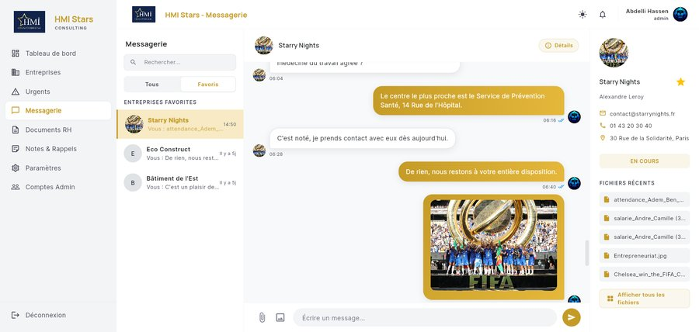
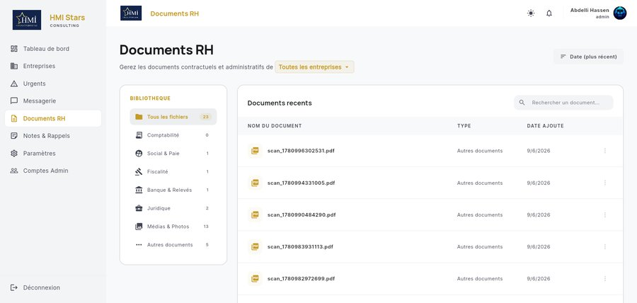
Every conversation,
every document, centralised
Central Messaging Workspace — one inbox for all companies, real-time WebSocket delivery.
HR Document Hub — categorised by type with inline PDF preview, no download needed.
Notes:
hassen

Slide 26
Execution & Deployment Environment
Local Testing
◐
VS Code editor, Flutter SDK, and virtual emulators for testing screens.
▤
Web Server
The actual programs, servers, and tools used to build and run the application.
Web administration panel deployed and hosted on Vercel cloud servers.
◷
Backend Cloud
Supabase platform hosting our database, logins, and files.
◫
Code Storage
Git and GitHub for storing and tracking code changes during development.

Slide 27
06
CHAPTER 06
Testing
Testing results, live demonstration, and project wrap-up
Notes:
This chapter covers

Slide 28
Live Demo &amp; Functional Validation
18 / 18 Tests
All 18 tests (login, RLS, offline sync) passed
Demo Video
Real-time walkthrough of mobile and web apps
Offline Caching
App saves check-ins offline and syncs automatically
Notes:
18 out of 18 tests passed: login, RLS, offline sync.
Live demo shows mobile and web with offline caching and auto-sync

Slide 29
Delivered, and what's next
✓
Full mobile app — auth to warnings
✓
Full web platform — CRM to accounts
✓
Real-time backend, 100% data isolation
✓
Bilingual · adaptive · cloud-deployed
Short-term
Medium-term
Long-term
Automated email
PDF generation
Document OCR
Notes:
We delivered mobile and web platforms with realtime backend and data isolation; next steps: automated emails, PDF payslips, and document OCR

Slide 30
Thank you.
We're happy to take your questions.
Hassen ABDELLI · ibdellihassen7@gmail.com
Yassine ELHADJ · yassineehadj@gmail.com
University of Kairouan · Faculty of Sciences and Techniques of Sidi Bouzid · 2025/2026

