Slide 1
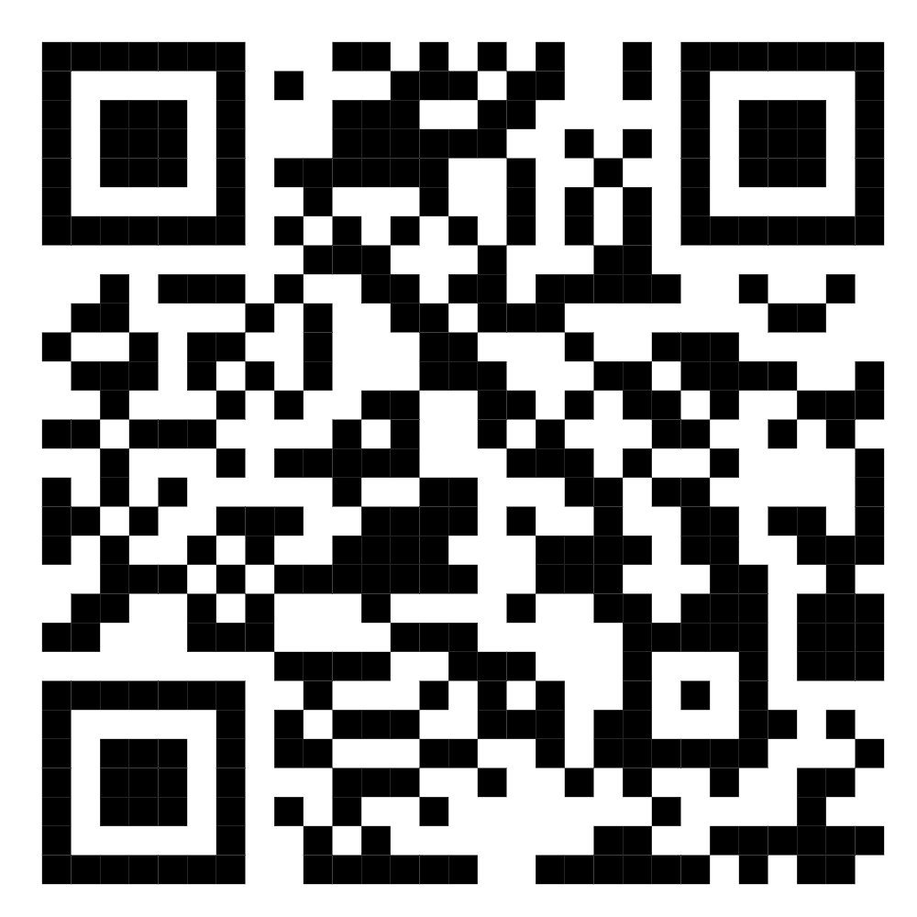
🏫
SMART
CLASSROOM
Scan for Source Code
IoT
IoT Final Project · CS433 · Benha University
TEAM MEMBERS
1. Abdelmoneim Adel Abdelmoneim
2. Mahmoud Ahmed Abd El-Fattah
github.com/AbdelmenamAdel
3. Muhammad Ibrahim Muhammad
Academic Year 2025 – 2026
4. Abdelrahman Amr Mohammed
5. Mahmoud Ahmed Hosny
6. Kamal Sayed Kamal
1 / 10

Slide 2




PROBLEM STATEMENT
The Problem We're Solving
Energy Waste
No Climate Control
Lights left ON in empty classrooms with no automated control system.
Temperature & humidity never monitored — impacts student focus.
Manual Attendance
No Remote Control
No real-time automated system to count students entering/leaving.
Facility managers can't control or monitor classrooms remotely.
2 / 10

Slide 3



PROPOSED SOLUTION
Our Solution
A four-layer smart ecosystem that monitors, controls & visualizes your classroom in real-time.
01
02
03
04
Hardware Layer
Cloud & MQTT
Simulation Layer
Flutter App
ESP8266 + DHT11 + IR Sensors + Relay + LDR
Firebase Realtime DB + Mosquitto Broker
Mobile Simulator + Web Simulator (WebSockets)
BLoC + Zoom Drawer + FL Chart + Glassmorphism UI
3 / 10

Slide 4

DEVICE LAYER
Hardware Components
DHT11
Dual IR
LDR
Temperature & Humidity Sensor
Bi-directional Student Counter
Ambient Light Detection
Relay
ESP8266
Simulators
Lighting Control Actuator
NodeMCU Gateway
Mobile + Web Testing
4 / 10

Slide 5
SYSTEM ARCHITECTURE
Three-Tier Architecture
TIER 1
TIER 2
TIER 3
Device Layer
Cloud & MQTT
Flutter App
ESP8266 NodeMCU Gateway
Firebase Realtime Database
BLoC / Cubit State Management
DHT11 · IR Sensors · LDR · Relay
Mosquitto MQTT Broker
Zoom Drawer Navigation UI
Mobile & Web IoT Simulators
Dual-protocol architecture
FL Chart + Glassmorphism
5 / 10

Slide 6


KEY FEATURE
Dual-Protocol Connectivity
The system runs Firebase AND MQTT simultaneously — best of both worlds
Firebase
VS
MQTT
Realtime Database
Mosquitto Broker
✔ Persistent cloud storage
✔ Ultra-low latency < 1s
✔ Historical trend logging
✔ Lightweight IoT protocol
✔ Real-time listeners
✔ Pub / Sub messaging
✔ Auto-sync across devices
✔ Device control commands
6 / 10

Slide 7
APPLICATION LAYER
Flutter Mobile App
Zoom Drawer Nav
Live Dashboard
FL Chart History
Premium Glassmorphism navigation drawer experience
Real-time Temperature, Humidity & Student Count cards
Interactive line charts for historical sensor trends
Remote Control
IoT Simulator
BLoC Architecture
Toggle classroom lights & switch Auto / Manual mode
Built-in mobile simulator — test without hardware
Clean state management with Cubit pattern
7 / 10

Slide 8
PROJECT HIGHLIGHTS
By The Numbers
2
6
<1s
Protocols
Sensors
Latency
Firebase + MQTT
DHT11 + 2×IR + LDR + Relay
Real-time data update
12
3
100%
Test Cases
Simulators
PASS Rate
Full QA coverage
Mobile + Web + Embedded
All test cases passed
8 / 10

Slide 9


TEST STRATEGY
Testing Methodology
12 test cases · 4 testing approaches · 100% pass rate
Unit Testing
12
BLoC cubits tested with mock data repositories
Integration Testing
Test Cases
End-to-end: Simulator → MQTT → App → UI
100%
Hardware Testing
Real classroom with ESP8266, DHT11, IR, Relay
PASS RATE
All test cases passed ✔
Web Simulator
Controlled JSON payloads via WebSockets
9 / 10

Slide 10

Thank You!
Source Code
Smart Classroom IoT — CS433 · Benha University
github.com/AbdelmenamAdel/Smart-Classroom-IOT
ESP8266 · Arduino C++ · Firebase · MQTT
Scan with your phone
Flutter · BLoC · FL Chart · Zoom Drawer
🏫 Smart Classroom IoT
Academic Year 2025 – 2026

Slide 11

Source Code
Thank You!
Scan with your phone
🏫 Smart Classroom IoT

