Slide 1
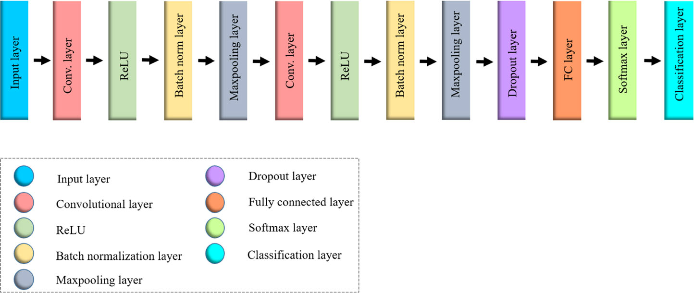
Architecture used in the Paper

Slide 2
Dataset details
Chest X-ray if it is PNEUMONIA or NORMAL
The folder contain of three files
Train have 1341 normal images and 3875 pneumonia images
Test have 243 normal images and 390 pneumonia images
Validation have 8 normal images and 8 pneumonia images

Slide 3
Implementation details
Use Kaggle notebook to handle the run process.
Make function take path of train or test file and return numpy array contain of all images in this file with labels.
Put all images in x and all labels in y to randomize them.
Split data to train and test, test size = 30% of data.
Create CNN model has 6 layers contain of zero padding, convolutional, batch normalization, max pooling then dropout and 4 hidden layers each one has dropout then activation function.
Evaluate model with plot accuracy, loss and confusion matrix

Slide 4
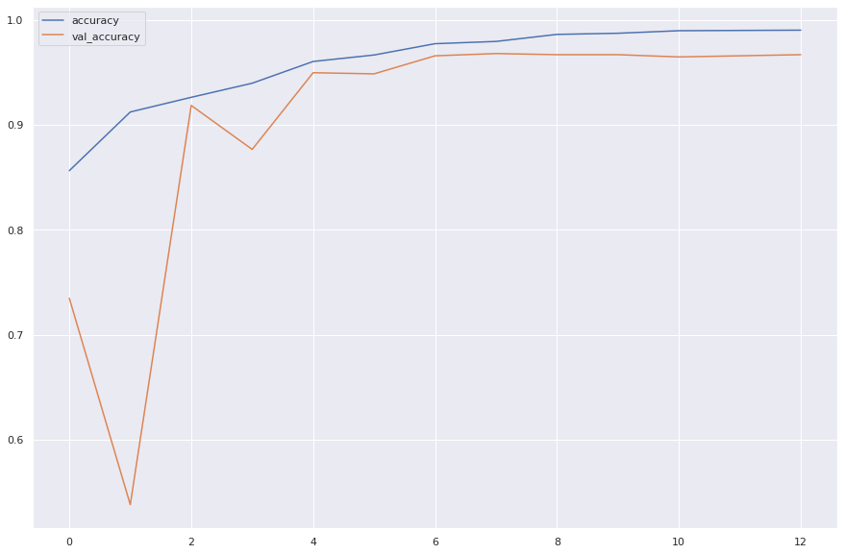
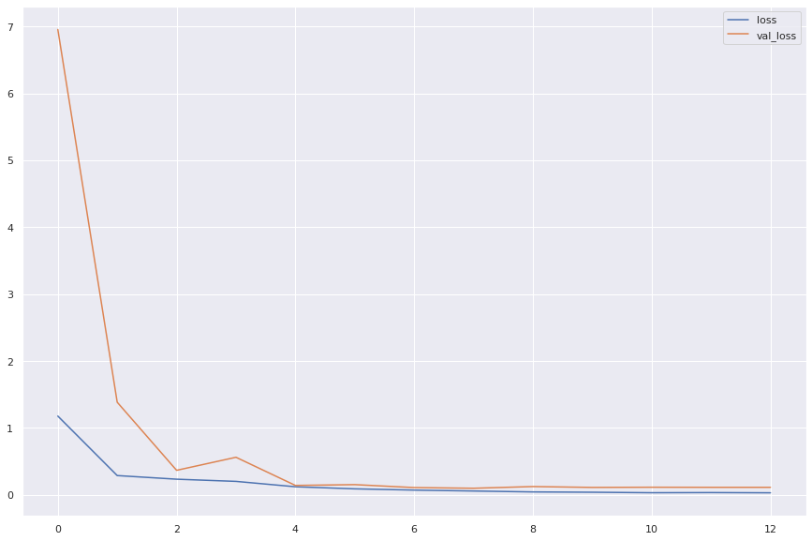


Results and visualizations

Slide 5
