Slide 1
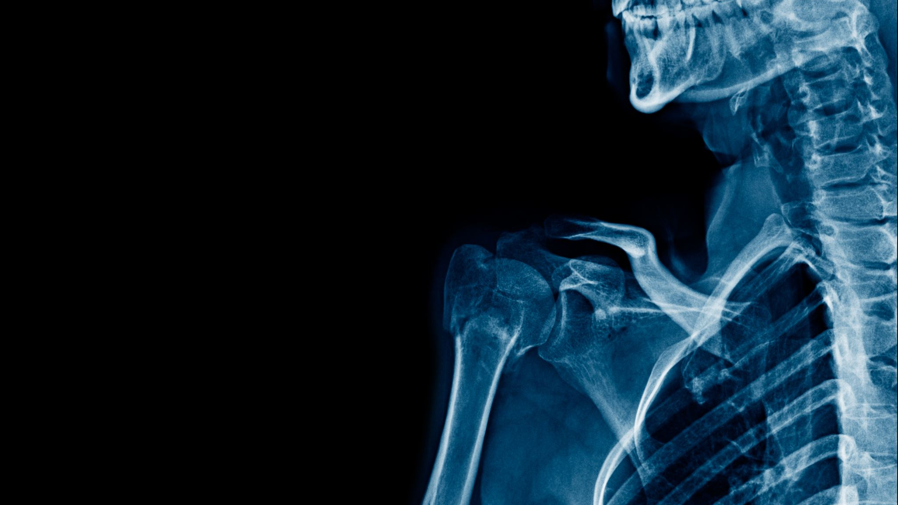
VinBigData x-ray Competition: Abnormalities Detection using Deep Learning
By Abdelmomen Mustafa

Slide 2

Problem Statement
The VinBigData competition aimed to develop an accurate abnormalities detection system using deep learning techniques.
Accurate abnormalities detection is crucial for timely diagnosis and treatment, leading to improved healthcare outcomes.

Slide 3

Dataset Overview
The VinBigData dataset was used in the competition, comprising a collection of chest X-ray images.
The dataset was resized to a resolution of 512x512 pixels to standardize the input for the model.
It consisted of multiple classes representing different types of abnormalities, enabling multiclass classification.

Slide 4

Methodology
The YOLOv5 model was chosen for abnormalities detection, known for its efficient object detection capabilities.
The model was trained using the VinBigData dataset with a batch size of 20 and trained for 30 epochs.
Preprocessing techniques such as resizing and normalization were applied to the images before feeding them into the model.

Slide 5

Model Training
The YOLOv5 model underwent training to optimize its performance for abnormalities detection.
Model selection and hyperparameter tuning were performed to achieve optimal results.
The training process involved iterative optimization based on the loss function and backpropagation.

Slide 6

Results and Visualizations
The trained YOLOv5 model demonstrated impressive performance in pneumonia detection.
The convolution_matrix.png file shows the confusion matrix, highlighting the model's performance across different classes.
The result.png image showcases sample predictions made by the model, comparing them with ground truth labels.

Slide 7
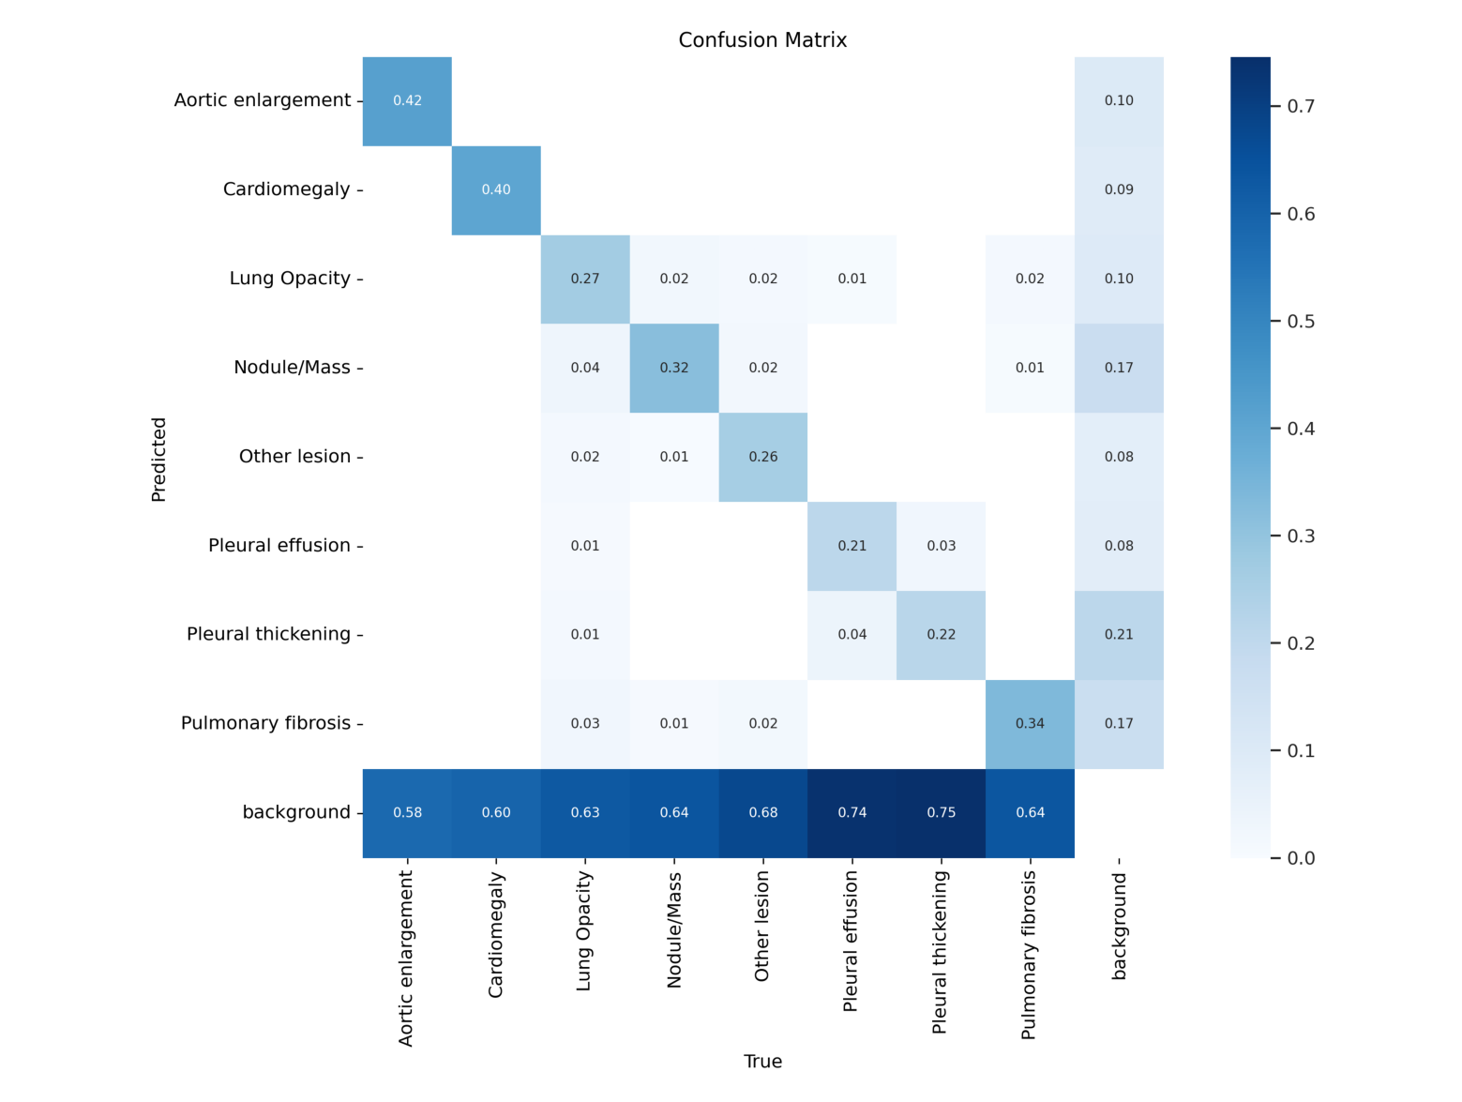
confusion_matrix

Slide 8
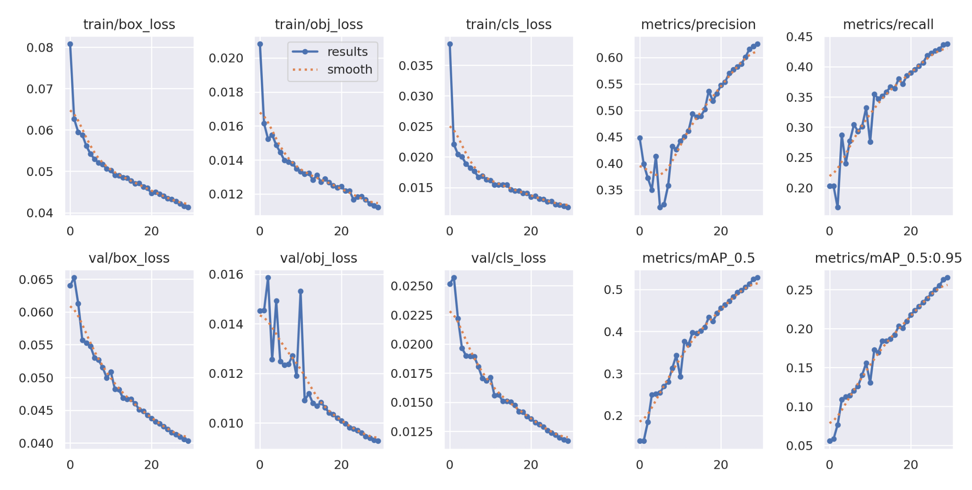
results

