Slide 1



Pharmacy Management System under supervision Dr. Mohamed Abdelfattah Eng. Shereen Adel

Slide 2
Team members
Rana Farid Shawky.
Rola Hossam El-Din.
Rawan Hossam Ibrahim.
Rana Mustafa Mohamed.
Safa Anwar Arafa.
Abdel Moniem Elsayed Abdel Moniem.

Slide 3
Abstract
Nowadays, Pharmacy management system is one of the most essential tools that are mostly used in medical store. it is mostly used to manage pharmacy related activities such as medical inventory, record keeping, sales management as well as managing the drug stock and information of the expired medicines.
Many pharmacies are still operating manually; they don’t have adequate software to manage their daily activities. It needs the pharmacist assistant to check the expired date of the medicine twice a week, and it can take a lot of time to find out whether certain medicine are out of stock. In this project we tried to develop a computerised and web based Pharmacy management system.
Pharmacy management system has its own significance to the retail pharmacy shops. Using this system, it will help us to records all transaction made at the daily sales, recognize all debtors, customers, employees, balance stock, etc. It will manage all activities around the shop that increases productivity and maximize profit, it will also minimizing the risk of getting loss because all transactions are recorded to the system.

Slide 4
Introduction
In this project we tried to develop a computerized and web based Pharmacy management system. Our main intention is to allow this application to be used in most retailing pharmacies , where a small point of customization will be required to each pharmacy in the implementation period.
This system is designed to overcome all challenges related to the management of medicine that were used to be handled locally and manually.
So, we designed this system to improve the accuracy, enhance safety , efficiency and help the Pharmacist to improve inventory management, cost and medical safety in the pharmaceutical store.
Pharmacy management system was developed to ensure the security of information and reliability of Pharmacy records when accessing and providing services to the customers. The information gathered during the data collection was properly analyzed and the results provided the basis for the new system. The system was tested and found to be functional and the outputs produced by this system were encouraging. The application will hence reduce the loss of information unlike the existing system and also information will be processed fast.

Slide 5
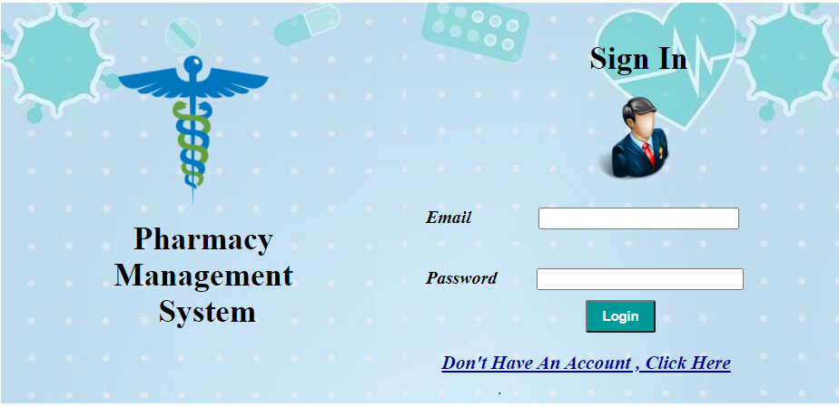
Forms
1) SIGN IN

Slide 6
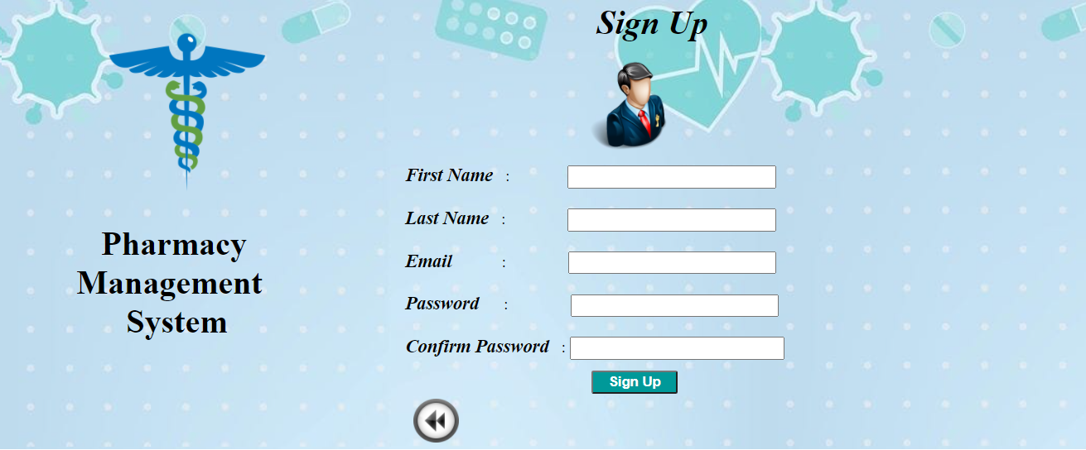
2) SIGN UP

Slide 7
- Description
The first page in our system is login page.
If the Administrator has already account he will enter his email and his password in the text boxes and press login to submit his inputs and move him to home page if the user enter wrong email or password message will appear indicating that His email or password is invalid .If the user doesn’t have account, he should press the hyperlink "Don't Have An Account , Click Here " A sign up page appears that contains
The Administrator will enter his name, email, password, confirm password then enter register button Now he can login to the system and entering his email and password. There are validators on the Text boxes First name and last name text boxes administrator can't login with out filling them Email text box if that administrator enter invalid email error message will appear " Email Not Valid " And compare validator in confirm password to compare the data entered in password box and confirm password box if the data match error message will appear indicating that " password don't match "

Slide 8
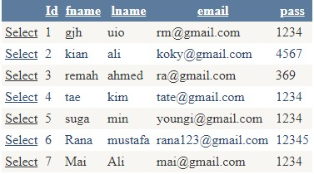
- Grid View

Slide 9
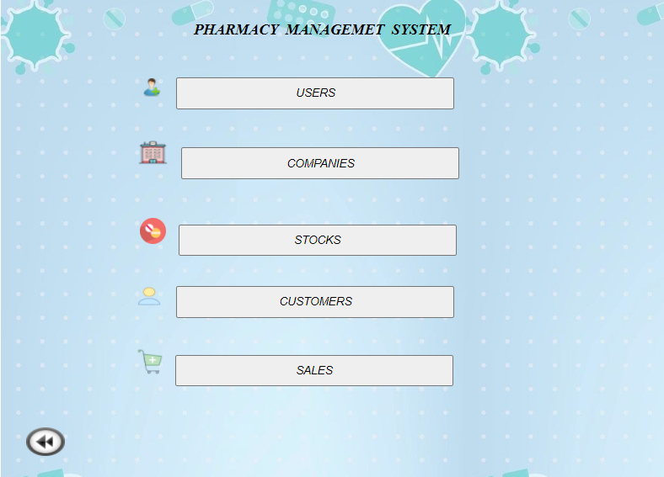
3) HOME PAGE

Slide 10
- Description
After logging in by the system administrator, he will enter the home page, which includes a group of system branches that are dealt with by the supervisor and the first branch we have is the user through which the supervisor allows users to enter the system and the second branch, which is the shrimp through which it is done Registration of the companies that will deal with the system and the third branch, which is the stocks branch, through which the user can enter the data for the required medicines and their information, and the fourth branch through which the user can enter customers into the system and the last branch is sales, which are determined through sales for the system by The way of history

Slide 11
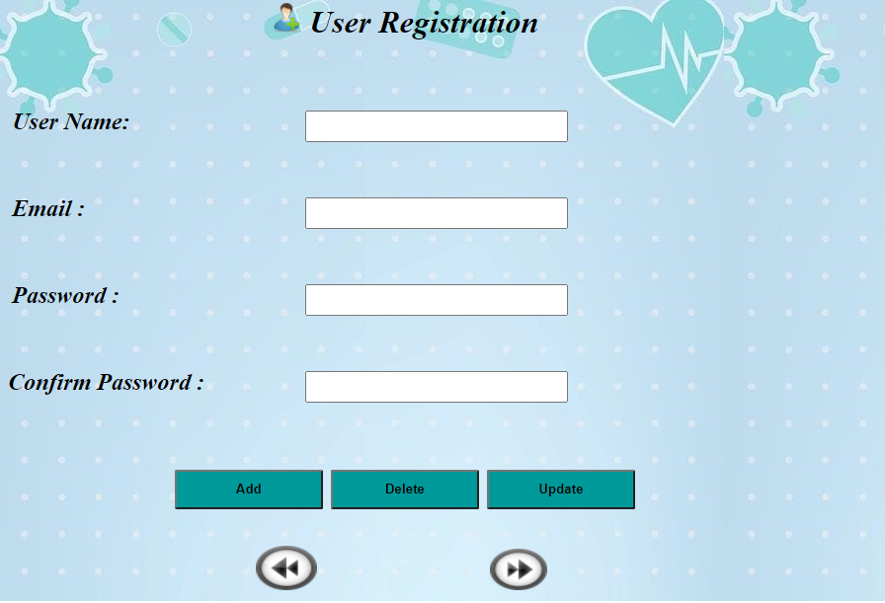
4) USERS

Slide 12
- Description
This form shows how the administrator enters the user data for registration in the system to have the probability to access the next specific screens in the system .
The admin enters the username, e-mail, password and confirm password in text boxes, It contains validation on username, e-mail and confirm password.
It has the ‘ADD’ button that contains ‘INSERT Function’ to enter the new data in database so when clicked secondly ,the message(Sorry , user already exist!) shown .
It has the ‘UPDATE’ button that allows updating in email, password as soon as entering the username .
It has the ‘DELETE’ button that removes the all row in the database when entering the e-mail and pressing the button .

Slide 13
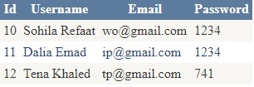
- Grid View

Slide 14
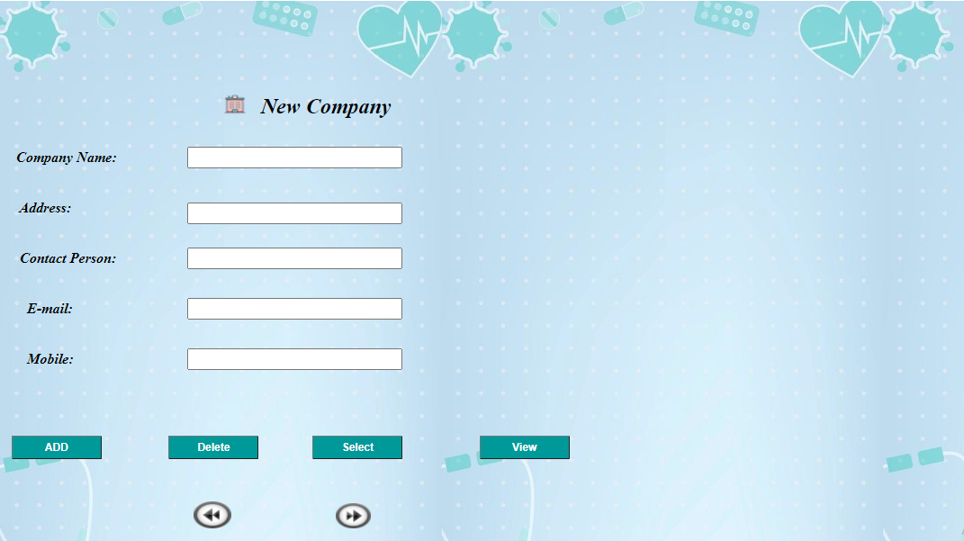
5) COMPANIES

Slide 15
- Description
In this screen, the administrator adds a group of companies or more that we deal with in importing medicines and some other supplies.
In this screen, the names of the companies are added to all of the data for each company.
In this screen, including the name of the company, its address, and the name of the person responsible for dealing with him within the company, as well as the company's e-mail address for quick communication.
There are five Buttons in this screen:
The First Button is ADD, and through it, all screen data is added.
The Second Button is Delete, through it, the data of the company that has been stored it is deleted from the data base.
The Third Button is Select, through it, the data for each company is determined and presented.
The Fourth Button is View, through it, all the companies' data added in the system are shown.
The Fifth Button is Next, and through it, the administrator moves to the screen of registering the drugs to be Import them.

Slide 16
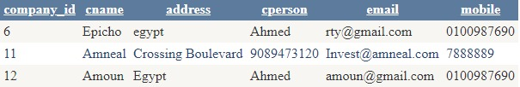
- Grid View

Slide 17
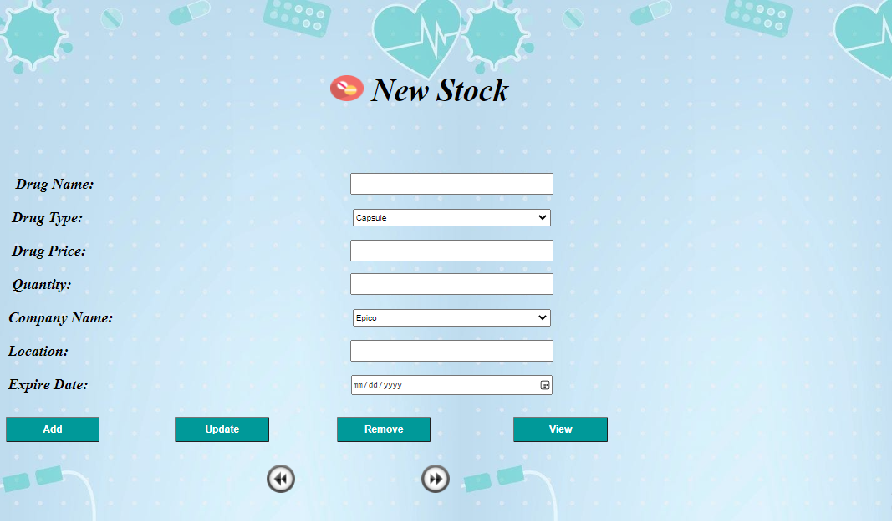
6) STOKES

Slide 18
- Description
This is the stock screen which is talking about the drugs which come from companies to the pharmacy. We can add the drug name, type (capsule, liquid or tablets), price, quantity of the requested drug, exporting company name, location and drug expire date which we can choose from the calendar.
The button ADD which can add all these information to the database.
the button UPDATE which updates drug price on data base depending on drug name.
the button REMOVE which removes the row depending on drug name from data base and finally the button view which show us a grid view of data base attributes and values and modifications on them.

Slide 19
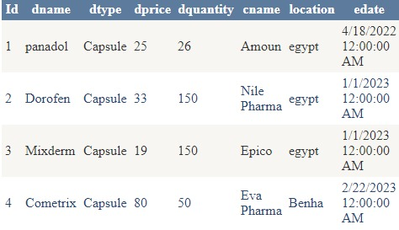
- Grid View

Slide 20
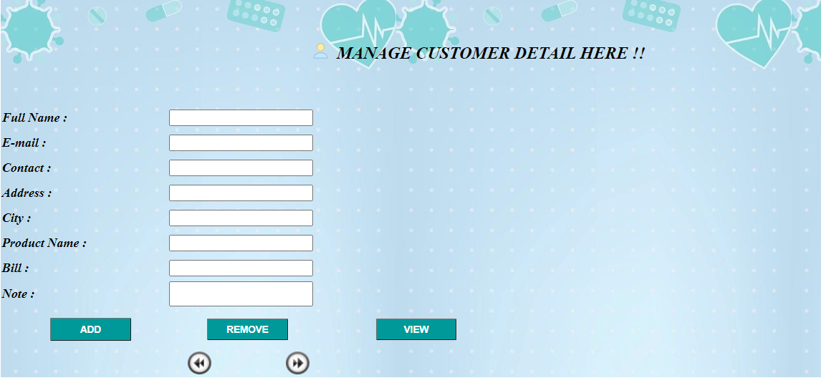
7) CUSTOMERS

Slide 21
- Description
This form called “ Manage Customer Details Here! ” which indicates that the user is the one who has the control to enter all the basic details related to the customer.
The user begins to enter all the customer-related details such as Full Name , E-mail , Contact Number , Address , City , Product Name , Bill and Note .
There are 3 buttons :
Button ADD that insert customer in database If the customer is new, a message will appear “ The customer inserted successfully ” But if the customer is there before, a message will appear “ The customer already exist ” .
Button REMOVE which delete data depends on full name.
Button VIEW which shows all data in Grid View.
There are 2 image buttons:
Button BACK which moves to the previous page.
Button NEXT which moves to the next page.

Slide 22
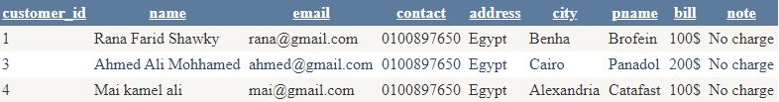
- Grid View

Slide 23
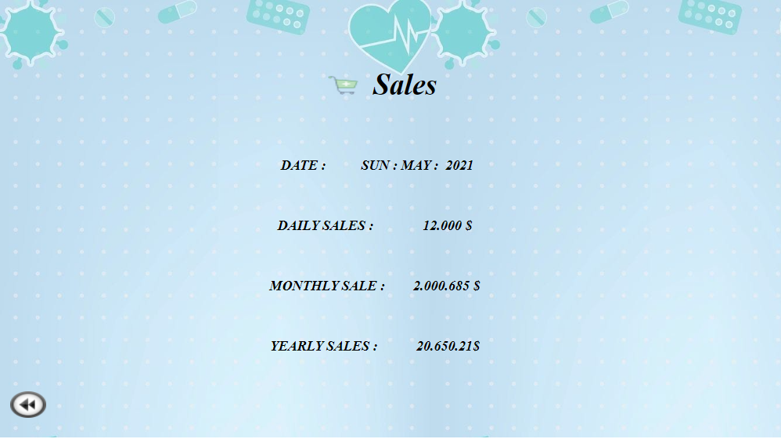
8) SALES

Slide 24
- Description
In the sales page, the system compensates its sales according to the date, whether daily, monthly, or secondary. The percentage of sales will vary on the date, and we display on this page those sales that will take place in here the system.

Slide 25
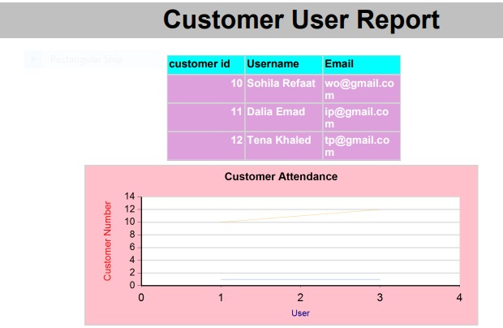
Customer User Report

Slide 26
- Description
This is a report which shows the relationship between user and customer tables in data base , As you can see there is a table which shows the customer id ,username and customer email. There is also a chart which shows the percentage of customers that users receive a day.

Slide 27
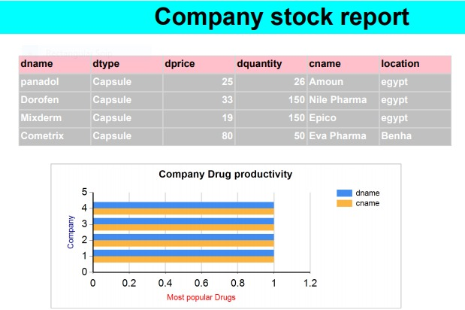
Company Stock Report

Slide 28
- Description
This is a report which shows the relationship between company and stocks tables. As you can see there is a table which shows the drug name attribute, the drug type, the drug quantity , the exporting company name and location and with some different values inserted. There is also a chart which shows most popular drugs in different companies with different percentage.

Slide 29
Conclusion
Pharmacy management system is actually a software which handle the essential data and save the data and actually about the database of a pharmacy and it's management.
This software help in effectively management of the pharmaceutical store or shop. It provide the statistics about medicine or drugs which are in stocks which data can also be updated and edited.
It works as per the requirement of the user and have options accordingly. It allow user to enter manufacturing as well as the expiry date of medicine placing in stock and for sales transaction.
This software also have ability to print the bill and invoices etc. The record of suppliers supplies can also be saved in it. There are other function available too . The main purpose is effectively and easily handling of pharmacy data and it's management.

Slide 30
Thank you

