Slide 1
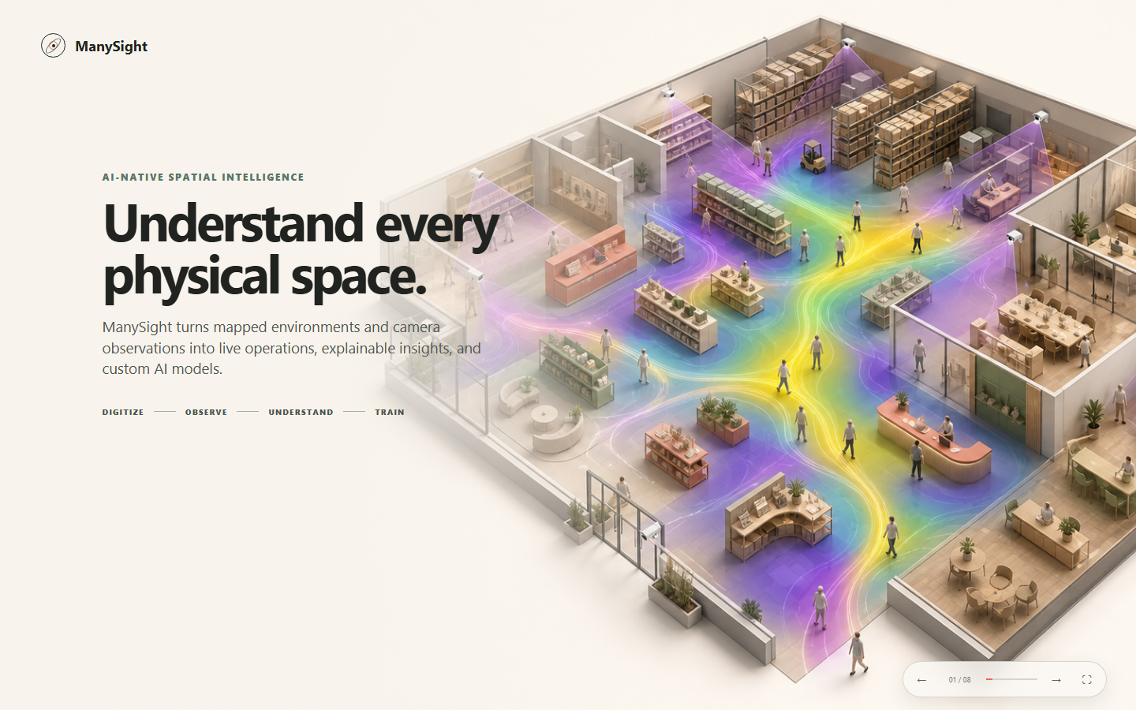

Slide 2
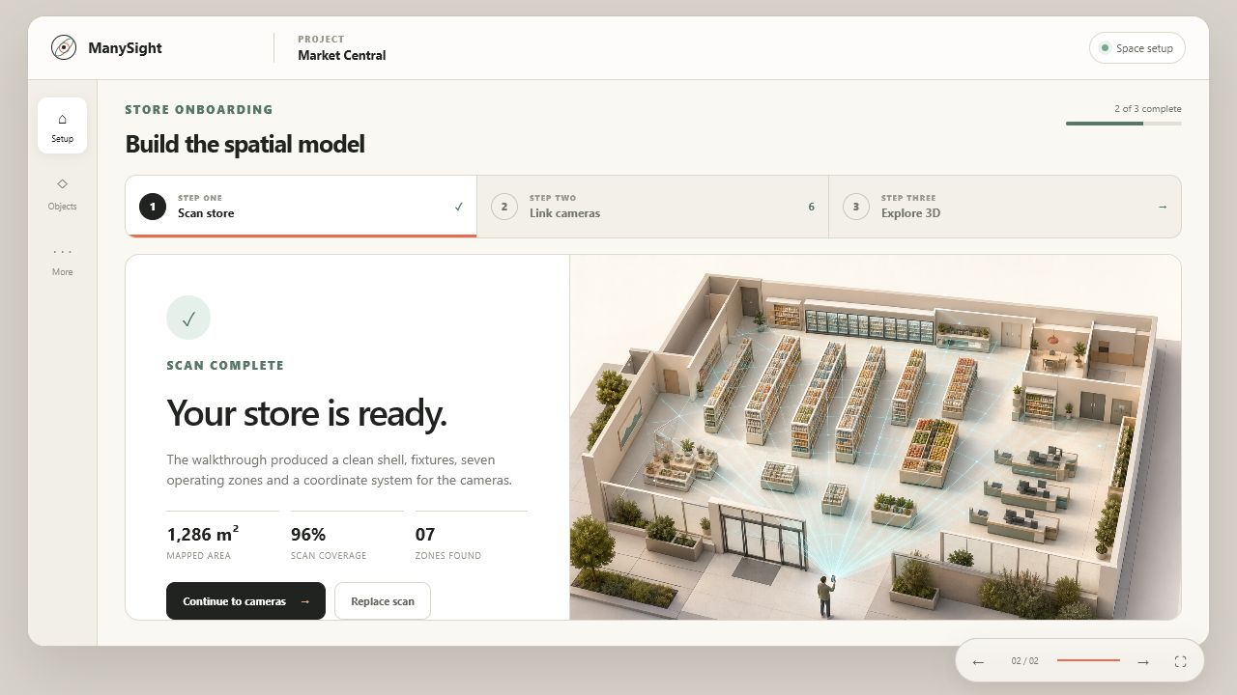
OPEN INTERACTIVE WORKSPACE ↗

Slide 3
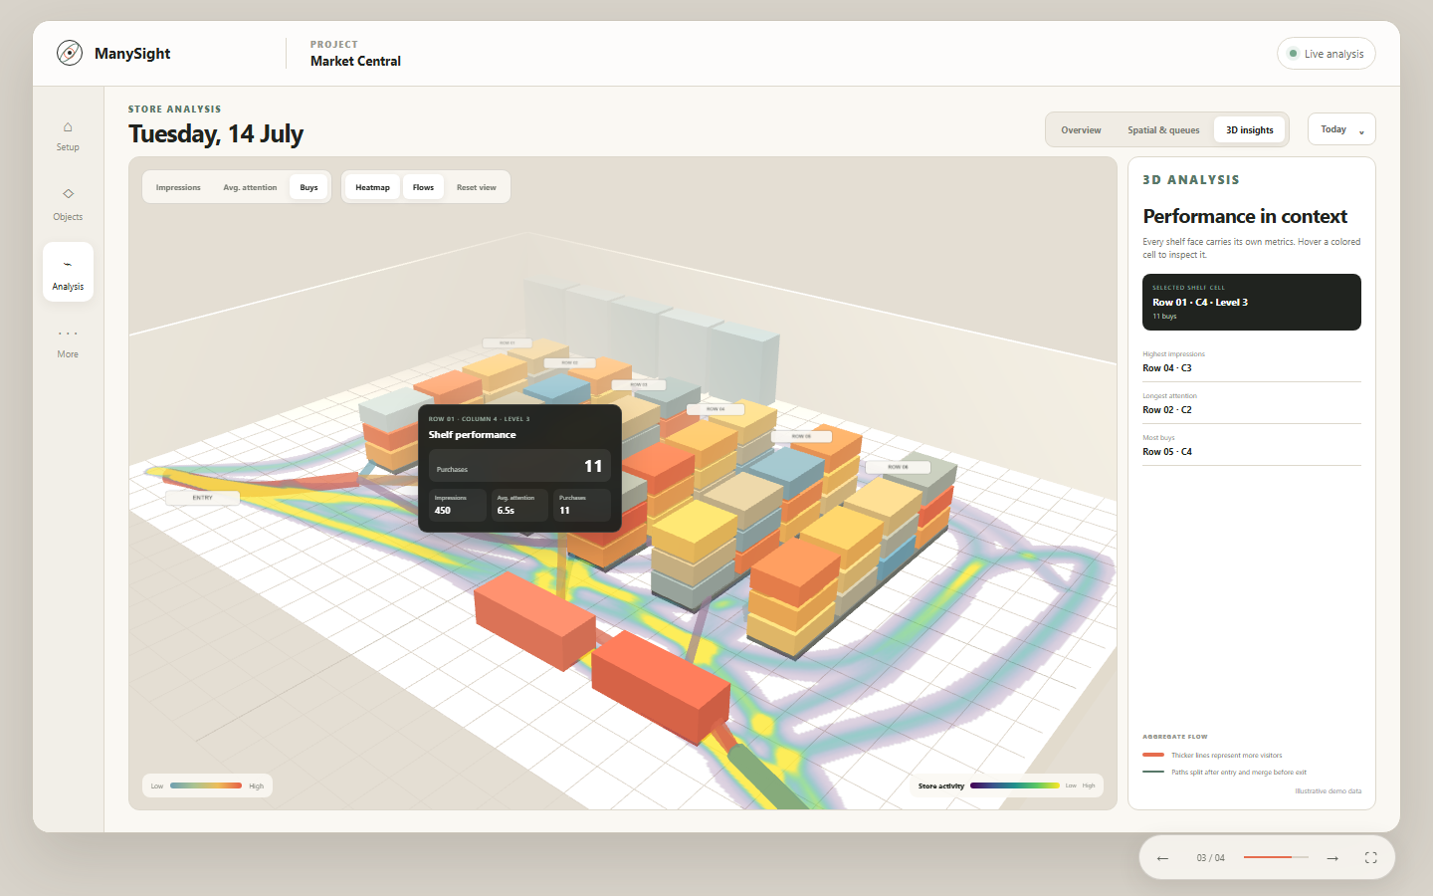
OPEN INTERACTIVE ANALYSIS ↗

Slide 4
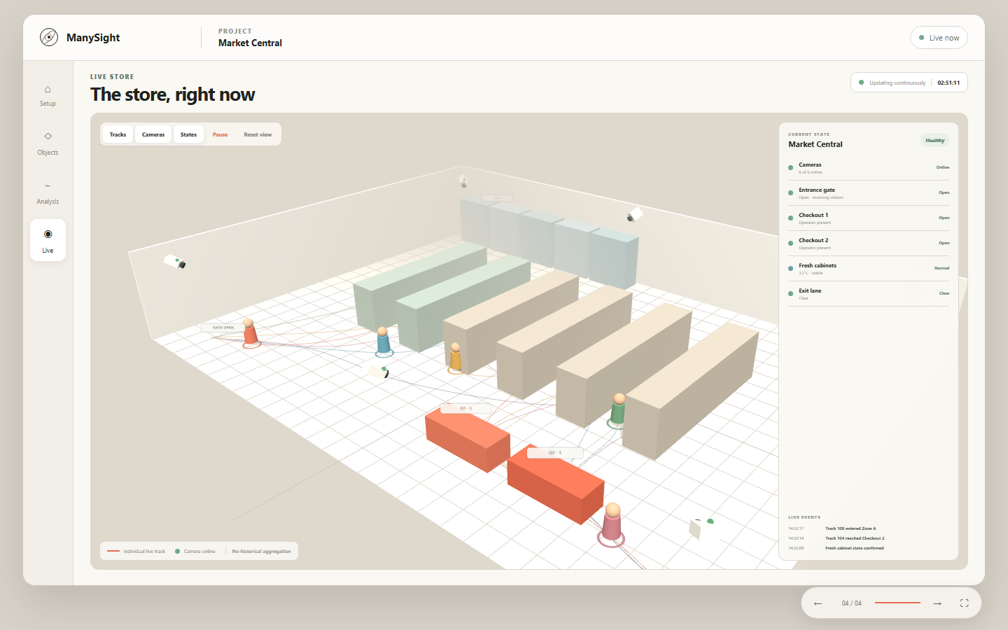
OPEN LIVE STORE ↗

Slide 5
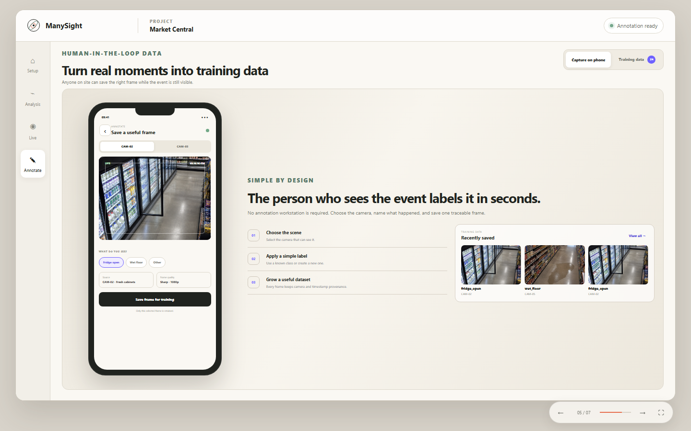
OPEN ANNOTATION FLOW

Slide 6
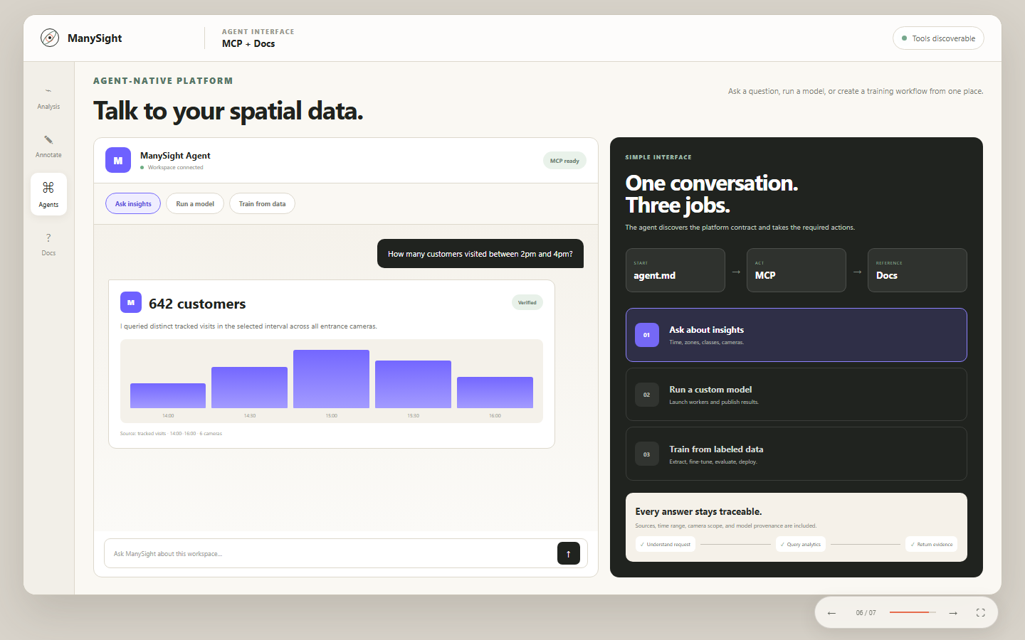
OPEN AGENT INTERFACE

Slide 7
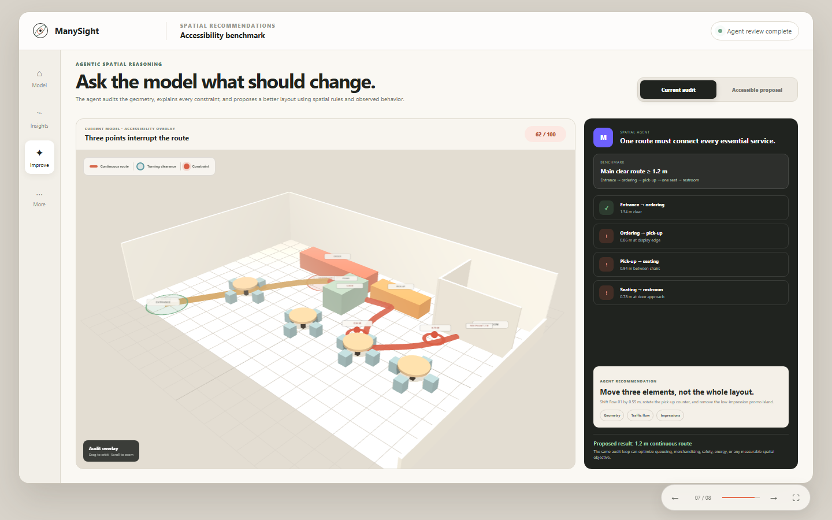
OPEN ACCESSIBLE PROPOSAL

Slide 8
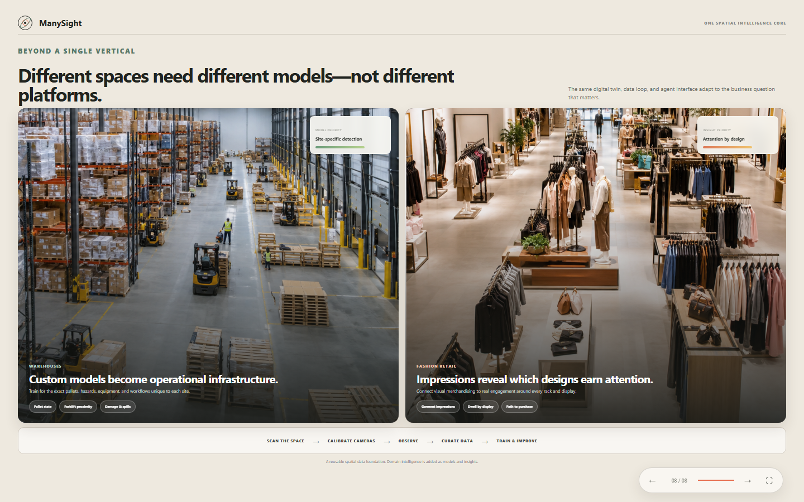
OPEN DOMAIN VIEW

