Slide 1

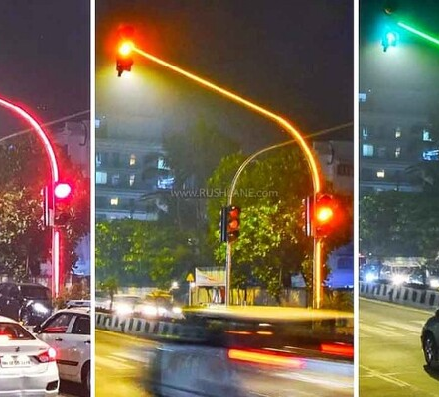
Project: - Traffic and Drugs Related Violations Dataset
This dataset contains around 65k+ traffic-related violation records.

Slide 2
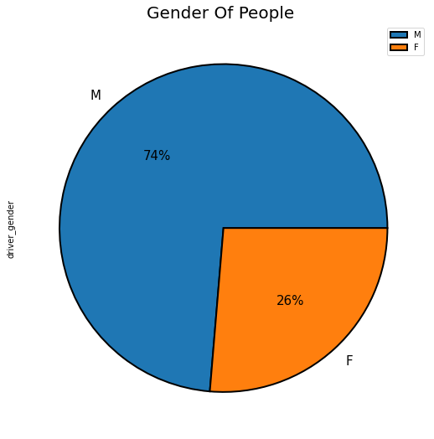
Which type of person has the most violations == male or female ?After examining the data, we found that the ratio of males to females is greater in cases of violation, Where males occupied 74% compared to females who occupied 26%

Slide 3
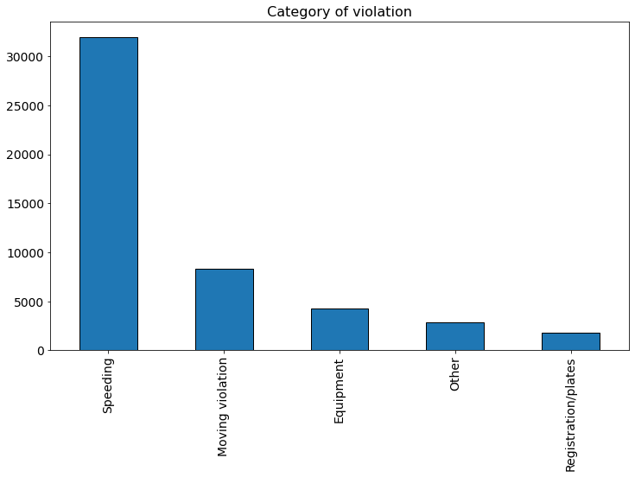
Question1: What are the most common causes of traffic violations? the most common causes of traffic violations The speed was where by looking at the graph, we found that the speed had achieved the highest traffic violations

Slide 4
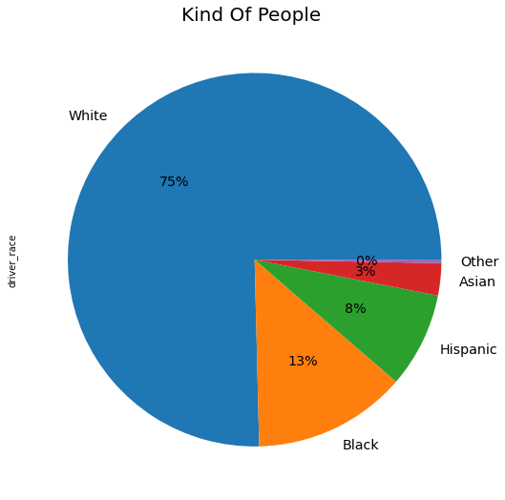
What type of skin is most violating in traffic [White , Black , Hispanic , Asian, Other]? After examining the data, I found that more than the white-skinned people were arrested, as they occupied 75%, black-skinned 13%, and Spaniards 8%.

Slide 5
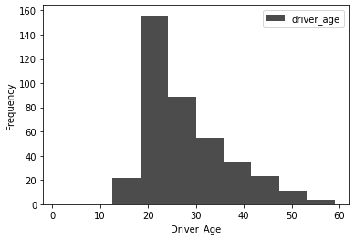
Is there a relationship between people's ages and their relationship to drugs? ::The largest percentage of violations in traffic violations was between the ages of 20 to 30 years, with the most violations under the influence of drugs.

Slide 6
soulations
*وضع الكثير من مطبات السرعة لتقليل السرعات المرورية
*قم بإجراء فحوصات دورية للأشخاص من سن 20:30 للمخدرات
نظام الغرامات يجب أن لا يكون ثابتا وإنما متغير يتبع عوامل يتم مراقبتها أولا بأول ومن هذه العوامل معدل ارتكاب المخالفة هل الشخص ارتكبها لأول مرة أم كل شهر مرة أم مرتين وهكذا و المدة+

